Slide 1
Creating High Value Collectors
Kate McGahee
Revenue Cycle Manager

Slide 2
The Factors
Input
Work
Output
FTEs
Work Accounts
Cash
Hours
With the constant pressure to keep costs low, increasing FTEs or overtime hours is not an option.

Slide 3
Efficiency Model
How can you increase the output without increasing the input?
  Work the right accounts
  Work more accounts
  Work accounts correctly
FTEs
Cash
Hours
Improve the efficiency of how staff works the receivable to maximize the value of each FTE and productive hour

Slide 4
Efficiency Improvement Strategies
The Right Accounts
  Streamline the workflow to prioritize accounts that need collector intervention today
  Stratify accounts according to the type of work required
Collector Efficiency
More Accounts
  Establish a productivity standard
  Measure and report collectors’ progress against stated goals
High Quality Work
  Review a handful accounts on a regular basis
  Adjust review frequency based on performance

Slide 5

Background
Two years as the Manager of Revenue Cycle Consulting and Workflow Implementations at Med-Metrix
  Med-Metrix is a leading provider of performance management analytics, consulting, extended business office, and revenue recovery services to the healthcare industry
  Proprietary Patient Accounting Workflow Solution and AR services work rely on the efficiency maximization strategies presented here
Designed and implemented workflow solutions and QA programs for healthcare organizations across the country
Notes:
Company made up
I have not been an AR manager, but before working for Med-Metrix I was an implementation consultant for Huron Consulting Group. I was that one of those 15 obnoxious 25 year olds that moved into your business office for a year and tried to make you implement productivity and QA standards.
- Like going to the dentist, or exercise.

Slide 6
Lessons Learned
Enforcing collector efficiency is an exercise in preventing the natural impulse to take the path of least resistance
  It’s a fight against human nature!
People do better work when they know that their work is being monitored and when performance is compared to their peers
No one likes a Quality Assurance Program
  ….Except the leadership that reads the reports
QA programs work!

Slide 7
Identify the “Right” Accounts
The right accounts to work are those that require a collector touch today to move forward towards resolution.
Group accounts into three categories:
Received a Payer Response ✓
Denials
277 Payer Rejection messages
Should have Received a Payer Response 
Typical claim processing time has expired
45+ days since appeal or other documentation was submitted
In line with Payer expectations •
T-Status Medicare Accounts
277 Payer Accepted or Paid messages
Pending a known payer/provider issue
Payments
Within normal processing time
These do not need a collector touch today
Work these first!
Work these next!

Slide 8
Working Payer Responses Strategically
  Identify all payer responses received
  ERAs, 277s, accounts in T-Status
  Denial letters
  Posted Payment Transactions, especially $0 transactions
Push to collectors as the highest priority
  Collector action is required for reprocessing, rebilling, or adjusting/transferring balances
  There is a timeliness component due to denial response deadlines
Additional information can further refine payer responses:
    Systematic identification of CARCs/RARCs and Patient Liability Amount from the ERA (Remit Processing System)
    Comparison to Expected Payment Amount (Contract Management System)

Slide 9
Working Payer Responses Strategically
With the CARC/RARCs, Patient Liability amount, and Expected Payment amount, payer responses can be further classified by the type of work required
This distinction allows organizations to get to the next level of efficiency
Denial Resolution Action Required
Actionable CARC/RARC on ERA
$0 Payment Transaction
Payment Posted but Balance ≠ 0
Payment Posted ≠ Expected Amount
Requires Balance Adjustment/Transfer
Balance = Patient Liability

Slide 10
Payer Response Expected but not Received
Identify accounts where a denial, payment, or 277 response has not been received after a reasonable amount of time has passed since bill or most recent action
Three ways to assign reasonable timeframes to accounts:
Determine payer-specific, data-driven initial pend timeframes after billing
  Review your payment and denial data to identify the typical time to receive a response…and add a few days
Rely on collectors to apply pend timeframes (“tickle times”) after action is taken
  Establish standards for appropriate tickle times for frequently used actions, e.g., submitting medical records
Pend out accounts for additional time if a 277 Accepted or Paid response is received
  No longer a risk for “no claim on file”

Slide 11
Days to Payer Response Analysis

Slide 12
Ensuring Collectors Work the Right Accounts
Rely on your timeframes to drive exceptions
  Don’t fall into the trap of following up on accounts too quickly!
  The account will become high priority once the payer response is received
Enforce a priority structure that puts denials first, payment review second, and exception-based follow up third
  Limit choice – our tendency is to work the easiest accounts first!
  Encourage time-saving strategies such as inquiring about multiple accounts in a single call
Remove accounts from the workflow or worklist that have not hit an exception
  Put all collector effort towards the accounts that they can impact today
Leverage the information that you have, and make your systems work for you

Slide 13
Establish Productivity Standards
Productivity expectations should be fair and achievable, and should be aligned with what you consider a “full FTE”
    1. Take into account the type of work required
    Two effective methods:
Remember! If the workflow is not exception-based, productivity will be higher because collector activity will include assigning a quick claim status for accounts that may not need work today.
Assign a “weighted” productivity touch to actions
Denial-related Action | 1.1 Productivity Points
Adjustment Action | 0.6 Productivity Points
          Establish a separate standard for different types of work
Follow-Up Worklist | 40 accounts / day
Denials Worklist | 35 accounts / day
Notes:
Without productivity standards, there is no rational basis for determining how many staff members are needed and when to hire, other than a general notion that “everybody’s really busy.” Examples of controls that can be used in managing the back-end process are shown in exhibit 3.

Slide 14
Establish Productivity Goals
    2. Factor in time “out of the system”
        Only hold users accountable to the time that they were expected to work through their daily work drivers
        Use an adjusted productivity formula to calculate:
Actual Productivity
(Expected Productivity per hour) X (Actual Hours Worked)
Example:
Productivity standard = 40 accounts for an 8 hour day
Kate worked 35 accounts in 6 hours
35
(5 accts/hr) X 6 hrs
= 117 % of Goal
        Remember! Are special projects held to the same productivity expectations? If no, don’t include that time in their productivity equation!

Slide 15
Establish Productivity Standards
    3. Implement a goal range, and evaluate using a weekly average
      A range (e.g., 95% of standard) provides a little padding to accommodate variations in the difficulty of accounts worked
      Example: Productivity standard is 40 accounts, or 200 accounts per week. If goal is 95% of standard, then total productivity above 190 is acceptable!
  4. Provide feedback
      Provide updates on progress at least daily, and throughout the day is ideal
      Share the results with the team (blinded if necessary) so collectors can see how they compare to their peers
      Observe high performers for their best practices and share with the team!

Slide 16
Ensure High Quality Work
Frequent quality reviews are absolutely necessary to ensure that accounts are worked correctly and therefore resolved quickly
Evaluating quality should be just as clear-cut as measuring productivity:
  Develop scoring criteria
  Establish a goal and measure collector scores against that goal
  Conduct reviews with consistent frequency
  Provide results to collectors so that they can improve

Slide 17
Effective QA Program: Scoring
Only a handful accounts are required per review to provide significant insight into performance
  Med-Metrix reviews only consist of five accounts per collector
Similar to productivity, assign a goal range (e.g., 95% of a perfect score)
Did the collector…
Read the account history and understand the issues preventing payment?
Consult the right systems and take the correct next step?
Take ALL steps required/possible to move the account forward?
Apply a pend an appropriate pend timeframe with regards to the account balance and identified issues?
Clearly document the status of the account and actions taken?
Keep the scoring simple!
  Incorporate a few, comprehensive scoring criteria
  Grade the account using a simple Yes / No (point / no point) evaluation method

Slide 18
Effective QA Program: Scoring
Best practice performance measurement should include both productivity and quality of account touches to ensures that staff is working quickly, but not ineffectively.
Quality Goal = 4.8
Productivity Goal = 95%

Slide 19
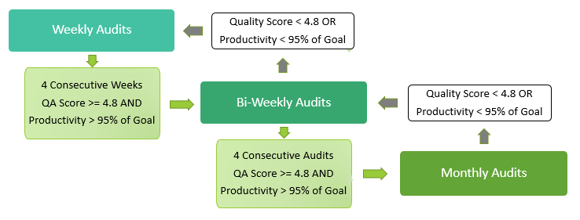
Effective QA Program: Review Frequency
Audit frequency should be determined by how consistently each collector meets the stated goals for both productivity and quality
Begin with a ramp up period where all collectors are reviewed weekly for four weeks
Use the average score as a baseline to determine how often a collector is reviewed and adjust as needed according subsequent reviews

Slide 20
Effective QA Program: Feedback and Reporting
Give feedback directly to collectors timely and in person to allow them to correct missteps and learn from mistakes
    Face-to-face discussion promotes staff development by creating an environment of conversation instead of criticism
    Frequent feedback serves as a reminder that work is being monitored
Incorporate Quality Review scores into annual performance reviews and bonus structure
  Reward high performing representatives to increase team moral and incentivize continued high performance
  Consider initiating disciplinary action for representatives that consistently perform below stated expectations
Include QA reporting in the standard report deck used in management meetings
  Importance of QAs needs to come from the top!
  Identify process breakdown and training deficiencies

Slide 21
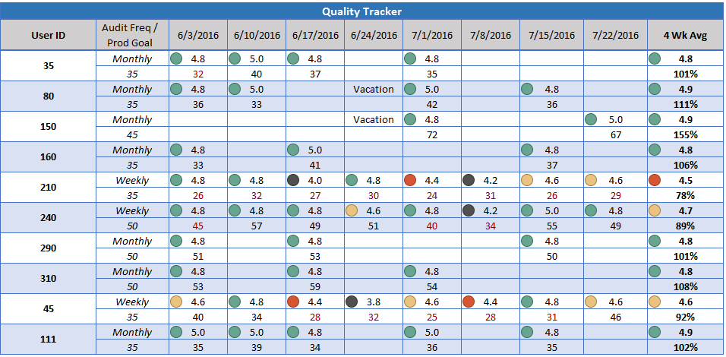
Sample Quality Report
Blind out the collectors’ names so that you can share with staff
Display the 4 week average for quality & % of productivity standard to summarize performance
Trend over time to show progression
Use conditional formatting to apply color indicators for easy reading

Slide 22
Key Takeaways
Instead of increasing staff or asking for overtime, maximize how efficiently collectors work each day
Concentrate collectors’ effort on the accounts they can impact today: i.e., the accounts with a payer response that requires action or that require collector intervention because a payer response is delayed
      Remove accounts that do not require collector action from the workflow!
Utilize the ERA information available to make your workflow system work for you!

Slide 23
Key Takeaways
Establish a productivity standard that is fair and achievable with respect to the type of work performed and time spent on collection activities
Execute a comprehensive Quality Review Program that evaluates collector productivity and quality against the stated goals
          Know that this requires a significant amount of time to roll out, but is absolutely necessary!
Provide feedback to collectors directly, and incorporate scores into annual reviews and bonuses - Give the program teeth!

Slide 24
Thank you!

