Slide 1
May 2021
Massachusetts Association of Patient Account Management
Susan DiGloria, Megan Miller, and Michael Sullivan
Healthcare Contracting & Management
Notes:
Thank you for inviting us here today. I’m Susan DiGloria, a Network Representative at Blue Cross Blue Shield of Massachusetts. Joining me today are my colleagues, Megan Miller and Michael Sullivan.
We appreciate the opportunity to attend and present important information and updates at your annual MAPAM meeting.
We want to partner with you to ensure that our members – your patients – receive the highest quality, most effective care possible, while at the same time continuing to work together to make healthcare more accessible and affordable.

Slide 2
Legal notes
These training materials have been provided to help you in your administrative interactions with Blue Cross Blue Shield of Massachusetts (Blue Cross).
The information and representations herein do not replace or supersede the terms of your Blue Cross provider Agreement, your Blue Book manual or Indemnity Handbook, or other Blue Cross policies and procedures.
To the extent the foregoing terms and policies conflict with or are otherwise inconsistent with anything in these training materials, your Blue Cross provider Agreement, your Blue Book manual or Indemnity Handbook, or other Blue Cross policies and procedures will govern.

Slide 3
AGENDA
  Provider Central updates
  COVID-19 information
  Medical policy site
  Authorization Manager
  Medication coverage changes
  New quality care cancer program
  Helpful contacts
Notes:
Here is the agenda of topics that we will be talking to you about today during this presentation.

Slide 4
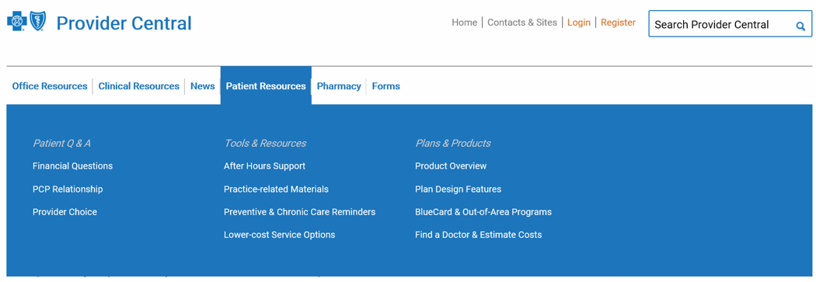
Provider Central updates
We’ve made changes to Provider Central: bluecrossma.com/provider
The Patient Resources section is now available without logging in and combines information previously located in Patient Engagement and Plans & Products.
The pages Find a Doctor & Estimate Costs and BlueCard Program are now in Patient Resources
Prior Authorization Management is now called Authorization Manager.
Notes:
You may have noticed that our website was updated recently.
Provider feedback helped us make several improvements:
We made patient resources available without logging in. You can go there for:
Practice-related materials like fact sheets and template letters
Information for members who require care beyond normal business hours
Lower cost referral options
Blue Cross plan and product information, and much more.
We also moved the Find a Doctor and BlueCard Program pages to the same section.
And, we changed the name Prior Authorization Management to Authorization Management. More about that shortly.

Slide 5
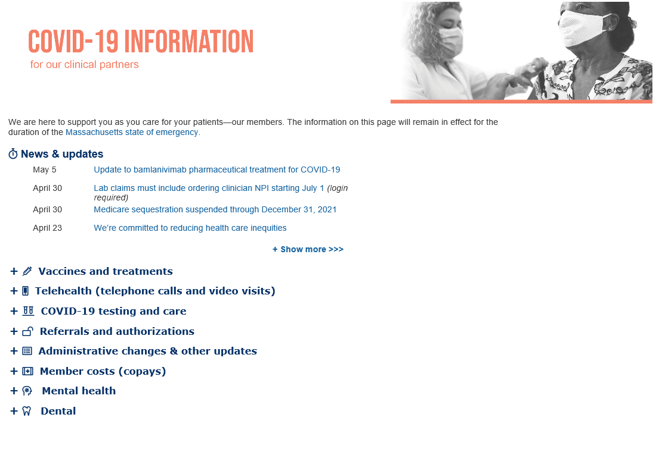

Provider Central COVID-19 information page
Quick access to:
Vaccines
Testing
Telehealth
Temporary payment policy
News & updates
Notes:
To help you out during the public health emergency, we added a COVID-19 information page to Provider Central.
When you open Provider Central, you’ll see a COVID-19 Information image on the righthand side of the screen. Clicking on the graphic takes you right to the COVID-19 landing page. There, you will find links to relevant news and updates on topics such as vaccines, testing, and telehealth; a link to our temporary payment policy; and much more important information for you to use.
Please refer to this page of Provider Central in the coming months for BCBSMA updates regarding the current PHE and any changes in the future.

Slide 6
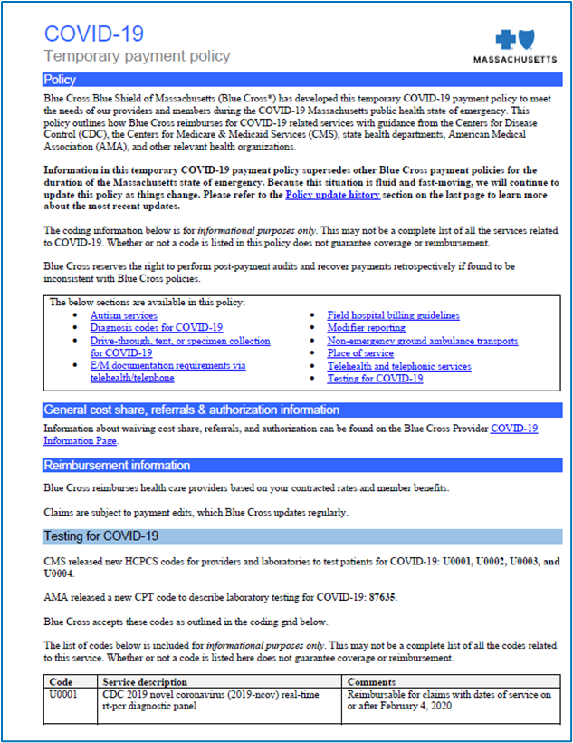
COVID-19 payment policy & other info
COVID-19 Temporary payment policy
  In place during the public health emergency
  Codified in new state law
COVID-19 testing and care
  Billing and coding guidelines
Vaccine administration
  Billing and coding guidelines
Telehealth expansion
  Reimbursed at same rate as in-person visits
  Telephone calls and video visits covered
  Use modifier GT, 95, G0, or GQ to designate services
Notes:
If you have not reviewed our temporary COVID-19 payment policy, please do. It contains a ton of information about what is and is not covered during the public health emergency. It lists coding and billing guidelines for COVID-19 testing and care, along with vaccine administration, as well as the effective dates for those codes. We are actively monitoring regulatory updates. It is a top priority for Blue Cross to be in compliance with DOI mandates and the MH TH law that went into effect 1/1/21.
One of the biggest changes we have made is expanding the coverage for telehealth. During the public health emergency, all Blue Cross Blue Shield of Massachusetts contracted doctors and health care providers can provide care remotely, using any technology, for medically necessary covered services, both COVID-19 AND non-COVID-19 related, to our members. This includes visits by phone and your communication platform of choice.
We reimburse all providers at the same rate they would receive for an in-person visit and we removed all member cost share for all telehealth services for in-network providers. This is in place for the duration of the Massachusetts state of emergency.
When you submit a telehealth claim, include modifier GT, 95, G0, or GQ to designate that that you are providing services via synchronous/asynchronous telehealth audio and/or video telecommunications systems rather than an in-person encounter.
We also removed all member cost share for in-person doctor, urgent care, and emergency room visits related to the testing, counseling, vaccination and treatment of COVID-19.

Slide 7

COVID-19 information & updates
Referrals and authorizations
  Not required for outpatient COVID-19 care
  Notification only for inpatient care at acute care, mental health hospitals, skilled nursing facilities, long term care centers, and rehabs through March 31, 2021
Administrative changes and other updates
  Expedited credentialing and enrollment process
Member support
  Waiving cost share
  Early prescription refills
Please do not submit supporting clinical documentation for cases requiring notification only.
Notes:
We have received many questions about referrals and authorizations.
Referrals and prior authorizations are not required for medically necessary testing and treatment for COVID-19 throughout the Massachusetts-declared state of emergency.
Acute care & mental health inpatient settings
Recognizing that hospitals have administrative resource issues due to COVID-19, we have extended our waiving of authorization requirements at inpatient acute care and mental health hospitals for dates of service on or before March 31, 2021. This applies to both COVID-19 related and non-COVID-19 related admissions.
Inpatient acute care hospitals and mental health hospitals must, however, notify us of inpatient admissions through dates of service up to and including March 31, 2021. Timely notification serves to facilitate care coordination, mobilize additional services to support transition-of-care, and facilitate discharge planning. While this notification-only requirement is in place, we will not perform medical necessity reviews.
Starting with dates of service on or after April 1, 2021, authorization requirements will be reinstated. You will need to submit requests and supporting documentation for prior authorization at that time.
Other inpatient settings
For long-term acute care hospitals, acute and subacute rehabilitation (rehab) facilities, and skilled nursing facility admissions, we require referral and prior authorization for commercial products (all products except FEP and Medicare).
Expedited credentialing
We instituted an expedited credentialing process for providers joining our network, to be able to see members sooner. The expedited credentialing process allowed providers to be credentialed in about 72 hours.

Slide 8
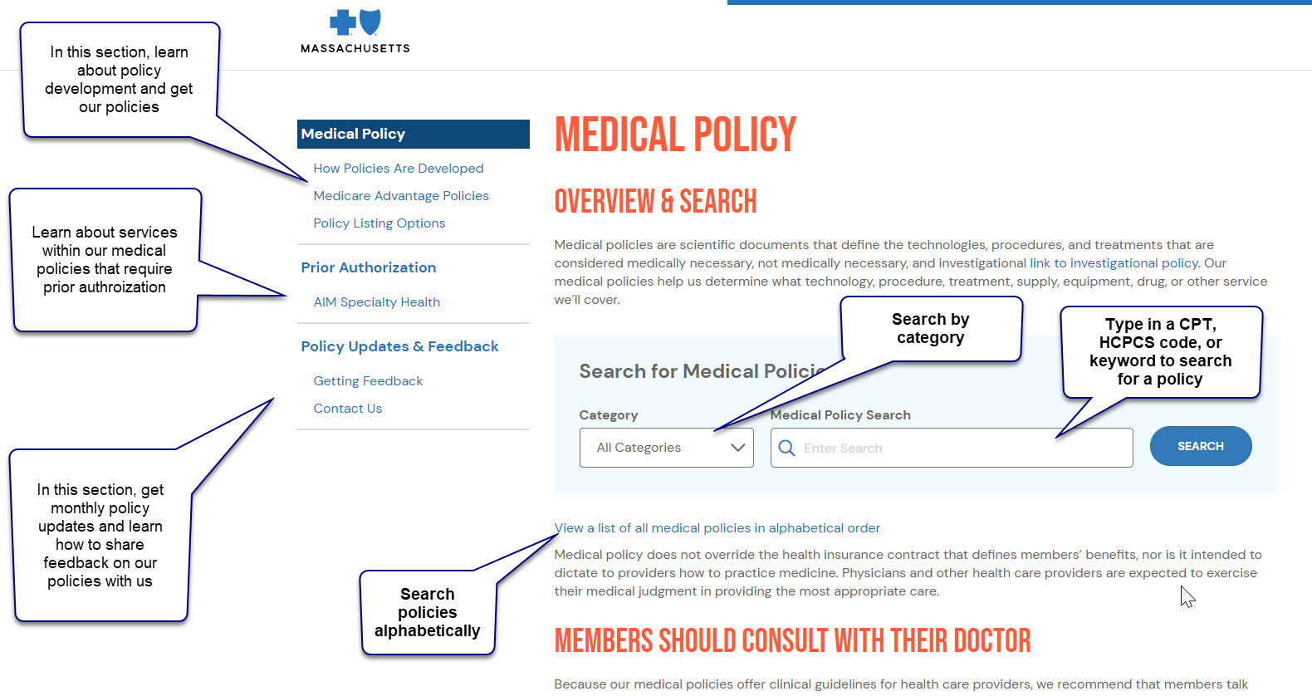
Medical policy site changes
Notes:
We’ve revamped our medical policy site. You should find it easier and quicker to find important medical policies.
When you go to the site, use the Category dropdown to search by category. Or, you can enter a keyword or procedure code into the Search box.
You also can choose to view all medical policies in alphabetical order.

Slide 9
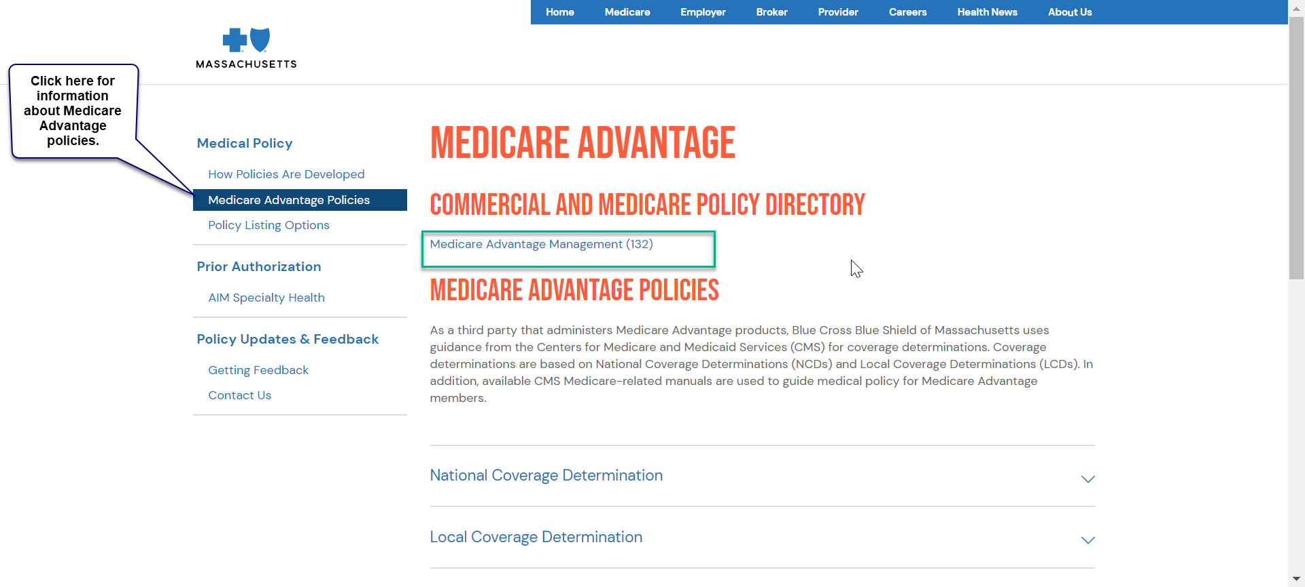
Medical policies for Medicare ADVANTAGE MEMBERS
In 2021, medical policies for our Medicare Advantage members can be found in the Medicare Advantage policies section of our medical policy website.
We’ve removed information about Medicare Advantage coverage from our commercial medical policies.
Our Medicare Advantage Management Policy Number: 132 provides a quick directory of policies to help you find what you need.
Notes:
We’ve removed any separate information about Medicare Advantage coverage from our commercial medical policies, so, if you are looking for medical policies for our Medicare Advantage members, go to the Medicare Advantage policies section of our medical policy website.
Look for Medicare Advantage Management Policy Number: 132. It will give you medical policy information for Medicare Advantage members when it’s different from the general policy used for commercial members.

Slide 10
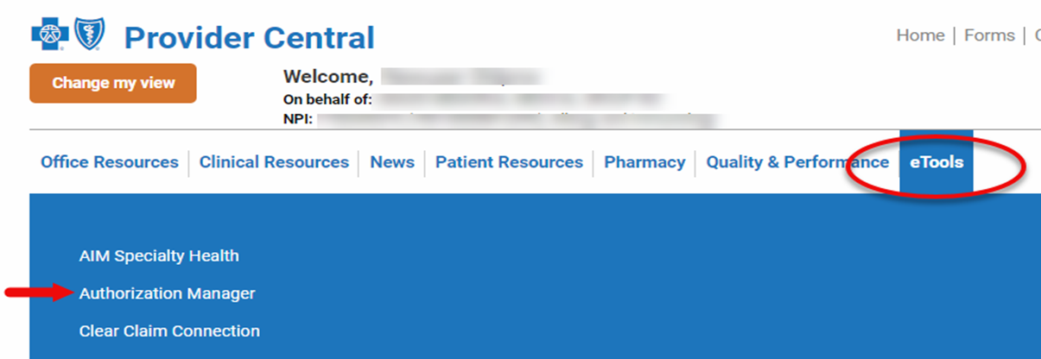
Authorization Manager 2021
Rolled out in February 2021 for members belonging to all of our products
Builds on the system we launched in 2020 for providers caring for our Medicare Advantage members.
Provides a new way to submit authorization requests and check on the status of submitted authorizations and referral inquiries
Notes:
On February 15, 2021, we rolled out a new Authorization Manager tool for authorization requests. The new tool was built on the system we launched in 2020 for Medicare Advantage members.
Authorization Manager allows providers to submit prior auth requests for behavioral health, medical, and surgical services online, and to check the status of referral requests. The tool is easy to use, more accessible, and available 24/7. It also is a repository for all documentation related to a prior authorizations and referrals, making it easier to look back at each case if audited or appealed.
You also can search for authorization requirements by code and view correspondence related to authorizations.
In addition to being a one-stop for our providers for most prior authorizations and referrals, Authorization Manager makes it easier for providers to upload additional documentation to support medical necessity decisions and gives them one place to view the status of authorizations and referrals, including requests previously submitted by telephone, fax, or via online services. It also allows users to view authorization decisions made by AIM Specialty Health, but not to submit.
Having one, windows-based, cutting-edge system allows us to better manage our members’ care.

Slide 11

Authorization Manager tools
The tool allows you to:
  Search member-specific authorization requirements by code
  Submit authorization requests for all lines of business
  Check on the status of submitted authorizations and referrals for all of our members for all medical and behavioral health services
  View correspondence related to authorizations
Resources found on Provider Central:
  Authorization Manager Guide
  Webinar recording and slides
  Quick tips for certain provider types
  Frequently asked questions
The portal does not currently accept authorization requests for medication in the medical benefit.
Notes:
We hosted a webinar to introduce the new tool on February 4, 2021. The recording is available via Provider Central link.
Also on Provider Central are links to:
The Authorization Manager Guide, which gives detailed information on the use of the tool
The February 4 webinar, as well as the slides we used
Quick tips for acute care hospitals, home health care providers, physical therapists, and skilled nursing facilities. We’ll be posting a quick tip for behavioral health providers soon.
Frequently asked questions – especially those asked during the webinar.

Slide 12
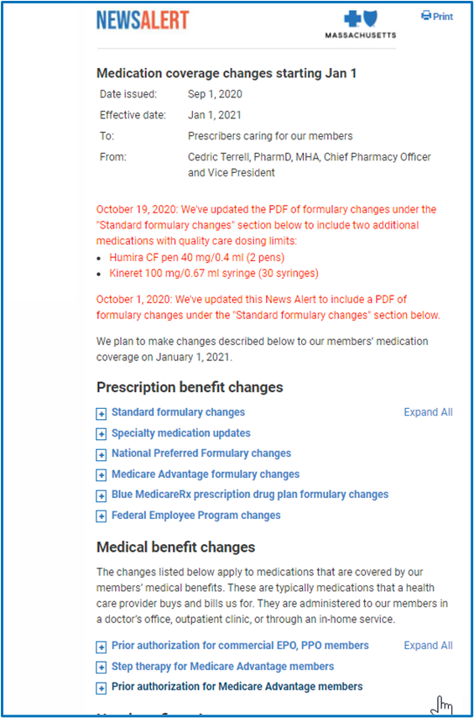
Prior authorization for medications
January 1, 2021 effective date
Prior authorization requirements for the medications listed in our Medical Benefit Prior Authorization Medication List expanded to EPO and PPO members
Applies to outpatient settings when the medication is administered using the member’s medical benefits
Members need an approved prior authorization for coverage (both those currently taking these medications or those newly prescribed)
Notes:
In January, we expanded prior authorization requirements for the medications listed in our Medical Benefit Prior Authorization Medication List to our commercial EPO and PPO members. Members currently taking these medications or those newly prescribed will need an approved prior authorization for coverage.
We already require prior authorization for these medications for our commercial HMO and POS members.
In outpatient settings, authorization is required for these medications when administered using a member’s medical benefit in:
A clinician’s or physician’s office
Outpatient hospital and dialysis settings
Or, by:
Home health care providers
Home infusion therapy providers
This change does not affect these medications in inpatient, surgical day care, urgent care centers, and emergency department settings.
We started accepting prior authorization requests on December 1, 2020 for dates of service on and after the January 1, 2021 effective date.
Please note: As new medications in these same therapeutic classes are added to the formulary or our medical policies, we will apply our medication management program requirements to them.

Slide 13

Medication coverage changes
July 1, 2021 effective date
Buy and bill medications: Authorization required
Formulary changes
Pharmacy medical policies
Medical benefit versus pharmacy benefit: Moving certain medications from one category to the other
Opioid safety program: Applying at the point of sale.
Expanding our Opioid and Opioid Combination Medication Management policy 102 to require prior authorization for members currently filling prescriptions for opioid medications
Xtampza ER to replace OxyContin and Oxycodone ER as covered oxycodone medication on our formulary
Notes:
We’re planning to make changes to our members’ medication coverage on July 1, 2021.
We announced the formulary changes and updates to pharmacy medical policies in a News Alert on March 1.
We’re adding authorization requirements to medications we cover under the medical benefit (buy & bill).
Also beginning July 1, 2021,we will no longer cover certain infused oncology medications under our pharmacy benefit for members in all plans, except Medicare Advantage and Federal Employee Program members. Instead, we will cover these medications under the member’s medical benefit.
Certain other medications will be covered under the member’s pharmacy benefit, instead of the member’s medical benefit.
We’re implementing an opioid safety program at the pharmacy. The safety edit is consistent with CDC guidelines for prescribing opioids for chronic pain.
Also, we’re expanding our Opioid and Opioid Combination Medication Management policy 102 to require prior authorization for members currently filling prescriptions for opioid medications.
And, we’re replacing OxyContin and Oxycodone ER with Xtampza ER.

Slide 14
New Quality Care Cancer Program
July 1, 2021 effective date
Program will promote cancer care that is evidence-based, safe, and clinically appropriate
Medical oncology (including infused and injectable medications) and radiation oncology treatment to be reviewed against evidence-based clinical criteria
Program specifics
AIM Specialty Health®'—an independent company—will administer the program on our behalf
Before ordering outpatient cancer treatments, request prior authorization for plan coverage from AIM
Request authorization with AIM for patients who:
  Received care before July 1, 2021 and need to continue their current course of treatment. Requests for the same ongoing treatment will be approved immediately, so the member’s coverage for care is not interrupted
  Are starting care on and after July 1, 2021
Applies to all members in our commercial and Medicare plans
Refer to our News Alert for more details and webinar training information
Notes:
We’re launching a new Quality Care Cancer Program in 2021 to promote coverage of cancer care that is evidence-based, safe, and clinically appropriate.
Before ordering outpatient cancer treatments, you’ll request prior authorization for plan coverage from AIM Specialty Health, the independent company that will administer this program on our behalf.
For:
Outpatient medical oncology services and supportive care medications (including infused and injectable medications)
Radiation oncology services
Request authorization with AIM for patients who:
Received care before July 1, 2021 and need to continue their current course of treatment. Requests for the same ongoing treatment will be approved immediately, so the member’s coverage for care is not interrupted
Are receiving care on and after July 1, 2021
Providers will be able to start submitting authorizations on June 1 for services after July 1
Why is Blue Cross implementing the Quality Care Cancer Program?
Scientific and medical advances are rapidly changing cancer treatment, leading to variations in cancer care. To help ensure that we cover the most appropriate and effective treatment regimens for our members, we’re launching our Quality Care Cancer Program.
When will more information be available?
A March 1 News Alert provides information about the program, including webinar trainings planned in May, June, and July. We are committed to working with you and your practice to make this a smooth process and will have many training and educational resources to support you. Please refer to April 13th New article in Provider Central titled: Join us for a Quality Care Cancer Program authorization webinar.

Slide 15



Contacting Provider Service
      For immediate assistance, call Provider Service
        Monday, Tuesday, Wednesday, Friday 8:30-4:30
        Thursday 9:30-4:30
Representatives can:
  Provide guidance on replacement and corrected claims
  Answer member eligibility and benefit questions
  Advise what services require prior authorization or referral
Notes:
We have a dedicated team of associates in Provider Service who can assist with typical provider questions. They are available Monday-Friday until 4:30 pm.
They can help explain how a claim processed, offer guidance regarding replacement claims, answer member benefit and eligibility questions, and advise what services require prior authorization.
The numbers for professional providers and institutional providers are on the screen.

Slide 16
Thank you!
bluecrossma.com/provider
Network Management & Credentialing Services
Providerapplicationstatus@bcbsma.com
Notes:
This concludes today’s session.
If you need more information, or if you have any questions about what you’ve seen here, please go to Provider Central at www.bluecrossma.com/provider, Email Network Management and Credentialing Services at providerapplicationstatus@bcbsma.com, or contact your Network Manager or Network Representative directly.
As you can see from everything that we’ve covered, we’re working hard to improve the quality and affordability of the care our members receive, but the bottom line is that we couldn’t do it without you. We truly appreciate the exceptional care you provide to your patients – our members.
Thanks for taking part today.

