Slide 1
WORKING WITH CIGNA
2021 Massachusetts Association of Patient Account Management (MAPAM) Conference
May 13, 2021
May 20, 2021
Offered by Cigna Health and Life Insurance Company or its affiliates
Confidential, unpublished property of Cigna. Do not duplicate or distribute. Use and distribution limited solely to authorized personnel. © 2021 Cigna

Slide 2
Agenda
  Introducing Evernorth
  Home care and sleep diagnostic services transition to eviCore healthcare (eviCore)
  Site of service updates
    High-tech Radiology Site of Service
    Oncology enhanced specialty care options program site-of-care review
  Express Scripts home delivery pharmacy
  Coverage and updates
    Telehealth and cost-share
    COVID-19 vaccine
  Keeping you updated
  Other coverage and reimbursement policy updates
  Precertification updates
AGENDA
Notes:
Note: Some of the content contained within will require you to have access as a registered user. If you are not already registered for CignaforHCP.com or need to register a new member, please visit: https://cignaforhcp.cigna.com/web/public/guest

Slide 3

Evernorth continues expansion
Evernorth is the new health services portfolio of Cigna. Evernorth brings together and coordinates premier health services offerings like pharmacy solutions, benefits management, care solutions, and virtual care to deliver innovative and flexible solutions for health plans, employers, government programs, and providers.
What this means to you
While you and your patients may see communications reflecting the Evernorth brand, your day-to-day business with Cigna, Express Scripts, eviCore, MDLIVE, and other affiliated companies remains the same at this time. You will continue to leverage existing systems and methods for submitting claims, requesting precertification, getting reimbursed, and other transactional activities.
Evernorth acquires MDLIVE
On April 19, 2021, we announced that Evernorth completed its acquisition of MDLIVE®, a leading 24/7 virtual care delivery platform. We believe this will strategically position our capabilities and solutions to address the critical needs of affordability, predictability, and simplicity for our customers.
There are no immediate changes for providers who deliver face-to-face or virtual care to patients with Cigna coverage. Providers remain a central part of our strategy, and our commitment to them remains the same – to ensure they can continue to deliver care how, when, and where they want to.
To learn more, visit Evernorth.com.
Notes:
We recently took a critical step forward in delivering on our mission to be the leading health service company in our industry to fundamentally transform and evolve the health experience for millions of people around the world.
Evernorth is a new brand for Cigna's growing, high-performing health services portfolio. The brand is anchored by Evernorth Health, Inc., a wholly-owned subsidiary of Cigna Corporation, and the parent company of the Express Scripts, Accredo, and eviCore companies.
It brings together our vast array of health service capabilities, as well as those of partners from across the health care system.
By coordinating these best-in-class service capabilities to complement one another and work seamlessly together, Evernorth will transform them into comprehensive solutions that drive the most value for employer groups, customers, and providers in areas including:
Pharmacy solutions
Benefits management
Care solutions
Behavioral health
Intelligence
What this means to you
While you and your patients may see communications reflecting the Evernorth brand, it will not affect your day-to-day business with Cigna, Express Scripts, eviCore, or other affiliated companies at this time. You will continue to leverage existing systems and methods for submitting claims, requesting precertification, getting reimbursed, and other transactional activities.
MDLive acquisition
Evernorth acquires MDLIVE
On April 19, we announced that Evernorth – the health services portfolio of Cigna – completed its acquisition of MDLIVE®, a leading 24/7 virtual care delivery platform. We believe this will strategically position our capabilities and solutions to address the critical needs of affordability, predictability, and simplicity for our customers.
What this means to providers
It is important to know that there are no immediate changes for providers who deliver face-to-face or virtual care. Providers remain a central part of our strategy, and our commitment to them remains the same – to ensure they can continue to deliver care how, when, and where they want to. That is why we implemented a new Virtual Care Reimbursement Policy, and are working to identify ways to promote the use of high-performing Cigna network-participating providers to customers who seek virtual or face-to-face care.
Future plans
As demand for virtual care grows – with over 75 percent of Americans seeing a future of health care at home – Evernorth and MDLIVE will be able to improve the patient experience, close the patient-provider accessibility gap, and bring providers opportunities to augment the services they currently offer. Over time, we believe the transition will enable a new end-to-end care experience to complement – not replace – the way patients interact with their existing providers to drive better health outcomes and more convenient access to care.
In the future, we anticipate that MDLIVE will be a resource for network-participating providers who want to seamlessly make specialty or behavioral referrals for their patients. Likewise, MDLIVE virtual care providers will be able to seamlessly make referrals to Cigna’s existing network of providers when face-to-face or follow-up care is needed.
For now, there remains no changes for providers who deliver face-to-face or virtual care to patients with Cigna coverage. Providers in our network can continue to offer virtual care through our new Virtual Care Reimbursement Policy, effective as of January 1, 2021.

Slide 4

Home care and sleep diagnostic services transitioned to eviCore healthcare
On February 1, 2021, eviCore replaced CareCentrix (CCx) as our home health (HH), home infusion therapy (HIT), durable medical equipment (DME) and sleep services provider.
eviCore now manages the network of HH/DME/HIT providers for Cigna commercial customers. The sleep network continues to be managed by Cigna.
What this means to you
Home health, DME, and nonspecialty home infusion services
Most providers offering these services to Cigna customers today will continue to be in the Cigna network.
There may be some exceptions. To find a participating provider, please refer to the list of participating providers at Cigna.com > Find a Doctor, Dentist or Facility. You may also call Cigna Customer Service at 800.88Cigna (882.4462).
Specialty home infusion services
Contact Accredo or a Cigna-participating home infusion therapy provider for services.
Sleep diagnostic services
The process for ordering sleep diagnostic services for your patients will not change. Please continue to send these orders to a sleep provider participating in the Cigna network. Refer to the current list of participating providers at Cigna.com > Find a Doctor, Dentist or Facility.
Additional information
eviCore.com
Provider resource pages can be found at www.eviCore.com/resources/healthplan/Cigna
eviCore Provider Services at 800.298.4806
Notes:
Transitioning a sub-set of our specialty home infusion customers to Accredo, a Cigna specialty pharmacy, from CCx while preserving home infusion network (through eviCore) with minimum disruption to care, customer, and provider experience.
CCx will not approve orders for services beyond January 31, 2021.
As a result of this transition, there will be changes to network management, clinical review and precertification, claim payments and ordering of services.

Slide 5
High-tech Radiology Site of Service
On August 1, 2020, we expanded our precertification requirements for CT scans and MRI to include a medical necessity review for site of care customers with fully insured Cigna plans and participants in the Cigna employer account. As of January 1, 2021, the program also applies to customers with IFP Plans.
What this means to you and your patients with Cigna plans
eviCore will approve:
Precertification requests that include an appropriate site of care, and are in accordance with the terms of our coverage policy and the customer’s benefits.
An outpatient hospital setting when medically necessary, as defined in the Site of Care: High-tech Radiology policy and the customer’s benefit plan.
Cigna will not cover certain MRI or CT scans performed in an outpatient hospital setting if there is a less restrictive setting available, unless there is clinical rationale.*
Additional information
Precertification request status: eviCore.com > PROVIDERS
High-tech Radiology Site of Care program: eviCore.com/resources/healthplan/Cigna
Precertification of high-tech radiology services – eviCore:
  eviCore.com/providers
  888.693.3297 (7am – 7pm ET)
  Clinical guidelines: eviCore.com
Benefits eligibility and coverage: Cigna Customer Service at 800.88Cigna (882.4462)
*Some hospitals with competitive costs will be exempt from the site-of-care review.
Notes:
eviCore healthcare (eviCore) manages precertification for high-tech radiology and diagnostic cardiology services for all customers with an outpatient precertification requirement.
On August 1, 2020, we expanded our precertification requirements for computed tomography (CT) scans and magnetic resonance imaging (MRI) to include a medical necessity review for site of care customers with fully insured Cigna plans and participants in the Cigna employer account.
As of January 1, 2021, the program also applies to customers with Individual & Family Plans (IFP).

Slide 6
Oncology enhanced specialty care options program site-of-care review
On March 15, 2021, Cigna expanded prior authorization requirements for select oncology drugs to include review of medical necessity of the site of care.
What this means to you
There is no change in the requirement for requesting prior authorization for qualifying specialty medications.
If a prior authorization request includes an outpatient hospital setting for administration of a drug, a Cigna medical director or pharmacist may contact you to discuss administration at a less intensive site of care.
Please note that a medical director may deny continued authorization of coverage if the outpatient hospital setting is determined to not be medically necessary for the patient.
Additional information
The full list of drugs subject to site of care review is included in the Medication Administration Site of Care – 1605 coverage policy. To review the coverage policy, go to the Cigna for Health Care Professionals website (CignaforHCP.com > Resources > Coverage Policies > Pharmacy (Drugs, Vaccines & Biologics) A-Z Index > Medication Administration Site of Care - 1605).
You may call Cigna Customer Service at 800.88Cigna (882.4462) with questions.
Notes:
If a hospital outpatient setting is determined to not be medically necessary, Cigna will redirect to an appropriate site of care.
There may be situations where the outpatient hospital setting is medically necessary due to the patient’s clinical
condition.

Slide 7

Express Scripts Pharmacy now the home delivery pharmacy for Cigna customers
Express Scripts Pharmacy, a Cigna company, is the home delivery pharmacy for Cigna customers. This change affects both home delivery prescription fulfillment and prior authorization.
What this means to you
All home delivery prescriptions should be sent to Express Scripts.
Use CoverMyMeds® or Surescripts® for electronic prior authorization to save time.
PromptPATM is no longer available. If you continue to use it for a Cigna customer, you may receive a message that says, “Eligibility not found.”
Additional information
Call Cigna Customer Service 800.88Cigna (882-4462) with questions.
Notes:
As of January 1, 2021, Express Scripts Pharmacy, a Cigna company, is now our home delivery pharmacy. This transition began in October 2019 with our own Cigna employer group and continued through 2020.

Slide 8

Coverage updates for telehealth and cost share
How Cigna covers virtual care (i.e., telehealth)
On January 1, 2021, we implemented the new Virtual Care Reimbursement Policy to ensure providers can continue to receive ongoing reimbursement at face-to-face rates for virtual care provided to their patients with Cigna commercial medical coverage.
  Reimbursement at parity (100% of face-to-face)
  Select commercial medical services covered*
  Synchronous communication required (audio & video) except for audio-only codes
View the full policy at CignaforHCP.com/virtualcare.
Through July 20, 2021:
Customers cost-share will be waived for COVID-19 related virtual services (e.g., telephonic screening).
We will continue to make additional virtual care accommodations by allowing:
  Facilities to bill on a UB-04 claim form
  Providers and facilities to bill certain home health codes
  Urgent care centers to offer virtual care
  Code G2012 to be billed for quick 5-10 minute phone conversations
  Most synchronous technology to be used (e.g., FaceTime, Skype, Zoom, etc.)
  eConsult codes (99446-99449, 99451, and 99452)
  Preventive care services (99381-99387 and 99391-99397)
* This Virtual Care Reimbursement Policy only applies to services provided to commercial medical customers, including those with Individual & Family Plans (IFP). Cigna Behavioral Health and Cigna Medicare Advantage customers continue to have covered virtual care services through their own separate benefit plans. For more information about current Cigna Behavioral Health virtual care guidance, please visit CignaforHCP.com > Resources > Behavioral Resources > Doing Business with Cigna > COVID-19: Interim Guidance. For more information about current Cigna Medicare Advantage virtual care guidance, please visit
medicareproviders.cigna.com > Billing Guidance and FAQ > Telehealth
Notes:
During COVID-19, as you and your patients sought more convenient and safer care options, we implemented interim COVID-19 virtual care guidelines, which allowed for broad virtual care (i.e., telehealth) coverage during the pandemic. Over the past year, we’ve seen a tremendous growing interest and use of virtual care by customers and providers seeking to stay connected. Because of this, we’re committed to ensuring continued access to virtual care for providers and their patients.
That’s why we’re pleased to introduce our NEW Virtual Care Reimbursement Policy for commercial medical services.
The new reimbursement policy ensures continued reimbursement at face-to-face rates for covered virtual care services for commercial medical services when all billing criteria are met.
The new policy allows for reimbursement of a variety of services typically performed in an office setting that are appropriate to perform virtually, such as:
Routine check-ups
General wellness visits
New patient exams
Behavioral assessments
Common codes included in the policy
Outpatient E&M codes for new and established patients (99202-99215)
Physical and occupational therapy E&M codes (97161-97168)
Telephone-only E&M codes (99441-99443)
Annual wellness visit codes (G0438 and G0439
The codes included in the policy account for approximately 95% of the services billed to Cigna during COVID-19.
Other services that were included in the interim COVID-19 virtual care guidelines, but that are not included in the new Virtual Care Reimbursement Policy, that will remain in effect. Through the public health emergency period (currently April 20, 2021), we will continue to made additional virtual care accommodations by allowing:
Facilities to bill on a UB-04 claim form
Providers and facilities to bill certain home health codes
Urgent care centers to offer virtual care
Code G2012 to be billed for quick 5-10 minute phone conversations
Most synchronous technology to be used (e.g., FaceTime, Skype, Zoom, etc.)
eConsult codes (99446-99449, 99451, and 99452)
Preventive care services (99381-99387 and 99391-99397)

Slide 9
Coverage and updates for telehealth and cost-share (continued)
Cost-share
Cigna will waive customer co-pay and cost-share for COVID-19 services, as follows.
Service | Cost-share waived through
The initial COVID-19 screening (virtually, in an office, or at an emergency room, urgent care center, “drive thru” specimen collection center, or other facility) | July 20, 2021
Specimen collection by a health care provider
Laboratory test (performed by state, hospital, or commercial laboratory; or other provider)
Treatment (treatments that Cigna will cover for COVID-19 are those covered under Medicare or other applicable state regulations.) | February 15, 2021
Additional information about these updates is available on the Cigna for Health Care Professionals website (CignaforHCP.com > Cigna’s response to coronavirus).
Notes:
Please note that as of February 15, 2021, Cigna will no longer waive cost-share for COVID-19 treatment.

Slide 10
Coverage and updates for the COVID-19 vaccine
Administration of the COVID-19 vaccine
Cigna covers the administration of the COVID-19 vaccine with no customer-cost share (i.e., no deductible or co-pay) when delivered by any provider.
Cigna will reimburse the administration of the vaccine at the established CMS rates ($40 per dose) for claims submitted under the medical benefit.
Cigna will not reimburse providers for the cost of the vaccine itself.
Additional FDA EUA approved vaccines will be covered consistent with guidance.
Billing
Vaccine administration codes to bill: 0001A, 0002A, 0011A, and 0012A, 0031A
No additional modifiers are necessary to include on the claim.
An E&M service and COVID-19 vaccine administration code should only be billed when a significant and separately identifiable E&M visit was performed at the same time as the administration of the vaccine.
For additional information about our coverage of the COVID-19 vaccine, please review our COVID-19 Vaccine coverage policy

Slide 11
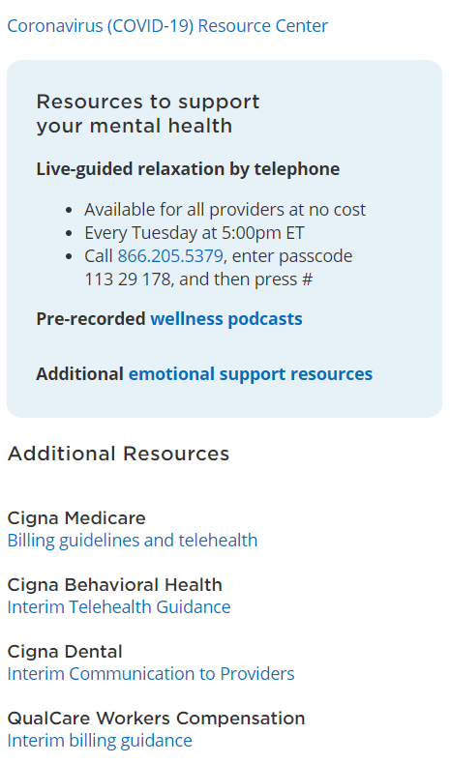
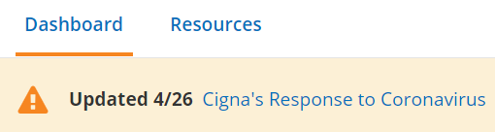
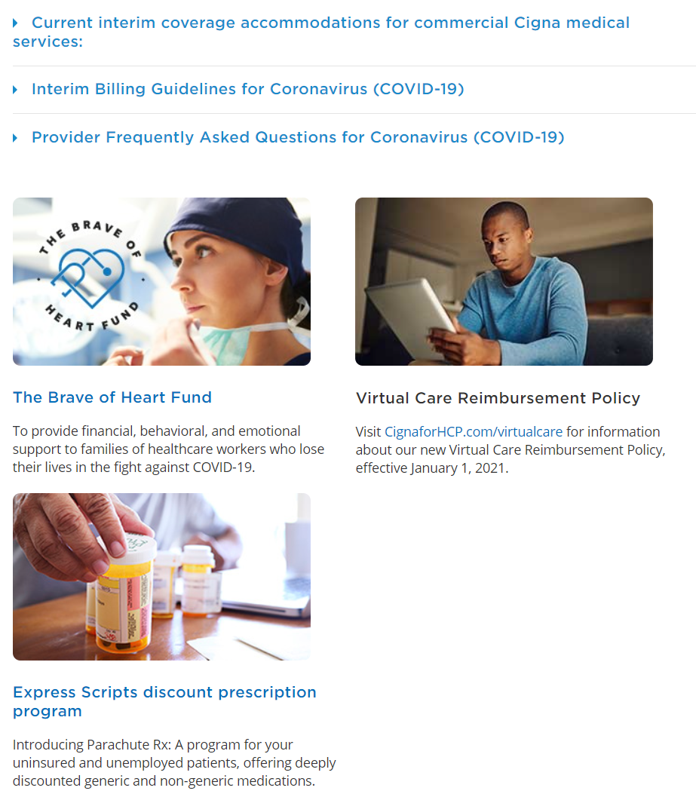
Keeping you updated
COVID-19 Resources on CignaforHCP.com
To access COVID-19 resources, go to the Cigna for Health Care Professionals website (CignaforHCP.com) and select Cigna’s Response to Coronavirus.
Resources include:
Interim billing guidelines
Frequently asked questions
Interim telehealth guidance
Additional resources
Notes:
We have a dedicated COVID-19 provider webpage at CignaforHCP.com that is updated regularly. Go to CignaforHCP.com and select Cigna’s Response to Coronavirus found in the banner across the top of the page. (Login is NOT required)
Here you can find resources that include:
Interim billing guidelines
Frequently asked questions
Interim telehealth guidance
Detailed coverage information for the COVID-19 vaccine and new treatments
And additional resources.
We encourage you to visit the site to get all the latest information.

Slide 12

Other coverage and reimbursement policy updates
Effective Date | Policy Name
February 2021 | Cardiac Rhythm Implantable Device (CRID) Guidelines Nutritional Support (0136) Minimally Invasive Spine Surgery Procedures and Trigger Point Injections (0139) Omnibus Reimbursement (R24) Ambulatory Electrocardiographic Monitoring (0547) Drug and Biologic Medical Necessity (Injectables & Non-Injectables) – medical benefits (2027 & 2028) Site of Care: High-tech Radiology (0550)
March 2021 | Airway Clearance Devices in the Ambulatory Setting (0069) Chiropractic Care (CPG 278) Physical Therapy (CPG 135) Occupational Therapy (CPG 155) Rhinoplasty, Vestibular Stenosis Repair and Septoplasty (0119)
April 2021 | Distinct Procedural Service (M59)
May 2021 | Ambulatory Electrocardiographic Monitoring (0547) Distinct Procedural Service (M59) Frequency Editing (R34) Pressure-Reducing Surfaces (0042)
For additional information about these updates, visit the Cigna for Health Care Professionals website (CignaforHCP.com).
12
Notes:
Lead in message: To support access to quality, cost-effective care for your patients with a medical plan administered by Cigna, we routinely review clinical, reimbursement, and administrative policies for potential updates. As a reminder, reimbursement and modifier policies apply to all claims, including those for patients with “G” ID cards.

Slide 13
Precertification updates
Precertification changes January through April 2021
Effective date | Code additions | Code removals
January 1, 2021 | 34 new Current Procedural Terminology (CPT®) codes 23 new Healthcare Common Procedure Coding System (HCPCS) codes | N/A
February 1, 2021 | Four new CPT codes | Two CPT codes removed
April 1, 2021 | Three new CPT codes Eight new HCPCS codes | Seven CPT codes removed
For a complete list of services requiring precertification:
Log in to the Cigna for Health Care Professionals website (CignaforHCP.com) > Resources > Clinical Reimbursement Policies and Payment Policies > Precertification Policies.
13
Notes:
Lead in message: To help ensure we are administering benefits properly, we routinely review our precertification policies for potential updates. As a result of a recent review, we want to make you aware that we have updated our precertification list.
To view the complete list of services that require precertification of coverage, log in to the Cigna for Health Care Professionals website (CignaforHCP.com) > Resources > Clinical Reimbursement Policies and Payment Policies > Precertification Policies.

Slide 14
PROVIDER DIGITAL SOLUTIONS
CignaforHCP.com enhancements
Notes:
Lead in Message:

Slide 15

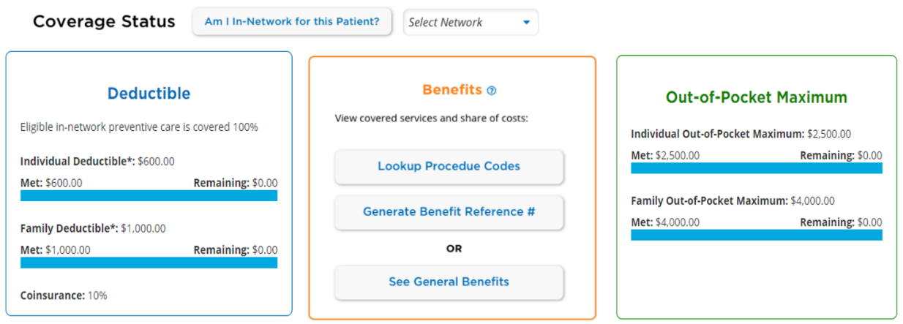
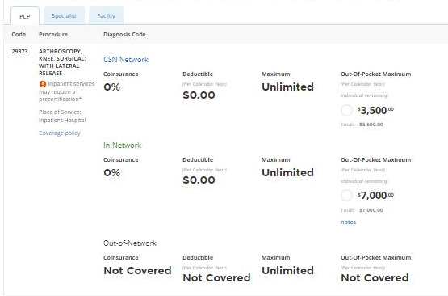
Benefit reference number
Access your patient’s benefit information with ease by using a procedure code
After locating your patient from the Patient Detail screen, start your benefit search here.
View benefits by code and procedure.
See the completed and remaining status bar when the benefit has limitations.
Verify if precertification is required.
Click Generate Benefit Reference Number to save your search.

Slide 16

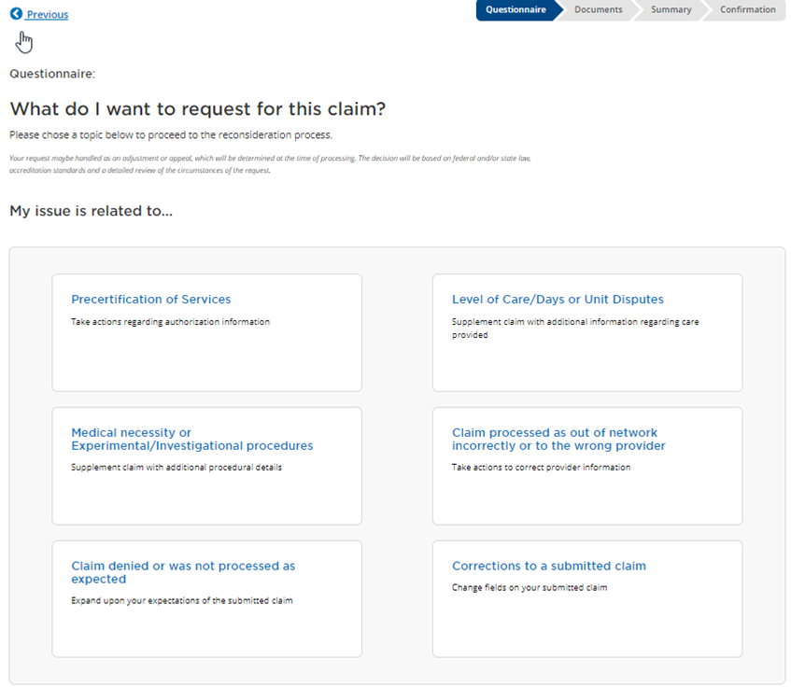
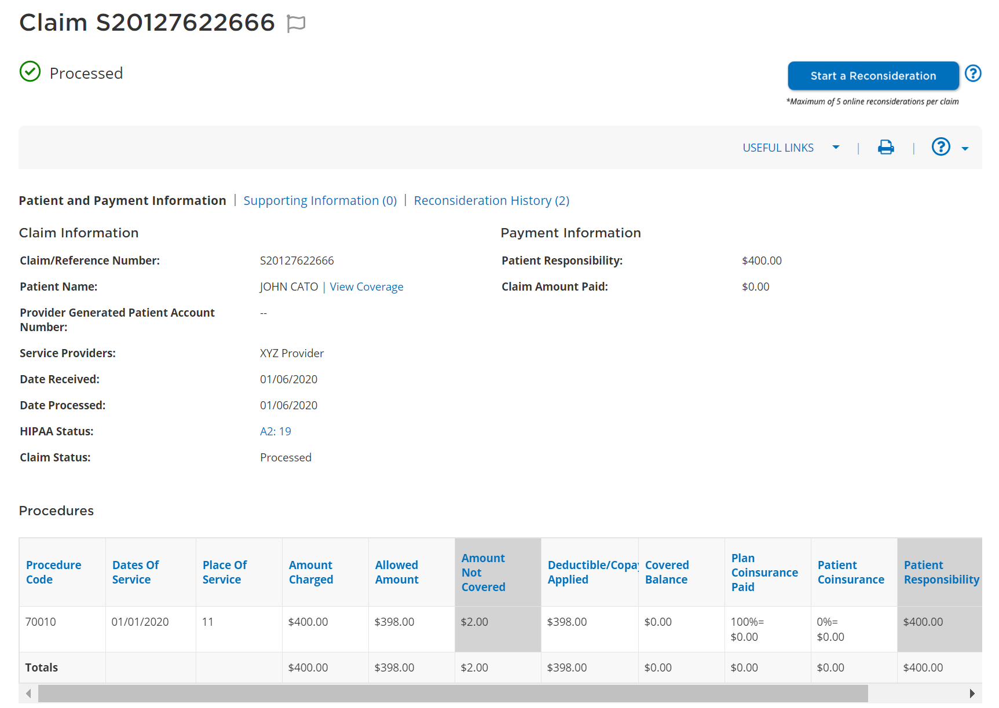
Claim reconsiderations and appeals online
You no longer need to call to start a claim reconsideration or appeal
Start a reconsideration
Access the reconsideration button directly from the claim details screen.
Questionnaire
Step-by-step guidance speeds up and simplifies the process.
Describe your reason for the request in the notes section.
Attach documentation, if needed.

Slide 17
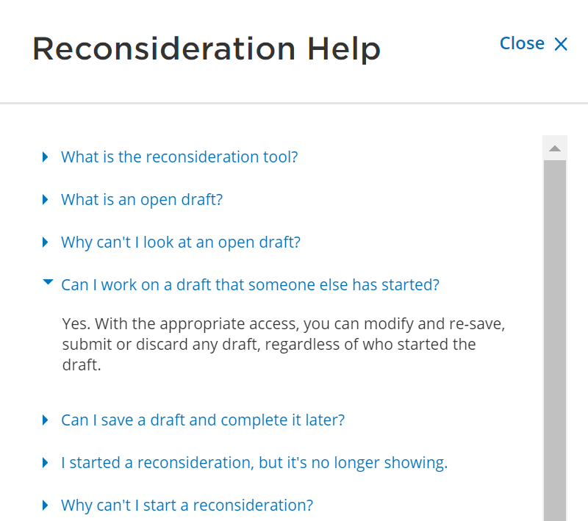


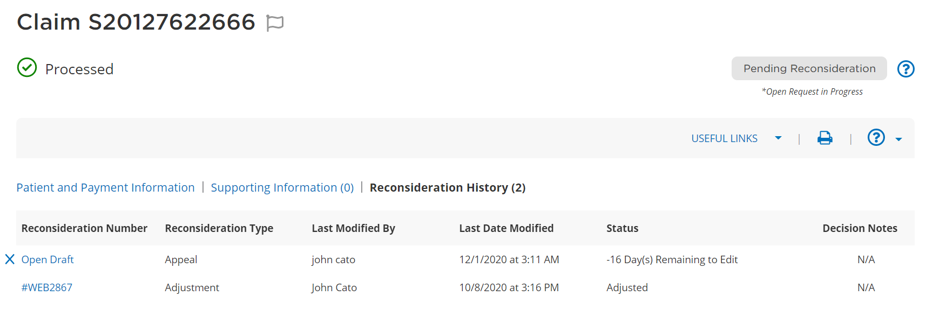
Claim reconsiderations and appeals online
Help, history, and status
?
Get answers to common questions by accessing the Reconsideration Help menu.
The Reconsideration History section will display
the status, who in your organization worked on it, and the Cigna processor’s decision notes, when applicable.

Slide 18

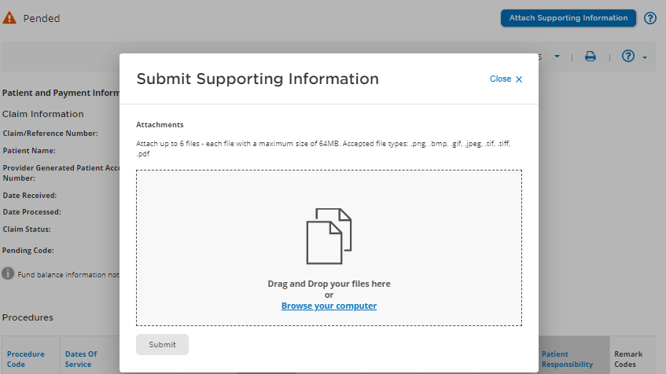


Upload documentation for pended claims
Attach and submit the requested information
1. Attach up to six files.
Each file may be a maximum of 64MB.
File types: .bmp, .png, .jpg, .gif, .tif, and .pdf.
2. See the status of the upload. Click submit.
3. Receive a reference number.

Slide 19

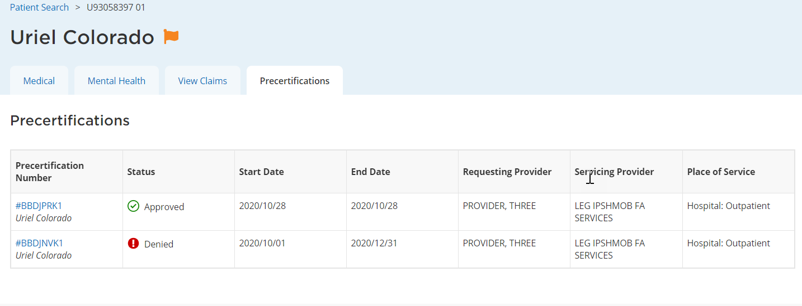
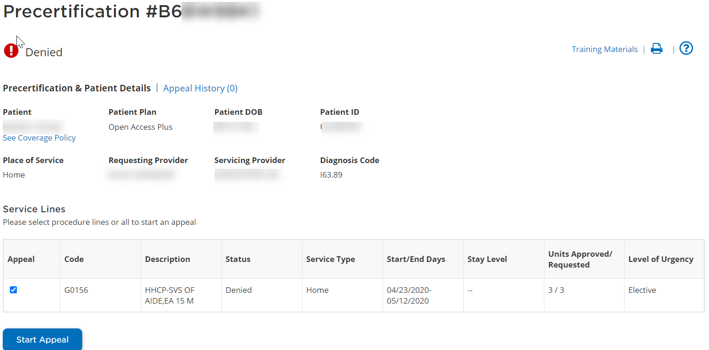
Precertifications
View precertifications that are on file for your patients
Click on the precertification number to view details.
To appeal the precertification decision, click Start Appeal.

Slide 20

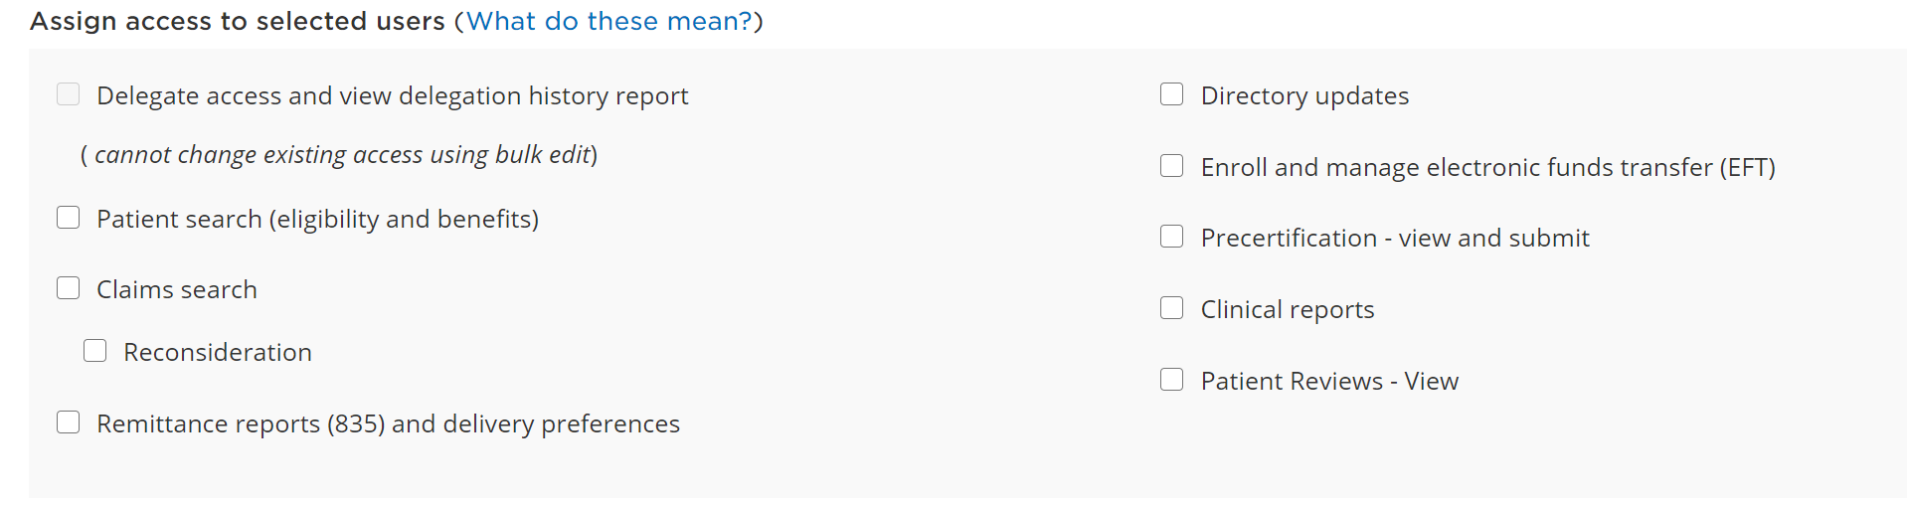
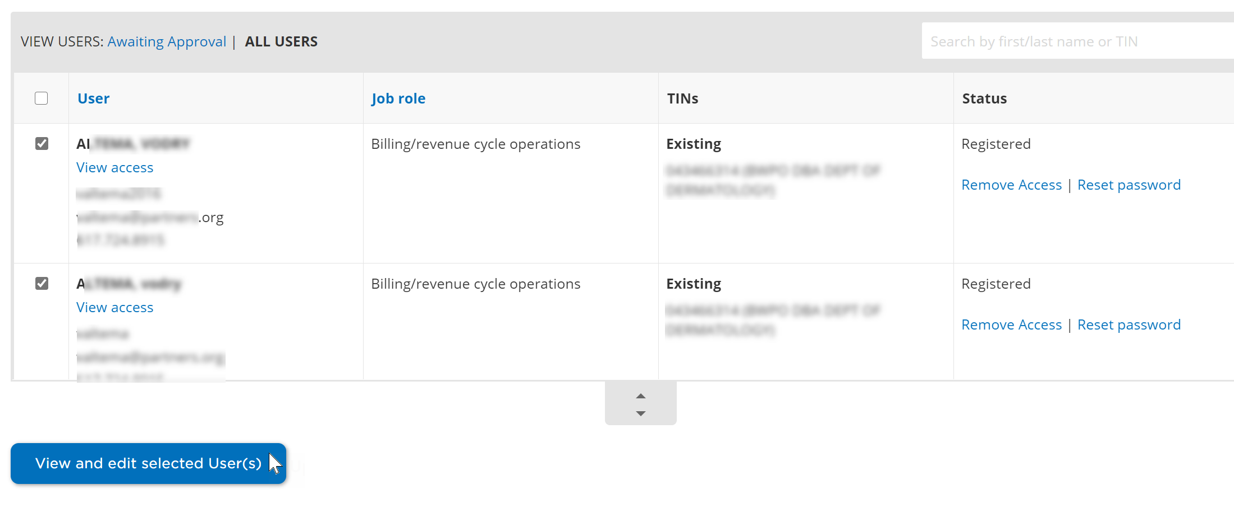
Do you have the right access?
Talk to your website access manager
Access to functions on the Cigna for Health Care Professionals website (CignaforHCP.com) are assigned by your website access manager.
To assign access, the website access manager begins by navigating to Working with Cigna > Manage Users Access.

Slide 21
Q&A

Slide 22

Offered by: Connecticut General Life Insurance Company or Cigna Health and Life Insurance Company.
All Cigna products and services are provided exclusively by or through operating subsidiaries of Cigna Corporation, including Cigna Health and Life Insurance Company, Connecticut General Life Insurance Company, Cigna Behavioral Health, Inc., and HMO or service company subsidiaries of Cigna Health Corporation. The Cigna name, logo, and other Cigna marks are owned by Cigna Intellectual Property, Inc.
All models are used for illustrative purposes only.
PCOMM-2021-473-MA 5/21 © 2021 Cigna. Some content provided under license.

