Slide 1
2021 Payers Day

Slide 2
Introductions
Mary Santiago, Sr. Provider Relations Representative
Mary Humel, Sr. Provider Relations Representative

Slide 3
Agenda
Introductions
Company Profile
Service & Eligibility Area
Provider Service Model
Working with Health New England
  ID cards
  Online Resources
  Formularies
  Guide to Procedures and Policies
  News and Articles
  Prior Authorization
  Telehealth
  Claims Editing
  Appeals
  Key Contacts
Specialty Partners
Added Value Program Resources
Product & Membership Updates
  Commercial
  Medicare Supplement

Slide 4
Company Profile
Health New England is a non-profit health plan owned by Baystate Health, one of the leading integrated delivery systems in Massachusetts.
Nearly 160,000 members in Western and Central MA trust Health New England for their health insurance needs.
We offer fully and self funded commercial health plans for employers as well as Connector, Medicare Advantage, Medicare Supplement and Medicaid plans for Individuals.
We partner closely with providers to achieve superior quality outcomes for our members while maintaining competitive costs for employers.
We take pride in the expertise, accessibility and superior service we are able to provide to our brokers, employers and members.

Slide 5
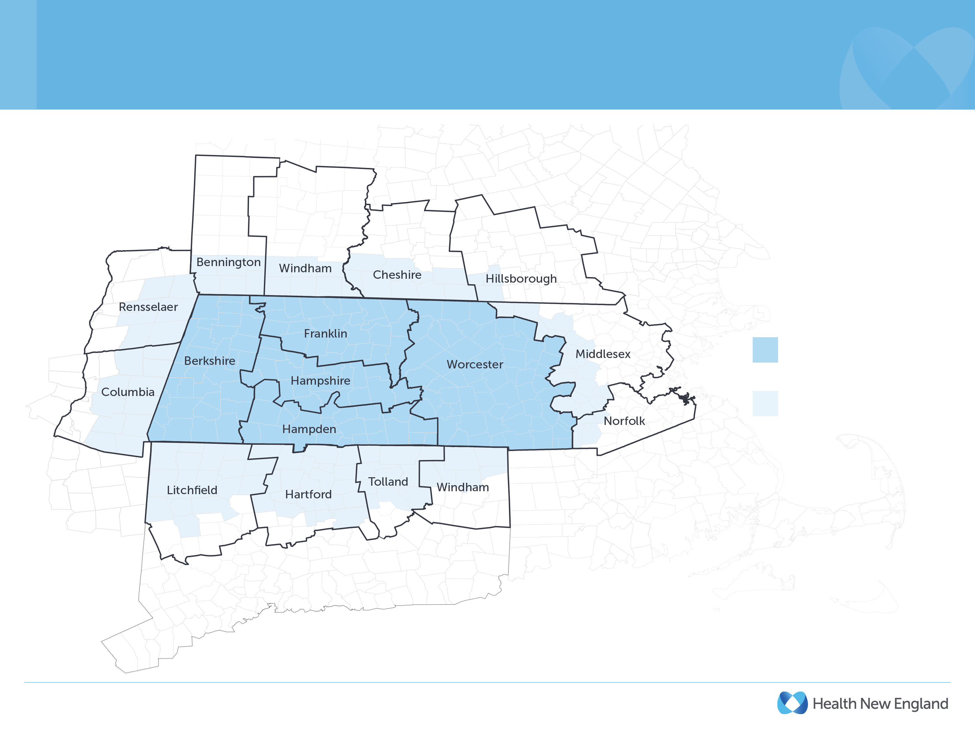
Health New England Fully Funded HMO Service and Eligibility Area
Service Area
Enrollment Eligibility Area
*Health New England serves Connecticut, New York, New Hampshire and Vermont residents (and their dependents) who are employed by Massachusetts companies, but is not licensed in those states.

Slide 6
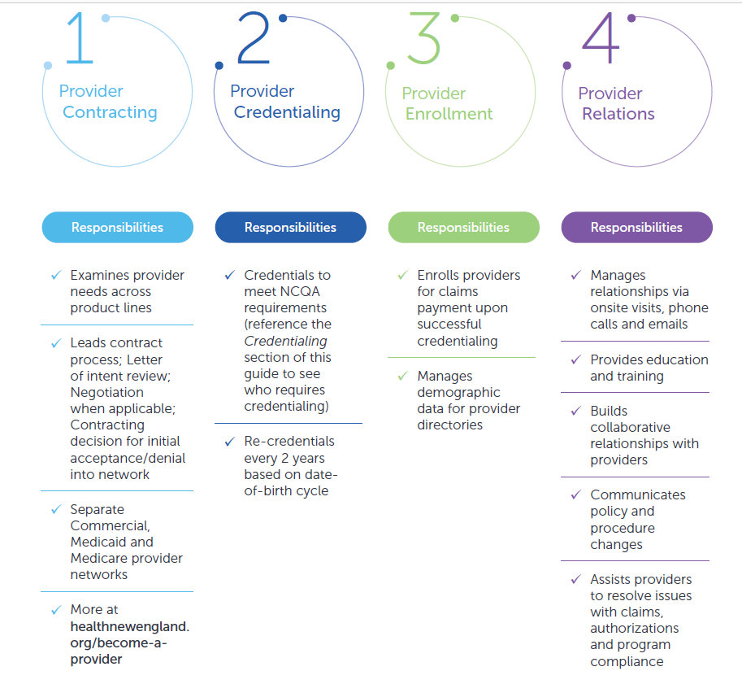
Health New England Provider Service Model

Slide 7
Working with Health New England

Slide 8
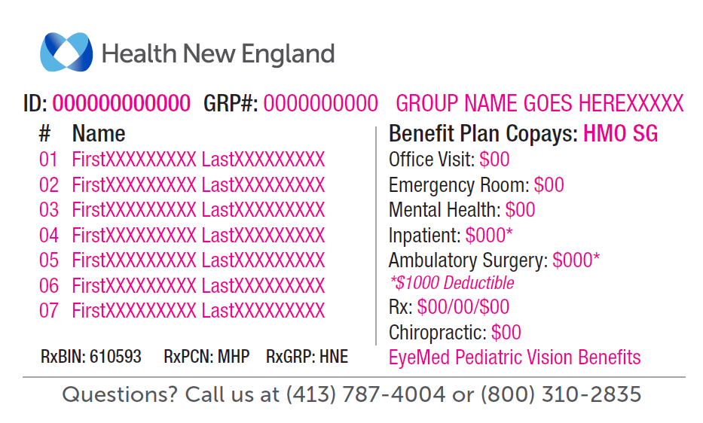
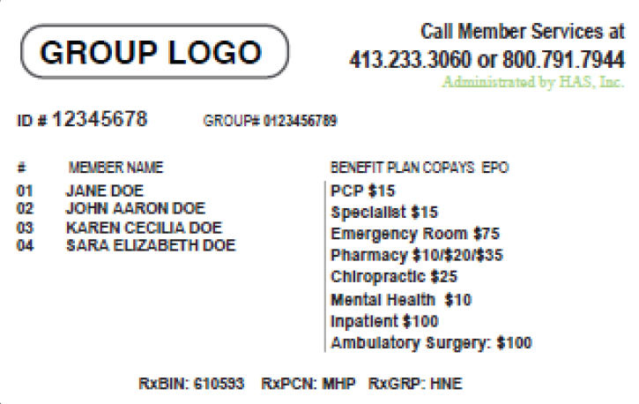
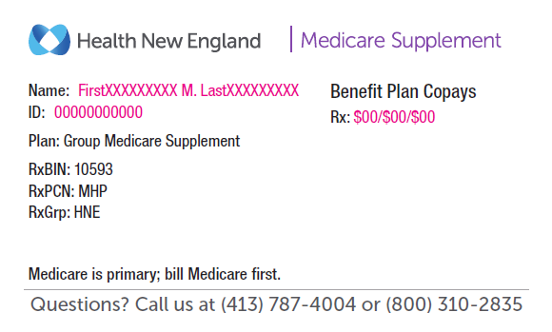
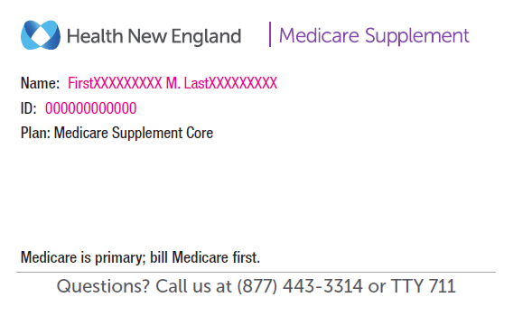
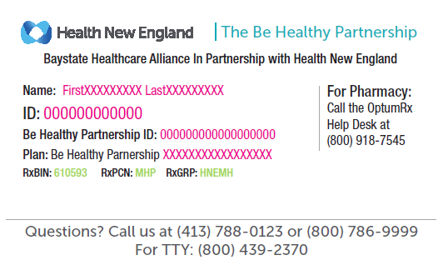
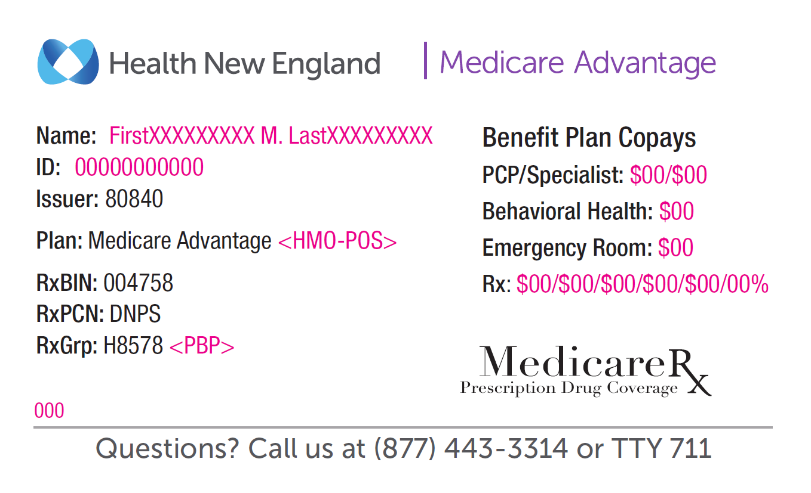
Health New England ID Cards
Commercial Fully Funded
Self-
Funded
Group Medicare Supplement
Individual Medicare Supplement
Medicaid / ACO
Medicare Advantage

Slide 9
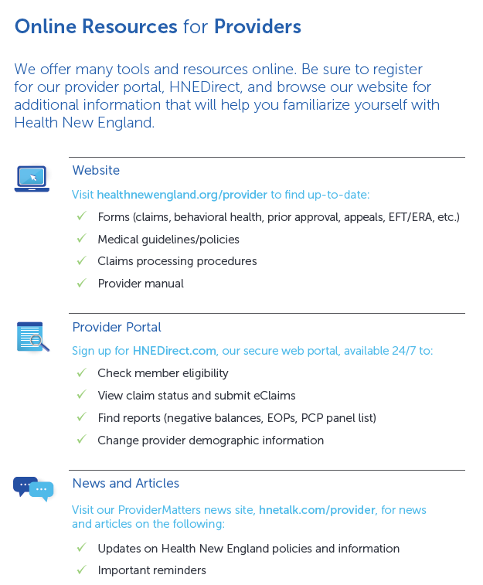
Online Resources

Slide 10
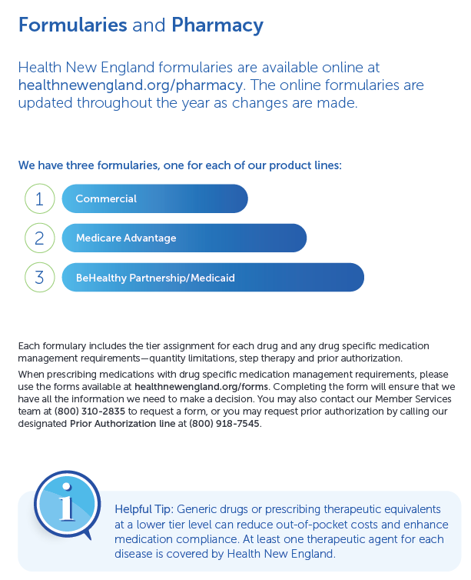
Online Formularies

Slide 11
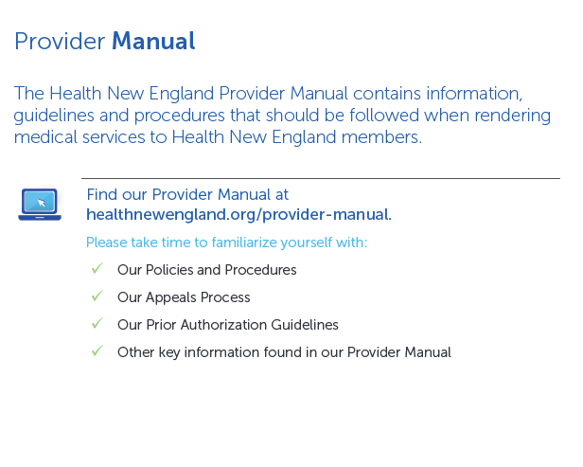
Online Guide to Procedures & Policies

Slide 12
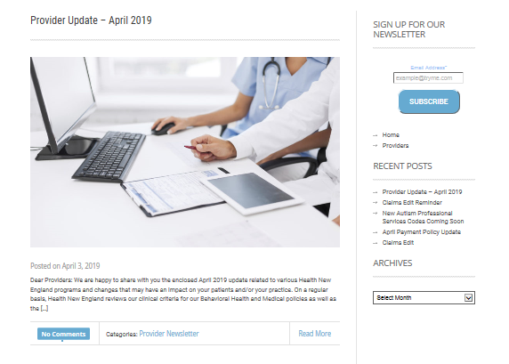
Online News and Articles
ProviderMatters, which allows providers to receive an email notification when important information is added, such as:
New HNE Products and Services
HNE/Industry News and Information
Notice of Policy Changes
Pharmacy Updates
Policy/Administrative Reminders
Semi-Annual Notice of Benefit Changes

Slide 13
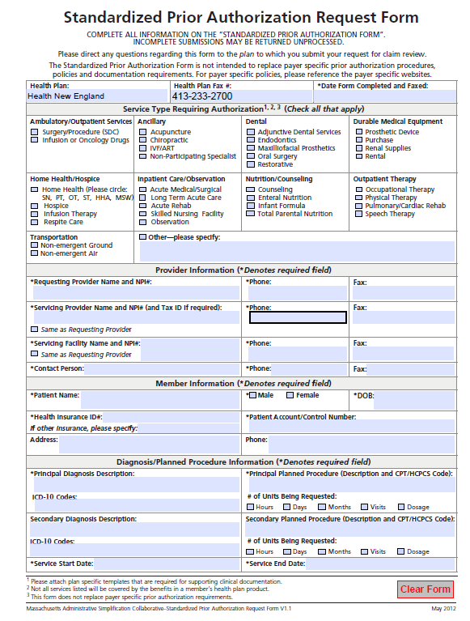
Prior Authorization
Guidelines for procedures and services requiring prior authorization, can be found in the Provider Manual
To verify a specific service, procedure, or treatment requiring prior
authorization, contact HNE Health Services directly at (413) 787-4000,
extension 5027 or (800) 842-4464, extension 5027, or HNE Member Services at (800) 310-2835
Form can be located at
http://healthnewengland.org/forms

Slide 14
Telehealth
State of Emergency:
CMS rules relaxed to meet State and Federal Mandates
Resources for HNE Business Decisions / State of Emergency Communications
  https://healthnewengland.org/provider
  https://healthnewengland.org/providers/coding
No State of Emergency (Awaiting guidance from Division of Insurance)
CMS rules will apply
Resources to understand CMS rules as it pertains to CPT / HCPC codes, modifiers, place of service
  https://www.ama-assn.org/amaone/cpt-current-procedural-terminology
  https://www.cms.gov/Medicare/Coding/ICD10

Slide 15
Claims Editing Rules
Historically HNE has been lenient with implementing CMS editing rules
Initiative underway to align to CMS guidelines
  Payment Policy includes a link to “newly released” NCD edits
  What HNE is working on is catch up
Changes will occur monthly
  Could see variances in payment
Resources to help with questions
  Lab National Coverage Determination
  Provider Relations Representative

Slide 16
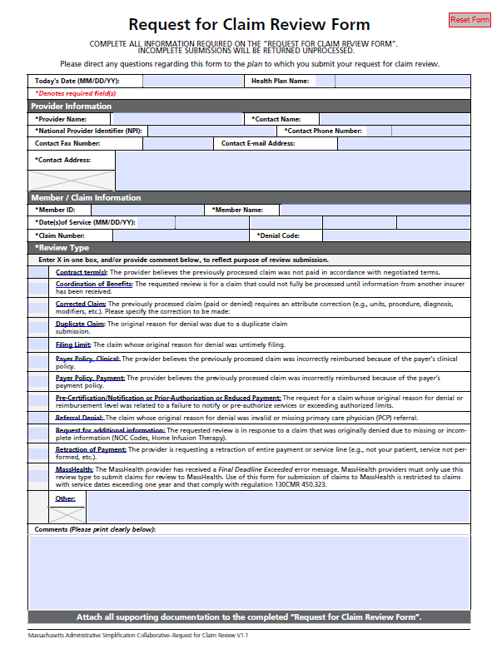
Appeals
Provider has a right to appeal.
Denied claim review comes to Provider Relations/Appeals Dept.
  Fill out claim review form
  Provide all necessary paperwork
  Fax or mail USPS
Health New England makes a determination within 90 business days

Slide 17
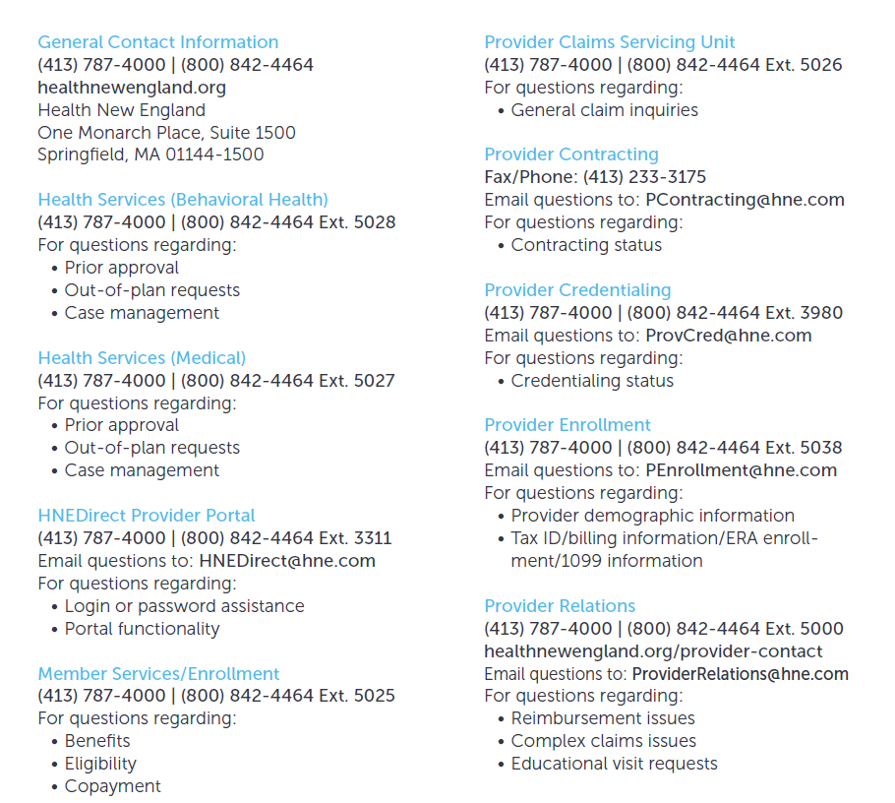
Key Contacts

Slide 18
Specialty Partnerships

Slide 19

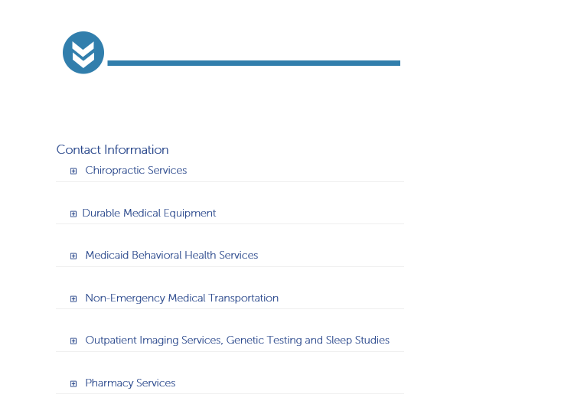
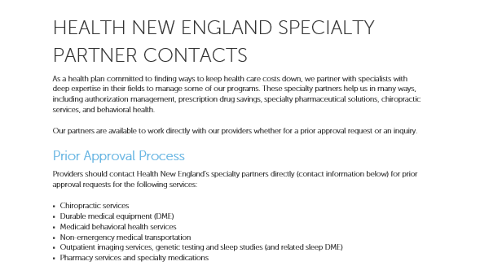
Health New England Specialty Partners
Notes:
Estimated savings $2.5M over 3 years

Slide 20
Claim & Coding Reviews
Zelis
  High dollar claim review
  Vendor to perform what was already in place/more efficient
  Communication was sent out February 2019
  Reviewing claims starting at $35K
  May request medical records for high dollars $100k
  Process of claim review is approximately 7 – 10 business day
Amenity (Nurse Audit)
  Institutional and Professional Coding & Clinical Review
Discovery Health Partner
  Claims audit on Medicare Advantage plan members with end-stage renal disease
  Ensures dialysis providers submit accurate and complete CMS-2728-U3 forms to the Centers for Medicare & Medicaid Services (CMS)

Slide 21
Care Management and Benefits Solutions
Healthmap Solutions
  Care Management benefit
  Identifies member with potential kidney disease or end-stage renal disease
Rx Savings Solution
  Pharmacy savings solution
  Works with providers to identify cost-effective medication
Optum
  Pharmacy Benefit Manager
  Acupuncture network
  Transplant assistance
Evicore
  Authorization management for genetic lab, high cost imaging, sleep studies
Northwood
  Network of providers supplying durable medical equipment & supplies
  Management of authorization

Slide 22
Added Value Program Resources

Slide 23
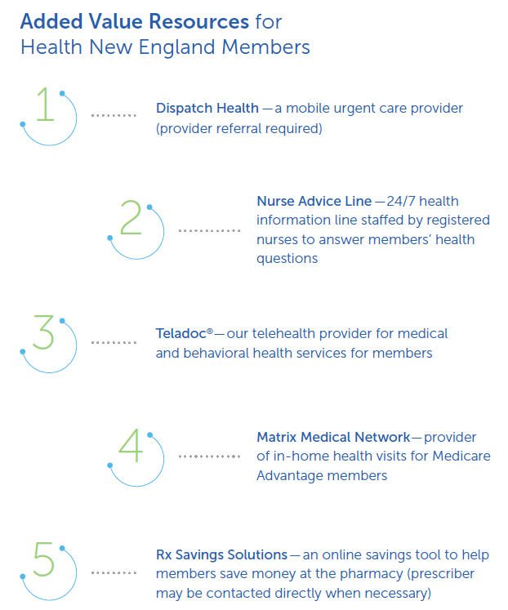
Health New England Resources
Notes:
Estimated savings $2.5M over 3 years

Slide 24
Product & Membership Updates

Slide 25
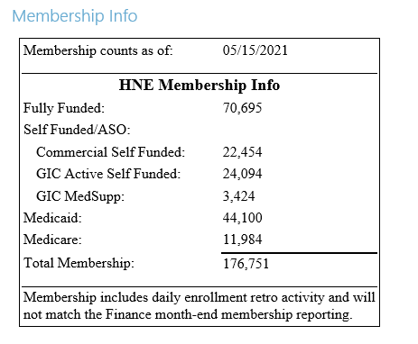
Membership Update

Slide 26
Commercial Product Update
Commercial Fully Funded HMO & PPO
  PHCS for out-of-network visits so member experience is in-network benefits
  Additional benefits like Acupuncture and Massage Reimbursement
Medicare Supplement throughout Massachusetts
  Health New England Core
  Health New England Supplement 1
  Health New England Supplement 1A
Medicare Advantage / Medicaid – Western Massachusetts area

Slide 27
Medicare Supplement Plans - Important to Know
Medicare Supplement members do not require a Primary Care Provider or a referral to see a specialist.
Part D drug coverage is not included; Medicare beneficiaries must purchase a Part D drug plan separately.
Medicare beneficiaries are covered throughout the US and US territories and must use a provider, doctor or hospital that accepts Original Medicare.
All Medicare Supplement plans have to cover the same set of core benefits.
Difference between carriers: Monthly Premium, Additional Benefits, Premium Discount.
Notes:
Slide 20:
Health New England Medicare Supplement plans have some unique features to them. Some of the highlights are as follows:
You are covered throughout the US, and US territories, you must use a provider, doctor, or hospital that accepts Original Medicare
The Health New England Supplement 1 and 1A plans have a wellness reimbursement program. We will reimburse you up to $150 per calendar year. This may be used for the following services: Fitness Club membership, Weight Watchers, School and Town Sports, Aerobic/Wellness Class, Personal Trainer fees, Athletic Event Registration Fees, Golf (lessons or rounds of golf), Ski tickets, Fitness Equipment and Devices, Nutrition Classes, Mindfulness Classes, Community Supported Agriculture (CSA) or Farm Shares)
You do not require a Primary Care Provider or a referral to see a specialist
Medicare Supplement plans do not include Part D drug coverage, must purchase separately

Slide 28
Questions

