Slide 1
Massachusetts Association of Patient Account Management
May 17, 2018
Devens Common Center, Devens, MA
Blue Cross and Blue Shield of Massachusetts (BCBSMA*) is an independent licensee of the Blue Cross and Blue Shield Association.
Proprietary. © Blue Cross and Blue Shield of Massachusetts, Inc.
*BCBSMA refers to Blue Cross and Blue Shield of Massachusetts, Inc., Blue Cross and Blue Shield of Massachusetts HMO Blue®, Inc.,
and/or Massachusetts Benefit Administrators LLC, based on Product participation Blue Cross and Blue Shield of Massachusetts is an independent licensee of the Blue Cross and Blue Shield Association.

Slide 2
Legal Notes
These training materials have been provided to help you in your administrative interactions with Blue Cross Blue Shield of Massachusetts (Blue Cross).
The information and representations herein do not replace or supersede the terms of your Blue Cross provider Agreement, your Blue Book manual or Indemnity Handbook, or other Blue Cross policies and procedures.
To the extent the foregoing terms and policies conflict with or are otherwise inconsistent with anything in these training materials, your Blue Cross provider Agreement, your Blue Book manual or Indemnity Handbook, and other Blue Cross policies and procedures will govern.

Slide 3
Agenda
BCBSMA Updates
Provider directory
Telehealth
Replacement claims
Referral/Auths Status
Q & A

Slide 4




What’s Happening … Blue Cross Updates
Leading health care insurer in Massachusetts
Improving access to high
quality & affordable care
Battling the opioid epidemic RIZE Massachusetts
Complete Care for
Advanced Illness program

Slide 5


NCQA Ranks BCBSMA Top in Country for Quality
NCQA rated our Commercial HMO plan 5 out of 5 rating two years in a row!
NCQA also rated our Commercial PPO plan 4.5 out of 5 and once again gave us an “Excellent” accreditation for operations.
BCBSMA is focused on providing our 2.8 million members with high quality, affordable health care

Slide 6

Named Top Health Plan in Massachusetts by J.D. Power
JD Powers focuses on six factors:
Coverage & Benefits
Provider Network
Communication
Claims Processing
Premiums
Customer Service

Slide 7




Provider Directory
The importance of keeping provider data and directories up-to-date.
Looking through
the patient lens
Directories help individuals and families find the care they need.
We’re committed to creating accurate directories that serve our members, your patients’ needs.
Provider information changes often; please update us as changes occur.
Provider information listed in the online directories must contain current and accurate information.
Patients searching for providers online
Incorrect information affects Patients’ ability to
access care
Providers required by contract to
keep directory
information current

Slide 8



Regulations
Health plans are required to ensure provider directories contain current and accurate information.

Slide 9
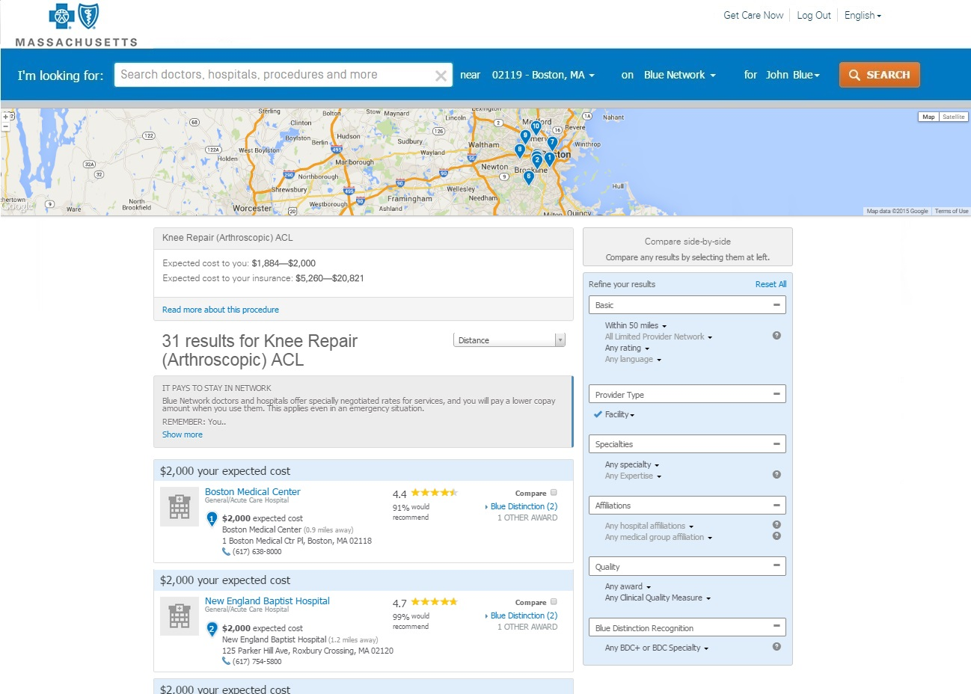
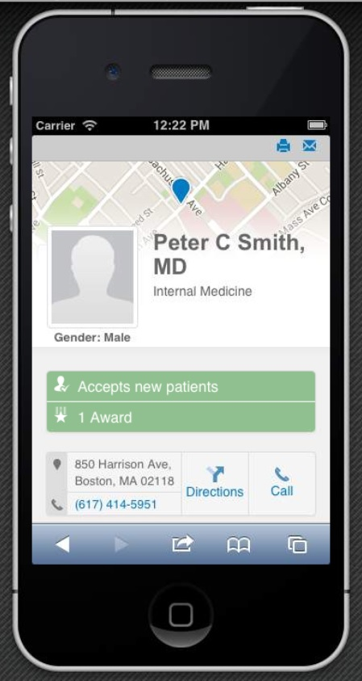
Provider Directory Demographics
network information,
Key Demographics
Provider Name
Phone number
Office locations - address
Specialties
Medical groups
Hospital affiliations
Panel status (open/closed) for All providers
Gender
Board certification
Languages spoken
Product participation (HMO/PPO/Ind/MedAdv)
Contractually you must notify us 90 days in advance.

Slide 10
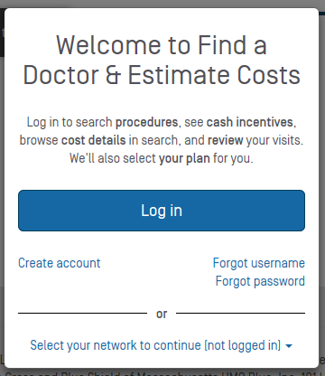
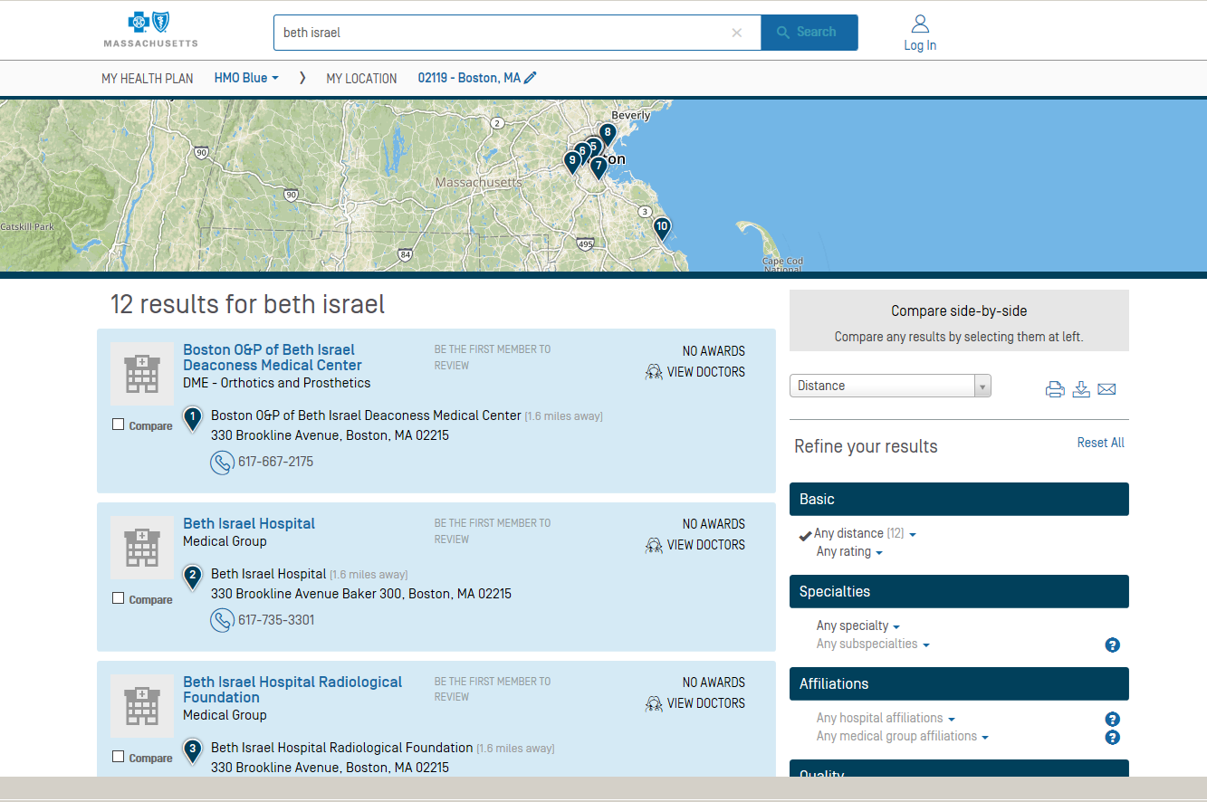
Verify Your Information Online
Go to Find a Doctor & Estimate Costs at myfindadoctor.bluecrossma.com.
You don't need to log in. Select and review all your site locations for each network in which you participate.
Check the record for all your site locations. Be sure to validate all addresses, phone numbers, medical groups, hospital affiliations, gender, board certification, languages spoken, whether you’re accepting new patients, and whether you offer telemedicine.
SEARCH
2
1
NETWORK

Slide 11
Verify Your Information Online (continued)
3. Accurate? You’re done. You may need to attest to your directory information in the future.
4. Need Updates? Complete the Standardized Provider Information Change form Visit Provider Central at bluecrossma.com/provider. Go to: Forms>Forms Library>Administrative to find the one you need.

Slide 12
Working Together to Keep the Provider
Directory Current
1. Share our quarterly provider communications regarding the provider directory with your staff:
  Provider Central - quarterly notices posted on-line
  Mail from Blue Cross to you - quarterly mailings to all Medicare Advantage participating providers not registered on Provider Central
2. Be Proactive - notify us as soon as you have a provider/practice change – we require 90 days notice.
When accurate information is available patients are able
to find the care they need for themselves and their families.

Slide 13


Telehealth
Allows patients to have real-time video visits with a health care provider using a smartphone, tablet, or computer. Members can access doctors and therapists for non-emergent care. This innovative benefit is secure, convenient and rapidly changing the way members can access quality care.
Telehealth

Slide 14
Telehealth Provider Participation
Provider Participation
Promote telehealth services offered through a secure and private HIPAA data connection
Complete the Standardized Provider Information Change Form by visiting Provider Central at www.bluecrossma.com/provider and Go to Office Resources>Enrollment >Maintaining & Changing Status.
Telehealth provider network
  Local Blue Cross of MA provider network
  American Well provider network
Payment Policy - www.bluecrossma.com/provider Go to Office Resources>Polices & Guidelines>Payment Policies>Telemedicine

Slide 15
New Payment Policy Telehealth
Medical Evaluation and Management Codes(Local Network)
Code | Narrative
99201 | Office or other outpatient visit for the evaluation and management of a new patient. Typically, 10 minutes are spent face to face with the patient and/or family.
99211 | Office or other outpatient visit for the evaluation and management of an established patient. Typically, 5 minutes are spent performing or supervising these services.
99212 | Office or other outpatient visit for the evaluation and management of an established patient. Typically, 10 minutes are spent face to face with patient and/or family.
Behavioral Health Codes (Local Network)
Code | Narrative
90791 | Psychiatric diagnostic evaluation
90832 | Psychotherapy, 30 minutes with patient and/or family member
90833 | Psychotherapy, 30 minutes with patient and/or family member when performed with an evaluation and management service
90834 | Psychotherapy, 45 minutes with patient and/or family member
90836 | Psychotherapy, 45 minutes with patient and/or family member when performed with an evaluation and management service
90837 | Psychotherapy, 60 minutes with patient and/or family member
90838 | Psychotherapy, 60 minutes with patient and/or family member when performed with an evaluation and management service (List separately in addition to the code for primary procedure)

Slide 16
New Behavioral Health Telemedicine codes
New Behavioral Health Codes (Local Network) as of 4/1/18
Code | Narrative
99213 | Office or other outpatient visit for the evaluation and management of an established patient. Usually, the presenting problems are of low to moderate severity.
99214 | Office or other outpatient visit for the evaluation and management of an established patient. Usually, the presenting problems are of moderate to high severity
90847 | Family psychotherapy (with patient present)
Telemedicine must be billed with GT or 95 modifier
Code | Narrative
95 | Synchronous telemedicine service rendered via a real-time interactive audio and video telecommunications system
GT | Interactive audio and video telecommunications system

Slide 17
Replacement Claims
Replacement claims to include partially denied claims
Effective June 1st, 2018
Benefits of the new mandate:
  Claims will finalize faster
  Check Claim status online
  No need to submit an appeal
If your practice management system is already set up to submit replacement claims for partially denied claims, you don’t have to wait for June 1st.
Start submitting today!

Slide 18
Online Services – Referral and Authorization Status
Save time and check referral and authorization status online
Use Online Services to check the status of your referral and authorization requests
  To access Online Services, log on to bluecrossma.com/provider.
  For instructions download our Online Services Quick Start Guide.
    From the home page, go to eTools>Online Services>Quick Start Guide.

Slide 19


Thank you!
bluecrossma.com/provider
Network Management and Services
1-800-316-BLUE (2583)
. ® Registered Mark of the Blue Cross and Blue Shield Association. ®′ and TM Registered Marks of their respective companies. © 2017 Blue Cross and Blue Shield of Massachusetts, Inc., and Blue Cross and Blue Shield of Massachusetts HMO Blue, Inc. Proprietary and Confidential All Rights Reserved.
PEP-5232 (4/15)

