Slide 1
Health Safety Net Updates
MAPAM
May 18, 2017

Slide 2
HSN Updates – Agenda
Billing Updates
Operational Reminders
HSN Eligibility Reminders and Update
Provider Guidebook
DentaQuest Information

Slide 3
HSN Billing Updates
HSN sent out information to providers and billing intermediaries on several billing updates in December, 2016.
HSN has also sent out Billing Reminders to providers, keeping providers updated on concerns seen at HSN, or other information for providers to take note.
  Beginning in March, 2017, providers began to see warnings associated with the updates on their INET edit/validation reports.
  HSN has been proactively reaching out to providers who have a high percentage of warnings on their claims.
  Providers will be notified (30 days) before HSN changes the warning to fatal edits.
  All Billing Updates can be found on the HSN website:
    Allhttp://www.mass.gov/eohhs/consumer/insurance/more-programs/health-safety-net/providers/provider-guides-and-information.html

Slide 4
HSN Operational Reminders
Fiscal Year 15 Closing – moving toward closing FY15 as of September 30, 2017. Please plan ahead and be sure any claim concerns are resolved
Providers must contact HSN before beginning to send claims using a new Billing Intermediary or changing the Billing Intermediary used to submit claims. Failure to complete notification to HSN will result in claims not processing at HSN and HSN will not be able to make payment on claims. A Business Partner Agreement must be completed prior to submitting claims using the new BI. Contact the HSN Helpdesk for more information.
Please be sure to let HSN know if you have staff that have left your facility so that HSN can deactivate their access to INET.
If you have new staff, please be sure to have them complete an HSN INET User Agreement. By completing an Agreement, staff will be added to the emailing list for HSN as well as giving them access to INET functions they may need. Agreements can be found on the HSN website:
  www.mass.gov/eohhs/docs/masshealth/hsn/hsn-user-agreement.pdf

Slide 5
HSN Eligibility Reminder
As a reminder:
  Individuals who are eligible for ConnectorCare can receive HSN medical and dental services for 90 days from their application date. This is called Temporary HSN.
    They also are eligible for HSN services 10 days retro from their application date. This accounts for 100 days of HSN medical and dental services.
  After those 90 days, individuals with ConnectorCare are eligible for HSN dental only.
Important! Individuals are only eligible for another segment of HSN medical and dental services for 100 days if they met one of the below criteria:
  They are newly eligible for a ConnectorCare plan
  They were previously eligible for a MassHealth or unsubsidized QHP
Individuals who are currently eligible for a ConnectorCare plan and are renewed into ConnectorCare (even if it’s a different plan type) do NOT get another 100 days of HSN medical and dental. They are eligible for HSN dental only until they meet one of the conditions above.

Slide 6
HSN Eligibility Updates
In May 2017, there will be an updated release to MAHealthConnector.org. that will provide more information for individuals with ConnectorCare and HSN-wrap.
The update will include the following:
  Updates to the eligibility screens to indicate:
    HSN medical eligibility is temporary (if within the first 90 days) OR
    HSN Dental eligibility only (if after the 90 days)
  Updates to the member noticing to indicate:
    HSN medical eligibility is temporary (if within the first 90 days) OR
    HSN Dental eligibility only (if after the 90 days)
90-days from the date of determination, individuals eligible for ConnectorCare with an HSN-wrap will automatically be moved to an HSN dental only benefit
  They will NOT receive a new notice, their first eligibility notice for HSN will contain all the information
Most individuals with ConnectorCare and HSN-wrap already have HSN dental only. As their eligibility is re-determined in the system, that information will update accordingly and appropriate notification will be sent

Slide 7
Example – New Notice Language with HSN Temporary Coverage
Health Safety Net is available for a limited time only.
The person listed above is also eligible for a ConnectorCare plan through the Massachusetts Health Connector. Because this person is eligible for ConnectorCare, the Health Safety Net will only pay for eligible medical services for a limited period of time.
If the listed person recently qualified for the Health Safety Net and ConnectorCareHealth, they can use the Health Safety Net for up to 90 days while they select and enroll in a ConnectorCare plan. After 90 days, the Health Safety Net will only pay for eligible dental services.
For more information about what the Health Safety Net pays for, including where to find information about HSN Providers, see the section below called “How Does the Health Safety Net Work?”.
Notes:
90 day expiration results aid cat Z4 and new ‘Health Safety Net Dental’ message.

Slide 8
Example – New Notice Language with HSN Dental Only Coverage
Health Safety Net is available for eligible dental services.
The person listed above is also eligible for a ConnectorCare plan. This person was given 90 days of HSN eligibility to give them time to select and enroll in a ConnectorCare plan. Because those 90 days have passed, the Health Safety Net will only pay for eligible dental services.
For more information what the Health Safety Net pays for, including where to find information about HSN Providers, see the section below called “How Does the Health Safety Net Work?”. If you have questions about this person’s Health Safety Net eligibility, call 1-877-910-2100.
If you want to know more about ConnectorCare, go to MAhealthconnector.org or call Health Connector Customer Service at 1-877 MA ENROLL (1-877-623-6765) or TTY 1-877-623-7773 if you are deaf, hard of hearing or speech disabled.
Notes:
90 day expiration results aid cat Z4 and new ‘Health Safety Net Dental’ message.

Slide 9
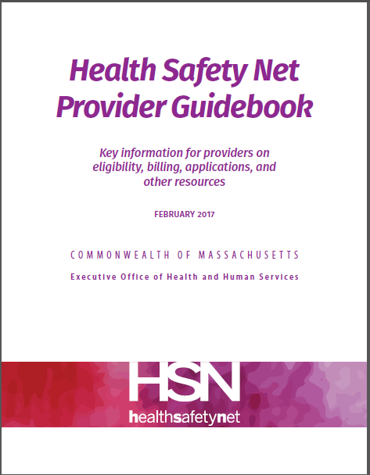
Provider Guidebook
This summer the HSN will be releasing a new Provider Guidebook.
This Guidebook will replace its predecessor, HSN Provider Frequently Asked Questions. The Guidebook contains the most recent information and includes direct, relevant, HSN-specific information.
The objective of this Guidebook is to offer a comprehensive, orientation for providers. This includes health care providers, billing departments, fiscal operations staff, patient navigators, and other providers who interact with the Health Safety Net. The guidebook serves as an introduction to HSN, and answers to frequently asked questions may be found within the document.

Slide 10
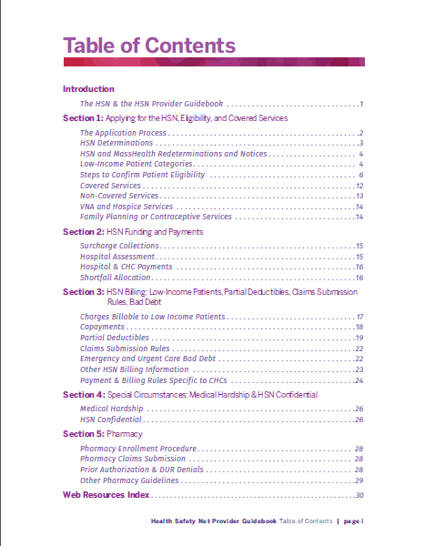
Provider Guidebook
There are five sections, in addition to the Web Resources Index in the appendix:
Section One: HSN eligibility as well as covered and non-covered services.
Section Two: Focuses on the fiscal operations of the Health Safety Net Office, funding streams, and how hospital and community health center payments are calculated and paid.
Section Three: Billing information including how to bill patients, the HSN Office, and HSN Bad Debt.
Section Four: HSN Special Circumstances.
Section Five: Pharmacy guidelines.

Slide 11


DentaQuest Provider Relations
Marianne Leahy: Vice President, Network Management
Phone: 617-886-1206
E-mail: Marianne.Leahy@GreatDentalPlans.com
Keishia Lopez-Christian: Provider Relations Representative. (Boston and Southern MA)
Phone: 617-886-1727
E-mail: Keishia.Lopez@DentaQuest.com
Daniel Archambault: Provider Relations Representative. (Western MA)
  Phone: 617-886-1736
  E-mail: Daniel.Archambault@DentaQuest.com
Adeola Staveley: Provider Relations Representative.
Phone: 617-886-1608
  E-mail: Adeola.Stavely@DentaQuest.com

Slide 12

DentaQuest- Additional Resources
Tracy Chase Gilman: Executive Director
Phone: 617-886-1310
E-mail: Tracy.Chase@dentaquest.com
Megan Mackin: Outreach Coordinator
Phone: 617-886-1728
E-mail: Megan.Mackin@dentaQuest.com
Flor Piedrasanta: Outreach Coordinator
Phone: 617-886-1797
E-mail: Flor.Piedrasanta@dentaQuest.com
Rhonda Small: Provider Intervention Specialist
Phone: 617-886-1725
E-mail: Rhonda.small@dentaquest.com
Notes:
Next I’d like to introduce you to your local Doral Boston team.
Keishia Lopez is the eastern regional provider relations representative and is responsible for recruiting and retention. She can help you with enrollment questions and will meet with your staff to get them up to speed on the most efficient ways to manage your MassHealth billing.
Megan Mackin (formerly Megan Burke) is currently the western regional provider relations representative but has recently accepted the position of Outreach Coordinator where she will provide education and outreach to the MassHealth member families.

Slide 13


Helpful Internet Links & Resources
Provider Web Page – Check eligibility, submit authorizations & claims
https://www.masshealth-dental.net
Provider Web Portal- https://www.masshealth-dental.net, Dentist Tab,
Provider Web Portal FAQ’s & Trainings- https://www.masshealth-dental.net, Dentist Tab, Resources
Customer Service- 1-800-207-5019, 8:00 am-6:00 pm EST
IVR– 1-800-207-5019, Available 24 / 7

