Slide 1
MAPAM Meeting
Thursday, May 18, 2017
Our United Culture. The way forward.
■ Integrity ■ Compassion ■ Relationships ■ Innovation ■ Performance

Slide 2
Agenda
Important Information and Updates
Advance Notification and Prior Authorization Updates
Telehealth
Link Overview
Credentialing and Re-credentialing
Questions

Slide 3
Important Information and Updates

Slide 4
Code Additions to Existing Prior Authorization Categories
Effective for dates of service on or after April 1, 2017, the following procedure code will require prior authorization for UnitedHealthcare Commercial plans (excluding Medicare Advantage plans).
Category Code
Durable Medical Equipment E0766 Electrical Stimulation Device (ESD)
Notes:
December Network Bulletin – Page 7
Effective for dates of service on or after April 1, 2017, the following procedure code will require prior authorization for UnitedHealthcare Commercial plans (excluding Medicare Advantage plans).
Durable Medical Equipment E0766
The most up-to-date Advance Notification lists are available online: Clinician Resources > Advance & Admission Notification

Slide 5
Telehealth Services

Slide 6
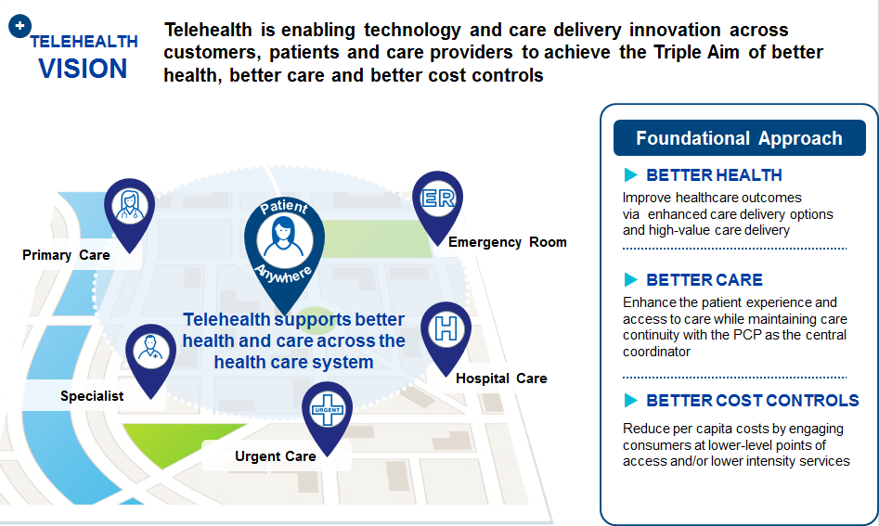
Telehealth Vision
Notes:
Telehealth is enabling technology and care delivery innovation across customers, patients and care providers to achieve the Triple Aim of BETTER HEALTH, BETTER CARE and BETTER COST CONTROLS.
Better Health and Outcomes
Our focus is enabling our strategic provider partners to leverage telehealth for their patient populations. We believe that we can continue to impact health care outcomes for our members.
Better Care and Access
The primary care relationship is the center of health care – we want to get our members to their PCP to manage their whole-person care
Appropriate consumer tools and benefit plan design also help enable telehealth. An example of this is Virtual Visits, where a benefit was added so that commercial members can access physicians for urgent-care like needs.
Better Cost Controls
We believe that telehealth allows for engaging consumers at appropriate entry points across the continuum and/or lower intensity services-lower ED utilization, inpatient admissions, increase PCP visits and generic Rx use

Slide 7

Telehealth Services
Telehealth services are live, Interactive Audio and Visual Transmissions of a physician-patient encounter from one site to another using telecommunications technologies.
They may include transmissions of real-time communications or those transmitted by store-and-forward technology.
Requirements:
All providers wishing to deliver clinical services using Telehealth technology must be licensed in the originating state where the patient presents.
There may also be some local or regional medical board originating site or patient relationship requirements prior to providing services through Telehealth.
Notes:
Telehealth services are live, Interactive Audio and Visual Transmissions of a physician-patient encounter from one site to another using telecommunications technologies.
They may include transmissions of real-time communications or those transmitted by store-and-forward technology.
Requirements:
All providers wishing to deliver clinical services using Telehealth technology must be licensed in the originating state where the patient presents.
There may also be some local or regional medical board originating site or patient relationship requirements prior to providing services through Telehealth.

Slide 8
UHC Policy
Telephone Calls
UHC follows CMS guidelines and does not reimburse for
telephone charges submitted with CPT codes 98966-98968 or 99441-99443 because they do not involve direct, in-person patient contact.
Internet Services
UHC follows CMS guidelines and does not reimburse for CPT codes 98969 and 99444 (Online Medical Evaluation), because these services do not involve direct, in-person, patient contact.
Consultation Services
UHC follow CMS guidelines and does not reimburse for interprofessional telephone/internet assessment and management services reported with CPT codes 99446-99449 because they do not involve direct, in-person patient contact.
Notes:
Telephone Calls
UHC follows CMS guidelines and does not reimburse for
telephone charges submitted with CPT codes 98966-98968 or 99441-99443 because they do not involve direct, in-person patient contact.
Internet Services
UHC follows CMS guidelines and does not reimburse for CPT codes 98969 and 99444 (Online Medical Evaluation), because these services do not involve direct, in-person, patient contact.
Consultation Services
UHC follow CMS guidelines and does not reimburse for interprofessional telephone/internet assessment and management services reported with CPT codes 99446-99449 because they do not involve direct, in-person patient contact

Slide 9

Modifiers
GQ – Via Asynchronous Telecommunications systems
GT – Via Interactive Audio and Video Telecommunications systems
The Centers for Medicare and Medicaid Service (CMS) have authorized specific Originating Sites as “eligible” for furnishing Telehealth service.
When reporting modifier GT, the physician, hospital, ambulatory surgical center, or qualified healthcare professional is certifying that they are rendering services to a patient located in an eligible Originating Site via an Interactive Audio and Visual Telecommunications system.
Notes:
GQ – Via Asynchronous Telecommunications systems
GT – Via Interactive Audio and Video Telecommunications systems
The Centers for Medicare and Medicaid Service (CMS) have authorized specific Originating Sites as “eligible” for furnishing Telehealth service.
When reporting modifier GT, the physician, hospital, ambulatory surgical center, or qualified healthcare professional is certifying that they are rendering services to a patient located in an eligible Originating Site via an Interactive Audio and Visual Telecommunications system.

Slide 10
Originating Sites
In accordance with CMS the eligible Originating Sites are listed below:
The office of a physician or practitioner;
A hospital (inpatient or outpatient);
A critical access hospital (CAH);
A rural health clinic (RHC);
A federally qualified health center (FQHC);
A hospital-based or critical access hospital-based renal dialysis center (including satellites);
A skilled nursing facility (SNF); and
A community mental health center (CMHC)
CMS has also authorized which practitioners may be reimbursed for Telehealth services. In accordance with CMS these practitioners are listed below:
Physician, Nurse practitioner, Physician assistant, Nurse-midwife, Clinical Nurse specialist,
Clinical psychologist, Clinical social worker, Certified Registered Nurse Anesthetists, Registered dietician or nutrition professional.
Notes:
In accordance with CMS the eligible Originating Sites are listed below:
The office of a physician or practitioner;
A hospital (inpatient or outpatient);
A critical access hospital (CAH);
A rural health clinic (RHC);
A federally qualified health center (FQHC);
A hospital-based or critical access hospital-based renal dialysis center (including satellites);
A skilled nursing facility (SNF); and
A community mental health center (CMHC)
CMS has also authorized which practitioners may be reimbursed for Telehealth services. In accordance with CMS these practitioners are listed below:
Physician, Nurse practitioner, Physician assistant, Nurse-midwife, Clinical Nurse specialist,
Clinical psychologist, Clinical social worker, Certified Registered Nurse Anesthetists, Registered dietician or nutrition professional.

Slide 11
Link Provider Portal

Slide 12
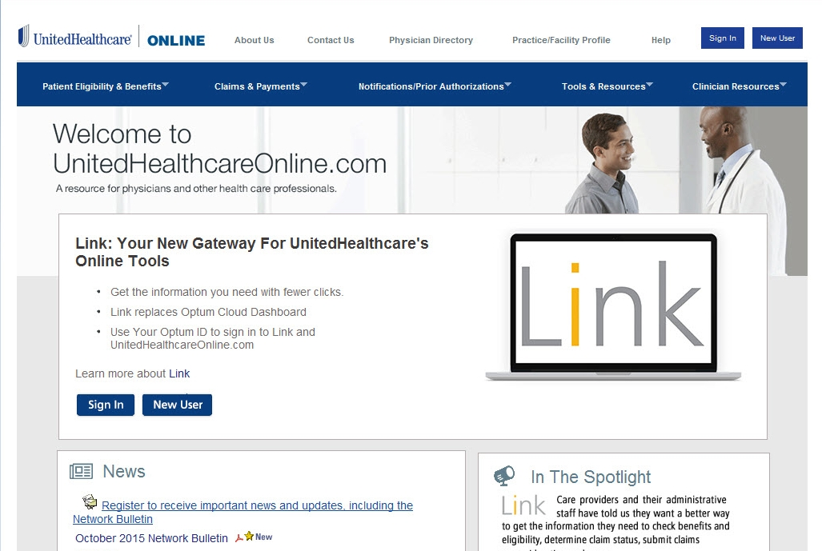
Sign In to UnitedHealthcareOnline.com to Access Link
Doc#: PCA—1-004602-12282016_01252017 Confidential Property of UnitedHealth Group. Do not distribute or reproduce without express permission of UnitedHealth Group.
Notes:
UnitedHealthcareOnline.com is the entry point you use to access Link.

Slide 13
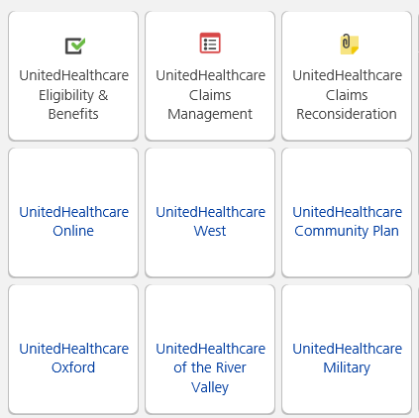
What’s on Link?
Applications on Link include:
Eligibility & Benefits
Claims Management
Claims Reconsideration
Access other UnitedHealthcare websites:
UnitedHealthcareOnline.com
UHCCommunityPlan.com
And more
Doc#: PCA—1-004602-12282016_01252017 Confidential Property of UnitedHealth Group. Do not distribute or reproduce without express permission of UnitedHealth Group.

Slide 14
Link Is Evolving!
We’re introducing new apps on Link ‒ your gateway to UnitedHealthcare's online tools.
The apps are launching to all UnitedHealthcareOnline.com users in waves.
The new eligibilityLink and claimsLink apps will replace the Eligibility & Benefits, Claims Status and Claim Reconsideration functions on UnitedHealthcareOnline.com.
These apps can help simplify your administrative workflow with enhanced features and a redesigned user interface that is faster and easier to use.
Your gateway to UnitedHealthcare's online tools
Doc#: PCA—1-004602-12282016_01252017 Confidential Property of UnitedHealth Group. Do not distribute or reproduce without express permission of UnitedHealth Group.
Notes:
We’re introducing new apps on Link ‒ your gateway to UnitedHealthcare's online tools.
The apps are launching to all UnitedHealthcareOnline.com users in waves.
The new eligibilityLink and claimsLink apps will replace the Eligibility & Benefits, Claims Status and Claim Reconsideration functions on UnitedHealthcareOnline.com. You should have access to the new eligibilityLink as NH was in the first set of waves and you should start seeing the new claimsLink app shortly if you haven’t already.
When you have access to the new apps, you will see a pop-up box inviting you to try the new apps
The eligibilityLink and claimsLink apps use newer technology that enables enhanced features, as well as an easy-to-use design developed with feedback from Link users.
New eligibilityLink and claimsLink features are in progress, and we will continue to make improvements based on the feedback we receive from users.
Our goal is to have one set of apps you can use for eligibility, benefits and claims transactions, so these apps will ultimately replace corresponding functions on UnitedHealthcareOnline.com and the Eligibility & Benefits, Claims Management and Claims Reconsideration apps on Link.
Policies, guidelines, resources and other functions will continue to be available on UnitedHealthcareOnline.com

Slide 15
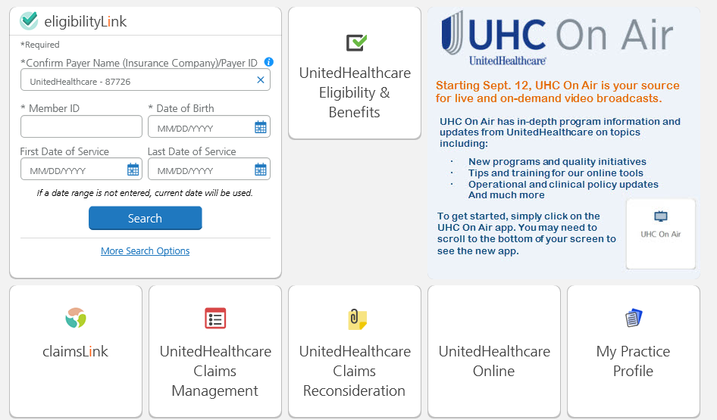
New Link Apps
Doc#: PCA—1-004602-12282016_01252017 Confidential Property of UnitedHealth Group. Do not distribute or reproduce without express permission of UnitedHealth Group.

Slide 16
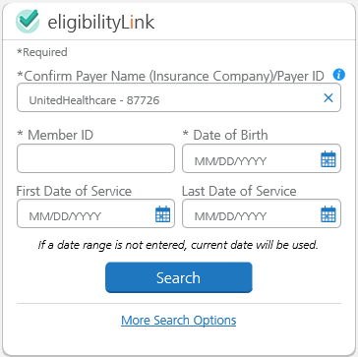
eligibilityLink
Use the eligibilityLink app to check member eligibility and review detailed benefits information. You may also use the app to find out if referrals, notifications and prior authorizations are required for the member’s plan.
With eligibilityLink, you can:
Search for covered members
Find out the member’s cost share, deductible or out-of-pocket responsibility
View preventive care opportunities information for some members
View detailed benefits information for multiple plans
See coverage details and limits specific to each benefit plan
Doc#: PCA—1-004602-12282016_01252017 Confidential Property of UnitedHealth Group. Do not distribute or reproduce without express permission of UnitedHealth Group.
Notes:
Use the eligibilityLink app to check member eligibility and review detailed benefits information. You may also use the app to find out if referrals, notifications and prior authorizations are required for the member’s plan.
With eligibilityLink, you can:
Search for covered members
Find out the member’s cost share, deductible or out-of-pocket responsibility
View preventive care opportunities information for some members
View detailed benefits information for multiple plans
See coverage details and limits specific to each benefit plan

Slide 17

claimsLink
Use the claimsLink app to get the most up-to-date claims status and payment information quickly and conveniently, and submit your claim reconsideration requests.
With claimsLink, you can:
View claim information for multiple UnitedHealthcare plans in a single app
View letters and remittance advice
Flag claims for future viewing
Submit additional information requested on closed or pended claims
Submit claim reconsideration requests with or without electronic attachments
Doc#: PCA—1-004602-12282016_01252017 Confidential Property of UnitedHealth Group. Do not distribute or reproduce without express permission of UnitedHealth Group.
Notes:
Use the claimsLink app to get the most up-to-date claims status and payment information quickly and conveniently, and submit your claim reconsideration requests.
With claimsLink, you can:
View claim information for multiple UnitedHealthcare plans in a single app
View letters and remittance advice
Flag claims for future viewing
Submit additional information requested on closed or pended claims
Submit claim reconsideration requests with or without electronic attachments

Slide 18
My Practice Profile-Data Attestation
Use the upgraded My Practice Profile app on Link to view, update* and attest to the accuracy of the care provider demographic data that UnitedHealthcare members see for your practice.
Changes you make in My Practice Profile will update the data we have for you throughout our systems.
We can process the changes you request through the app faster than by any other means.
Notes:
You may be familiar with the solution … My Practice Profile. We’ve been rolling out an upgraded version of the app over the past several months, so you may even be using it!
This app allows you to view, update and attest to the care provider demographic data that UnitedHealthcare members see for your practice.
When you update your data using the app, we make those changes throughout our systems – and make those changes faster than if you submit them in other ways like phone or fax.

Slide 19
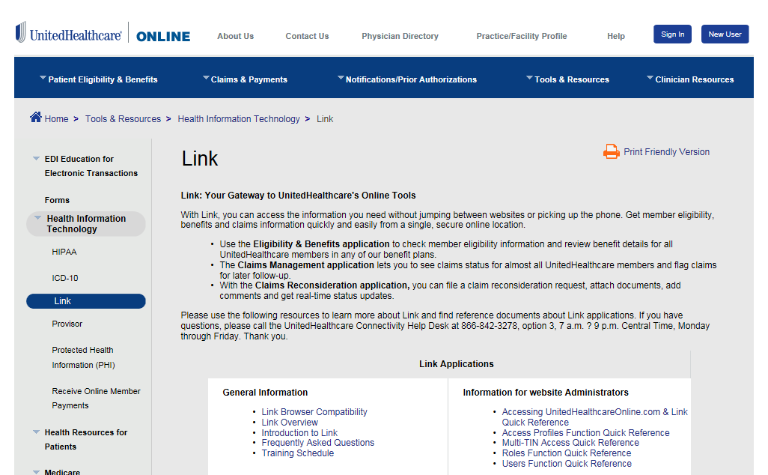
Link Resources
To learn more about Link, please visit the Link resources page at UnitedHealthcareOnline.com > Quick Links > Link: Learn More.
Doc#: PCA—1-004602-12282016_01252017 Confidential Property of UnitedHealth Group. Do not distribute or reproduce without express permission of UnitedHealth Group.
Notes:
To learn more about Link, please visit the Link resources page at UnitedHealthcareOnline.com > Quick Links > Link: Learn More.

Slide 20
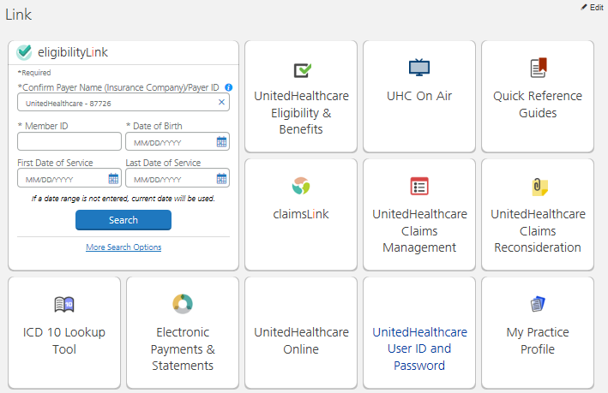
UHC On Air
Find on-demand Link training on UHC On Air ‒ your source for live and recorded video broadcasts created specifically for UnitedHealthcare care providers. New broadcasts are posted regularly.
Doc#: PCA—1-004602-12282016_01252017 Confidential Property of UnitedHealth Group. Do not distribute or reproduce without express permission of UnitedHealth Group.
Notes:
Find on-demand Link training on UHC On Air ‒ your source for live and recorded video broadcasts created specifically for UnitedHealthcare care providers. New broadcasts are posted regularly.

Slide 21
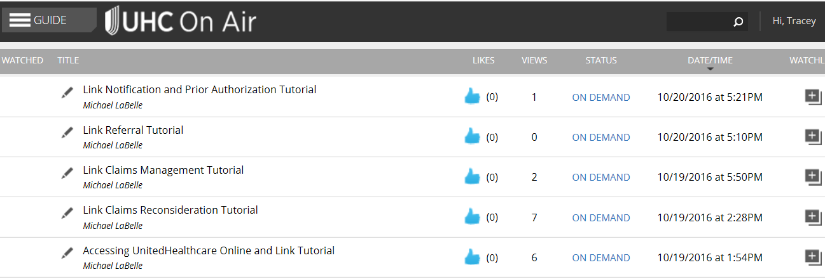
UHC On Air Programming
The following Link tutorials are currently available on the
UHC News Now channel:
Doc#: PCA—1-004602-12282016_01252017 Confidential Property of UnitedHealth Group. Do not distribute or reproduce without express permission of UnitedHealth Group.
Notes:
The following Link tutorials are currently available on the
UHC News Now channel:

Slide 22

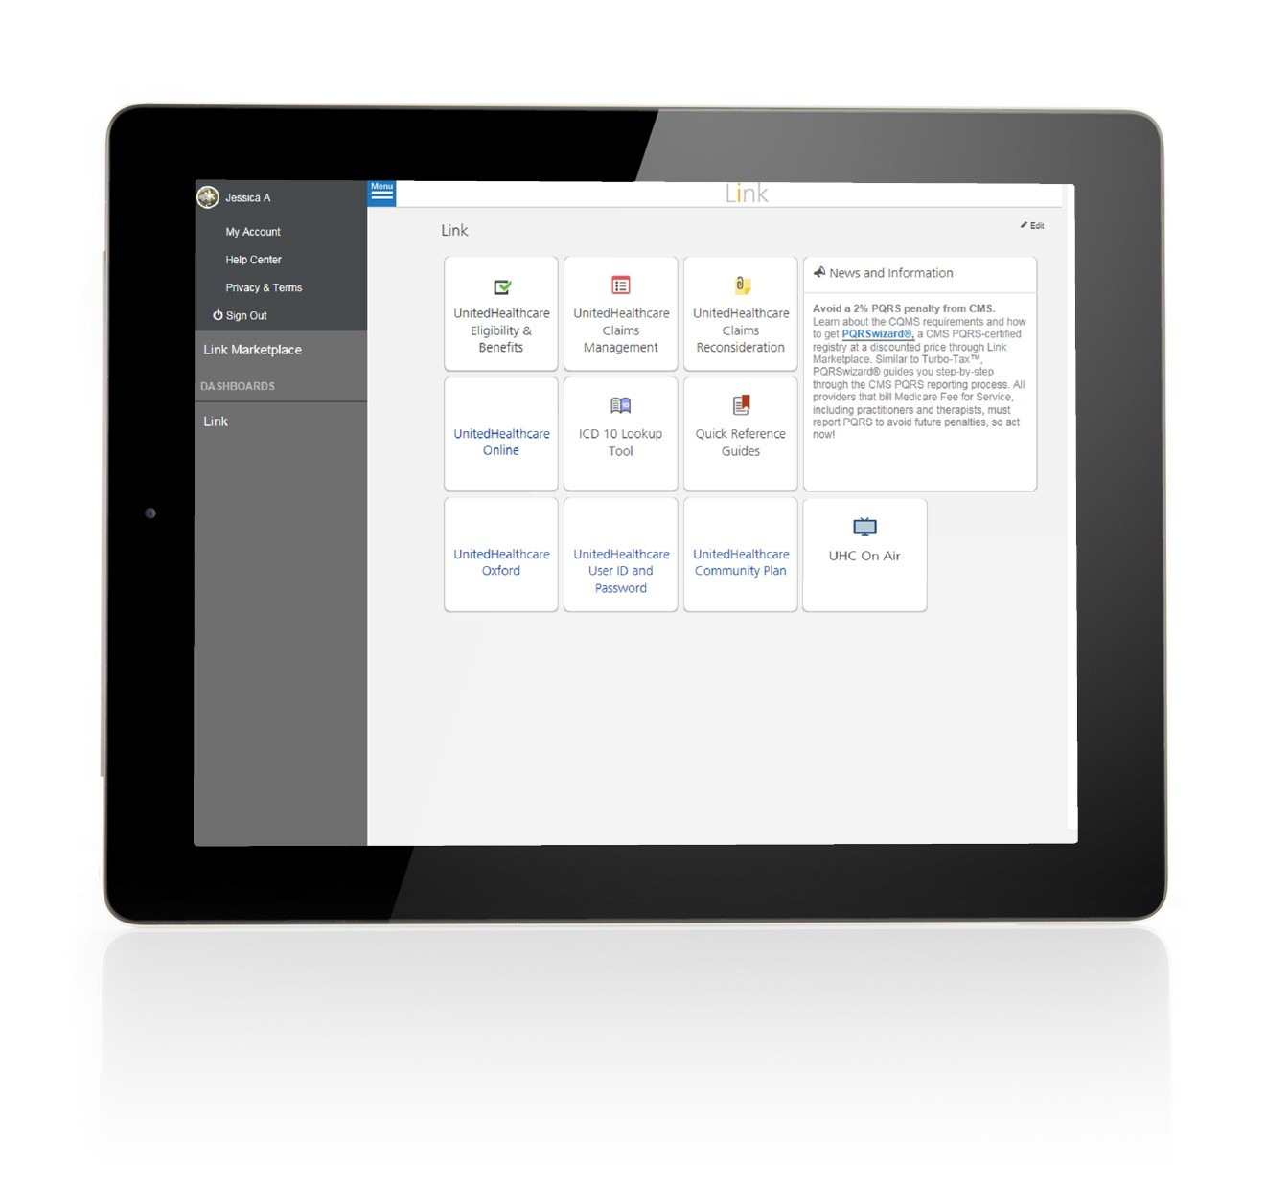

How to get access
UHC ON AIR
1
Log in to Link and select the UHC On Air button.
Notes:
LC

Slide 23
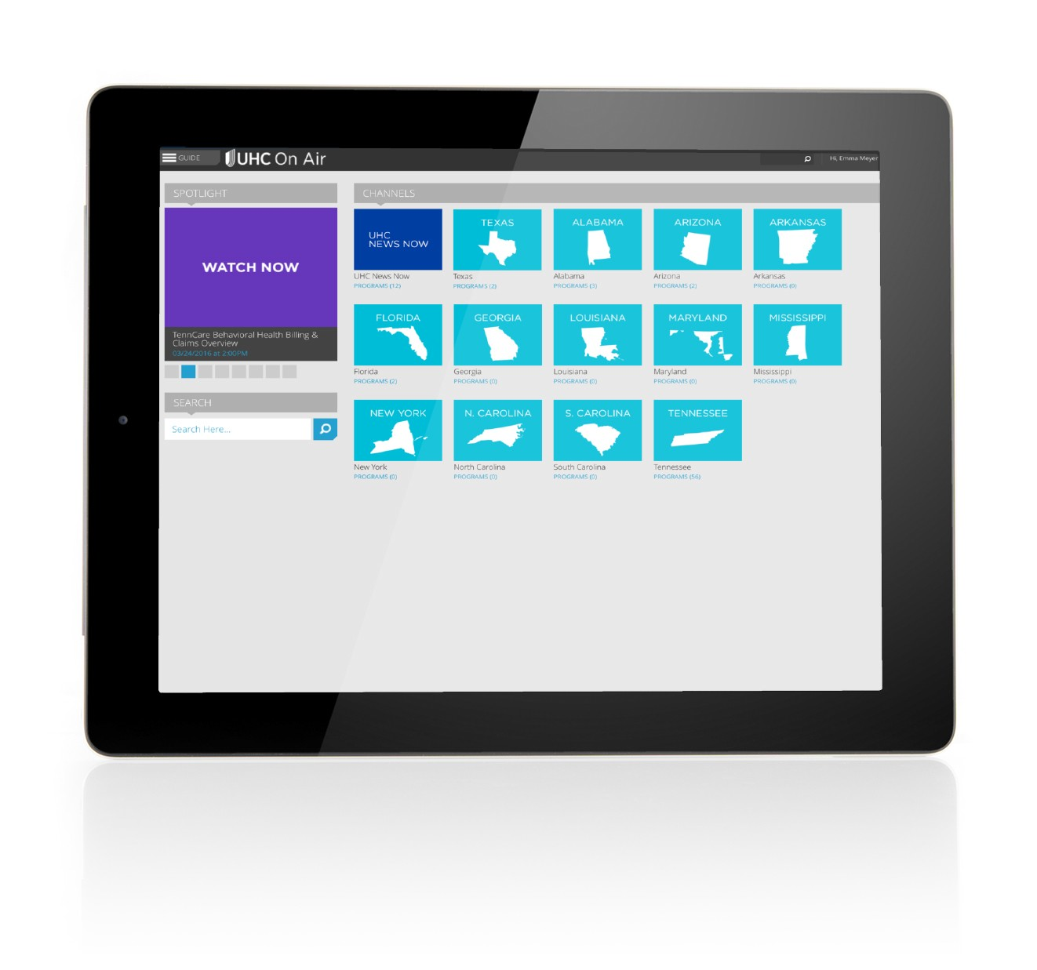
How to get access
UHC ON AIR
2
Select the UHC News Now channel to watch national UnitedHealthcare information, related to Medicare, Medicaid, Military & Veterans and Commercial benefit plans, programs and services.
Select your state-specific channel to see our local programming.

Slide 24
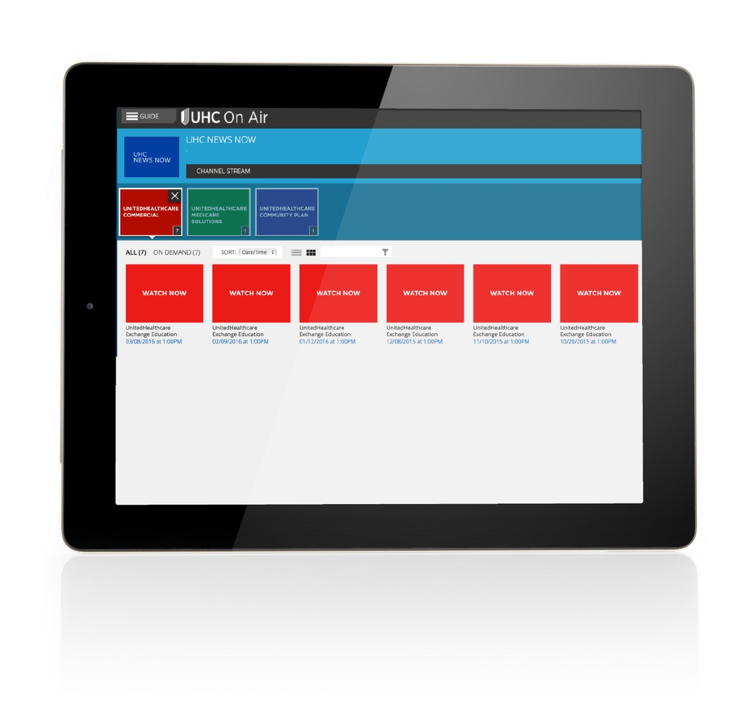
How to get access
UHC ON AIR
3
After selecting your channel, you’ll see videos categorized by plan type.

Slide 25
Credentialing and Re-credentialing
Proprietary Information of UnitedHealth Group. Do not distribute or reproduce without express permission of UnitedHealth Group.

Slide 26
Credentialing Rights
Physicians and other health care providers applying for the UnitedHealthcare network have the following rights regarding the credentialing process:
• To review the information submitted to support your credentialing application;
• To correct erroneous information; and
• To be informed of the status of your credentialing or re-credentialing application,
upon request.
If a physician or other health care provider is not currently credentialed with UnitedHealthcare, they may call (877) 842-3210 to initiate the credentialing process or send a provider profile and W-9 to national_credentialing@uhc.com.
Once credentialed in UnitedHealthcare systems, physicians or other health care providers can email hpdemo@uhc.com to request to be linked to an existing UnitedHealthcare group contract.
Physicians can check on the status of their credentialing by calling the Enhanced Voice Portal at (877) UHC-3210, select Other Professional Services, then Credentialing.
Notes:
Physicians and other health care providers applying for the UnitedHealthcare network have the following rights regarding the credentialing process:
• To review the information submitted to support your credentialing application;
• To correct erroneous information; and
• To be informed of the status of your credentialing or re-credentialing application,
upon request.
If a physician or other health care provider is not currently credentialed with UnitedHealthcare, they must call (877) 842-3210 and connect with National Credentialing team to initiate the credentialing process.
Once credentialed in UnitedHealthcare systems, physicians or other health care providers can email hpdemo@uhc.com to request to be linked to an existing UnitedHealthcare group contract.
Physicians can check on the status of their credentialing by calling the Enhanced Voice Portal at (877) UHC-3210, select Other Professional Services, then Credentialing.

Slide 27

Important Contact Information
Gabriel Martinez, Provider Advocate, MA (Essex and Middlesex Counties – Physician)
gabriel_j_martinez1@uhc.com
Kristine Shiroma, Senior Provider Advocate – Physician
kristine_shiroma@uhc.com
Claire Tigges, Senior Provider Advocate - Facility
claire_tigges@uhc.com
Pamela Connolly, Manager, Provider Relations & Advocacy, Northern New England (MA,NH,ME,VT - Physician)
pamela_a_connolly@uhc.com
Alexandra Shephard-Rowe, Associate Director Hospital Advocacy, New England (Facility)
ashephard@uhc.com
Jim Dubreuil, VP Provider Service, New England
james_m_dubreuil@uhc.com
United Provider Service (877) 842-3210
Northernne_prteam@uhc.com

Slide 28
Thank you!
Doc#: PCA—1-004602-12282016_01252017 Confidential Property of UnitedHealth Group. Do not distribute or reproduce without express permission of UnitedHealth Group.

