Slide 1


Blue cross 2024 updates
05/23/2024
Patrice Inda
Network Manager, Contracting & Network Management.
Blue Cross Blue Shield of Massachusetts is an Independent Licensee of the Blue Cross and Blue Shield Association.

Slide 2
Legal notes
These training materials have been provided to help you in your administrative interactions
with Blue Cross Blue Shield of Massachusetts (Blue Cross).
The information and representations herein do not replace or supersede the terms of your Blue Cross provider Agreement, your Blue Book manual or Indemnity Handbook, or other Blue Cross policies and procedures.
To the extent the foregoing terms and policies conflict with or are otherwise inconsistent with anything in these training materials, your Blue Cross provider Agreement, your Blue Book manual or Indemnity Handbook, or other Blue Cross policies and procedures will govern.

Slide 3

  CONTENTS
Industry News
Blue Cross News
3

Slide 4


  industry news

Slide 5

Change Healthcare Event
BLUE CROSS BLUE SHIELD OF MASSACHUSETTS
CONFIDENTIAL – NOT FOR DISTRIBUTION
Blue Cross Blue Shield of Massachusetts is an Independent Licensee of the Blue Cross and Blue Shield Association.

Slide 6
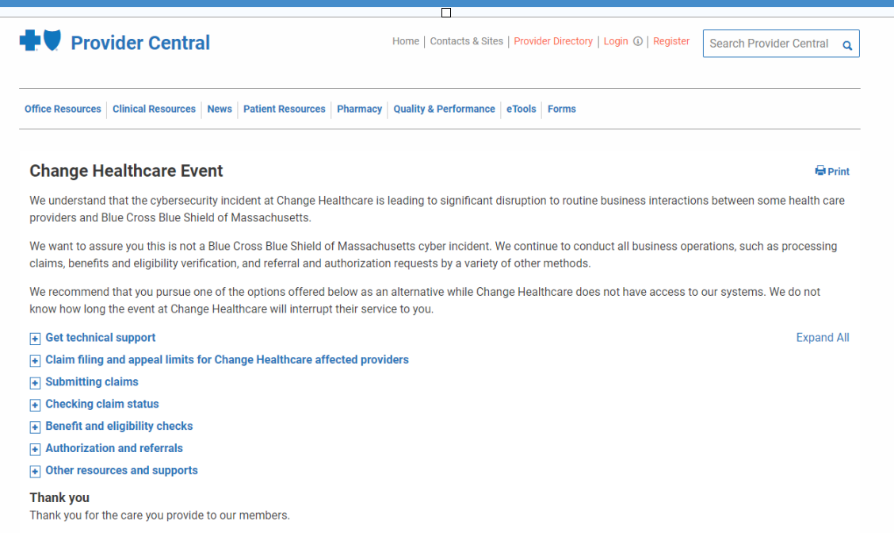

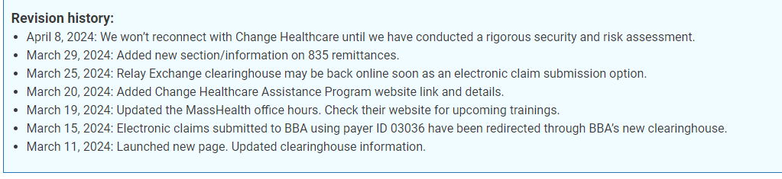
Support during the CHAnge Healthcare Event
We continue to conduct all business operations ̶ processing claims, benefits and eligibility verification, referral and authorization requests ̶ by a variety of other methods.
Our support to you
Created dedicated Change Healthcare Event page on Bluecrossma.com/provider with the latest news
Provided alternative list of electronic clearinghouses
Stored all 835 remittances created since the event first occurred February 21
Partnered with the Mass Collaborative to establish the Change Healthcare Assistance Program to identify claim submission solutions
  Call 1-888-402-3550
  Visit mahealthdata.org/chap
organization.
Continually updated

Slide 7

While connectcenter is unavailable …
Claim filing and appeal limits
We have temporarily waived the following for provider-submitted claims for all plans:
The claim filing limit of 90 days from the date of service
The one-year provider appeals filing limit
Submit claims
Use alternative clearinghouse
Submit electronically to us
Mail in a paper claim
Verify member benefits & eligibility
Use an alternative clearinghouse
Check claim status
Payspan
InfoDial - 1-800-443-6657

Slide 8

  Blue Cross news

Slide 9
Customer Experience
BLUE CROSS BLUE SHIELD OF MASSACHUSETTS
CONFIDENTIAL – NOT FOR DISTRIBUTION
Blue Cross Blue Shield of Massachusetts is an Independent Licensee of the Blue Cross and Blue Shield Association.

Slide 10





Addressing high costs underlies all our initiatives
Our strategy is driven by the need to responsibly moderate the growth in health care spending. Among the steps the company is taking:
Contracts that protect families & businesses
Work closely with hospitals and physicians to agree on contracts that protect families and businesses from unsustainable health care price increases.
Innovating for access & affordability
Offer new, innovative options that improve access to affordable primary care and mental health services.
Streamlining prior authorization
Streamline prior authorization requirements to ensure that services and treatments contribute to improved health outcomes at lower costs for members.
Addressing prescription drug costs
Address prescription drugs costs to ensure members are getting high quality, clinically appropriate prescription drugs.
Keeping admin costs down
Spend 90 cents or more of every premium dollar directly on medical care and prescription drugs and less than 10 cents on administrative costs.
Read president and
CEO Sarah Iselin’s
Boston Globe op ed.

Slide 11








Focus on customer experience
member
needs
drive our
focus
Simple ways to
find what’s covered
and get the most
out of their plan
Clear and easy access
to the doctors and hospitals they want
Predictable costs
and coverage
and ways to
decrease costs
A personalized
experience with
quick issue resolution
Support for
the whole
health journey
Taking care of them
and their families when they need it most
How we’ll deliver
BLUE CROSS BLUE SHIELD OF MASSACHUSETTS
CONFIDENTIAL – NOT FOR DISTRIBUTION
Blue Cross Blue Shield of Massachusetts is an Independent Licensee of the Blue Cross and Blue Shield Association.

Slide 12
Medicare advantage
BLUE CROSS BLUE SHIELD OF MASSACHUSETTS
CONFIDENTIAL – NOT FOR DISTRIBUTION
Blue Cross Blue Shield of Massachusetts is an Independent Licensee of the Blue Cross and Blue Shield Association.

Slide 13



Medicare 5-star: New member incentives
quality outreach
Medicare 5-Star quality outreach
To help ensure our Medicare Advantage members are getting the care they need, we’ll continue to send you:
Gaps-in-care patient reports
Resources* to help you satisfy various quality measures.
*Resources may include faxes on your patients that fall in HEDIS measure populations and regular coding education.
Improving 5-Star performance
To improve Stars performance, we’re adding member incentives to close gaps in care for:
Osteoporosis
Diabetes
Controlling Blood Pressure
Eligible Medicare Advantage members who are enrolled in MyBlue can receive incentives for:
  Bone density scan - $100
  Blood pressure check - $25
  For members with diabetes:
  A1c and blood pressure check - $25
  Retinal eye scan - $25
We’ll pay member incentives through their Flex Card.
Coming soon!
Medicare 5-Star Provider Playbook
Provides actionable steps you
can take to close gaps in care for your patients
Notes:
.

Slide 14
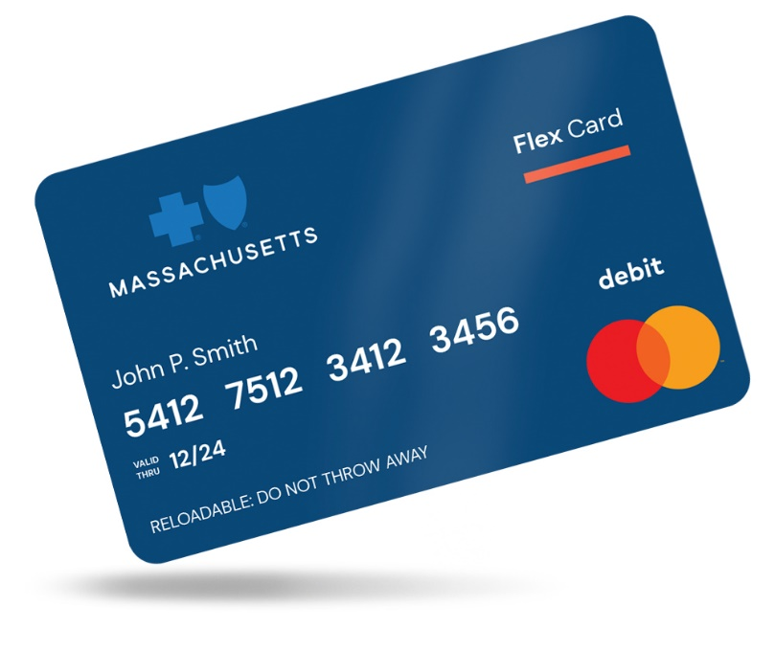
Medicare Advantage flex card
New Flex Card for plan benefits and rewards
In 2024, we sent our new Flex Card to Medicare Advantage to use on their plan benefits and rewards, such as:
Dental, vision, and hearing allowance
Quarterly over-the-counter allowance
Fitness and weight loss benefits
Wellness Rewards for health screenings like $25 incentives for completing an annual wellness visit and $10 incentives for completing in-home health risk assessments
The Flex Card functions like a debit card and we auto-load money for members to use on eligible products and services.

Slide 15
Mental health
BLUE CROSS BLUE SHIELD OF MASSACHUSETTS
CONFIDENTIAL – NOT FOR DISTRIBUTION
Blue Cross Blue Shield of Massachusetts is an Independent Licensee of the Blue Cross and Blue Shield Association.

Slide 16




The Mental Health Crisis
A Better Approach to Mental Health
100% Increase
A wide range of
care options at every level
IN MENTAL HEALTH CARE VISITS SINCE 2019¹
41% OF U.S. ADULTS HAVE EXPERIENCED
HIGH LEVELS OF PSYCHOLOGICAL DISTRESS
AT LEAST ONCE.²
Navigation to appropriate,
lower-cost care
Supportive benefits with
fewer administrative barriers
Blue Cross Blue Shield of Massachusetts book of business, 2019-2022
Giancarlo Pasquini and Scott Keeter, Pew Research Center, "At least four-in-ten U.S. adults have faced high levels of psychological distress during COVID-19 pandemic", December 12, 2022

Slide 17
Focused Network Expansion
NETWORK GREW 50% IN THE LAST FIVE YEARS,
MOST SIGNIFICANTLY IN THESE PROVIDER TYPES:
Licensed Applied Behavioral Analyst
Licensed Alcohol & Drug Counselor - 1
Psychiatric Nurse Practitioner
EXPANDING SOLUTIONS FOR IN-DEMAND SERVICES:
Options for needs that don’t require a clinician
Primary mental health groups, including virtual options
Subspecialty partnerships
We offer an expanded professional network of
20,000
OVEr
mental health clinicians

Slide 18
How?
Guiding Members to the right care for them
Increasing access to care by offering Primary Care with Mental Health and Primary Mental Health Groups
Dedicated mental health line for members and Mental Health advocates
In-house experts with a wide range of mental health expertise

Slide 19























EAP AND SELF-MANAGEMENT
SUBSPECIALTY MENTAL HEALTH
PRIMARY MENTAL HEALTH GROUPS
PRIMARY CARE WITH MENTAL HEALTH
OUR PROVIDER NETWORK
COACHING
Wide Range of Options for Mental Health Care
Human and Digital Infrastructure
Independent Practitioners
Telehealth Video Visits
Intermediate & Inpatient Care

Slide 20
pharmacy
BLUE CROSS BLUE SHIELD OF MASSACHUSETTS
CONFIDENTIAL – NOT FOR DISTRIBUTION
Blue Cross Blue Shield of Massachusetts is an Independent Licensee of the Blue Cross and Blue Shield Association.

Slide 21


Addressing medication cost and quality
High-cost Specialty Drugs
Most medications administered in doctor’s offices, outpatient facilities, and ambulatory clinics that are covered under the medical benefit are high-cost specialty drugs that we carefully manage—like medications covered by the pharmacy benefit.
Because of the complexity and rising cost of these drugs, we need to monitor their use while still making sure our members have access to needed therapeutics. We do this through:
Medical policies and prior authorization processes
March 1, 2024 and July 1, 2024: Adding dosing and frequency edits to several medical policies for certain medications (refer to next slide)
Drug waste policies (examples include our Drug Wastage and General Coding and Billing payment policies)
Jan. 1, 2024: General Coding and Billing payment policy updated. Claims to reject if certain information about the medication is incorrect, such as use of expired National Drug Code (NDC).
Claims monitoring

Slide 22

Dosing and frequency required for medical benefit medications – March 1, 2024 & July 1, 2024
March 1, 2024 changes
Actemra (Tocilizumab)
Avsola, Inflectra, Renflexis, Remicade
Orencia (Abatacept)
Eylea (Aflibercept)
Prolia, Xgeva (Denosumab)
Tepezza (Teprotumumab)
Soliris (Eculizumab)
Lanreotide (Somatuline Depot)
Xolair (Omalizumab)
Riabni, Ruxience, Rituxan, Truxima
Entyvio (Vedolizumab)
July 1, 2024 changes
Cinqair (reslizumab)
Dupixent (dupilumab)
Fasenra (benralizumab)
Nucala (mepolizumab)
Tezpire (Tezepelumab-ekko)
Xolair (Omalizumab)
When we review authorization requests for these medications, our coverage is based on FDA and other recommendations on the dosing and frequency of use.
Applies to medical benefit medications (buy & bill) for all members, except Medicare Advantage and Federal Employee Program.
Medical policies updated with this information.

Slide 23


Requesting authorization & submitting claims
We’ll review the authorization request.
If the dose and frequency you requested is in line with our medical policy and FDA recommendations, the request may be approved.
If it’s over the limit, the authorization request will deny.
If you disagree with the decision, you can request an appeal.
If the submitted claim matches what’s been approved, your claim will process.
If it does not match what’s been approved, the claim will deny in its entirety.
  Request authorization for the medication.
  Include the dose and frequency of administration with your request.
Note: If the member had an existing authorization for the medication prior to the effective date of this change, then the dosing and frequency edits will apply when a new authorization is requested.
23
Blue Cross Pharmacy Operations reviews authorization requests

Slide 24
  Reminders

Slide 25

Please verify your directory information every 90 days
Regulations require us to verify provider directory information every 90 days.
Here’s how:
Please verify
your directory
information
Clinicians Behavioral health providers | Go to the CAQH Provider Data Portal to review your information.
Dentists Facilities Group practices | Use the link we send each quarter in an email or letter to complete a validation survey.
every
90 Days

Slide 26

Questions?
bluecrossma.com/provider
Blue Cross Blue Shield of Massachusetts is an Independent Licensee of the Blue Cross and Blue Shield Association. ® Registered Marks of the Blue Cross and Blue Shield Association. ®´ Registered Marks of Blue Cross and Blue Shield of Massachusetts, Inc., and
Blue Cross and Blue Shield of Massachusetts HMO Blue, Inc. ®, TM, Registered Marks, and Trademarks are the property of their respective owners. © 2023 Blue Cross and Blue Shield of Massachusetts, Inc., and Blue Cross and Blue Shield of Massachusetts HMO Blue, Inc.

Slide 27
Thank you

