Slide 1
Enhancing lives, together
Improving the health and vitality of those we serve
May 22, 2024
Notes:
Good morning I’m Mark Andrews Provider Relations with Cigna. It may be news to some of you, Ron Pelton retired last June after 27 years with Cigna, I’ve caught up with Ron a few times, he’s enjoying retirement and no surprise, doesn’t sit still. Let’s take a look at the agenda.

Slide 2
Agenda
      Welcome!
Policy updates
Virtual care
Digital solutions
Claim submission, payments, and appeals
Provider resources
Q&A
Advocating for better health at every step of the way, at every stage
Notes:
I’ll be going over policy updates, virtual care, digital solutions, claims submission/payments/appeals and provider resources.
We will have time for Q&A.

Slide 3
Policy updates
May 22, 2024
Notes:
Frist I’ll review some current and upcoming policies updates.

Slide 4

We support access to quality, cost-effective care
When we review our coverage, reimbursement, and administrative policies, we take into consideration one or more of the following:
Evidence-based medicine.
Professional society recommendations.
Centers for Medicare & Medicaid Services guidance.
Industry standards.
Other existing Cigna Healthcare^{sm} policies.
Note: Reimbursement and modifier policies apply to all claims.
For more information:
Log in to the Cigna for Health Care Professionals website (CignaforHCP.com)
> Resources
> Coverage Policies
> Policy Updates.
If you are not registered for the website, go to CignaforHCP.com > Register.
Notes:
To support access to quality care for your patients with a medical plan administered by Cigna, we routinely review our coverage, reimbursement, and administrative policies for potential updates. In that review, we take into consideration guidance such as Evidence-based medicine, professional society recommendations, CMS guidance, industry standards, and other existing Cigna policies.
For more information about our policy updates, visit the Cigna for Health Care Professionals website. If you are not registered for the website, go to CignaforHCP.com to register.

Slide 5

We review precertification policies
Easy-to-access guidelines
Precertification can be complicated. Knowing the right place to start can make a big difference.
You can find complete information about when and where to submit precertification requests to Cigna Healthcare and our national ancillary vendors by going to CignaforHCP.com > Resources > Precertification.
Updates
As a result of our precertification policy reviews, we make updates to our precertification list.
Codes may be subject to the following:
Code editing.
Benefit plan exclusions.
Post-service review for coverage.
To view the complete list of services that require precertification:
Log in to CignaforHCP.com
> Resources
> Clinical Reimbursement Policies and Payment Policies
> Precertification Policies.
If you are not registered for the website, go to CignaforHCP.com > Register.
Notes:
Precertification updates
To help ensure that we are administering benefits properly, we routinely review our precertification policies for potential updates. Updates are made to our precertification list as a result of these reviews. Codes may be subject to code editing, benefit plan exclusions, and post-service review for coverage.
I’ll review more on precertification in a few moments.

Slide 6

Clinical, reimbursement, and administrative policy updates
Effective | Policy name
February 2024 | Genetic Testing Panels (R28)
April 2024 | Omnibus Reimbursement Policy (R24) Revenue Code Billing Requirements (R41)
May 2024 | Code Editing Policy & Guidelines
June 2024 | Diagnosis Coding Requirements (R47) Omnibus Reimbursement Policy (R24) Unacceptable Primary/Principal Diagnosis (R38)
July 2024 | Bilateral Procedures (M50) Code Editing Policy & Guidelines Diagnosis Coding Requirements (R47)
For additional information:
Log in to CignaforHCP.com
> Resources
>Clinical Reimbursement Policies and Payment Policies
> Reimbursement and Modifier Policies.
Notes:
February 2024
Genetic Testing Panels policy update – We removed Current Procedural Terminology (CPT®) codes 81407 and 81408 from precertification and bundled them into genetic testing laboratory panel CPT codes 81412 or 81443. This update is effective for dates of service on or after February 17, 2024.
April 2024
Omnibus Reimbursement Policy update – We administratively deny Current Procedural Terminology (CPT®) code 76377 as incidental, consistent with the process in place for CPT code 76376. This update is effective for dates of service on or after April 14.
Revenue Code Billing Requirements policy update - We administratively deny revenue codes 960-989 for professional services when billed by facilities on Form UB-04. Professional services should be billed on Form CMS-1500. This update is effective for dates of service on or after April 14.
May 2024
Code Editing Policy & Guidelines update - We added 10 codes with a status B indicator: CPT codes 38204, 92921, 92925, 92929, 92934, 92938, 92944, and 97602, and Healthcare Common Procedure Coding System (HCPCS) codes A4262 and A4263. These codes will be administratively denied when billed with another service not indicated as bundled. This update is effective for dates of service on or after May 11.
June 2024
Diagnosis Coding Requirements update – We will administratively deny claims submitted with an unspecified laterality diagnosis code when it is the only code billed on the claim. This update is effective for dates of service on or after June 16.
Omnibus Reimbursement Policy update - We will administratively deny facility claims billed with CPT code 76376 as incidental, consistent with the process in place for professional claims. This update is effective for dates of service on or after June 16.
Unacceptable Primary/Principal Diagnosis policy update - We will administratively deny claims when an unacceptable primary or principal diagnosis code is the only code billed. This update is effective for dates of service on or after June 16.
July 2024
Bilateral Procedures policy update – We will administratively deny unilateral procedure codes when billed with modifier 50. This update is effective for dates of service on or after July 14.
Code Editing Policy & Guidelines – We will add 27 CPT Codes and four HCPCS codes for professional and outpatient facility services. These codes will be administratively denied when billed at a frequency greater than the medically unlikely edit set by the Centers for Medicare & Medicaid Services, by the same provider, for the same patient, on the same day. The CPT codes are 86000, 86161, 86235, 86255-86256, 86316, 86403, 86406, 90840, 90845-90847, 90849, 90853, 90863, 95012, 96146, 97151-97158, 0362T, and 0373T. The HCPCS codes are G0447, G0451, G0473, and Q4050. This update is effective for dates of service on or after July 14.
Diagnosis Coding Requirements policy update – We will administratively deny the medical evaluation and management (E&M) code when billed with a preventive E&M code and only an International Classification of Diseases, 10th Revision, Clinical Modification (ICD-10-CM) Z diagnosis code on the claim. This update is effective for dates of service on or after July 14.
Reminder for the most up-to-date information, please visit CignaforHCP.com.

Slide 7
Preventive care services policy updates
During the fourth quarter 2023, updates became effective for the Cigna Healthcare Preventive Care Services Administrative Policy (A004).
Description | Update
Routine Immunization: COVID-19 | Added five Current Procedural Terminology (CPT®) codes to reflect American Medical Association (AMA) coding changes.
Routine immunization: Influenza vaccine | Removed 10 CPT codes and one Healthcare Common Procedure Coding System (HCPCS) code to reflect AMA coding changes.
Routine immunization: Respiratory syncytial virus | Added six CPT codes and one International Classification of Diseases, 10th Revision (ICD-10) code to reflect AMA coding changes.
Cholesterol screening | Removed one CPT code as it does not reflect a preventive service.
Code Group 1 diagnoses | Added six ICD-10 codes to reflect AMA coding changes; removed one ICD-10 code as it is no longer a billable code.
Fluoride application | Added one CPT code to reflect an additional type of fluoride application as a new preventive service.
HIV infection: PrEP injection cabotegravir (apretude) | Added one HCPCS code and one ICD-10 code for prevention of human immunodeficiency virus (HIV) infection: Pre-exposure prophylaxis (PrEP) injection cabotegravir (apretude) as it is a new preventive service.
Hearing screening | Removed two CPT codes as they do not represent preventive services.
For additional guidance
on preventive care services, refer to the Preventive Care Services Administrative Policy (A004). Go to CignaforHCP.com
> Review coverage policies: information on Cigna standard health coverage plan provisions
> Medical, Behavioral, and Administrative A-Z Index: View Documents
> Preventive Care Services - (A004).
Notes:
During the fourth quarter 2023, updates became effective for the Cigna - Preventive Care Services Administrative Policy - A004.
You can find more details related to these updates on the CignaforHCP.com website (point out box showing path).

Slide 8

Precertification updates
To help ensure that we are administering benefits properly, we routinely review our precertification policies for potential updates.
As a result of a recent review, we want to make you aware that we have updated our precertification list.
Effective | Updates
October 1, 2023 | Removed one CPT code and one HCPCS code. Added 10 new HCPCS codes.
January 1, 2024 | Added 25 new CPT codes and 24 new HCPCS codes.
To view the complete list of services that require precertification:
Log in to CignaforHCP.com
> Resources
> Clinical Reimbursement Policies and Payment Policies
> Precertification Policies.
Notes:
Last summer Cigna made significant updates to our precertification requirements removing 25% of medical services from our prior authorization requirements equating to more than 600 codes.
On October 1, 2023, we added 10 new HCPCS codes and removed one CPT code and one HCPCS code.
On January 1, 2024, we added 25 new CPT codes and 24 new HCPCS codes.
To view the complete list of services that require precertification, you may visit the Cigna for Health Care Professionals website (point out box showing path).

Slide 9
Key updates: COVID-19
On September 11, 2023, six new CPT codes* related to new COVID-19 vaccine boosters became effective.
The vaccines:
Are available at certain pharmacies and providers.
Remain covered at 100 percent under the preventive benefit (same as the flu shot) when any Cigna Healthcare commercial or Medicare Advantage customer receives it from a participating provider.
For additional COVID-19 vaccine coverage information:
Go to CignaforHCP.com
> Review Coverage Policies: information on Cigna standard health coverage plan provisions
> Medical, Behavioral, and Administrative A-Z Index: View Documents
> Preventive Care Services - (A004).
For additional information about our response:
Go to CignaforHCP.com
> Get questions answered: Resource
> Medical Resources
> Doing Business With Cigna: View Documents
> Cigna’s response to COVID-19.
Notes:
Back in September six new CPT codes* related to new COVID-19 vaccine boosters became effective.
The vaccines remain covered at 100 percent under the preventive benefit (same as the flu shot) when any Cigna commercial or Medicare Advantage customer receives it from a participating provider.
As always, state mandates and customer benefit plans may supersede our guidelines.
For more details, you may visit the CignaforHCP website (point out box showing path).

Slide 10
Virtual care
May 22, 2024
Notes:
Now we will review information on Virtual Care

Slide 11


Helping you deliver care
      Virtual care (telehealth) coverage
        We cover certain virtual care services per our Virtual Care Reimbursement Policy (R31).
        More information is available at CignaforHCP.com/VirtualCare.
      Cost-share
        Standard customer cost-share applies to all covered virtual care services.
      Accommodations
We will continue to allow facilities to bill for virtual care services on Form UB-04 until further notice.
May 22, 2024
Notes:
We are committed to helping you to deliver care how, when, and where it best meets the needs of your patients. And as your patients seek more convenient and safe care
options, we continue to see growing interest in virtual care – especially from consumers and their providers who want to ensure they have greater access and connection to each other.
We believe virtual care has the potential to help you attract and retain patients, reduce access barriers, and contribute to your ability to provide the right care at the right time.
We will continue to make some virtual care accommodations that are not specifically addressed by our reimbursement policy, including offering the ability for facilities to offer virtual care when billed on a UB-04 claim form until further notice.

Slide 12

Get reimbursed at the same rate as face-to-face visits
Common services
Routine checkups
General wellness visits
New patient exams
Behavioral assessments
Common codes
Outpatient evaluation and management (E&M) codes for new and established patients (99202–99215)
Physical and occupational therapy E&M codes (97161–97168)
Telephone-only E&M codes (99441–99443)
Annual wellness visit codes (G0438 and G0439)
May 22, 2024
12
Notes:
The policy allows for reimbursement of a variety of services that are typically performed in an office setting but also appropriate to be performed virtually, such as:
Routine check-ups
General wellness visits
New patient exams
Behavioral assessments
Common codes included in the policy
Outpatient E&M codes for new and established patients (99202-99215)
Physical and occupational therapy E&M codes (97161-97168)
Telephone-only E&M codes (99441-99443)
Annual wellness visit codes (G0438 and G0439)

Slide 13
Digital solutions
The right electronic tools for you
and your practice
May 22, 2024
Notes:
Now I’ll review information regarding our Cigna provider portal and tools – we refer to these as Digital Solutions.

Slide 14

We offer solutions to help providers reduce their administrative burden and make it easier to do business with us.
Notes:
The CignaforHCP.com website, is designed to……….. Offer solutions to help providers reduce their administrative burden and make it easier to do business with Cigna.
We are your digital partners, to help you carry out your daily tasks.

Slide 15
Committed to making your life easier
        Provider website
Verify eligibility and benefits.
Check claim status information.
Submit reconsideration and appeals.
View precertification status.
Enroll and manage electronic funds transfer (EFT).
Access remittance reports.
Access resources, including video tutorials, clinical reimbursement and payment policies, and provider reference guides.
Trading partners and electronic data interchange (EDI) vendors
Health Information Portability and Accountability Act 5010 transactions
Submit claims electronically, including coordination of benefit claims.
Receive payment information, including claim status.
Submit eligibility and benefit inquiries.
Submit request for precertification review.
To take a self-guided tour:
Go to CignaforHCP.com > Quick website overview.
For more information about transaction availability:*
Go to Cigna.com/EDIvendors.
Notes:
Our digital solutions include:
The CignaforHCP website which provides a robust source of information to help with your day-to-day tasks from registration, to claim status / resolution, managing EFT and providing online training.
Users could have some or all the functionality depending on the access that has been granted by your organization’s Website Access Manager.
Reimbursement and payment polices are available with applicable permissions from the Web Access Manager (Left side of slide)
We also have many educational resources which include Video Tutorials for each functionality;
I believe everyone here is using EDI, see here (point to right side of the slide) if you are not.

Slide 16

EFT enrollment
When you enroll, you’ll be able to:
Receive payments directly into your checking or savings account – no mail delays.
Access funds on the day of payment.
Receive bulk deposits instead of multiple separate checks.
Increase efficiency and improve cash flow.
View and share remittance reports on the day of payment.
To enroll in EFT:
Log in to CignaforHCP.com
> Working With Cigna
> Electronic Funds Transfer (EFT).*
Notes:
I’m pretty sure everyone here uses EFT with Cigna and other payers, If you aren’t there are many good reasons to enroll.
EFT - Eliminates the waiting for checks to clear the bank and provides for may benefits that increase efficiency.
Please see enrollment instructions found in the Working with Cigna section of the portal. If anyone needs information EFT, please reach out.

Slide 17
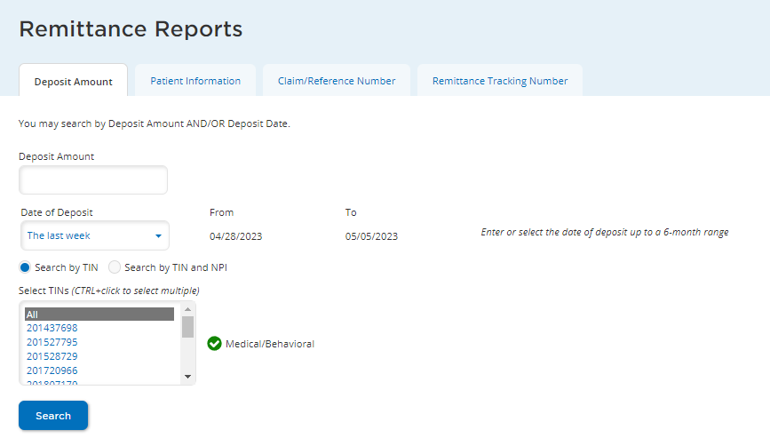
Search for a remittance report
Once your EFT enrollment is complete, you will be able to access and view your remittance reports online the same day you receive your electronic payment.
1. Choose any of four ways to search for a remittance report and complete the listed fields.
If searching by deposit, you can enter a dollar amount, leave the field blank for all deposits and zero pays, or enter 0 for zero pays only.*
If you do not see the Remittance Reports link, you do not have the level of website access necessary to view reports. Ask your office’s primary administrator for this website to assign you access to this functionality.
3. Click Search.
2. Choose the Taxpayer Identification Number (TIN) involved in your search.
Notes:
Once the EFT enrollment is complete, you will be able to access and view remittance report online the same day you receive your electronic payment. Users with appropriate permissions granted by the Web Access Manager are able to search online for Remittance reports – choose any of the four ways to search, choose TIN if appliable, click search.

Slide 18

Digital ID cards are here
Cigna Healthcare continues to leverage the power of technology and data to accelerate its transition to fully adopt digital-only ID cards.*
Your patients with Cigna Healthcare coverage may already be presenting you with a digital version of their ID card. They can share it by:
Showing it to you on their smart phone or tablet.
Uploading it to your health portal (as technology allows).
Emailing it directly to your office.
Printing a copy.
To learn more:
Go to CignaforHCP.com
> Get questions answered: Resource
> Medical Resources
> Doing Business With Cigna: View Documents
> Digital ID cards.

Slide 19
Change Healthcare
In February, Change Healthcare, part of Optum and one of the largest companies handling multiple electronic transactions for providers, publicly announced a cybersecurity incident.
The Change Healthcare cyber incident continues to affect Cigna Healthcare, third-party vendors we work with, and you — our health care providers.
We encourage all providers impacted by the Change Healthcare cyber incident to utilize the many alternative digital trading partners we offer to submit claims directly to Cigna Healthcare.
For more information about our response and alternative ways to submit claims or check patient eligibility:
Go to the Provider Newsroom.
For a list of our digital trading partners:
Go to Cigna.com
> For Providers
> Coverage and Claims: Claims
> Electronic Data Interchange Vendors.
For the latest updates on the cybersecurity incident:
Go to UnitedHealth Group’s dedicated website.

Slide 20
Claim submission, payments, and appeals
Notes:
On to Claim submission, payments and appeals

Slide 21

Easily access claim information
Features of Claims 360
Search function with broadened capabilities
Claim information at an organizational level
Flexibility
Results in a table
Filter option for results
Report download option
Notes:
Claims 360
CignaforHCP.com
Features:
Newly designed search function with broadened capabilities
View claims at an organizational level
Creates flexibility
View results in a table
Filter your results
Download results into a report

Slide 22
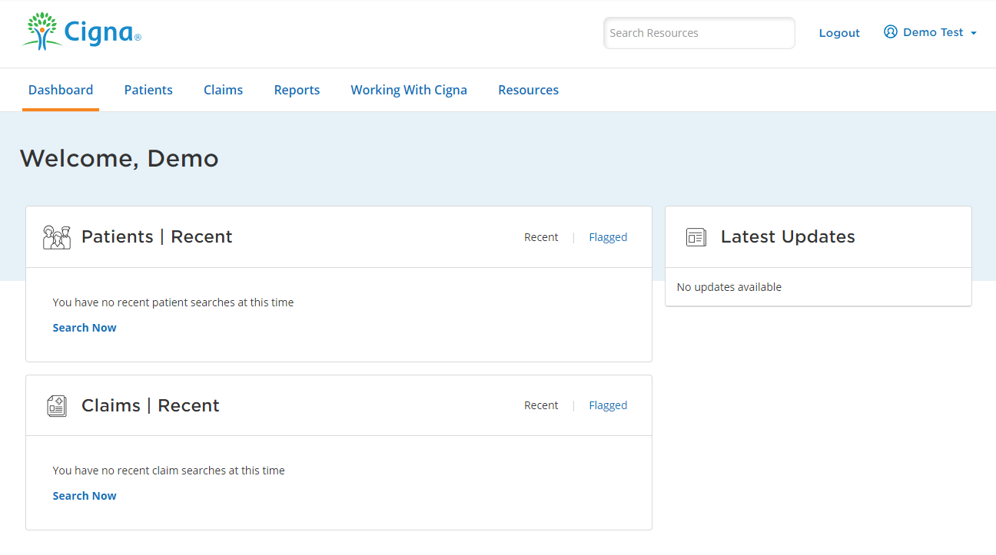
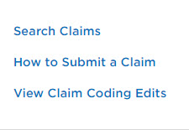
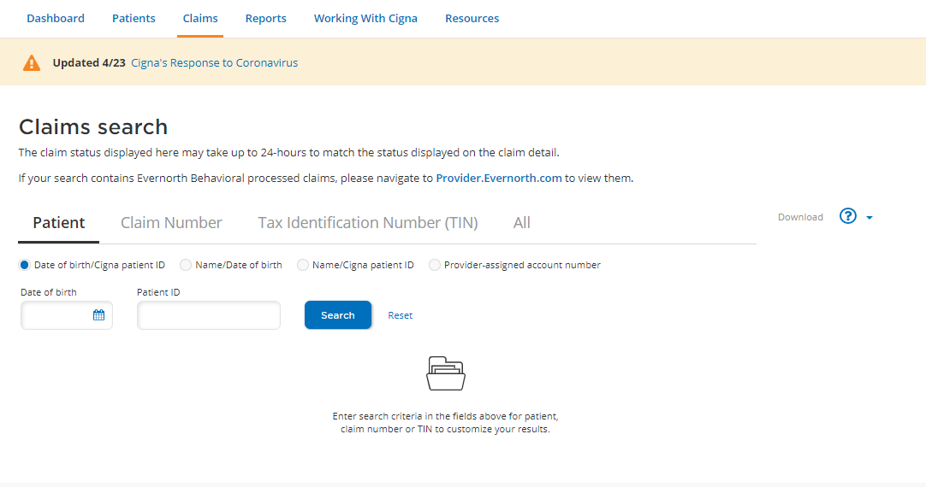
Get a holistic view of your claims
To get started, click “Search Claims” from the claims drop-down menu.
To search for your claims, click the search option you would like to use.
Notes:
To get started, click “Search Claims” from the claims drop-down menu.
When using this option, you may search by one or more of the TINs associated with your user ID, offering a more holistic view of your claims
You can also view all claims for all TINs for which you have been granted access
To search for your claims, simply choose and click the search option, you would like to use.

Slide 23
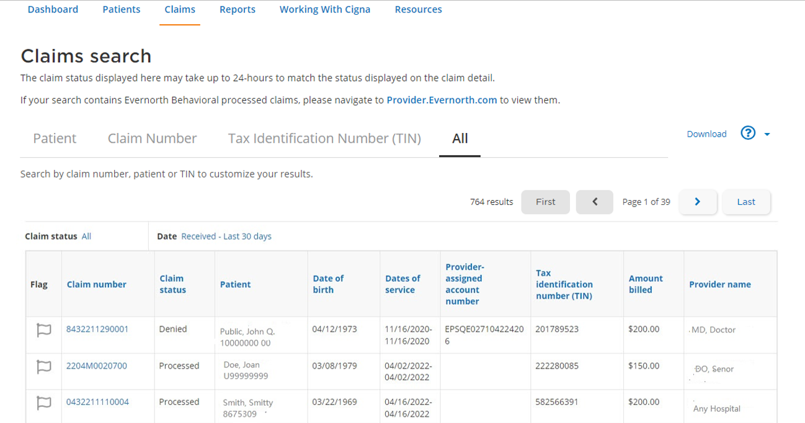
Display the claim information you need
Click “Download” to download the results.
Flag claims to save them to your dashboard for easy access.
Click the claim number
to view in-depth details about the claim.
Sort by any of the columns by clicking on
the heading.
Notes:
The search results table has a lot of functionality to help you get what you need:
Flag claims to save them to your dashboard for easy access.
Click the claim number to view in-depth details about the claim.
Sort by any of the columns by clicking on the heading.

Slide 24
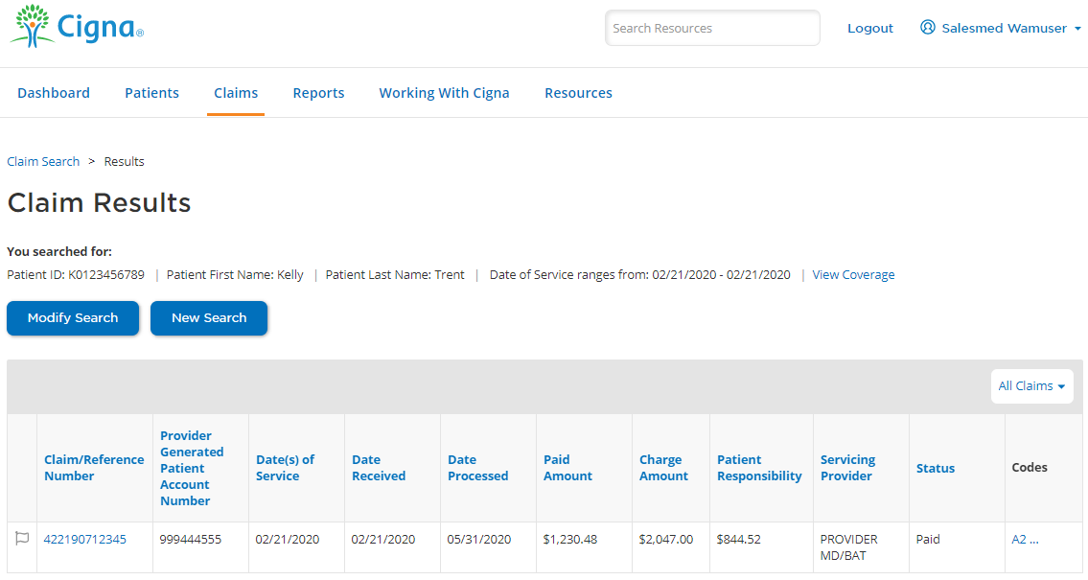
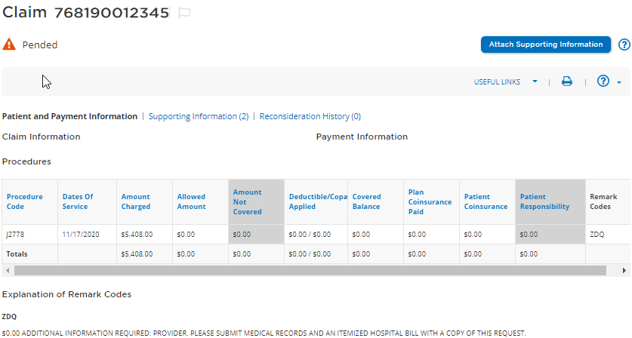
View pended claim details
Search for, identify, and check the status of the claim.
Pended claim details
Know why a claim is pended by the remark code description.
Access help by clicking “?”.
View previously submitted attachment details, including who and when.
Notes:
Upload documentation for pended claims
Understand details about your pended claims
Pended claim details:
Know why a claim is pended by the remark code description.
Access help by clicking “?”
View previously submitted attachment details, including who and when.

Slide 25

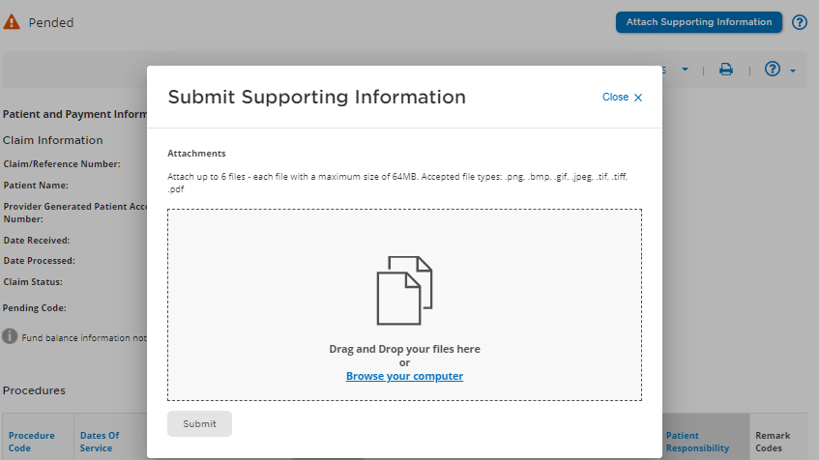

Submit the requested information
1. Attach up to six files.
Each file may be a maximum of 64MB. Total of 999 pages.
File types: .bmp, .png, .jpg, .gif, .tif, and .pdf.
2. See the status of the upload and click “Submit.”
3. Receive a reference number.
Notes:
Upload Documentation for Pended Claims
Attach and submit the requested information
Attach up to six files - Each file may be a maximum of 64MB. Note the File types (.bmp, .png, .jpg, .gif, .tif, and .pdf. )
See the status of the upload then click submit
Receive a reference number

Slide 26

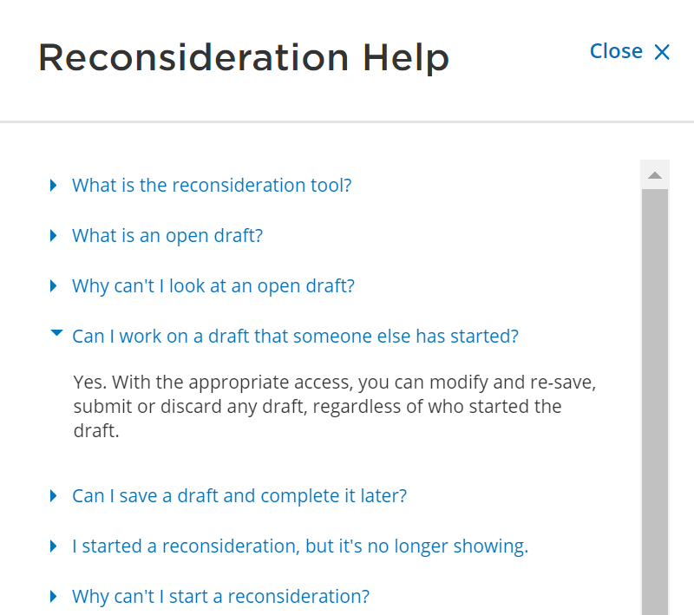

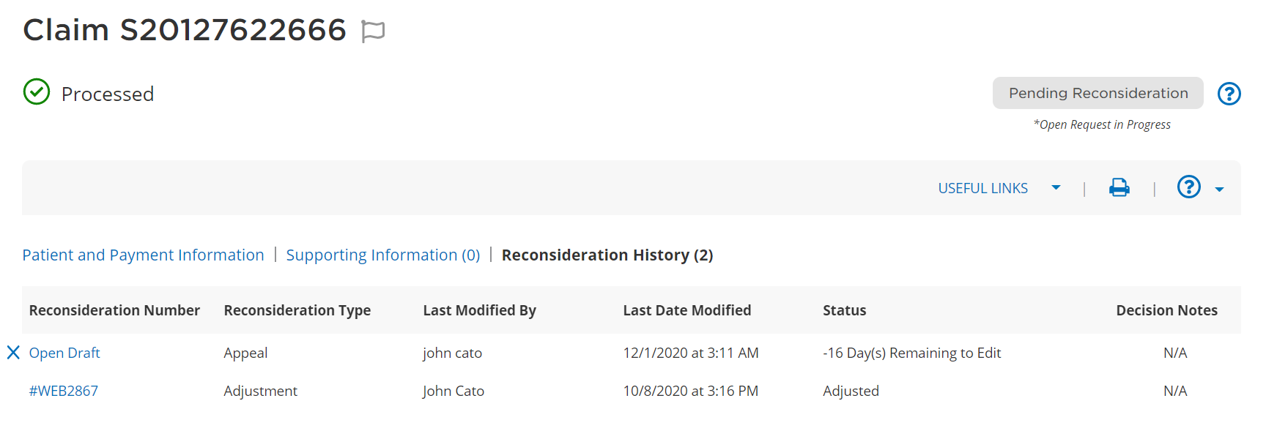
Find the answers you need
Claim reconsiderations and appeals
?
Get answers to common reconsideration questions by accessing the Reconsideration Help menu.
The Reconsideration History section will display status and the Cigna Healthcare processor's name and decision notes.
Notes:
Claim reconsiderations and appeals online
Help, history, and status
Get answers to common questions by accessing the Reconsideration Help menu.
The Reconsideration History section will display the status, who in your organization worked on it, and the Cigna processor’s decision notes, when applicable.

Slide 27
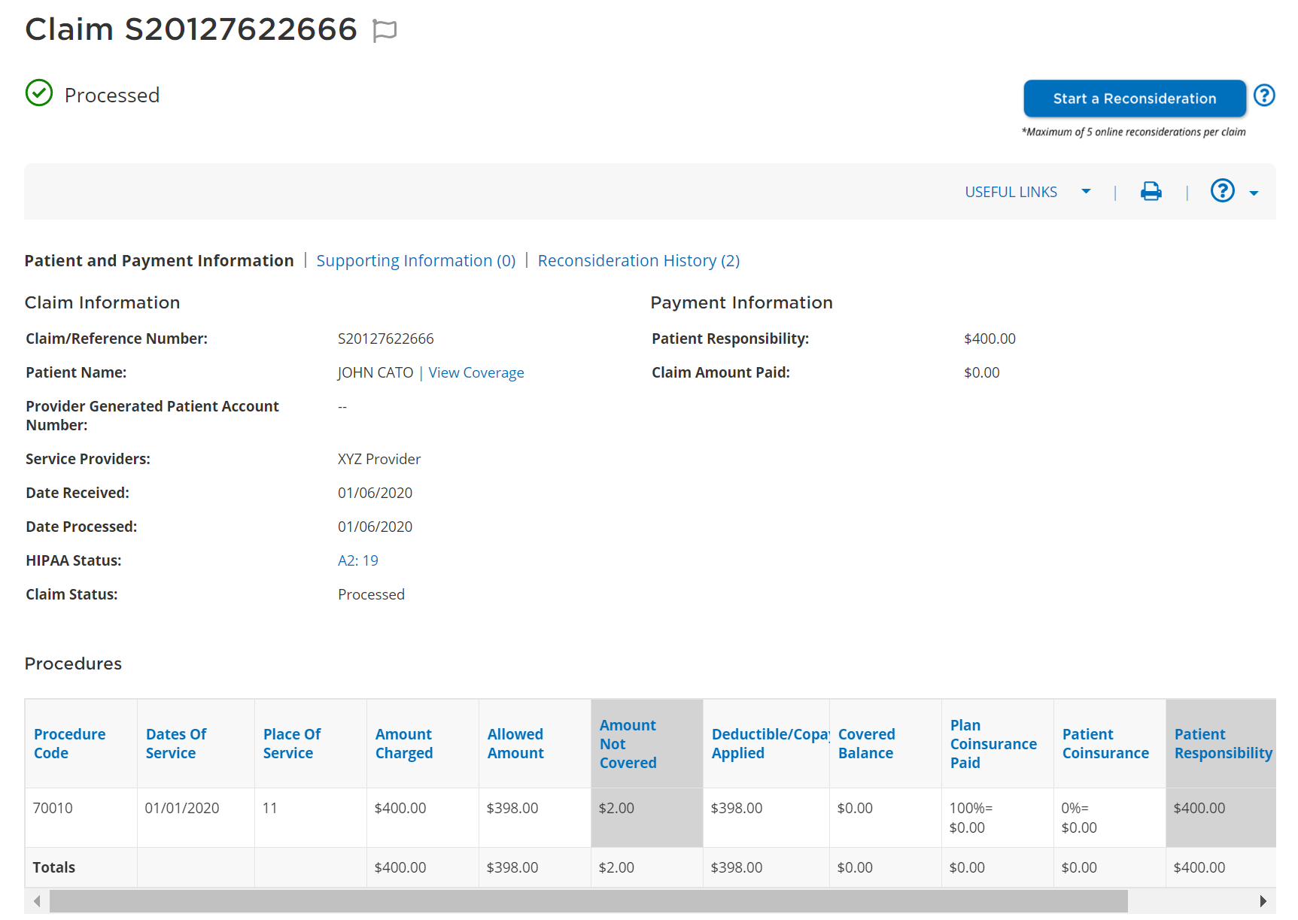
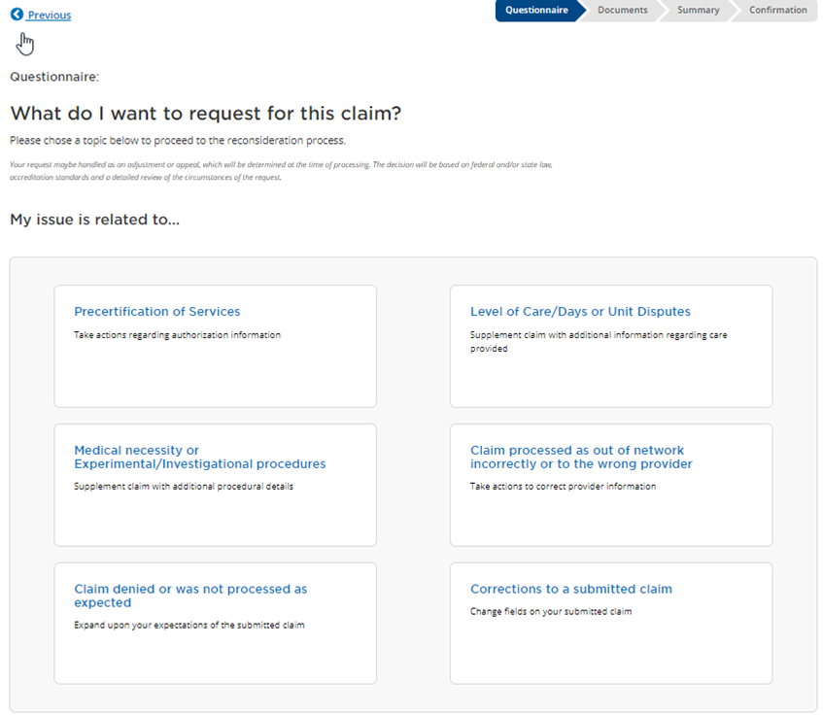
Experience an improved process
You no longer need to call to start a claim reconsideration or appeal
Start a reconsideration
Step-by-step guidance speeds up and simplifies the process.
Describe your reason for the request in the notes section.
Attach documentation, if needed.
Access the reconsideration button
directly from the claim details screen.
Questionnaire
Notes:
Claim reconsiderations and appeals online
You no longer need to call to start a claim reconsideration or appeal
Start a reconsideration
Access the reconsideration button directly from the claim details screen.
Step-by-step guidance speeds up and simplifies the process.
Describe your reason for the request in the notes section.
Attach documentation, if needed.

Slide 28
Provider resources
Tools to make your life easier
May 22, 2024
Notes:
The following slides include just of couple of resources and reminders for you as we round out our presentation for the day.

Slide 29
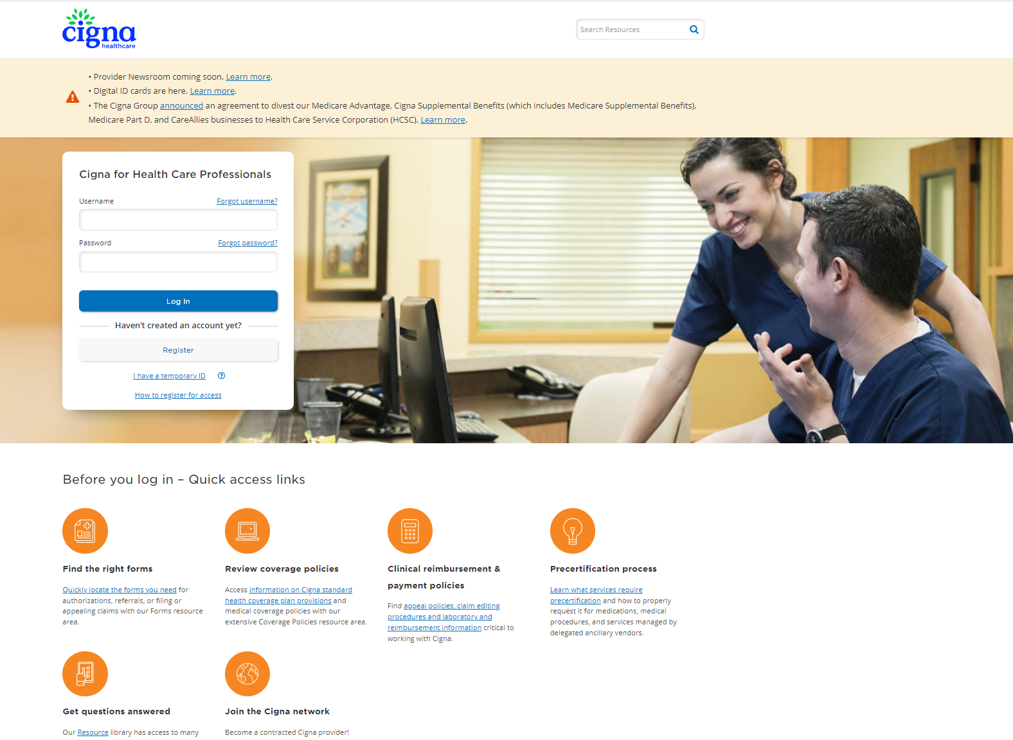


Easily access the information you need
Provider website
Provider Reference Guide
Provider Newsroom
Go to the Cigna for Health Care Professionals website (CignaforHCP.com).
Log in to CignaforHCP.com > Resources > Reference Guides.
Access news and updates on topics that are most important to you — all in one place. Go to ProviderNewsroom.com.
Note: The Provider Newsroom replaced these provider newsletters: Network News, Network Insider, and Transformations.
May 22, 2024
Notes:
This slide shows resources available to you, the first being Cigna for Health Care Professionals website: CignaforHCP.com, which I would encourage everyone to register if you have not already. Note the search functionality in the upper right corner - the website provides information, tools, and resources, such as the Provider Reference Guide – where you will find comprehensive information for your reference, download and check here first. The Provider Newsroom replaced Network News, Network Insider, and Transformations. You should receive an email soon, next few weeks providing links to the newsroom and how to use this new function.

Slide 30

Use our resources to improve your experience
  Digital solutions
  Access our self-service tools to improve your office’s efficiency and reduce your administrative burden. For more information, visit the Medical Education and Training resource page.
  Webinars
  Learn how to navigate CignaforHCP.com and perform time-saving transactions (e.g., eligibility and benefits inquiries, claim status inquiries, EFT enrollment). To register for a webinar, view the webinar schedule.
  Quick Guide to Cigna Healthcare ID Cards
  View sample ID cards with descriptions of the various fields on the cards. You may save, download, or print card guides for use in your office.
  Questions?
  Call Cigna Healthcare Provider Service at
  800.88Cigna (882.4462).
Notes:
As a reminder, additional tools and contacts include:
Digital solutions
Free webinar access
A Quick Guide to Cigna ID Cards
Our Provider Service team, that can be reached at 800.88Cigna.

Slide 31

Update your demographic information
We use your demographic information to:
Publish online provider directories.
Send important communications to you.
Process claims.
Assign a primary care provider to individuals whose plan requires one but who haven’t made a selection.
Comply with state laws.
Determine network adequacy.
To submit demographic changes:*
Log in to CignaforHCP.com
> Working With Cigna
> Update Directory Information.
You may also submit demographic changes as directed below.
Practitioner and group changes
Fax: 877.358.4301 or
Email Intake_PDM@Cigna.com
Hospital and ancillary changes only
Fax: 646.459.2180
Please notify us in writing
90 days before changing your office or billing address, telephone number, TIN, National Provider Identifier, or specialty.
Notes:
Updating your demographic information is vital as we use your demographic information to do things such as:
Publish online provider directories
Send important communications and
Process claims
Cigna Healthcare asks that you notify us in writing 90 days before changing your office or billing address, telephone number, Tax ID Number (TIN), NPI, or specialty.
Providers can submit demographic changes electronically by logging in to CignaforHCP.com
You may also submit demographic changes using the fax and email addresses noted in this slide. My suggestion is to always ask for confirmation which should be sent by PDM confirming the change.

Slide 32
Q&A
May 22, 2024
Notes:
That wraps up our presentation for the day. Now we can take the few minutes we have left to address any questions you may have.

Slide 33
All Cigna Healthcare products and services are provided exclusively by or through operating subsidiaries of The Cigna Group, including Cigna Health and Life Insurance Company (CHLIC), Connecticut General Life Insurance Company, Evernorth Behavioral Health, Inc., Evernorth Care Solutions, Inc., Express Scripts, Inc., or their affiliates.
PCOMM-2024-351 03/2024
Notes:
Thank you all for your attention today!

