Slide 1
Massachusetts Association of Patient Account Management
05/23/2024
Notes:
Welcome remarks.
HOUSEKEEPING – please keep yourself muted. If you have questions during the webinar please type them in the chat. We have a moderator to keep an eye on incoming questions and we will answer those at the end of the presentation.
INTRODUCTIONS
- Shana Sullivan – moderating today’s webinar
- Caroline Leblanc – expert panelist
- Elaine Pedrosa – monitoring questions and will ask panelists incoming questions from the live webinar at the end

Slide 2



The Wellpoint Team in the Community

Slide 3
UniCare is now Wellpoint
New name.
Same plans.
Same doctors.
Same hospitals.
Same coverage.
Same commitment to you.
Notes:
Shana present
Focus on nothing is changing except our name. We have NOT been acquired.
Becoming Wellpoint reflects our commitment to helping you live a healthy life, providing you with access to healthcare programs and services whenever and wherever members need them. Because at UniCare we take a broader view of health and have been working hard to address not only the physical factors that affect health, but the mental, emotional, and social factors that affect one’s overall well-being — your whole health. To more accurately reflect our mission of supporting your whole health, UniCare will become Wellpoint on July 1st.
All UniCare health plans will officially become Wellpoint as of July 1, 2024. If you are currently enrolled in a UniCare health plan, your plan will remain UniCare until July 1, 2024.
Under the Wellpoint name, you will still have:
- Access to the doctors and hospitals you know and trust.
- Access to the benefits you’re familiar with.
- Three plans to choose from to fit your health needs and budget.
- Our Medicare Extension plan as an option for GIC retirees
Rest assured, there will be no impact or changes to coverage, access to healthcare providers, or level of support as a result of any brand changes. Your health plan will continue to operate as it does today. Any plan changes made by the GIC for the new plan year are not associated with the new name.

Slide 4
Do current UniCare members have to do anything?
No.
Existing UniCare plan coverage remains the same through the end of this plan year (June 30, 2024).
If members are happy with their current medical plan, no action is required.
Notes:
Shana

Slide 5





What makes Wellpoint plans unique?
No referral needed
No PCP required
Some of the lowest premiums
Travel anywhere and get covered
High customer satisfaction
Notes:
Caroline

Slide 6
What is an Indemnity Plan?
No network
Wellpoint plans cover all doctors, facilities, and healthcare providers. Use the plan’s contracted providers for the highest benefits at the lowest out-of-pocket costs. The choice is always yours.
No referrals, no PCP requirement
Our plans don’t require you to choose a primary care provider (PCP) or to obtain referrals for specialty office visits.
Coverage beyond the Commonwealth
When you travel, Wellpoint’s travel network protects you from unexpected bills.
Notes:
Caroline

Slide 7
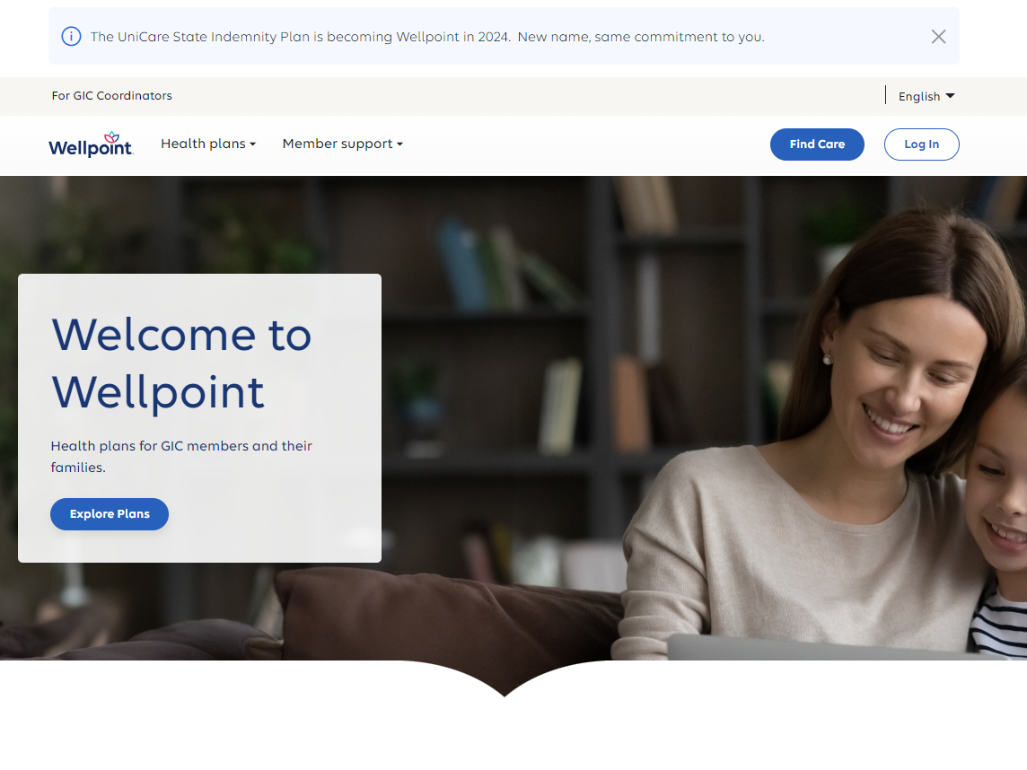

Will there be a new website or app?
​Our new website can be found at wellpointmass.com.
The unicaremass.com site will remain in place until all UniCare plan officially become Wellpoint plans on July 1, 2024.
Members can still access their member account and Sydney Health app the same way.
Notes:
Shana present

Slide 8



What’s new this year for Total Choice, PLUS & Community Choice?
The family fitness reimbursement is increasing. Families can now be reimbursed up to $200 in a plan year.
The benefit for individuals remains the same — up to $100 in a plan year.
There will no longer be a limit on physical therapy or occupational therapy visits in a plan year.
More than 30 visits will require preapproval.
Nutritional counseling, conditions other than obesity with risk of cardiovascular disease, diabetes, cleft lip/palate and certain eating disorders are now covered for up to three visits in a plan year.
Notes:
We should also include the nutritional counseling benefit enhancement. All members regardless of their diagnosis are eligible for 3 nutritional counseling visits
Caroline

Slide 9
What’s new this year for Medicare Extension?
Nutritional counseling, conditions other than obesity with risk of cardiovascular disease, diabetes, cleft lip/palate and certain eating disorders are now covered for up to three visits in a plan year.
Notes:
We should also include the nutritional counseling benefit enhancement. All members regardless of their diagnosis are eligible for 3 nutritional counseling visits
Caroline

Slide 10

How do Wellpoint plans compare?
Plan | Offered to | Plan type | Pharmacy | Behavioral Health
Total Choice | Members who live in New England (total access) | Indemnity – any provider, without referrals, no matter where the member gets services. | CVS | All UniCare plans provide access to the largest behavioral health network in the nation through Carelon Health Options.
PLUS | Members residing in New England (CT, MA, ME, NH, RI and VT) | Indemnity / PPO-type – network of providers that are “preferred;” coverage and lower costs. | CVS
Community Choice | Members residing in MA (not including Martha’s Vineyard or Nantucket) | Indemnity / Limited network – A PPO-type plan with a network of MA hospitals. If you need to use an out of network hospital you still have coverage with higher out of pocket member costs. | CVS
Medicare Extension (OME) | Medicare members living anywhere in the U.S. Must be enrolled in Medicare Parts A & B. | Medicare Supplement | SilverScripts
Notes:
Caroline

Slide 11
Member tools and resources
  Website
  unicaremass.com
  The UniCare website has a robust amount of information and resources for members all in one place.
  Explore our health plans, navigate to the Find Care tool and secure member portal login, download plan materials, member handbooks and forms, and submit a form to request printed materials via the mail.
  Find customer service and contact information.
  Member information on our website is also available in Spanish.
  Member Portal
  unicare.com/mass/login
  Login to the secure member portal to access plan materials, reimbursement forms, chat with member services, submit and check claims and more.
  Sign up for direct deposits
Instead of waiting for a check to come in the mail, you can receive your money directly in your bank account by signing up for direct deposit.
Visit our website to learn more.
  Fitness Reimbursement
  Receive reimbursement of up to $100 for an individual plan and $200 for a family plan toward membership at a fitness club or other fitness activities such as yoga and Zumba classes, personal trainers, sports teams, and more.
  Download the reimbursement form on our website.
  Diabetes Prevention Program Reimbursement
  Receive reimbursement of up to $500 when you complete 20 or more sessions in an approved diabetes prevention program.
  Download the reimbursement form on our website.
  Special Offers / Discounts
  Get discounts on many health-related products and services, like programs for weight management, stress reduction, baby items, glasses, pet care, and more.
  Log in to the secure member portal to view Special Offers.
  Smoking Cessation
  Counseling for tobacco dependence/smoking cessation is covered up to a limit of 300 minutes per plan year. It is reimbursed up to the Plan's allowed amount.
  Find details in your member handbook.

Slide 12
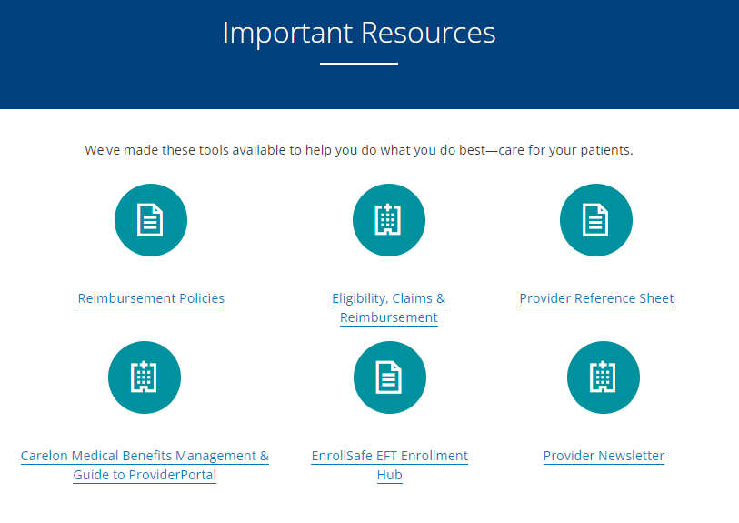
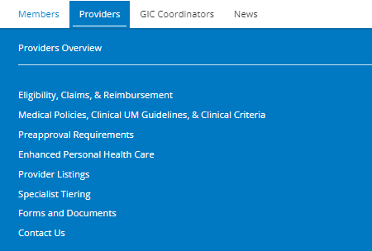
Website overview
Dedicated Provider Section with the following resources:
Notes:
Caroline

Slide 13


Credentialing
About UniCare’s Credentialing Department
UniCare requires CAQH for providers who participate in the UniCare network. We follow the National Committee of Quality Assurance (NCQA) standards.
UniCare has designated delegated providers. The organization/delegate submits credentialed provider data to UniCare for addition to the network
For more information contact us at:
Phone: (800) 516-7587
Fax: (978) 474-6188
unicareproviderrelations@anthem.com

Slide 14
Notifications
UniCare requires notification for certain procedures and services, to determine eligibility for benefits. See our
Provider Reference Sheet for the list of these procedure and who to contact for review.
Contact Carelon directly for services they will be reviewing (such as echocardiography and high-tech imaging):
  By phone: 866-766-0247 or via
  Provider portal: https://www.careloninsights.com/provider-resources
Services remaining under UniCare review:
  Call 800-442-9300 or Fax information to 877-745-8636
Contact CVS for most specialty drug questions or patient-related pharmacy questions: (toll free) 877-876-7214
Behavioral Health Authorizations: Carelon is continuing to do the authorizations for BH and Substance Abuse services. They have a new ProviderConnect system.
  https://www.valueoptions.com/pc/eProvider/providerLogin.do
Carelon has a dedicated EDI Helpdesk for direct support with ProviderConnect:
  Phone: 888-247-9311 8 a.m. to 6 p. m. EST
  E-mail: e-supportservices@beaconhealthoptions.com

Slide 15
Appeals for reconsideration of a denial by Managed Care department must be filed by telephone or in writing. All supporting documentation must be received within 3 business days of when the denial was received.
Appeals for claims reconsideration must be received by UniCare within 180 days of when the determination was made.
Send appeal requests and supporting documentation to:
Appeal rights
UniCare State Indemnity Plan
P. O. Box 2011
Andover, MA 01810
Fax: 978-474-5179 (Managed Care)

Slide 16
Provider tools and resources
Visit unicarestateplan.com > Provider Tab
Plan resources include:
  Medical and reimbursement policies
  Member handbooks
  Notification requirements
  Physician Listing with tier levels
  for specialists
  Electronic claims filing
Availity:
  Web portal: Verify eligibility, check and submit claims
  Availity Client Services 1-800-282-4548 M-F 8:00 to 7:30 EST.

Slide 17
Accurate provider data is key to effective
provider transactions and communication.
Roster updates are completed to note provider changes in your group and reflect the updates in our system.
Practices must notify UniCare when a provider leaves or joins their group.
Requests to change financial addresses must be submitted in writing with a W-9 form.
Provider Rosters

Slide 18
Contact Us
Provider Relations
800-480-7587
unicareproviderrelations@anthem.com
The mailbox is checked daily to ensure a timely response to your requests. Use this mailbox to submit changes (including roster updates), data sheets, demographic updates, terminations and other inquiries
Customer Service
800-442-9300
Notes:
Caroline

Slide 19
Questions?
Notes:
Thank you all for your time!
Now, we’ll answer any questions that came in during the webinar.
Elaine – could you share the first question?

