Slide 1
MA Provider Orientation & Plan Overview
MassHealth MCO & ACO
Clarity Plan
Senior Care Options
Special Kids Special Care

Slide 2
Topics
WellSense Overview
    Who We Are
    Overview of our Plans
    Identification Cards
  Eligibility
  Special Kids Special Care (SKSC)
  Care Management & Community
  Claim and Appeal Information
  Fraud, Waste and Abuse
  Provider Responsibilities

Slide 3
Topics
Updates and Reminders
  Provider Demographics
  Provider Contacts
  EFT
  EDI
  Senior Care Options –
    Model of Care
  Clinical Vendors
  MassHealth Enrollment
  Questions

Slide 4
WellSense Overview

Slide 5
Who We Are…
WellSense Health Plan is a non-profit managed care organization committed to providing the highest quality healthcare coverage to underserved populations.
We operate in MA and NH
  MA Medicaid or MassHealth (including ACO)
  MA Clarity plans which includes ConnectorCare
  MA Senior Care Options (available in Barnstable, Bristol, Hampden, Plymouth & Suffolk counties)
  NH Medicaid
  NH Medicare Advantage

Slide 6
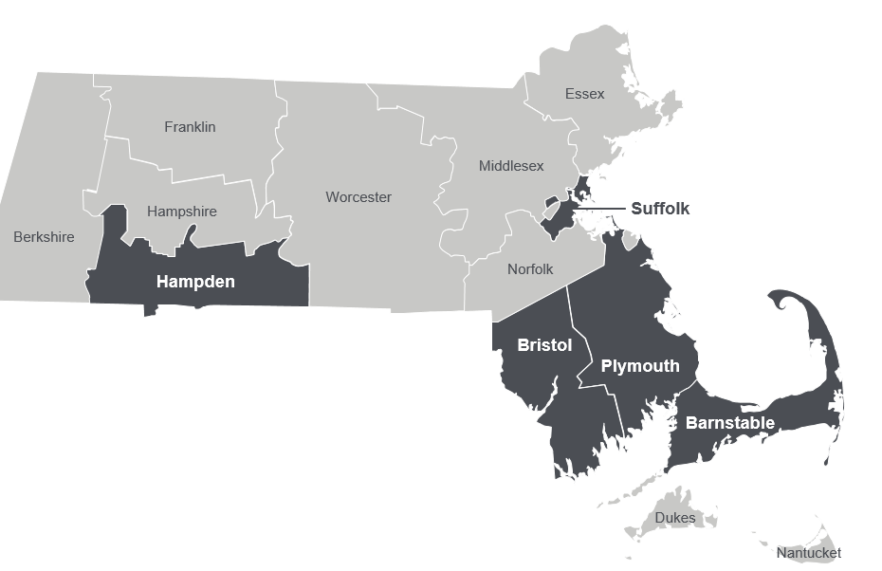
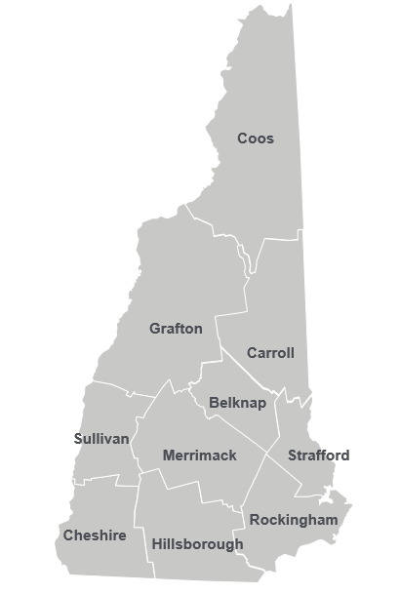


Our Member and Provider Network
Massachusetts
New Hampshire
Over 600,000 Members across the state
Over 70,000 Members across the state
17,900 primary care, specialists & behavioral health providers
Community resources

Slide 7
Plan MCO/ACO’s Plans include:
WellSense Essential MCO – Primary Care within the WellSense MCO Network
WellSense Boston Children’s Alliance (ACO)– Primary Care within the WellSense Boston Children’s Alliance ACO Network..
WellSense Beth Israel Lahey Alliance (ACO)– Primary Care within the WellSense Beth Israel Lahey Alliance ACO Network.
WellSense Care Alliance (ACO)– Primary Care within the WellSense Tufts Alliance ACO.
WellSense Southcoast Alliance (ACO) – Primary Care within the WellSense Southcoast Alliance ACO.
WellSense Community Alliance (ACO) – Primary Care within the WellSense Community Alliance ACO Network.

Slide 8
Plan ACO’s Plans include:
WellSense Mercy Alliance (ACO) – Primary Care within the WellSense Mercy Alliance ACO Network.
WellSense Signature Alliance (ACO) – Primary Care within the WellSense Signature Alliance ACO Network.
East Boston Neighborhood Health WellSense Alliance (ACO) – Primary Care within the WellSense East Boston Neighborhood Health Alliance ACO Network.
WellSense’s full network of MassHealth contracted facilities, specialists and ancillary services is available for all above Plans

Slide 9

Plan Products include:
Clarity Plan- WellSense’s full network of Qualified Health Plan, include Connector Care contracted facilities, primary care, specialists and ancillary services is available.
Senior Care Options - WellSense’s full network of Senior Care Options contracted facilities, primary care, specialists and ancillary services is available.
Special Kids Special Care - MassHealth and the Department of Children and Families (DCF) co-sponsor the Special Kids Special Care (SKSC)program medical program called for children with highly complex medical needs who are in foster care

Slide 10
Member ID Numbers – MassHealth ACO’s
ACO Member ID’s have number sequencing according to the ACO they are assigned:
ACO | Prefix | ID numbering Scheme (note: the 00 is the suffix for all subscribers and will be on the ID card)
Community Alliance | 20 | 2#########00
Mercy Alliance | 30 | 3#########00
Signature Alliance | 40 | 4#########00
Southcoast Alliance | 50 | 5#########00
Boston Children’s ACO Alliance | 71 | 71########00
East Boston Neighborhood Health Alliance | 72 | 72########00
Beth Israel Lahey Health | 70 | 70########00
Tufts Medicine Care Alliance | 73 | 73########00

Slide 11
Member ID Numbers – MCO, Clarity Plan & SCO
Member ID sequencing for MCO, Clarity plan & SCO
 | Prefix | ID numbering Scheme (note: the 00 is the suffix for all subscribers and will be on the ID card)
MassHealth MCO | 20 | B#########00
Clarity Plan | 30 | C#########00
Senior Care Options | 40 | 1#########00

Slide 12
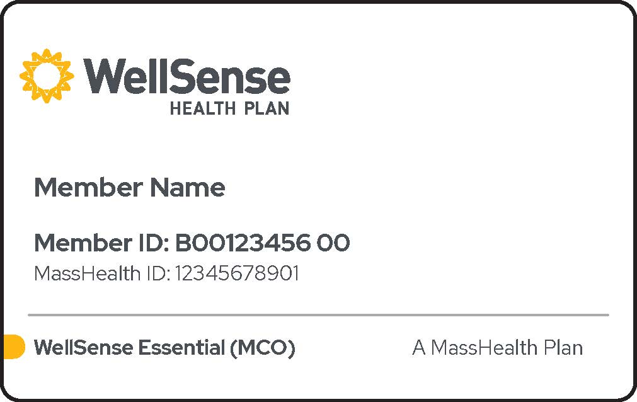
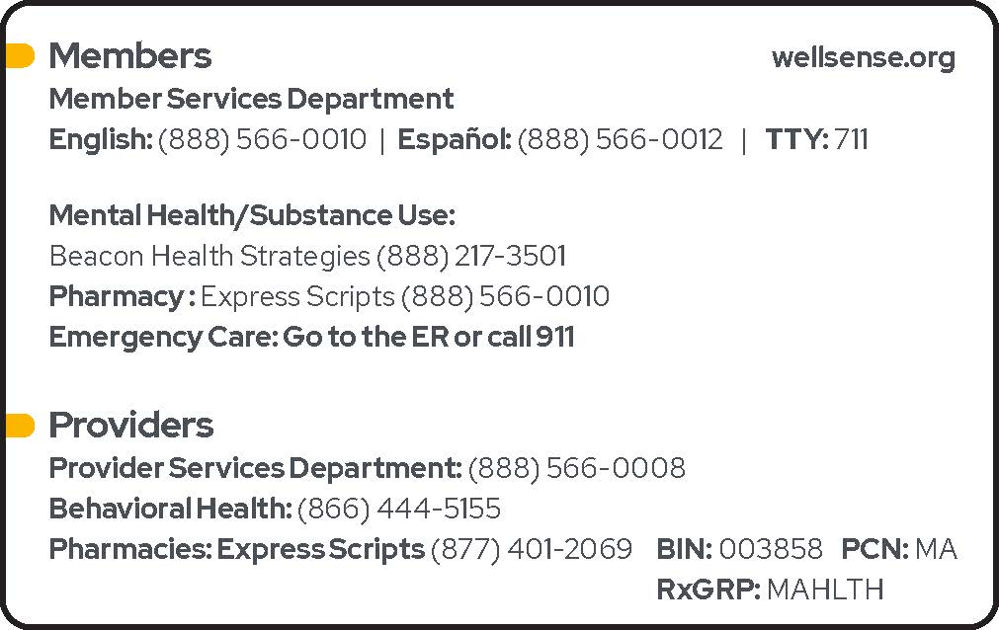
MassHealth Member ID Cards
Member ID Cards begin with the letter “B” for our MassHealth (MCO) members.
Special Kids Special Care member ID cards also begin with the letter “B”. In addition to these categories below, they may also qualify for MassHealth CommonHealth.
Statewide Network
Products include:
  MassHealth Standard / Disabled
  Family Assistance
  CarePlus A & B

Slide 13
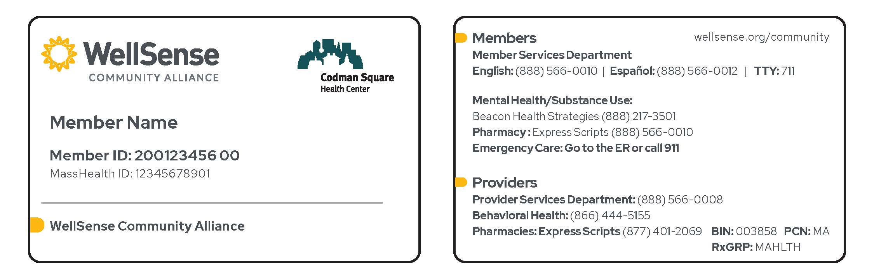
MassHealth Member ID Cards – ACO
Member ID Cards begin with a # for MassHealth ACO Plans
PCP Site logo will be included in the upper right corner
Products include:
  MassHealth Standard / Disabled
  Family Assistance
  CarePlus A & B

Slide 14
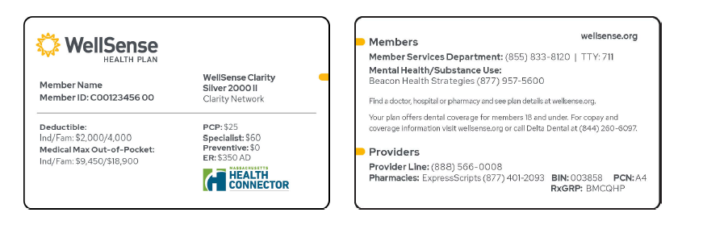
Clarity Plan Member ID Cards
Member ID Cards begin with a “C” for Clarity Plans
Provider Network: “Clarity Network”
Products include:
  ConnectorCare
  Platinum
  Gold
  Silver
  Bronze

Slide 15
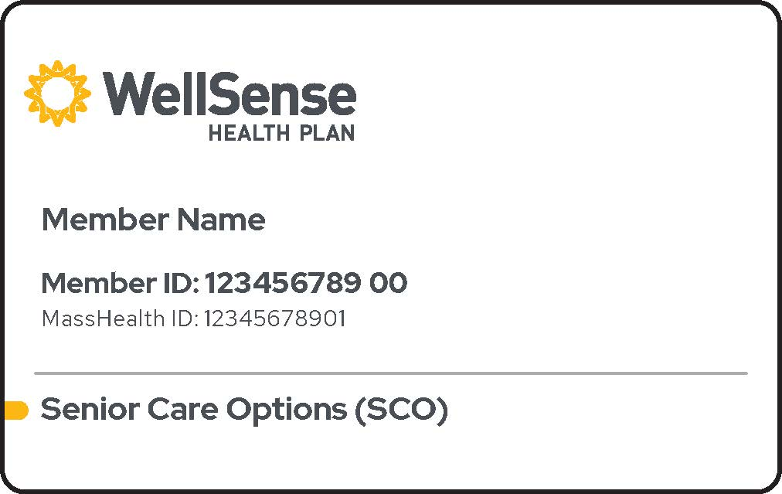
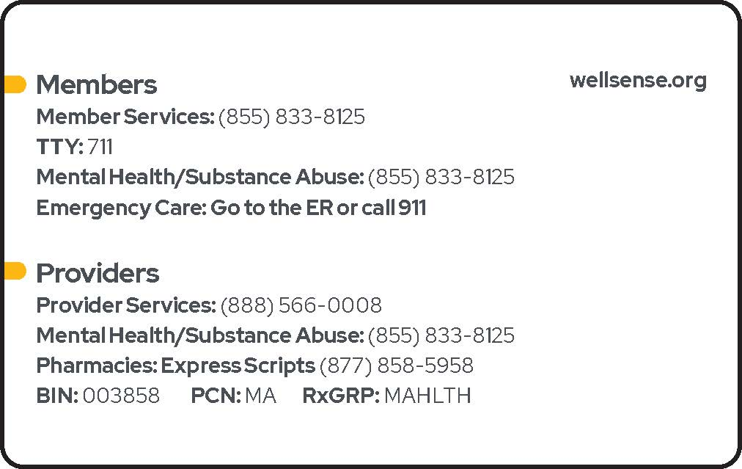
Senior Care Options(SCO) Member ID Cards
SCO for eligible members with MassHealth Standard only
ID Cards begin with the number “1” for our Senior Care Options members
Products include:
  Members with MassHealth Standard only
  HMO-SNP for members also enrolled with Medicare A and B, dually eligible

Slide 16
Member Eligibility
MH (including ACO): By accessing the MassHealth website: @sso.hhs.state.ma.us/
WellSense: Secure Provider Portal: www.WellSense.org via My HealthNet or 1-888-566-0008 (most accurate method of verification for Clarity Plan members)
Clarity Plans: Secure Provider Portal: www.WellSense.org via HealthTrio or
1-888-566-0008 (most accurate method of verification for Clarity Plan)
Senior Care Options: WellSense: Secure Provider Portal: www.WellSense.org via HealthTrio or
1-888-566-0008
*****Important Note*****
SCO Members - Eligibility for SCO members changes on the first of the month, however we still recommend that you verify eligibility prior to the date of service. Member panel reports are not an accurate method for verifying eligibility. These reports are only intended to inform you of the member’s assigned to your panel.
Clarity Plans - For Clarity plan Members you are not able to verify eligibility via EVS, you must verify eligibility with Wellsense
Please check member eligibility on the date of service before delivering services and daily for inpatient admissions

Slide 17
Special Kids Special Care (SKSC)

Slide 18
Special Kids Special Care (SKSC) Program
MassHealth and the Department of Children and Families (DCF) co-sponsor the Special Kids Special Care (SKSC)program medical program called for children with highly complex medical needs who are in foster care.
The Plan welcomed approximately 100 members within this program to begin coverage on March 1, 2018. Today, our SKSC membership is over 125 members.
Plan types include MH Standard, Standard Disabled, and MassHealth CommonHealth.
SKSC members have access to the same medical benefits as our MCO and ACO members. They also have access to the following additional services:
  Private Duty Nurses (PDN)
SKSC members receive the same benefits and extras, with same restrictions, as our Medicaid members
Notes:
Add that PCP exclusivity doesn’t apply for these members.

Slide 19

Special Kids Special Care Program
Eligibility
Members must be 21.5 years or younger
Reside in a foster home or other group setting, or in an adoptive or guardianship home once enrolled in the program
Meet medical criteria that include requiring medical management by or under the supervision of a physician on a regular basis over a prolonged period of time, and
Require direct administration of skilled nursing care that necessitates complex procedures (e.g., tube feedings, ostomy care, IV nutrition/medication, tracheotomy tube, ventilator care), or
Require skilled assessment or monitoring related to an unstable medical condition that may necessitate advanced care or supervision

Slide 20
Special Kids Special Care Program
Care Model & Contact Info
The SKSC program includes dedicated Pediatric Nurse Practitioners (PNPs) and Pediatric Nurse Care Managers (PNCMs) who develop a plan of care and arrange the delivery of care for each qualified program participant.
The PNPs and PNCRs collaborate with the member’s PCP, specialists and other health care providers in addition to DCF, the foster family, guardians and birth parents.
Care and services can be rendered in the member’s home, doctor’s office, hospital, outpatient facility, day care center or school.
  SKSC Members will have access to clinical staff at WellSense 24/7 365 days: (617) 638-7572
  SKSC members will call also have access to our MassHealth member line: (888) 566-0010

Slide 21
Provider Portal

Slide 22

WellSense Provider Portal
Skilled Hands should be spent with patients – not paperwork!
Our Provider Portal can be accessed from the login button at wellsense.org. When you log in, look out for:
1) Improved Claims Process: Providers can submit corrected claims, appeals, COB, EOB, and TPL review requests online and get reimbursed faster.
2) Streamlined Authorization Process: Our submission process is now more intuitive and allows providers to upload supporting documentation to their requests. ** Online Submission of authorization requests is mandated.
Skilled Hands should be spent with patients – not paperwork.

Slide 23

WellSense - Provider Portal
Our Provider Portal is your one stop place to:
Prior Authorization submissions and status inquires
Check Eligibility
Submit Claims (professional only)
Check Claims Status (mandated)
Submit Appeals and Corrected Claims
PCP Change Requests
Member Demographic Changes (report member phone and address changes)
Provider Relations is here to train you on utilizing the Provider Portal to its fullest potential. Please reach out if training is needed in your office or if you need secure access.

Slide 24
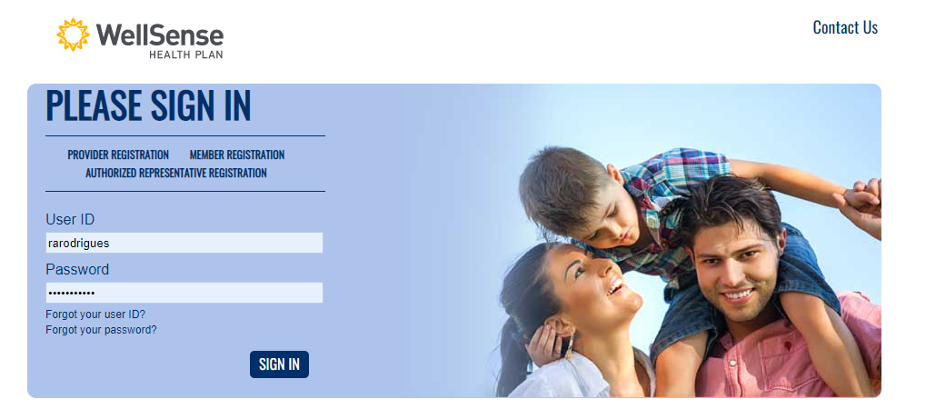
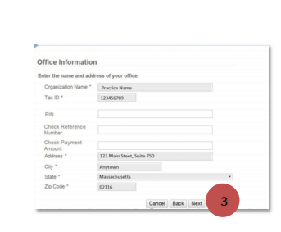
For providers who do not have an existing HealthTrio Connect account
On the home page of the portal, under PLEASE SIGN IN, click Provider Registration.
On the User Information page, fill in all fields and click Next
On the Office Information page, fill in the information as requested and click Next.
On the Registration Summary page, verify information and click Finish.
Once registration is complete, all those registered from your provider office by the office administrator will be listed in a screen as pictured to the right.
If you do not have account access, please contact your designated office administrator.
If you do not have account access, please contact your designated office administrator.

Slide 25
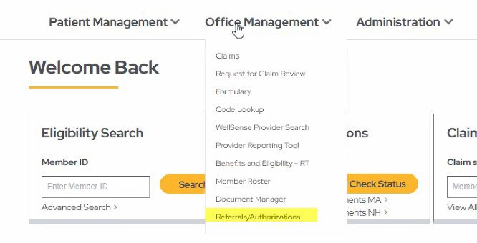
Authorization Submissions – Please submit via portal
PA Submissions via the Portal vs. Paper – High area of focus for the Plan
Streamlined Process
Reduces paper, time and resources, resulting in efficiency.
Ability to check the status of your submitted request online
Faster & more secure than faxing
** Online Submission of authorization requests is mandated.

Slide 26
Claim and Appeal Information

Slide 27
Claims and Filing Limits
To expedite payment, we strongly encourage you to submit claims electronically and only submit paper claims when necessary
Filing Limits:
  MassHealth (including ACO) 150 days
  ConnectorCare/QHP 90 days
  Senior Care Options 150 days
  *Coordination of Benefits and other party liability rules apply
Electronic Claims:
  WellSense has partnered with TriZetto Provider Solutions (TPS) to manage our electronic data interchange (EDI) transactions exclusively. All clearinghouse service organizations and billing agencies that submit EDI transactions must send through TPS.
Paper Claims Mailing Address: Boston Medical Center HealthNet Plan
P.O. Box 55282
Boston, MA 02205-5282
Professional Claims (only) can also be submitted via our Online Portal @ wellsense.org via MyHealthNet

Slide 28
Provider Administrative Claim Appeals
  Provider administrative appeals include requests for reviews of denied claims, including but not limited to, untimely claims filing, level of compensation/reimbursement, no prior authorization/inpatient notification, member eligibility issues, clinical editing and coordination of benefits denials.
  Provider Administrative Appeal
If you wish to appeal a claim we have denied, you must file a Provider Administrative Appeal by completing a Claim Review on MY HealthNet
You can also complete and submit the Universal Request for Claim Review Form, which is available on our website (www.wellsense.org) in the Forms and Documents section.
For questions about a Provider Administrative Claims Appeal, call the provider line at 1-888-566-0008, select option 2 to speak to a Provider Services Representative
The Plan provides ONE level of thorough review for administrative claims appeals that include all required information. Decisions are made within 30 calendar days from the date the appeal is received at the Plan. If an administrative claims appeal is submitted without all required information, the Plan will dismiss the appeal and providers will be notified by the Plan in writing.
  If sending Provider Administrative Claims Appeals by mail, please use the following address:
Boston Medical Center HealthNet Plan
Attn: Provider Appeals
P.O. Box 55282
Boston, MA 02205-5282

Slide 29
Provider Administrative Claim Appeals
Timeframes for filing an Administrative Appeal
For our MassHealth and SCO Plan products, Appeals must be filed with us within 150 calendar days from the original denial date and no later than 300 calendar days from the date of service
For our QHP Plans products, Administrative Appeals must be filed within 90 calendar days from the original denial date and no later than 180 calendar days from the date of service.
An administrative appeal filed after these timeframes will be denied, and BMCHP will be held harmless. Retrospective adjustments (beyond the maximum 300 calendar days) will be denied or considered at BMCHP’s discretion.

Slide 30
Provider Administrative Claim Appeals
  Providers who have questions on their claims appeal must contact the Plan’s Customer Care/Provider Services Department where a representative will be happy to assist with inquiries.
  Provider Services Department 888-566-0008
  Please refer to our Provider Administrative Claim Appeals Policy, Number: O.5.019 for additional guidance on the provider administrative appeals process. The policy can be found on our website.
Please also reference our Provider Manual, Billing & Reimbursement section for more information on filing provider administrative claims appeals

Slide 31
Member Appeals and Grievances
WellSense strives to promptly resolve member appeals and grievances.
Difference Between Member Appeals and Provider Appeals:
Provider Administrative Claims Appeals = a formal process for providers to request reviews of their denied claims pertaining to the areas mentioned on the previous slide.
Member Appeals = a formal process for members or their Authorized Representatives, which includes providers, for reviews of denied services that have not yet occurred*. When a prior authorization or inpatient stay is denied in advance of the member receiving the services, a Plan denial letter is issued to the member and requesting and servicing provider(s) and includes Member Appeal rights.
*The member appeals process also includes Plan applicable benefit reviews for excluded services/member reimbursements pertaining to out of pocket member liability. These are typically filed by members themselves.

Slide 32
Member Appeals and Grievances (cont.)
Member Appeals
WellSense has an efficient process in place to resolve member appeals. A member or authorized representative, which includes a provider acting on behalf of a member, may request three types of member appeals. Member internal appeals must be submitted to WellSense within 60 calendar days of the date of the notice of an adverse action.
Standard Internal Appeal - resolved within 30 calendar days, unless extended. A signed Authorized Representative Form is required from the member for a provider or any other Authorized Representative to file the appeal on the member’s behalf. The appeal is dismissed if this form is not received by the 30th calendar day.
Expedited Internal Appeal - resolved within 72 hours unless extended. For the Plan’s records, a provider must formally assert that a member’s health and/or life is in serious jeopardy awaiting the Standard Internal Appeal timeframe. If this is the case, a signed Authorized Representative Form from the member is not required for a provider to file the appeal on the member’s behalf.
External EOHHS Hearing - may be utilized only after the internal appeals process has been exhausted. These appeals must be filed within 120 calendar days of the date of the Plan’s internal appeal denial letter.

Slide 33
Member Appeals and Grievances (cont.)
Information on the Member Appeals process is included in all initial denial letters sent to members and requesting/servicing providers and is located after the denial or partial approval rationale. The detailed information in the letter from the Plan includes but is not limited to:
  timeframes for filing member appeals
  methods and contact information for filing member appeals
  timeframes for processing of member appeals
  rights of the member throughout the appeal
  information on Authorized Representatives
  an informative member appeals insert
  an Authorized Representative Form
It is essential that providers/office staff review the denial or partial approval letter in its entirety to ensure any Member Appeals for prospective services are sent to the appropriate department at the Plan. This will allow the Plan to process the member appeal as quickly as possible for the member.

Slide 34
Member Appeals and Grievances (cont.)
Provider Tips for effective and efficient Member Appeals process:
  Review the initial denial/partial approval rationale. The rationale for the decision will inform the provider which part(s) of the clinical criteria a member did not meet to qualify for coverage of the service/supply/medication/inpatient stay.
  If clinical information/documentation exists to prove the member meets the clinical coverage criteria but was not sent initially, be sure to include that information with the member appeal request.
  Include a written narrative supporting your member appeal on the member’s behalf, including documentation of new/additional information being sent, reason(s) the member should be covered for the service/supply/medication/inpatient stay and any other information pertinent to the request*
  *These Tips will reduce the number of follow-up phone calls required, based upon provider availability, and allow for faster processing of the member appeal.

Slide 35
Member Appeals and Grievances (cont.)
A Hearing through the Massachusetts EOHHS is an independent review by an EOHHS Hearing Officer (attorney) of a Plan internal appeal adverse action.
  A member may be eligible for an external Hearing Appeal only after they have exhausted the Plan’s Internal Member Appeals process.
  The external Hearing Appeal must be filed within 120 calendar days of the date on the Plan’s Internal Member Appeal adverse action notice.
  The member or their Authorized Representative, including providers filing on behalf of members, must be present for the EOHHS Hearing.
  Representatives from the Plan also participate in the Hearing.

Slide 36
Member Appeals and Grievances (cont.)
Member Grievances
  Process where members or their Authorized Representative, including providers on a member’s behalf, express dissatisfaction about the services they receive from the Plan and/or providers. Types of grievances include but are not limited to:
    Plan processes
    Plan staff
    provider and/or provider staff attitude/service
    quality of care
    quality of practitioner office site
    billing/financial issues
    access and availability

Slide 37
Member Appeals and Grievances (cont.)
Providers may assist members or their Authorized Representatives in bringing forth grievances. Grievances may be filed with the Plan verbally through the Plan’s Member Services department, via fax to the Member Appeals and Grievances department to 617-897-0805 or in writing to:
  Member Appeals & Grievances Department
  100 City Square, Suite 200
  Charlestown, MA 02129
If a member or their Authorized Representative files a grievance against a facility, provider and/or provider staff member, providers are expected to work with Plan staff by reviewing the expression of dissatisfaction and responding timely to the Plan’s requests for administrative and/or clinical information. The applicable information is crucial to the Plan’s timely review and response to the member.

Slide 38
Provider Responsibilities

Slide 39
Provider Responsibilities - ACO
Members will have a PCP within their ACO and must use that PCP for all primary care. Primary Care providers may only enroll in one ACO.
The PCP will make efforts to direct members to specialists and other providers within the ACO or with whom there is an established relationship.
However, members may go to any contracted specialist/other provider within the BMCHP network – subject to the specialist/provider obtaining a prior authorization for the service, if applicable.
Non-PCP (Specialists, Facilities, Ancillary Services etc.) participation is not limited by ACO participation.
There is no need for a new contract for non-PCP services for ACO participation; providers will remain contracted under their current MCO Agreement.

Slide 40
Provider Responsibilities- ACO
Community Partner Program
MassHealth launched the Community Partners Program in 2018 to support the ACO initiative. This initiative impacts ACO & MCO providers, as well as, members with significant behavioral health and Long Term Services and Supports (LTSS) needs across Massachusetts.
What is a Community Partner?
A Community Partner is a community-based organization that works with a member and his or her ACO's or MCO's primary care provider and health plan to help coordinate and manage health care services.
Behavioral Health Community Partners support members with serious behavioral health needs. There are 18 Behavioral Health Community Partners agencies across the state.
Long Term Services and Supports Community Partners work with members who need help meeting their needs for self-care and basic activities of daily living. There are nine LTSS Community Partners across the state.
All Behavioral Health & LTSS Community Partners participate with MCOs. Relationships vary among ACOs due to regional access.

Slide 41
Provider Responsibilities- ACO
Community Partner Program
What can Community Partners do?
Community Partners may be able to help:
Assess members' needs
Assist providers with planning the right treatments and services for members
Work with providers to change the type of care a member receives, for example: inpatient to outpatient care
Manage and check medications
Provide health and wellness information to members
Identify community & social services programs that can support members
Assist members in selecting culturally sensitive providers
Who qualifies for participation in a Community Partners program?
A portion of our membership will be eligible based on specific criteria.
For Behavioral Health Community Partners there are approximately 3,500 eligible enrollees statewide. For LTSS Community Partners there are approximately 24,000 eligible enrollees statewide. This means that a small percentage of your MassHealth panel will be eligible for Community Partners services.
MassHealth initially will assign members to specific Community Partners in the first six months. After that, ACOs and MCOs will be able to assign members to Community Partners.

Slide 42
Provider Responsibilities- ACO
Community Partner Program
How does this affect PCP practices?
Community Partners care coordinators who want to speak with you about your patients. You'll work with the Community Partner as a member of your patient's care team and help develop the person-centered care plan.
The care coordinator can help you enhance your patient's treatment experience by:
Increasing awareness of your patient's medical and functional needs
Helping to connect you to your patient's other health care providers
Helping your patient carry out goals of your patient's care plan
Helping your patient better understand his or her care instructions
Each PCP practice must identify a care team point of contact responsible for communicating updates regarding the member's care to the Community Partners. In addition, each PCP practice must sign off on behavioral health or LTSS care plans. The required signatures must come from a PCP or PCP's designee such as an RN or other licensed medical professional, or a covering MD, nurse practitioner, physician assistant or doctor DO.
As is current practice, the patient's PCP makes referrals to medically necessary specialty care for which the ACO, MCO or MassHealth requires referrals. Conducting medication reconciliation is part of patient care transitions.

Slide 43
Provider Responsibilities
Responsibilities of Contracted Hospitals
Hospitals are required to notify the Plan of emergency care and observation services rendered to patients.
Hospitals must notify the Member’s PCP within one business day of the Member’s presentation at the emergency department. Notification may include a secure electronic notification of the visit.
Hospitals must notify the plan of newborn births.
Coordinate with the Plan’s hospital care coordinators on concurrent review and discharge planning activities for medical & surgical services.
Adhere to Clinical Authorization Policies.

Slide 44
Provider Responsibilities
Senior Care Options Model of Care Training Requirement
Our Senior Care Options (SCO) Model of Care requires that network providers receive WellSense-specific Model of Care training. Attesting to this training is required annually.
A short, web-based training module regarding our Model of Care is available to you on our Provider Portal at www.wellsense.org, under Provider, Training.
At the end of the training providers are asked to attest to having completed the training. NPI is required to attest

Slide 45
Provider Responsibilities
Verifying PCP; Requesting PCP Changes
Our MassHealth members may request a change in their PCP at any time; Clarity plan members may request a PCP change up to three times per year
  * For ACO members, PCP changes outside of the members selection period can only be done within their assigned ACO.
Reminder: It is very important to check PCP assignment at every visit! If a provider has multiple affiliations you must verify that the member is assigned to the affiliation where services are being provided.
Verify member assignment on date-of-service via our Plan’s web site, www.wellsense.org, or our provider hotline 1-800-900-1451
Primary Care Provider (PCP) Change Requests should be submitted online via our Provider Portal, HealthTrio. Completed PCP Change forms may also be faxed to our Enrollment department. PCP Selection Form must be received before or on the date of service to avoid claim denial

Slide 46
Provider Responsibilities
PCP Member Transfer Policy
Provide 60 days notice to member before effective date of member termination.
Submit a Member PCP Transfer Request Form with appropriate documentation to help support the reason for your request to transfer the member, online through our Provider Portal, MyHealthNet.
Completed forms may also be faxed to our Enrollment Department: fax # 617-897-0838, if necessary.
Plan will initiate member outreach and reassign member.
Transition plan will be arranged to ensure there is no interruption in care.

Slide 47
Involuntary Member Transfer or Plan Disenrollment
The Plan is expected to make all reasonable efforts to support and furnish services to all members, including members who exhibit disruptive behavior which may impair the provider’s ability to furnish services to that member or other members.
In an extremely limited number of circumstances, the involuntary disenrollment of a member from a Primary Care Provider (PCP) panel, from specialty or ancillary services, or from the Plan may be considered.
The Plans Involuntary Member Transfer or Plan Disenrollment Policy describes the processes and EOHHS requirements that must be considered in the event of an MCO or ACO member’s involuntary disenrollment from a PCP panel, a specialty or ancillary provider, or the Plan.

Slide 48
Involuntary Member Transfer or Plan Disenrollment
Involuntary disenrollment of a member is reserved for rare and extraordinary circumstances only and will not be considered under the following circumstances:
  An adverse change in the member’s health status
  The member’s utilization of medical services
  The member’s diminished mental capacity
  Missed appointments
  The member exercises their option to make treatment decisions with which the Provider or Plan disagrees, including the option to decline treatment or diagnostic testing
  The member’s uncooperative or disruptive behavior resulting from his or her special needs (except when the member’s enrollment seriously impairs the provider’s and other staff’s ability to furnish services to the particular member or other members)
Please refer to the Involuntary Member Transfer or Plan Disenrollment Policy on the BMCHP provider website under Policies for the full guidance.

Slide 49
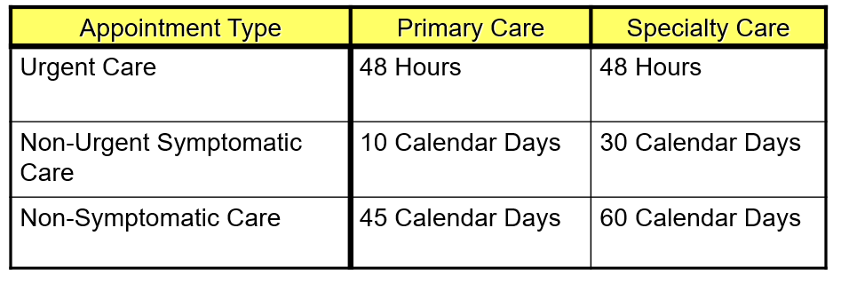
Provider Responsibilities
Wait Time Policies - MH & Clarity Plans

Slide 50
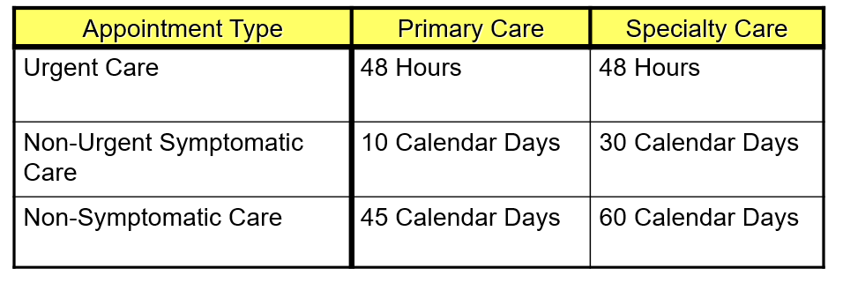
Provider Responsibilities
Wait Time Policies - SCO

Slide 51
Provider Responsibilities
Cultural Competency
The Plan encourages and expects providers to:
  Be aware of cultural differences and the potential impact of those cultural differences
  Acquire cultural knowledge and skills to understand the needs of the populations they serve –
  https://www.wellsense.org/providers/ma/training-and-support
  Ask questions relevant to how the family and culture values might influence the patient’s health care perceptions and needs
  Listen to the patient’s opinion in considering treatment options
  Assist members (such as those with disabilities) in maximizing both their involvement in their care as well as their independence and functioning

Slide 52
Provider Responsibilities
Primary Care Providers
Resources for training on the following topics are available on the Plan’s provider portal and also via Massachusetts Health Quality Partners (MHQP) link:
http://www.mhqp.org/
  Issues concerning adult men and women & regular care they should receive
  Issues of adolescence
  Issues concerning women
  Issues concerning persons with disabilities
  Issues concerning other special populations including homeless, high-risk pregnant women, and children in the care and custody of DCF and youth affiliated DYS

Slide 53
Provider Responsibilities
Adult Prevention Guidelines SCO
Provide awareness and training for Fall Prevention to our SCO members
Falls are the leading cause of injury to the Elder Population. Every 17 seconds an elder will be treated in the ED for a Fall.
Support members by providing awareness &training to your SCO members.
Screen all members for Fall Risk by completing:
A full medication and functional assessment review
A screening for previous Falls to determine member risk
Implement interventions based on Falls Risk
Educate office staff on assessing & documenting previous member Falls, the cause and interventions put in place to prevent future Falls
Evaluate the effectiveness of the Fall Prevention activities through a 30 day follow up
For Adult Preventive Guidelines & a Fall prevention checklist visit this link at the Massachusetts Health Quality Partners website: http://www.mhqp.org/products_and_tools/?content_item_id=169#C9

Slide 54
Behavioral Health Services
Mental Health and Substance Abuse
Integrated Care (Medical and Behavioral Health)
We partner with Beacon Health Strategies to administer our behavioral health program for our members.
Early and Periodic Screening, Diagnosis and Treatment (EPSDT)
Behavioral health screens are a normal and integral part of comprehensive well-child care. Along with MassHealth, we require primary care providers to offer a behavioral health screen to all MassHealth members under age 21 at every well child visit as part of the Early and Periodic Screening, Diagnosis and Treatment (EPSDT) schedule.
Please visit www.wellsense.org, Provider Resources, for a list of resources available, including but not limited to, the PCP Tool Kit or Tips for CBHI Providers working with MCPAP. We also provide a link to the MassHealth-approved screening tools.

Slide 55
Behavioral Health Services
Mental Health and Substance Abuse
Contact Information:
  For MassHealth Members: 888-217-3501
  For Clarity Plans: 877-957-5600
  For SCO Members: 855-833-8125
  For Providers: 866-444-5155
  For Claims: 888-249-0478

Slide 56
Updates and Reminders

Slide 57
Provider Demographic Changes
It is critical to notify us of Provider Demographic Changes timely!
Plan is required to keep provider information up to date and ensure plan online directory is kept current with the most accurate information.
Providers are expected to notify the plan of any provider changes or updates as they occur and regularly, by working with their Provider Consultant to verify their Provider Demographic Rosters.
Demographic changes that you should notify us about include:
  Payment Changes- this affects payments and will delay or interrupt payment if incorrect
  Tax Identification Number or Entity Affiliation change (W-9 required)
  Group Name or Affiliation change
  National Provider Identifier
  Mailing Address change
  Telephone and/or Fax number update
  Termination or Expiration
  Provider updates in Panel Status

Slide 58
How to submit Provider Demographic Changes
Provider changes and updates are critical. Please submit within 60 days of change via the methods below.
Provider/Termination Change Form can be emailed to Provider.ProcessingCenter@BMCHP-WellSense.org. Please include a W9 for remittance changes.
Providers who appear in our directory will receive updates on our progress in rolling out DirectAssure.

Slide 59
Importance of Provider Contacts
To ensure you receive important updates and notices please be sure to keep your contact information up to date with us.
Please reach out to your Provider Relations Consultant to inform us of staff changes in your office to ensure you and they are receiving our important email notifications.
You can also reach us at Provider.Info@bmchp-wellsense.org to request a General Contact Form so we can update your contacts as requested.

Slide 60
EFT Reminder!
Make sure that your provider office takes advantage of Electronic Funds Transfer (EFT), a convenient and efficient option for claims payments.
EFT permits an electronic direct deposit of your WellSense claim reimbursements into the bank that you designate.
Advantages of EFT include:
  Prompt payment – no waiting for checks to clear
  Improved cash flow
  No lost checks or postal delays
  Administrative savings
  Reduced paperwork
  Secure payment environment
For more information about how to enroll in EFT, please call your dedicated Provider Relations Consultant or call the provider line at 888-566-0008.

Slide 61
Change Healthcare Outage
On February 21, 2024, Change Healthcare experienced a disruption to their systems due to a cybersecurity threat.
Due to unexpected events with Change Healthcare, WellSense continues to experience delays in posting PDF versions of electronic remittance advices (ERAs) across all product lines. 835 ERAs aren’t impacted and will be available per our usual schedule. However, if you use Change Healthcare to download your 835 ERAs, you won’t have access to your ERAs until Change Healthcare is back online. Please contact your clearinghouse with any questions and available options.
Providers who weren’t enrolled in EFT payments experienced delays receiving checks. Change Healthcare has resolve the issue and checks will be sent in the next couple of weeks.

Slide 62
EDI Reminder!
Electronic Claim Submission
To expedite payments, we suggest and encourage you to submit claims electronically. Providers can submit claims electronically directly to WellSense through our online portal or via a third party. You can register with Trizetto Payer Solutions or, use the following clearinghouses:
Gateway EDI
NEHEN (New England Healthcare EDI Network)
For more information about how to enroll in EDI, please call your dedicated Provider Relations Consultant or call the provider line at 888-566-0008.

Slide 63
SCO Model of Care – Required Annually
As with all Senior Care Options plan, WellSense’s Model of Care requires that network providers receive annual training and attest on an annual basis.
For the convenience of our providers, we have prepared a short, web-based training module – Senior Care Options Model of Care Training which is available to you through our online portal.
https://www.WellSense.org/providers/ma/training-and-support
At the end of the training you will be asked to click through to attest that you have completed the training. To complete the attestation you must have your NPI number.
If you are a larger group practice, we suggest that you reach out to your Provider Relations Consultant who can assist with coordinating the training and attestation process.

Slide 64
Who are the Plan’s Clinical Vendors?
Beacon Health Strategies
Behavioral Health
Available 24/7 for members and providers.
Manages inpatient and outpatient behavioral health and substance use services, and will be contracting on behalf of the ACO for BH Community Partner services.
Prior authorization may be required for certain services.
Visit: Beacon’s website for more resources or to find a provider
Call Beacon Health Strategies at:
For QHP Members: 1-888-217-3501
For ACO and MCO Members: 1-877-957-5600
For SCO Members: 1-855-833-8125
Northwood
Durable Medical Equipment, Prosthetics, and Orthotics
Manages durable medical equipment, prosthetics, orthotics, and medical supplies (DMEPOS) network.
Prior authorization is required for all DMEPOS dispensed and billed by a DMEPOS supplier.
Visit: Northwood, Inc.
Call: 866-802-6471

Slide 65
Who are the Plan’s Clinical Vendors?
Express Scripts - Pharmacy Benefits
Submit a coverage review request online through one of these ePA portals: Surescripts, CoverMyMeds, or ExpressPAth.
If you do not have access to an ePA system, you may contact Express Scripts to submit your request at 877-417-1822 (for MassHealth members) or 877-417-0528 (for Qualified Health Plan members), or you can submit the General Medication Request Form
eviCore
High End Radiology
Manages outpatient non-emergency high end radiology (MRI, CT, PET, Nuclear Cardiology)
Prior authorization may be required for certain services.
Visit: eviCore (formerly MedSolutions)
Call: 866-802-6471
AxisPoint Health
Nurse Advice Line
Available 24/7 for members
An audio health library of recorded information, by topic, can be accessed through the advice line
Call: 866-763-4695 (ConnectorCare/QHP)
Call: 800-973-6273 (MH)

Slide 66
Important Phone Numbers
MassHealth
&
Clarity Plans
1-888-566-0008
Option 1: Automated Eligibility and/or Claims Status
Option 2: Claims or Provider Enrollment Status
Option 3: Medical Services, Prior Authorizations and Notifications, other than BH & Pharmacy
Option 4: Pharmacy Authorizations & Eligibility, other than Claims Status
Option 5: DME Inquiries including authorization status

Slide 67
Requirement for Network Providers to enroll with MassHealth
Changes in federal law ( set forth at 42 CFR § 438.602) require all managed care entity (MCE) network providers, including BMC HealthNet Plan network providers, to enroll with MassHealth. This means all BMCHP network providers must have two provider contracts in place:
A network provider contract with BMC HealthNet Plan; and
A provider contract with MassHealth.
MassHealth has developed the MassHealth Nonbilling Managed Care Entity (MCE) Network-only Provider Contract for MCE network providers who do not already have a provider contract with MassHealth. This specific MassHealth provider contract does not require the BMCHP network providers to render services to MassHealth fee-for-service members.
Visit https://www.mass.gov/forms/submit-the-masshealth-nonbilling-managed-care-entity-network-only-provider-contract to complete a MassHealth Nonbilling MCE Network-only Provider Contract under this requirement.
Should you have any additional questions please contact your dedicated Provider Relations Consultant or send your inquiry to our Provider Engagement Team at provider.info@bmchp-wellsense.org .

Slide 68
Training Opportunities
Our Provider Engagement Team is here for you!
New or “Refresher” Orientations
HealthTrio Trainings/ “Refreshers”
CPT-HCPCS Look-Up Tool Training
Re-education
Review of Polices and Procedures
General Plan questions
Inquiries on Participation status
Requests to join our Plan
Requests for materials
Initiatives and other exciting ventures

Slide 69

Questions?
Provider Engagement
WellSense Health Plan
Provider.info@bmchp-wellsense.org

