Slide 1
UniCare
Mass Association of Patient Account Mgt
May 25, 2023

Slide 2


UniCare Overview
  UniCare is a health benefits company that administers health care coverage for Massachusetts state employees, retirees, and municipal employees insured by the Group Insurance Commission (GIC).
  UniCare’ s corporate offices are located in Andover, MA.
  UniCare is a Massachusetts company with hundreds of employees who live across Massachusetts and New England.

Slide 3

UniCare Offers Four Plans
Plan | Offered to | Plan type | Pharmacy | Behavioral Health
BASIC Total Choice (as of 7/1/23) | Members who live anywhere in the world (total access) | Indemnity – any provider, without referrals, no matter where the member gets services. | ESI CVS as of 7/1/23 | All UniCare plans provide access to the largest behavioral health network in the nation through Carelon Health Options.
PLUS | Members residing in New England (CT, MA, ME, NH, RI and VT) | Indemnity / PPO-type – network of providers that are “preferred;” coverage and lower costs. | ESI CVS as of 7/1/23
Community Choice | Members residing in MA (not including Martha’s Vineyard or Nantucket) | Indemnity / Limited network – A PPO-type plan with a network of MA hospitals. If you need to use an out of network hospital you still have coverage with higher out of pocket member costs. | ESI CVS as of 7/1/23
Medicare Extension (OME) | Medicare members living anywhere in the U.S. Must be enrolled in Medicare Parts A & B. | Medicare Supplement | SilverScripts
Notes:
Community choice is a lower cost in premiums when utilizing preferred facilities.
A narrow network is a type of health plan that incentives members to receive care through a choice network of doctors, hospitals, outpatient facilities and labs usually in the member’s local community. When you join this plan and these care providers you receive discounts in premiums and co-insurance. Unlike other Narrow Networks where if a member with receives care out of network, you are responsible to pay for the full cost of their care. UniCare’s Community Choice allows you to see out of network providers, and although you have higher out of pocket expense, UniCare pays a substantial portion of the care.

Slide 4
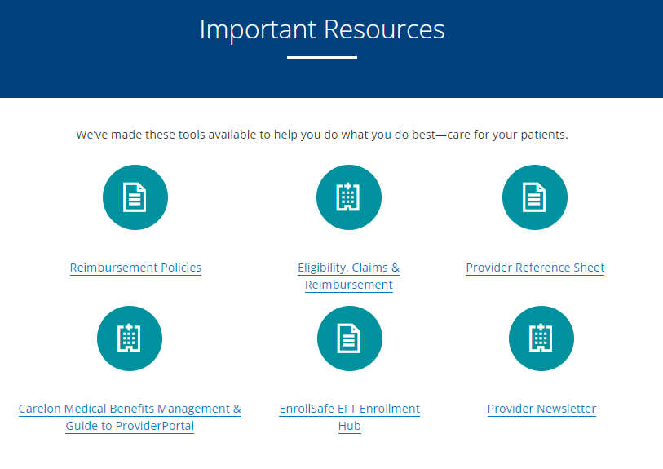
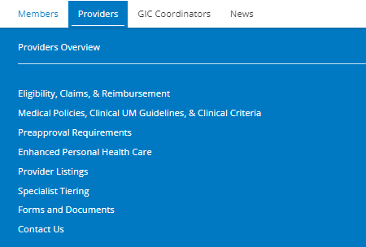
Website Overview
Dedicated Provider Section with the following resources:

Slide 5

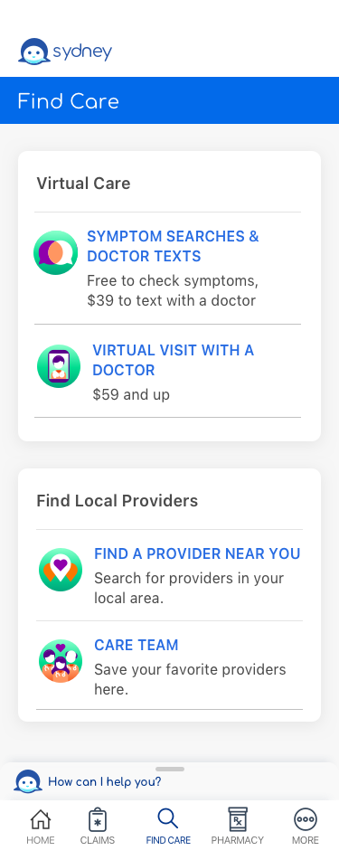
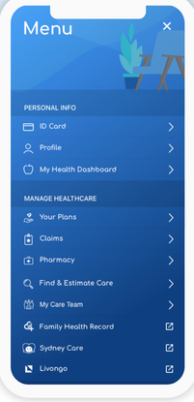
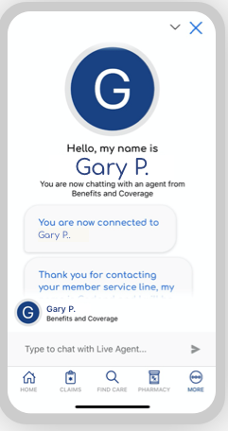
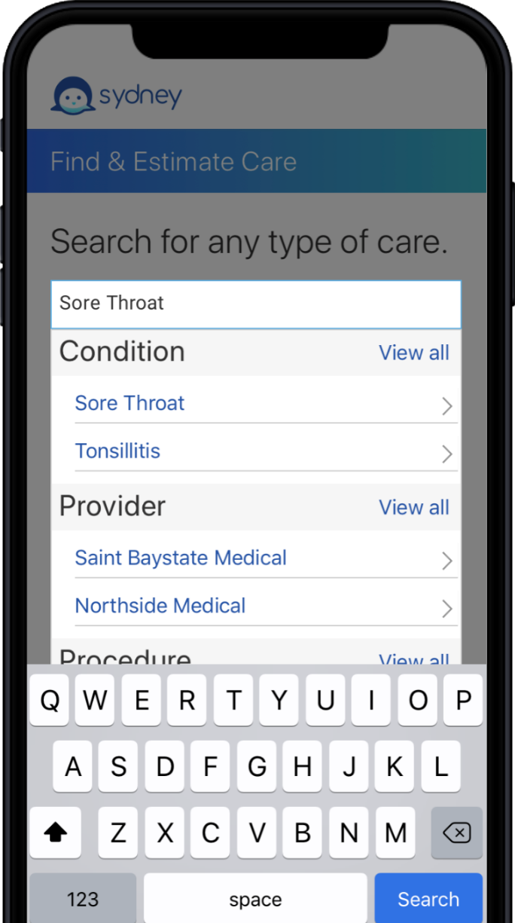
Sydney Health Mobile App
Your personalized, digital health tool
  Live Chat with member services
  Tap to receive a callback from member services
  Send messages through secure message center
  Find doctors, hospitals, labs, and other health care providers in your plan
  Check costs for care
  Access digital ID cards
  See what your plan covers
  Find your deductible, copay and share of costs
  Check your spending account balance
  Access the My Health Dashboard

Slide 6
More Tools & Wellness Resources for UniCare Members
  Website
  unicaremass.com
  The UniCare website has a robust amount of information and resources for members all in one place.
  Explore our health plans, navigate to the Find Care tool and secure member portal login, download plan materials, member handbooks and forms, and submit a form to request printed materials via the mail.
  Find customer service and contact information.
  Member information on our website is also available in Spanish.
  Member Portal
  unicare.com/mass/login
  Login to the secure member portal to access plan materials, reimbursement forms, chat with member services, submit and check claims and more.
  Sign up for direct deposits
Instead of waiting for a check to come in the mail, you can receive your money directly in your bank account by signing up for direct deposit.
Visit our website to learn more.
  Fitness Reimbursement
  Receive reimbursement of up to $100 toward membership at a fitness club or other fitness activities such as yoga and Zumba classes, personal trainers, sports teams, and more.
  Download the reimbursement form on our website.
  Diabetes Prevention Program Reimbursement
  Receive reimbursement of up to $500 when you complete 20 or more sessions in an approved diabetes prevention program.
  Download the reimbursement form on our website.
  Special Offers / Discounts
  Get discounts on many health-related products and services, like programs for weight management, stress reduction, baby items, glasses, pet care, and more.
  Log in to the secure member portal to view Special Offers.
  Smoking Cessation
  Counseling for tobacco dependence/smoking cessation is covered up to a limit of 300 minutes per plan year. It is reimbursed up to the Plan's allowed amount.
  Find details in your member handbook.

Slide 7
Notification Process
UniCare requires notification for certain procedures and services, to determine eligibility for benefits. See our
Provider Reference Sheet for the list of these procedure and who to contact for review.
Contact Carelon directly for services they will be reviewing (such as echocardiography and high-tech imaging):
  By phone: 866-766-0247 or via
  Provider portal: https://www.careloninsights.com/provider-resources
Services remaining under UniCare review:
  Call 800-442-9300 or Fax information to 877-745-8636
Contact Express Scripts for most specialty drug questions or patient-related pharmacy questions: 1-855-283-7679 (toll free)
Behavioral Health Authorizations: Carelon is continuing to do the authorizations for BH and Substance Abuse services. They have a new ProviderConnect system.
  https://www.valueoptions.com/pc/eProvider/providerLogin.do
Carelon has a dedicated EDI Helpdesk for direct support with ProviderConnect:
  Phone: 888-247-9311 8 a.m. to 6 p. m. EST
  E-mail: e-supportservices@beaconhealthoptions.com

Slide 8
Claims
UniCare accepts electronic claims submission from clearinghouses or via direct submission. The electronic Payor ID number for the UniCare State Indemnity Plan is 80314.
Direct submissions for claims – You can submit claims direct to UniCare via Availity.com. Register for Availity at availity.com and follow the prompts.
For more details, see our website at:
unicarestateplan.com>Providers>Electronic Claims Filing

Slide 9
Appeal Rights
Appeals for reconsideration of a denial by Managed Care department must be filed by telephone or in writing. All supporting documentation must be received within 3 business days of when the denial was received.
Appeals for claims reconsideration must be received by UniCare within 180 days of when the determination was made.
Send appeal requests and supporting documentation to:
UniCare State Indemnity Plan
P. O. Box 2011
Andover, MA 01810
Fax: 978-474-5179 (Managed Care)

Slide 10

Provider Rosters
Accurate provider data is key to effective
provider transactions and communication.
Roster updates are completed to note provider changes in your group and reflect the updates in our system.
Practices must notify UniCare when a provider leaves or joins their group.
Requests to change financial addresses must be submitted in writing with a W-9 form.

Slide 11


Credentialing
About UniCare’s Credentialing Department
UniCare requires CAQH for providers who participate in the UniCare network. We follow the National Committee of Quality Assurance (NCQA) standards.
UniCare has designated delegated providers. The organization/delegate submits credentialed provider data to UniCare for addition to the network
For more information contact us at:
Phone: (800) 516-7587
Fax: (978) 474-6188
unicareproviderrelations@anthem.com

Slide 12

Provider Tools and Resources
Visit unicarestateplan.com > Provider Tab
Plan resources include:
  Medical and reimbursement policies
  Member handbooks
  Notification requirements
  Physician Listing with tier levels
  for specialists
  Electronic claims filing
Availity:
  Web portal: Verify eligibility, check and submit claims
  Availity Client Services 1-800-282-4548 M-F 8:00 to 7:30 EST.

Slide 13
Contact Us
Provider Relations 800-480-7587
  unicareproviderrelations@anthem.com
  This mailbox is checked daily to ensure a timely response to your requests. Use this mailbox to submit changes (including roster updates), data sheets, demographic updates, terminations, and other inquiries
Customer Service 800-442-9300

Slide 14



Follow us on social media for health tips and real-time updates from UniCare
UniCare State Indemnity Plan
facebook.com/UniCareMA
UniCare State Indemnity Plan
linkedin.com/company/unicarema
UniCare State Indemnity Plan
@UniCareMA

Slide 15
Our customer service team is always here to help.
800-442-9300
Call us Monday to Friday from 8am – 6pm
OR
Live Chat with member services via the Sydney Health mobile app.
Download Sydney at sydneyhealth.com
Send us a message through the secure message center in the member portal.
Log in at unicare.com/ma/login

Slide 16
Appendix

Slide 17
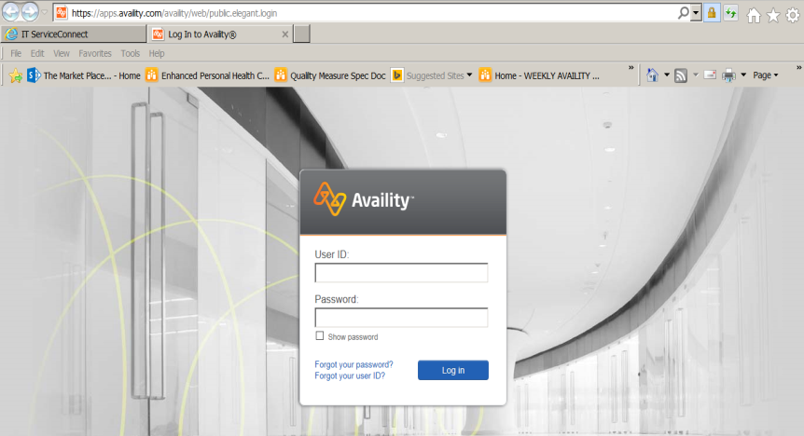
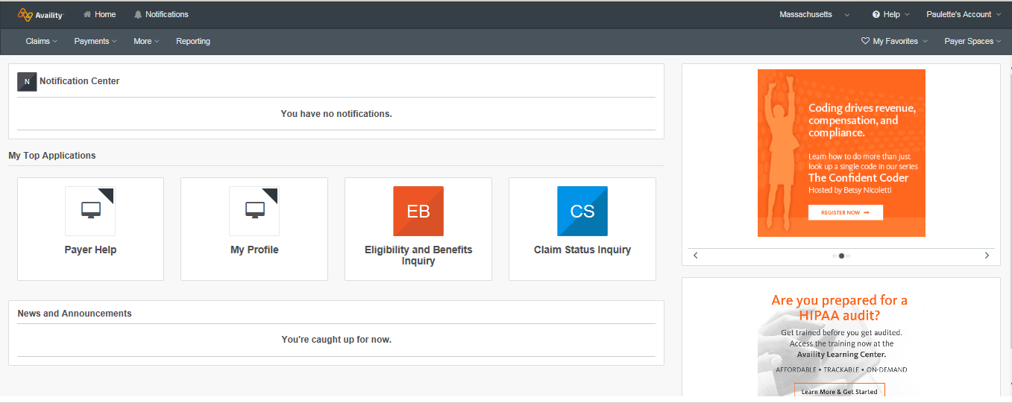
How do I Register for Availity
Registration is easy. Go to www.availity.com and
choose Register; then select Let’s get started.

Slide 18
What makes UniCare the best choice?
GIC-dedicated – The only health plan offering benefits exclusively to GIC members for 35 years.
No PCP requirement – Members do not have to choose a PCP (though it’s a good idea).
No referrals – UniCare members do not need a referral to see a specialist. Preapproval is needed for certain services.
No balance billing in MA – State law protects members from being balanced billed by Massachusetts medical providers.
Using contracted providers – Some UniCare plans have higher benefits and lower costs when members use certain providers. It’s our job to educate the members about how their choice of provider impacts their out-of-pocket costs and plan selection.
Comprehensive network – Members can use any provider, benefits vary depending on which providers they use and the provider’s contract status.
National provider network outside of MA – Using providers in the national network protects members from balance billing when getting care in another state.
Premiums – UniCare (PLUS and Community Choice) has lower premiums than it’s competitors. However we encourage associates to refer any questions regarding premiums to the GIC.
Tiering – UniCare offers a tier free plan – Total Choice. This is the biggest difference between PLUS and Total CHOICE, e.g. no provider tiers
Customer Service – Our Customer Service team are your health guides. They advocate on your behalf. They will take the lead when you need help so you can sit back and relax knowing all your concerns are being taken care of.
  They will alert you if you’re overdue on any preventive services. Or if you’re eligible for a service due to age/gender/medical history.
  Help you with extra services such as member portal or our member app – Sydney.
  Customer Service will help you find physicians who are accepting new patients and help schedule appointments. Calling dr. offices on your behalf, to settle a bill or help obtain prior authorization.
  Customer Service’s goal is to help the member be taken out as the middleman, and advocate on the member’s behalf.
  Customer Service is available via chat, email and telephone.

Slide 19
Commercial plans
Options!– UniCare offers three different plans for commercial (non-Medicare) members. The best plan depends on where a member lives, which providers they use, and how much premium they’re comfortable paying.
Total Choice (formerly Basic) – This plan allows you the freedom to choose any medical provider and any hospital – the out-of-pocket cost to the member stays the same. Subscribers must live in New England or can live Internationally (outside of the US), however the subscriber can have dependents (students, spouse, etc) that live outside of New England.
PLUS – PLUS keeps out-of-pocket costs lowest when members use PLUS providers. All medical providers and hospitals in Massachusetts are PLUS providers. All UniCare-contracted doctors and hospitals in the other New England states are also PLUS providers. Subscribers must live in New England, however they can have dependents that live out of New England.
Community Choice – The GIC’s lowest premium health plan. Non-hospital services are covered the same with all medical providers. Costs for hospital services are lowest at Community Choice hospitals. Members pay more out-of-pocket when getting hospital services at non-Community Choice hospitals. Subscribers and their dependents must live in Massachusetts (excluding Martha’s Vineyard/Nantucket).

Slide 20
FY 24 Benefit Summary by Product
 | Basic/ Total Choice | PLUS | Community Choice
Deductible (individual / family) : | $500 / $1,000 | $500 / $1,000 | $500 / $1,000
Maximum out-of-pocket (individual / family) : | $5,000 / $10,000 | $5,000 / $10,000 | $5,000 / $10,000
Primary care provider (PCP) office visit : | $20 | $10 / $20 / $40 | $20
Specialist office visit (Tier 1/ Tier 2/ Tier 3) | $45 | $30 / $60 / $75 | $30 / $60 / $75
Preventive care : | No member cost | No member cost | No member cost
Inpatient hospital care : | $275 copay and deductible (maximum 4 per plan year) | $275 / $500 / $1500 (maximum 4 per plan year) | copay and deductible (maximum 4 per plan year)
Eye and GI at Outpatient surgery @ a freestanding location (non‑hospital‑owned) : | $150 copay and deductible (maximum 4 per plan year combined) | $150 copay and deductible (maximum 4 per plan year combined) | $150 copay and deductible (maximum 4 per plan year combined)
Outpatient surgery @ a hospital or hospital-owned location : | $250 copay and deductible(maximum 4 per plan year combined) | $250 copay and deductible (maximum 4 per plan year combined) | $250 copay and deductible (maximum 4 per plan year combined)
Outpatient surgery @ a freestanding location (non‑hospital‑owned) : | $250 copay and deductible (maximum 4 per plan year combined) | $250 copay and deductible (maximum 4 per plan year combined) | $250 copay and deductible (maximum 4 per plan year combined)

