Slide 1
MAPAM 2022
Boston Medical Center HealthNet Plan

Slide 2
Topics
BMCHP Overview
My HealthNet
Brand Change
Updates and Reminders
  Provider Demographics
  Provider Contacts
  Senior Care Options – Model of Care
  Special Kids Special Care
Questions

Slide 3
BMCHP Overview

Slide 4
Who We Are…
BMCHP is a non-profit managed care organization committed to providing the highest quality healthcare coverage to underserved populations.
We operate in MA and NH
  MassHealth (including ACO)
  MA Qualified Health Plan which includes ConnectorCare
  MA Senior Care Options*
    *Available in these counties: Barnstable, Bristol, Hampden, Plymouth & Suffolk
  WellSense Health Plan
ACOs are provider-led organizations that coordinate care, have an enhanced role for primary care, and are rewarded for value – improving total cost of care and outcomes – not volume
The primary focus is on improving patient outcomes by:
  Promoting healthy behaviors
  Expanding population health management programs, and
  Improving data exchange between payers and providers

Slide 5
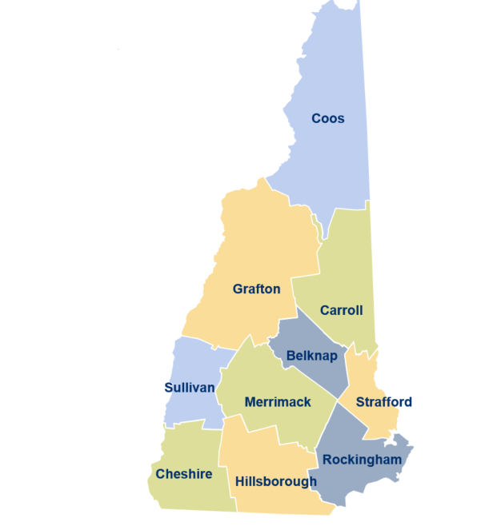



Our Member And Provider Network
Massachusetts
New Hampshire
94,290 members across the state
17,900 primary care, specialists & behavioral health providers
Community resources

Slide 6
BMCHP MassHealth Plans include:
BMCHP MassHealth MCO – Primary Care within the BMCHP MCO Network
BMCHP Community Alliance ACO – Primary Care within the BMCHP Community Alliance ACO Network.
BMCHP Mercy Alliance ACO – Primary Care within the BMCHP Mercy Alliance ACO Network.
BMCHP Signature Alliance ACO – Primary Care within the BMCHP Signature Alliance ACO Network.
BMCHP Southcoast Alliance ACO – Primary Care within the BMCHP Southcoast Alliance ACO.
BMCHP’s full network of MassHealth contracted facilities, specialists and ancillary services is available for all above Plans

Slide 7
Additional BMCHP Plans include:
ConnectorCare – BMCHP’s full network of ConnectorCare contracted facilities, primary care, specialists and ancillary services is available.
Qualified Health Plans - BMCHP’s full network of Qualified Health Plan contracted facilities, primary care, specialists and ancillary services is available.
Senior Care Options - BMCHP’s full network of Senior Care Options contracted facilities, primary care, specialists and ancillary services is available.

Slide 8











Find a participating Doctor, Hospital, or Pharmacy by visiting the BMCHP Provider Directory:
https://www.bmchp.org/utility-nav/find-a-provider

Slide 9
Member ID Numbers – MH ACO’s
ACO Member ID’s have number sequencing according to the ACO they are assigned:
ACO | Prefix | ID Numbering Scheme (note: the 00 is the suffix for all Subscribers and will be on the ID Card)
COMMUNITY ALLIANCE | 2 | 2#########00
MERCY ALLIANCE | 3 | 3#########00
SIGNATURE ALLIANCE | 4 | 4#########00
SOUTHCOAST ALLIANCE | 5 | 5#########00

Slide 10
Member ID Numbers – MCO, QHP & SCO
Member ID sequencing for MCO, QHP & SCO
 | Prefix | ID Numbering Scheme (note: the 00 is the suffix for all Subscribers and will be on the ID Card)
Masshealth MCO | 2 | B#########00
Qualified Health Plan | 3 | C#########00
Senior Care Options | 4 | 1#########00

Slide 11
Member Eligibility
MH (including ACO): By accessing the Masshealth website: @ gateway.hhs.state.ma.us/authn/login.do
BMC HealthNet Plan: Secure Provider Portal: www.BMCHP.org via My HealthNet or 1-888-566-0008 (most accurate method of verification for ConnectorCare/QHP members)
ConnectorCare/QHP: BMC HealthNet Plan: Secure Provider Portal: www.BMCHP.org via HealthTrio or 1-888-566-0008 (most accurate method of verification for ConnectorCare/QHP members)
Senior Care Options: BMC HealthNet Plan: Secure Provider Portal: www.BMCHP.org via HealthTrio or 888-566-0008
*****Important Note*****
SCO Members - Eligibility for SCO members changes on the first of the month, however we still recommend that you verify eligibility prior to the date of service. Member panel reports are not an accurate method for verifying eligibility. These reports are only intended to inform you of the member’s assigned to your panel.
ConnectorCare/QHP - For ConnectorCare/QHP Members you are not able to verify eligibility via EVS, you must verify eligibility with the QHP Plans directly
Please check member eligibility on the date of service before delivering services and daily for inpatient admissions

Slide 12
My HealthNet

Slide 13


BMC HealthNet - My HealthNet.
We've launched our improved Provider Portal, MyHealthNet! Based on provider feedback, we've enhanced features to help make your job easier. Check out our new homepage to access top time-saving features. When you log-in, be on the look-out for:
1) Improved Claims Process: Providers can submit corrected claims, appeals, COB, EOB, and TPL review requests online and get reimbursed faster.
2) Streamlined Authorization Process: Our submission process is now more intuitive and allows providers to upload supporting documentation to their requests.

Slide 14

BMC HealthNet - My HealthNet.
Our Provider Portal is your one stop place to:
Check Eligibility
Submit Claims
Check Claims Status(now mandated)
Submit Appeals and Corrected Claims
Prior Authorization submissions and status inquires
Provider Relations is here to train you on utilizing the Provider Portal to its fullest potential. Please reach out if training is needed in your office or if you need secure access.

Slide 15

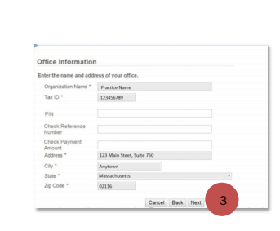
For providers who do not have an existing HealthTrio Connect account
On the home page of the portal, under PLEASE SIGN IN, click Provider Registration.
On the User Information page, fill in all fields and click Next
On the Office Information page, fill in the information as requested and click Next.
On the Registration Summary page, verify information and click Finish.
Once registration is complete, all those registered from your provider office by the office administrator will be listed in a screen as pictured to the right.
If you do not have an account set up, please contact your designated office administrator.

Slide 16
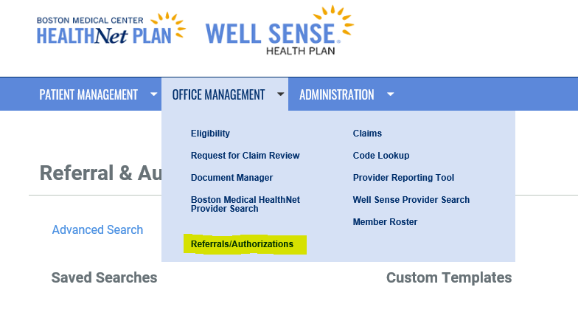
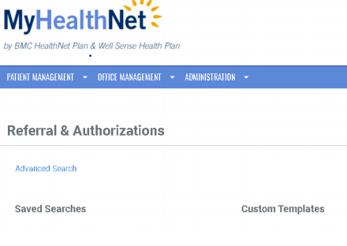
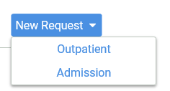
Authorization Submissions – Please submit online
PA Submissions via the Portal vs. Paper – High area of focus for the Plan
Streamlined Process
Reduces paper, time and resources, resulting in efficiency.
Ability to check the status of your submitted request online
Faster & more secure than faxing
Submissions via the portal to be mandated in the future, become acquainted now!

Slide 17
Brand Change

Slide 18

Big News! Upcoming Brand Change
In May, BMC HealthNet Plan will be rebranding and renaming to better reflect our growth and statewide reach, so we'll be known as Wellsense Health Plan.
We look forward to continuing to work with you as a valued partner for the health of our shared members and patients under this new identity.
More information and training regarding the impacts that our rebranding may have on your practice is coming your way over the next few months.
In the meantime, please be aware that re-contracting is not required and we will not have any changes to our remit ID, address, policies, contacts and company phone numbers.

Slide 19
Updates And Reminders

Slide 20
BMC HealthNet - Demographic Changes
It is critical to notify us of Provider Demographic Changes
Plan is required to keep provider information up to date and ensure plan online directory is kept current with the most accurate information.
Providers are expected to notify the plan of any provider changes or updates as they occur and regularly, by working with their Provider Consultant to verify their Provider Demographic Rosters.
Demographic changes that you should notify us about include:
  Payment Changes- this affects payments and will delay or interrupt payment if incorrect
  Tax Identification Number or Entity Affiliation change (W-9 required)
  Group Name or Affiliation change
  National Provider Identifier
  Mailing Address change
  Telephone and/or Fax number update
  Termination or Expiration
  Provider updates in Panel Status
Provider/Termination Change Form can be emailed to Provider.ProcessingCenter@BMCHP-wellsense.org. Please include a W9 for remittance changes.
Providers who appear in our directory will receive updates on our progress in rolling out DirectAssure.

Slide 21
BMC HealthNet - Provider Contacts
To ensure you receive important updates and notices please be sure to keep your contact information up to date with us.
Please reach out to your Provider Relations Consultant to inform us of staff changes in your office to ensure you and they are receiving our important email notifications.
You can also reach us at Provider.Info@BMCHP-wellsense.org to request a General Contact Form so we can update your contacts as requested.

Slide 22
BMC HealthNet – EFT Reminder
Make sure that your provider office takes advantage of Electronic Funds Transfer (EFT), a convenient and efficient option for claims payments.
EFT permits an electronic direct deposit of your BMC HealthNet Plan claim reimbursements into the bank that you designate.
Advantages of EFT include:
  Prompt payment – no waiting for checks to clear
  Improved cash flow
  No lost checks or postal delays
  Administrative savings
  Reduced paperwork
  Secure payment environment
For more information about how to enroll in EFT, please call your dedicated Provider Relations Consultant or call the provider line at 888-566-0008.

Slide 23
BMC HealthNet – EDI Reminder
Electronic Claim Submission
To expedite payments, we suggest and encourage you to submit claims electronically. Providers can submit claims electronically directly to BMC HealthNet Plan through our online portal or via a third party. You can register with Trizetto Payer Solutions or, use the following clearinghouses:
Gateway EDI
NEHEN (New England Healthcare EDI Network)
For more information about how to enroll in EDI, please call your dedicated Provider Relations Consultant or call the provider line at 888-566-0008.

Slide 24
BMC HealthNet – SCO Model of Care – (Required)
As with all Senior Care Options plan, BMC HealthNet Plan’s Model of Care requires that network providers receive annual training and attest on an annual basis.
For the convenience of our providers, we have prepared a short, web-based training module – Senior Care Options Model of Care Training which is available to you through our online portal.
https://www.bmchp.org/I-Am-A/Provider/Training-and-Support
At the end of the training you will be asked to click through to attest that you have completed the training. To complete the attestation you must have your NPI number.
If you are a larger group practice, we suggest that you reach out to your Provider Relations Consultant who can assist with coordinating the training and attestation process.

Slide 25
Special Kids Special Care (SKSC)
MassHealth and the Department of Children and Families (DCF) co-sponsor the Special Kids Special Care (SKSC) medical program for children in foster care with special health care needs
BMC HealthNet Plan was selected to provide to the SKSC MH Population
Plan types include MassHealth Standard, Standard Disabled, and MassHealth CommonHealth
SKSC members have access to the same medical benefits as BMCHP’s MCO and ACO members and in addition can be seen by Private Duty Nurses.
The SKSC program includes dedicated Pediatric Nurse Practitioners (PNP) and Pediatric Nurse Managers who develop a plan of care and arrange the delivery of care for each qualified program participant.
Collaboration of care may take place between the PCP, specialists and other health care providers in addition to DCF, the foster family guardians and birth parents.
Care and services can be rendered in the member’s home, doctor’s office, hospital, outpatient facility, day care center or school.
Per MassHealth guidelines, PCPs may contract with BMCHP to provide primary care services to these members regardless of the PCP participation with other MassHealth managed care plans or participation in any ACO.

Slide 26
Who are the Plan’s Clinical Vendors?
Beacon Health Strategies Behavioral Health | Available 24/7 for members and providers. Manages inpatient and outpatient behavioral health and substance use services, and will be contracting on behalf of the ACO for BH Community Partner services. Prior authorization may be required for certain services. Visit: Beacon’s website for more resources or to find a provider Call Beacon Health Strategies at: For QHP Members: 1-888-217-3501 For ACO and MCO Members: 1-877-957-5600 For SCO Members: 1-855-833-8125
Northwood Durable Medical Equipment, Prosthetics, and Orthotics | Manages durable medical equipment, prosthetics, orthotics, and medical supplies (DMEPOS) network. Prior authorization is required for all DMEPOS dispensed and billed by a DMEPOS supplier. Visit: Northwood, Inc. Call: 866-802-6471

Slide 27
Who are the Plan’s Clinical Vendors?
Express Scripts Pharmacy Benefits | Submit a coverage review request online through one of these ePA portals: Surescripts, CoverMyMeds, or ExpressPAth. If you do not have access to an ePA system, you may contact Express Scripts to submit your request at 877-417-1822 (for MassHealth members) or 877-417-0528 (for Qualified Health Plan members), or you can submit the General Medication Request Form
eviCore High End Radiology | Manages outpatient non-emergency high end radiology (MRI, CT, PET, Nuclear Cardiology) Prior authorization may be required for certain services. Visit: eviCore (formerly MedSolutions) Call: 866-802-6471
AxisPoint Health Nurse Advice Line | Available 24/7 for members An audio health library of recorded information, by topic, can be accessed through the advice line Call: 866-763-4695 (ConnectorCare/QHP) Call: 800-973-6273 (MH)

Slide 28
Claims and Filing Limits
To expedite payment, we strongly encourage you to submit claims electronically and only submit paper claims when necessary
Filing Limits:
  MassHealth (including ACO) 150 days
  ConnectorCare/QHP 90 days
  Senior Care Options 150 days
  *Coordination of Benefits and other party liability rules apply
Electronic Claims:
  BMC HealthNet Plan has partnered with TriZetto Provider Solutions (TPS) to manage our electronic data interchange (EDI) transactions exclusively. All clearinghouse service organizations and billing agencies that submit EDI transactions must send through TPS.
Paper Claims Mailing Address: Boston Medical Center HealthNet Plan
P.O. Box 55282
Boston, MA 02205-5282
Professional Claims can also be submitted via our Online Portal @ BMCHP.org via MyHealthNet

Slide 29
Requirement for BMCHP network provider to enroll with MassHealth
Changes in federal Medicaid law (set forth at 42 CFR § 438.602) require all managed care entity (MCE) network providers, including BMCHP network providers, to enroll with MassHealth. This means all BMCHP network providers must have two provider contracts in place: (1) a network provider contract with [MCE/Vendor]; and (2) a provider contract with MassHealth.
MassHealth has developed the MassHealth Nonbilling Managed Care Entity (MCE) Network-only Provider Contract for MCE network providers who do not already have a provider contract with MassHealth. This specific MassHealth provider contract does not require BMCHP network providers to render services to MassHealth fee-for-service members.
• Visit https://www.mass.gov/forms/submit-the-masshealth-nonbilling-managed-care-entity-network-only-providercontract to complete a MassHealth Nonbilling MCE Network-only Provider Contract under this requirement within 30 days of receiving confirmation of your BMCHP enrollment.

Slide 30

Questions?
Thank you!
Provider Relations
Provider.Info@bmchp-wellsense.org

