Slide 1
Annual 2022 MAPAM Insurance Session

Slide 2
Agenda
Introductions
Working with Health New England
  ID cards
  Public Site (healthnewengland.org)
  Provider Matters
  Specialty Partners
  Provider Portal (hnedirect.com)
  Provider Manual
  Prior Authorization
  Telehealth
  Claims Editing Rules
  CMS Editing Edit
  Appeals
Vendor Partnerships
Medicare Supplement Plan
Key Contacts
Questions

Slide 3
Introductions
Mary Humel
Senior Provider Relations Representative
ProviderRelations@hne.com
800-842-4464 Ext 5000
Mary Santiago
Senior Provider Relations Representative
ProviderRelations@hne.com
800-842-4464 Ext 5000

Slide 4
Working with Health New England

Slide 5
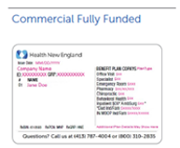
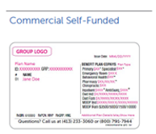
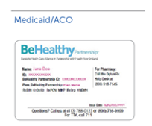
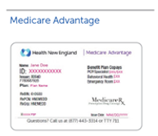
Health New England ID Cards

Slide 6
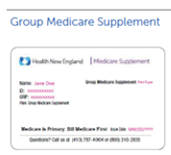
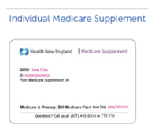
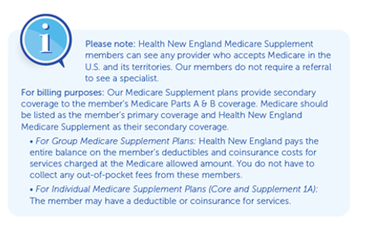
Health New England ID Cards

Slide 7
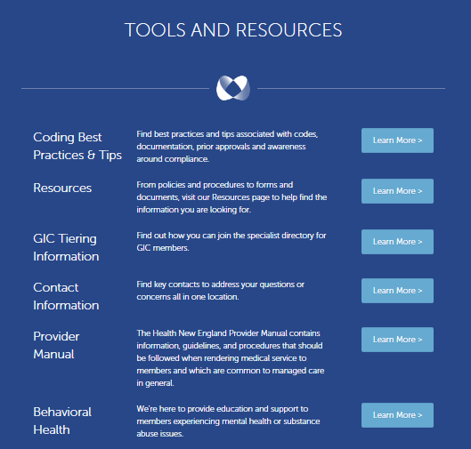
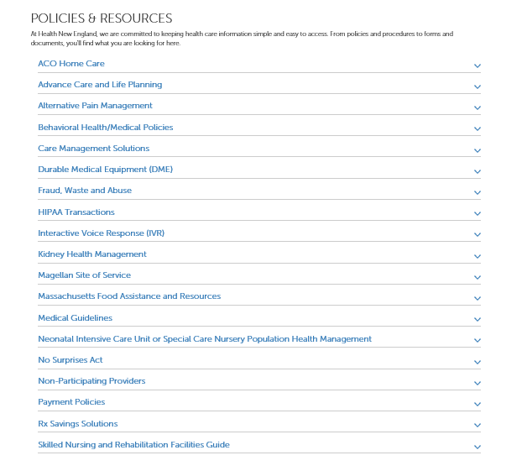
Public Site: http://healthnewengland.org/provider

Slide 8
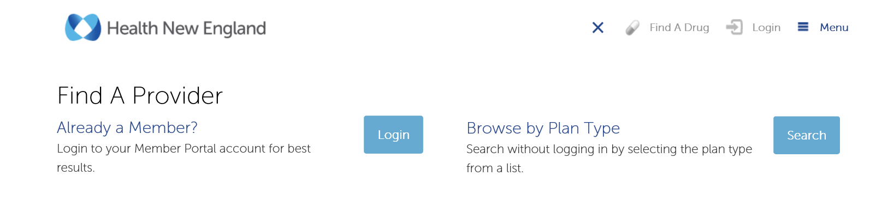
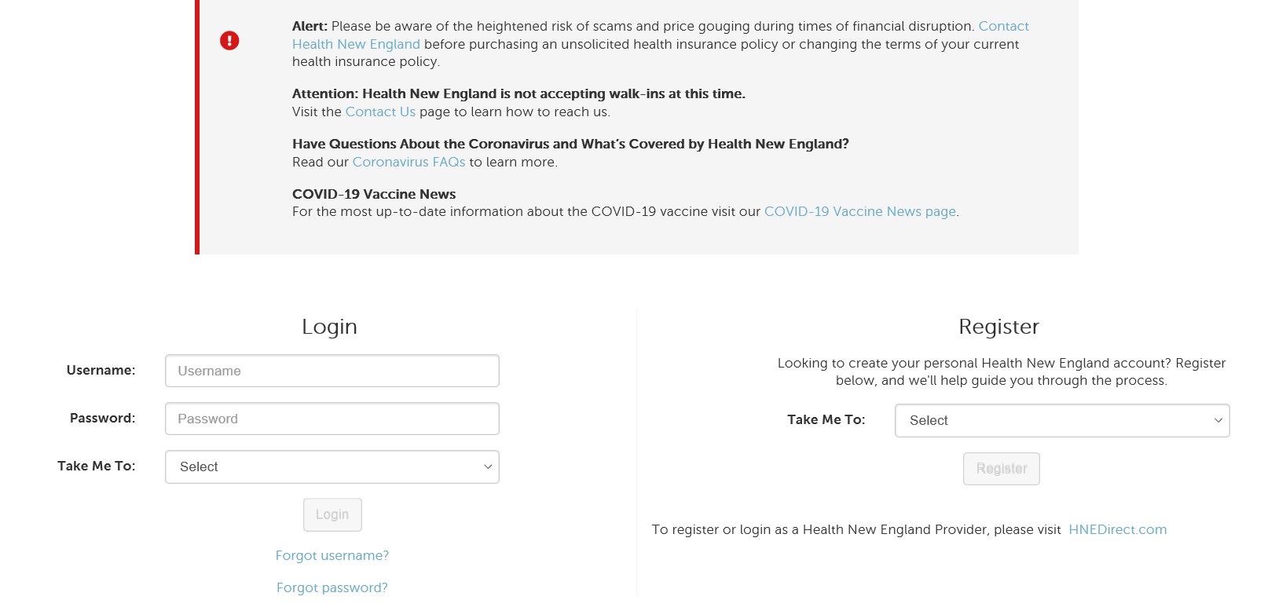
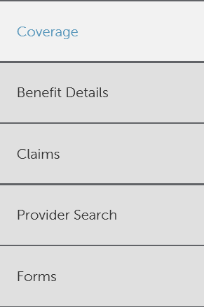
Public Site: (Provider Search) http://healthnewengland.org/provider
Click at Top: Find A Provider
“Already a Member?” Option: allows a Member to search for a provider within their protected portal. Easy links to PHCS/Multiplan

Slide 9
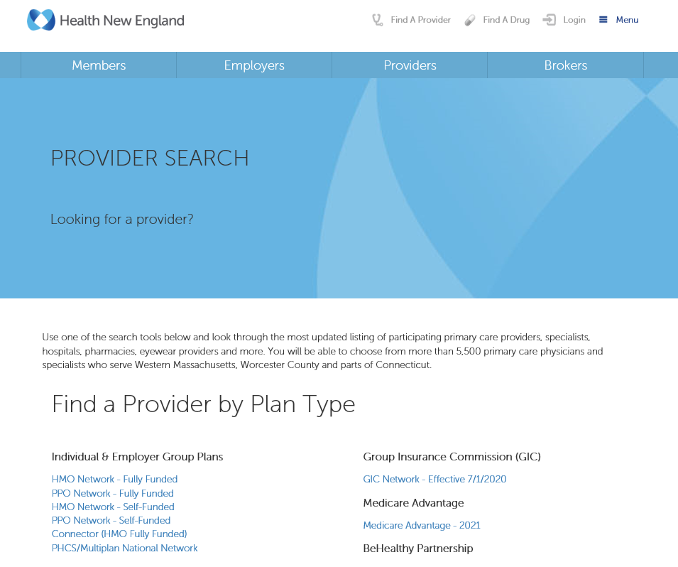
Public Site: (Provider Search) http://healthnewengland.org/provider
Click at Top: Find A Provider
“Browse by Plan Type” Option: allows anyone to assist a Member in finding a provider in the Health New England network. Search by plan type

Slide 10
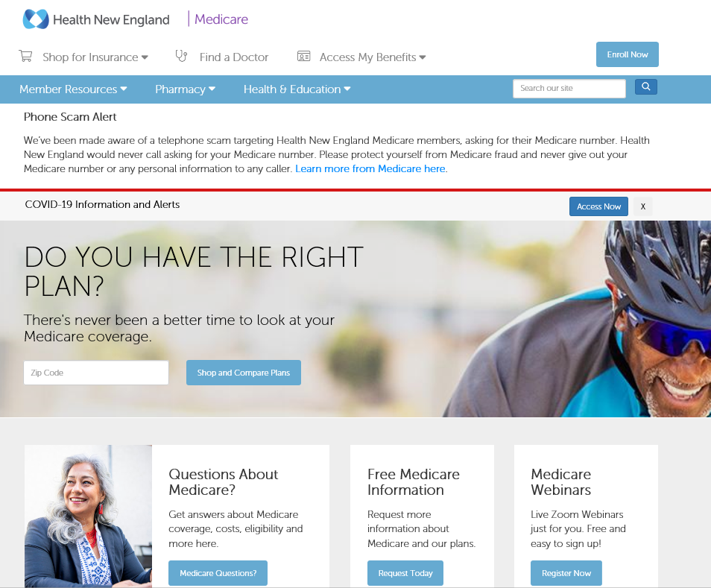
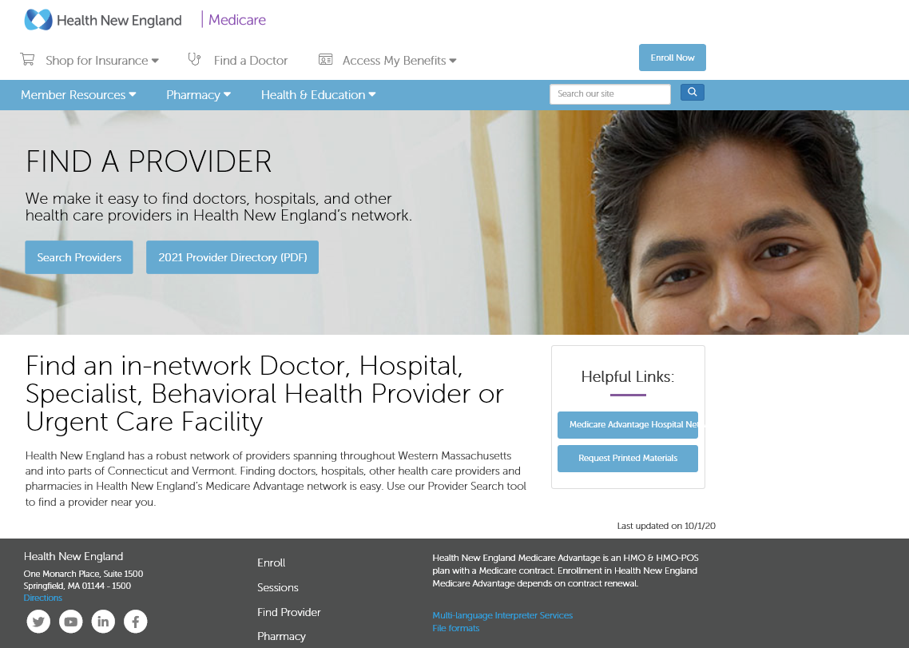
Public Site: (Provider Search/Medicare) http://healthnewengland.org/medicare
Click: Find a Doctor at the top and the site will help you find the provider of your choice.

Slide 11
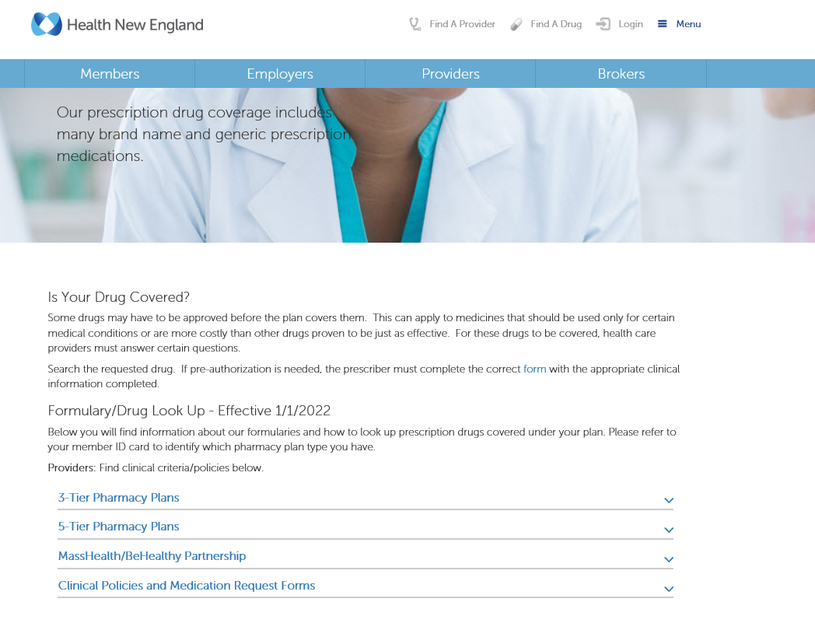
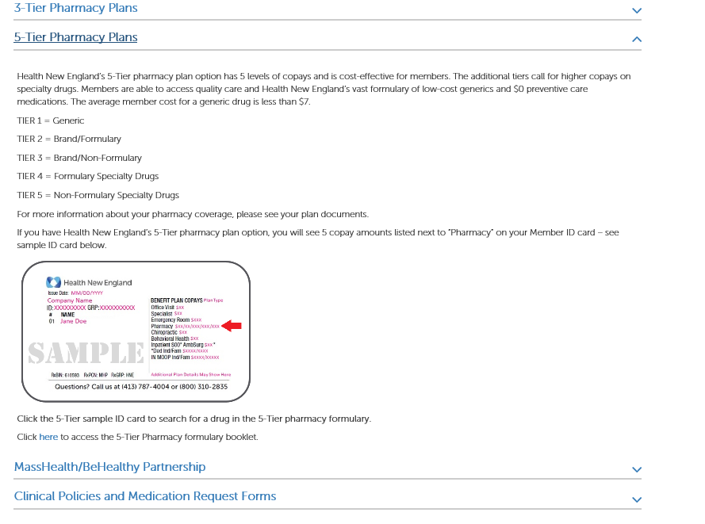
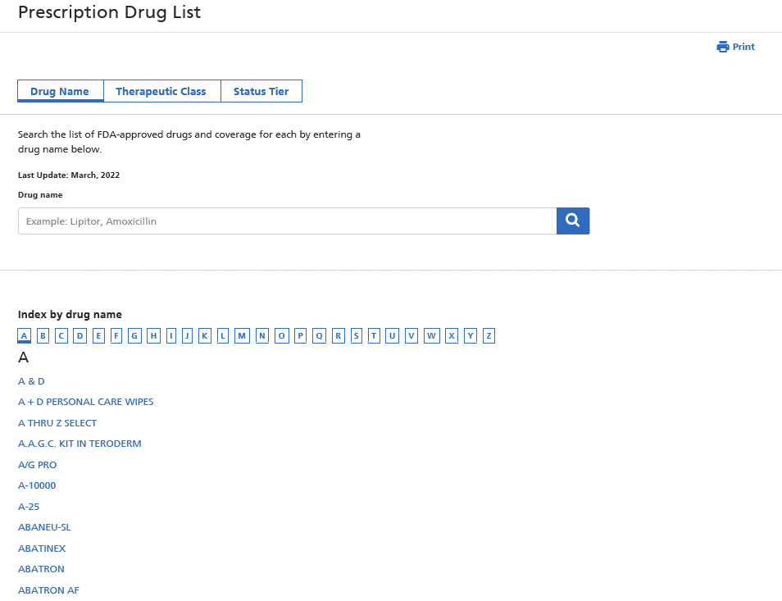
Public Site: (Pharmacy) http://healthnewengland.org/provider
1. Click at top: Find a Drug
3. Click ID card to search formulary
Searchable Prescription Drug List
2. Click appropriate tier pharmacy plan

Slide 12
Public Site: (Pharmacy/Medicare) http://healthnewengland.org/medicare/pharmacy/find-a-pharmacy

Slide 13
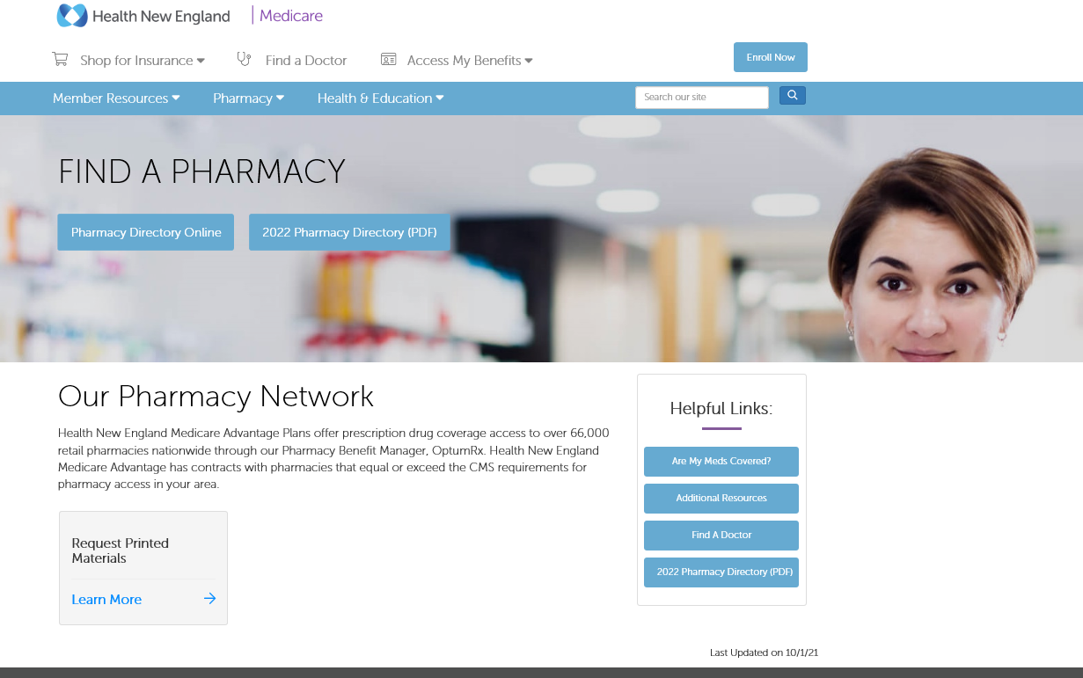
Public Site: (Pharmacy/Medicare) http://healthnewengland.org/medicare/pharmacy/find-a-pharmacy

Slide 14
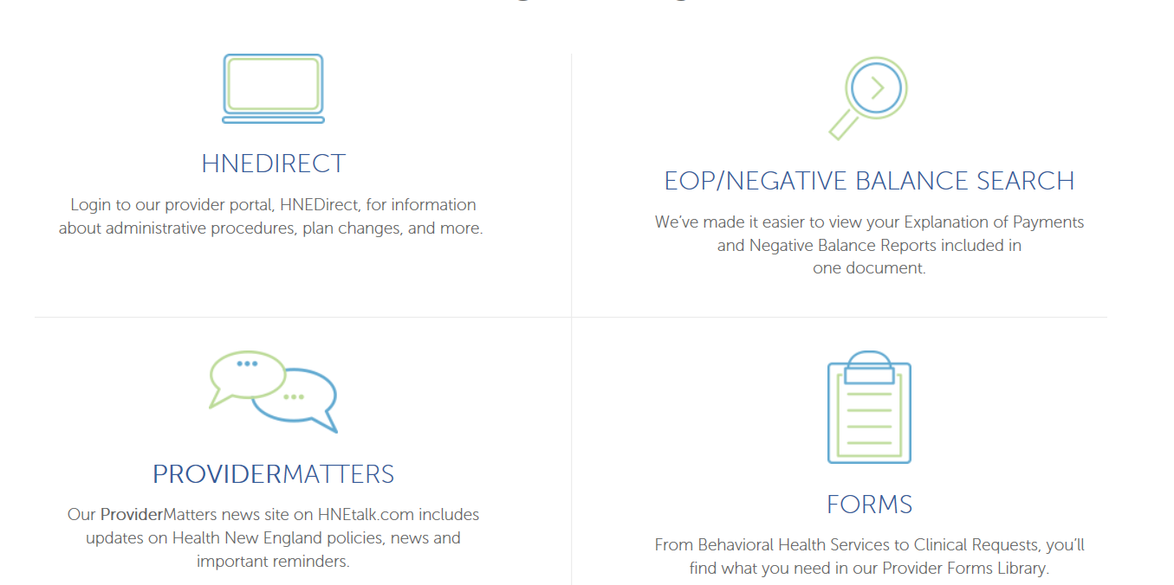
ProviderMatters
You can get to ‘Provider Matters’ at our public site, http://healthnewengland.org/provider

Slide 15
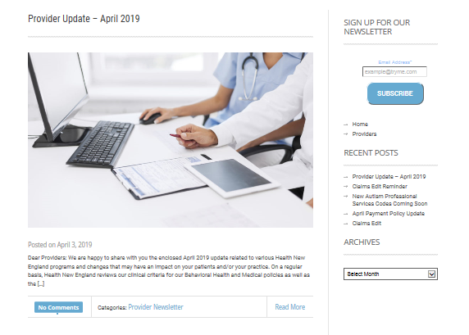
ProviderMatters
ProviderMatters, which allows providers to receive an email notification when important information is added, such as:
New HNE Products and Services
HNE/Industry News and Information
Notice of Policy Changes
Pharmacy Updates
Policy/Administrative Reminders
Semi-Annual Notice of Benefit Changes

Slide 16
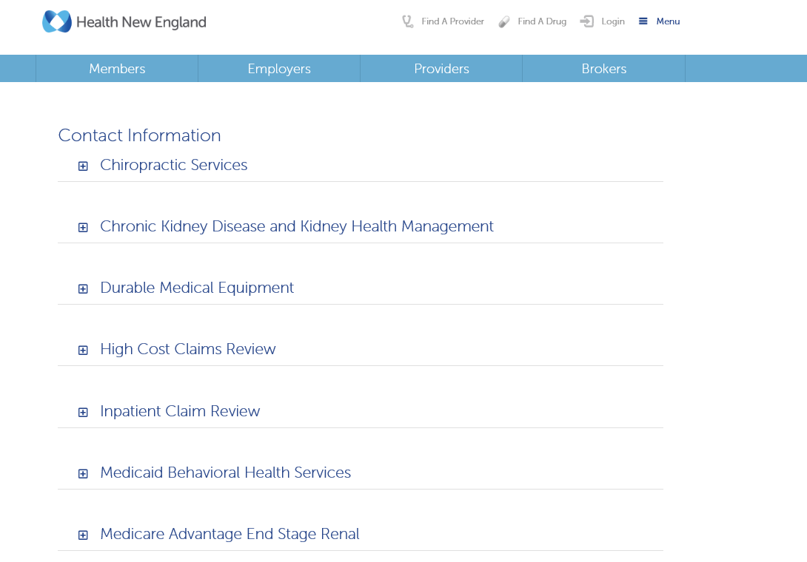
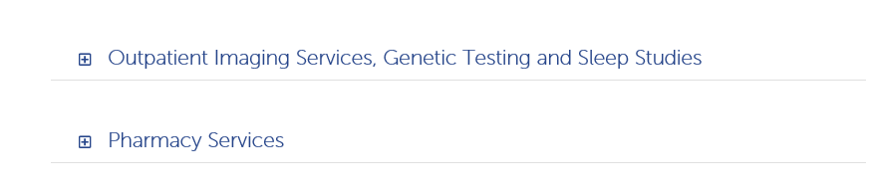
Health New England Specialty Partners https://healthnewengland.org/provider/partners
Notes:
Estimated savings $2.5M over 3 years

Slide 17
Provider Portal: https://www.hnedirect.com
HNEDirect is only available to Health New England contracted providers within our service area
HNE Providers can now view up-to-date information online including claim status, member eligibility, and member benefits
HNEDirect is a secure online portal that allows providers to get answers to questions 24 hours a day, 7 days a week
Providers who have questions about this provider portal or interested in registering for access, may contact Provider Relations at 800.842.4464, ext. 5000

Slide 18
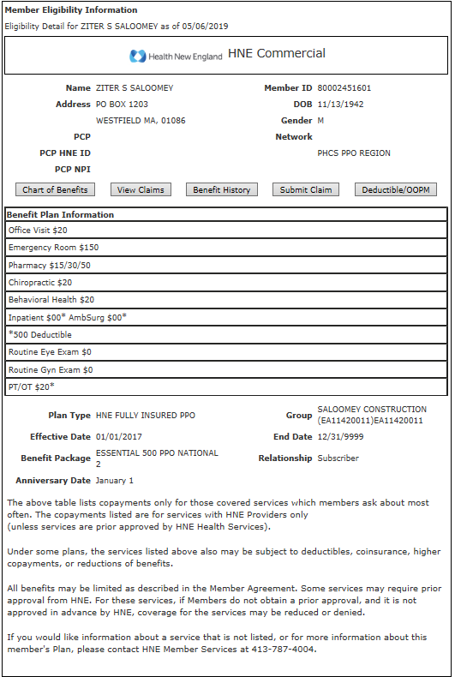
Provider Portal: https://www.hnedirect.com
Verify member eligibility
Look up a member by:
  Name/date of birth
  ID/date of birth
View demographics
View PCP
View how much the member has used towards their deductible by clicking on Deductible OOPM
View benefits and effective date

Slide 19
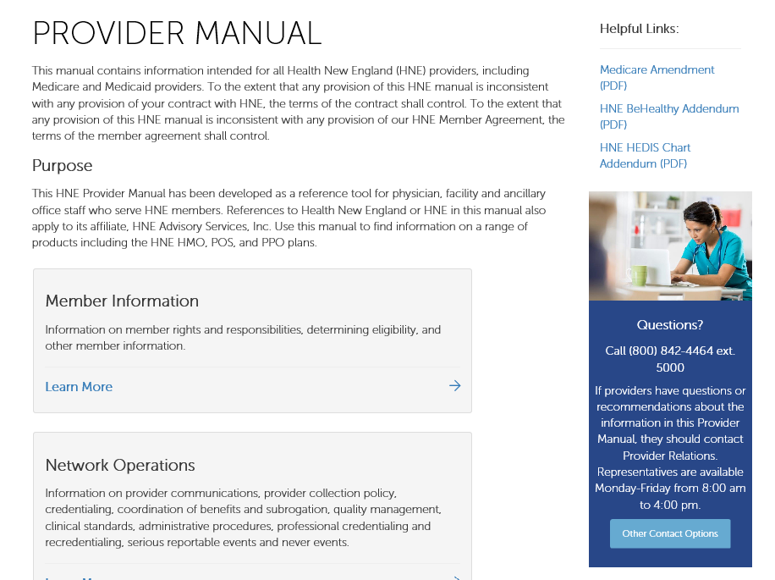
Provider Manual
Contains State and Federal requirements, accrediting organizational changes, guidelines and procedures when rendering medical services to members
Material changes to this manual, requires notification and then takes effect 60 days from distribution
  Current initiative underway throughout HNE, updates coming January 2021
Can be found on http://healthnewengland.org/provider as well as our secure provider portal (https://www.hnedirect.com)

Slide 20
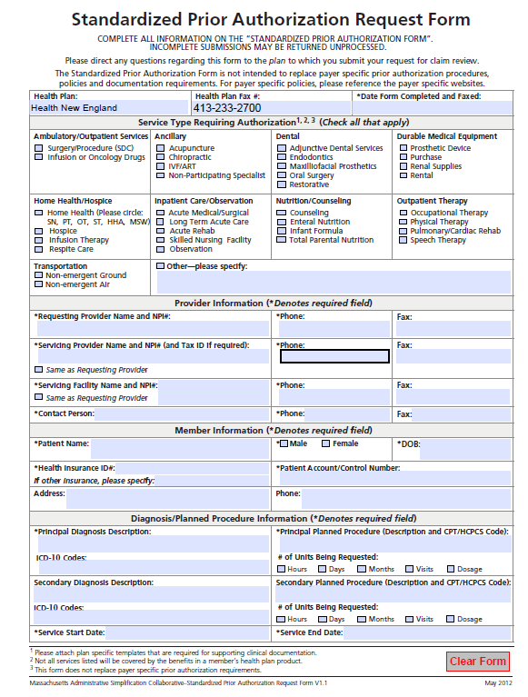
Prior Authorization
Guidelines for procedures and services requiring prior authorization, can be found in the Provider Manual
To verify a specific service, procedure, or treatment requiring prior
authorization, contact HNE Health Services directly at (413) 787-4000,
extension 5027 or (800) 842-4464, extension 5027, or HNE Member Services at (800) 310-2835
Form can be located at
http://healthnewengland.org/forms

Slide 21
Telehealth
CMS rules will apply
Resources to understand CMS rules as it pertains to CPT / HCPC codes, modifiers, place of service
  https://www.ama-assn.org/amaone/cpt-current-procedural-terminology
  https://www.cms.gov/Medicare/Coding/ICD10
Coming Soon
Guidance from the Department of Insurance regarding telehealth outside of a pandemic is currently being reviewed by Senior Leadership

Slide 22
Update: Telehealth Place of Service
Claims must be billed with POS 02 or 10
POS | Modifier | Description
02 |  | Effective January 1, 2022, Telehealth Provided Other than in Patient’s Home: The location where health services and health related services are provided or received through telecommunication technology. Patient is not located in their home when receiving health services or health related services through telecommunication technology.
10 |  | Effective January 1, 2022, Telehealth Provided in Patient’s Home: The location where health services and health related services are provided or received through telecommunication technology. Patient is located in their home (which is a location other than a hospital or other facility where the patient receives care in a private residence) when receiving health services or health related services through telecommunication technology.

Slide 23
Claims Editing Rules
Claim review against industry rules and coding guidelines
  National Coverage Determination (NCD) and Local Coverage Determination (LCD) Rules
  Rules and edits are consistent with CPT, ICD, CMS, and Health New England Payment Policies
Helpful links:
  CMS National and Local Coverage Determinations Indexes
  NGSMedicare.com > In the “Continue as Guest” Box, select Part B Provider and your state
  https://healthnewengland.org/Providers/Resources, Click “Payment Policies”

Slide 24
CMS Claims Edits
Lipid Testing 190.23
Thyroid Testing 190.22
STI 210.10
(L33574) Visual Fields Testing
(L37535) Vitamin D Assay Testing
Urine Drug Testing (L36037)
LCD Removal of Benign Skin Lesions (A54602)
Glycated Hemoglobin/Glycated Protein​ (190.21)​
Pr​ostate Cancer Screening Tests (210.1)
Serum Iron Studies (190.18)
Prothrombin Time (PT) (190.17)
Urine Culture, Bacterial (190.12)
Claims Editing Payment Policy is located at https://healthnewengland.org/Providers/Resources, click Payment Policy

Slide 25
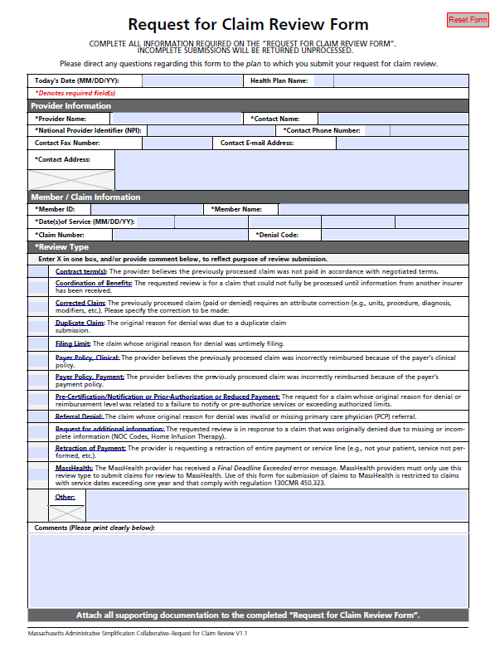
Provider Appeals (Dispute of Payment)
Provider has a right to appeal.
Denied claim review comes to Provider Relations/Appeals Dept.
  Fill out claim review form (All fields must be completed)
  Provide all necessary paperwork
  Fax or mail USPS
HNE will provide a determination within 90 business days
Coordination of Benefits (COB) disputes are managed by the Revenue Assurance and Risk Management Department. Reference Provider Manual for timeframes.

Slide 26
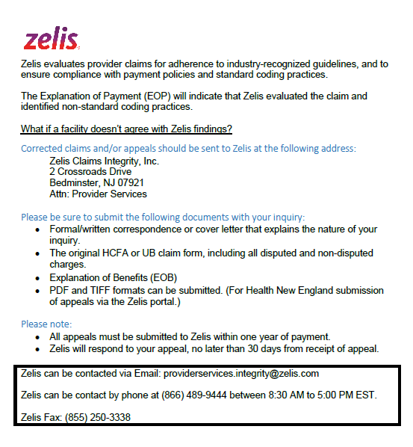
Provider Appeal (Dispute of Payment)
Zelis Appeal Process:

Slide 27
Vendor Partnerships

Slide 28
Audit, Authorization, Benefits & Pricing
Amenity (Nurse Audit)
  Institutional and Professional Coding & Clinical Review
Discovery Health Partner
  Claims audit on Medicare Advantage plan members with end-stage renal disease
  Ensures dialysis providers submit accurate and complete CMS-2728-U3 forms to the Centers for Medicare & Medicaid Services (CMS)
Zelis
  High dollar claim review
  Vendor to perform what was already in place/more efficient
  Communication was sent out February 2019
  Reviewing claims starting at $35K
  May request medical records for high dollars $100k
  Process of claim review is approximately 7 – 10 business day

Slide 29
Audit, Authorization, Benefits & Pricing
Healthmap Solutions
  Care Management benefit
  Identifies member with potential kidney disease or end-stage renal disease
Rx Savings Solution
  Pharmacy savings solution
  Works with providers to identify cost-effective medication
Optum
  Pharmacy Benefit Manager
  Acupuncture network
  Transplant assistance
Evicore
  Authorization management for genetic lab, high cost imaging, sleep studies
Northwood
  Network of providers supplying durable medical equipment & supplies
  Management of authorization

Slide 30
Audit, Authorization, Benefits & Pricing
Magellan Site of Service – New 1/1/2022
  Directs members to the most cost-effective, clinically appropriate location to receive their infusion(s) of select specialty medications
  Commercial Fully Funded members between the ages of 18 and 64,receiving infusions at outpatient hospital settings
  Need to meet medical necessity based on program description
  Policies and FAQ’s found here https://healthnewengland.org/Providers/Resources
BabyScript
  Digital maternity care program
  Commercial and BeHealthy Partnership® Members
Progeny
  Vendor partner specializing in Neonatal Intensive Care Unit (NICU) management
  Assist in Utilization Management and Care Management Services
  Commercial and BeHealthy Partnership® Members
Advanced Care and Life Planning
  Living Well is a specialized, advanced illness telehealth solution
  Advanced care plan
  Completes legally acceptable documentation / ability shared with family members and caring physicians.

Slide 31
Medicare Supplement Plan
Providers who are contracted with Medicare, are able to see our Medicare Supplement members

Slide 32
Medicare Supplement Plans - Important to Know
Medicare Supplement members do not require a Primary Care Provider or a referral to see a specialist.
Part D drug coverage is not included; Medicare beneficiaries must purchase a Part D drug plan separately.
Medicare beneficiaries are covered throughout the US and US territories and must use a provider, doctor or hospital that accepts Original Medicare.
All Medicare Supplement plans have to cover the same set of core benefits.
Difference between carriers: Monthly Premium, Additional Benefits, Premium Discount.
Notes:
Slide 20:
Health New England Medicare Supplement plans have some unique features to them. Some of the highlights are as follows:
You are covered throughout the US, and US territories, you must use a provider, doctor, or hospital that accepts Original Medicare
The Health New England Supplement 1 and 1A plans have a wellness reimbursement program. We will reimburse you up to $150 per calendar year. This may be used for the following services: Fitness Club membership, Weight Watchers, School and Town Sports, Aerobic/Wellness Class, Personal Trainer fees, Athletic Event Registration Fees, Golf (lessons or rounds of golf), Ski tickets, Fitness Equipment and Devices, Nutrition Classes, Mindfulness Classes, Community Supported Agriculture (CSA) or Farm Shares)
You do not require a Primary Care Provider or a referral to see a specialist
Medicare Supplement plans do not include Part D drug coverage, must purchase separately

Slide 33
Key Contacts

Slide 34
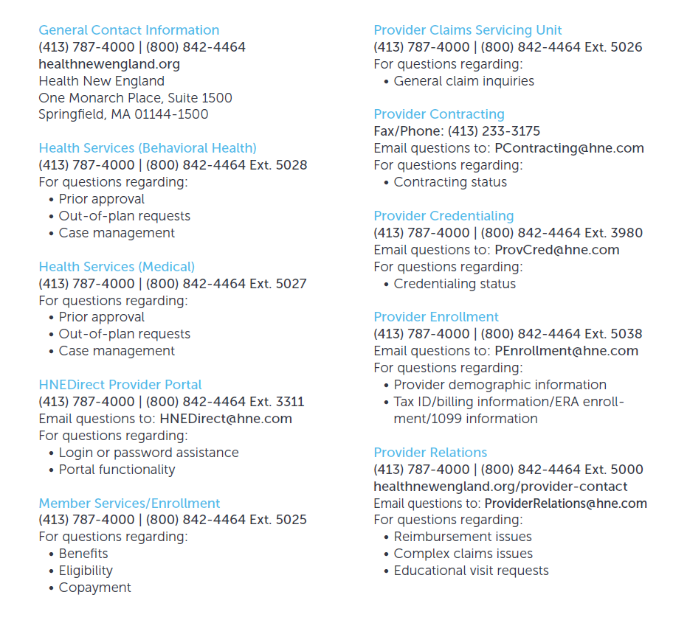
Key Contacts

Slide 35
Questions

