Slide 1
A Discussion on Modifier PO, Medical Necessity Claim Denials & Medically Unlikely Edits
MAPAM September 15, 2016

Slide 2
Today’s Presenters
Jeanine Gombos LPN, CPC
  Provider Outreach & Education Consultant
  Medicare Part A

Slide 3
Disclaimer
National Government Services, Inc. has produced this material as an informational reference for providers furnishing services in our contract jurisdiction. National Government Services employees, agents, and staff make no representation, warranty, or guarantee that this compilation of Medicare information is error-free and will bear no responsibility or liability for the results or consequences of the use of this material. Although every reasonable effort has been made to assure the accuracy of the information within these pages at the time of publication, the Medicare Program is constantly changing, and it is the responsibility of each provider to remain abreast of the Medicare Program requirements. Any regulations, policies and/or guidelines cited in this publication are subject to change without further notice. Current Medicare regulations can be found on the CMS website at http://www.cms.gov.

Slide 4
No Recording
Attendees/providers are never permitted to record (tape record or any other method) our educational events
  This applies to our webinars, teleconferences, live events and any other type of National Government Services educational events

Slide 5
Acronyms
Acronyms used in this presentation can be viewed on the NGSMedicare.com website. On the Welcome page, click on Provider Resources > Acronyms.

Slide 6
Objectives
Provide information regarding:
  Requirements for use of modifier -PO
  Provider-based status
  Medical necessity & claim denials
  MUE program

Slide 7
Agenda
Modifier -PO
  Provider-based status
Medical necessity & claim denials
  LCDs
  NCDs
  What you should do when your claim is denied
MUE overview
  MUEs & bilateral procedures

Slide 8
Modifier -PO & Provider-Based Status

Slide 9
Use of HCPCS Modifier -PO
Definition of modifier –PO
  Services, procedures, and/or surgeries furnished at off-campus provider-based outpatient departments
Reported with every HCPCS code for all outpatient hospital items/services provided in an off-campus provider-based department of a hospital
  UB-04 form
  837i electronic submission
Notes:
UB-04 form (CMS Form 1450), or the 837i electronic submission, for each service provided at these locations
No payment impact at this time, but CMS hopes to use it to show the frequency and types of services performed in off-campus, provider-based outpatient departments.

Slide 10
Use of HCPCS Modifier –PO
Voluntary for CY 2015
Required beginning 1/1/16
Modifier –PO should NOT be reported for:
  Remote locations of a hospital
  Satellite facilities of a hospital
  Services provided in emergency department
Notes:
Reporting of this new modifier was voluntary for 1 year (CY 2015), with reporting required beginning on January 1, 2016. This modifier should not be reported for remote locations of a hospital (defined at 42 CFR 413.65(a)(2)), satellite facilities of a hospital (defined at 42 CFR 412.22(h); see http://www.ecfr.gov/cgi-bin/text-idx?SID=867b6f12ebf5c84c0469ca86a7bbe88a&mc=true&node=pt42.2.412&rgn=div5#se42.2.412_122), or for services furnished in an emergency department.

Slide 11
Definition of “Campus”
Physical area immediately adjacent to provider's main buildings
Areas and structures not strictly contiguous to main buildings
  Located within 250 yards main buildings
Any other areas determined on an individual case basis, by CMS regional office, to be part of the provider's campus
Notes:
Campus means the physical area immediately adjacent to the provider's main buildings, other areas and structures that are not strictly contiguous to the main buildings but are located within 250 yards of the main buildings, and any other areas determined on an individual case basis, by the CMS regional office, to be part of the provider's campus
Any provider-based outpatient departments not falling under this definition could be considered “off-campus”

Slide 12
Provider-Based Determinations
A facility or organization is not entitled to be treated as provider-based simply because it or the main provider believe it is provider-based.

Slide 13
Provider-Based Determinations
42 CFR 413.65(a)(2)
  http://www.ecfr.gov/cgi-bin/text-idx?SID=867b6f12ebf5c84c0469ca86a7bbe88a&mc=true&node=pt42.2.413&rgn=div5#se42.2.413_165

Slide 14
Requirements for Seeking Provider-Based Status (On or Off Campus)
Licensure
Clinical services
Financial integration
Public awareness
Obligations of hospital outpatient departments and hospital-based entities
Notes:
Potential main provider must meet following requirements to be determined by CMS to have provider-based status
Requirements applicable to all facilities or organizations. Any facility or organization for which provider-based status is sought, whether located on or off the campus of a potential main provider,
(1) Licensure. The department of the provider, the remote location of a hospital, or the satellite facility and the main provider are operated under the same license, except in areas where the State requires a separate license for the department of the provider, the remote location of a hospital, or the satellite facility, or in States where State law does not permit licensure of the provider and the prospective department of the provider, the remote location of a hospital, or the satellite facility under a single license. If a State health facilities' cost review commission or other agency that has authority to regulate the rates charged by hospitals or other providers in a State finds that a particular facility or organization is not part of a provider, CMS will determine that the facility or organization does not have provider-based status.
(2) Clinical services. The clinical services of the facility or organization seeking provider-based status and the main provider are integrated as evidenced by the following:
(i) Professional staff of the facility or organization have clinical privileges at the main provider.
(ii) The main provider maintains the same monitoring and oversight of the facility or organization as it does for any other department of the provider.
(iii) The medical director of the facility or organization seeking provider-based status maintains a reporting relationship with the chief medical officer or other similar official of the main provider that has the same frequency, intensity, and level of accountability that exists in the relationship between the medical director of a department of the main provider and the chief medical officer or other similar official of the main provider, and is under the same type of supervision and accountability as any other director, medical or otherwise, of the main provider.
(iv) Medical staff committees or other professional committees at the main provider are responsible for medical activities in the facility or organization, including quality assurance, utilization review, and the coordination and integration of services, to the extent practicable, between the facility or organization seeking provider-based status and the main provider.
(v) Medical records for patients treated in the facility or organization are integrated into a unified retrieval system (or cross reference) of the main provider.
(vi) Inpatient and outpatient services of the facility or organization and the main provider are integrated, and patients treated at the facility or organization who require further care have full access to all services of the main provider and are referred where appropriate to the corresponding inpatient or outpatient department or service of the main provider.
(3) Financial integration. The financial operations of the facility or organization are fully integrated within the financial system of the main provider, as evidenced by shared income and expenses between the main provider and the facility or organization. The costs of a facility or organization that is a hospital department are reported in a cost center of the provider, costs of a provider-based facility or organization other than a hospital department are reported in the appropriate cost center or cost centers of the main provider, and the financial status of any provider-based facility or organization is incorporated and readily identified in the main provider's trial balance.
(4) Public awareness. The facility or organization seeking status as a department of a provider, a remote location of a hospital, or a satellite facility is held out to the public and other payers as part of the main provider. When patients enter the provider-based facility or organization, they are aware that they are entering the main provider and are billed accordingly.
(5) Obligations of hospital outpatient departments and hospital-based entities. In the case of a hospital outpatient department or a hospital-based entity, the facility or organization must fulfill the obligations of hospital outpatient departments and hospital-based entities described in paragraph (g) of this section.

Slide 15
Seeking Provider-Based Status (Off Campus)
Additional requirements for off-campus facilities or organizations:
  Operation under ownership and control of main provider
  Administration and supervision
  Location
Notes:
(e) Additional requirements applicable to off-campus facilities or organizations. Except as described in paragraphs (b)(2) and (b)(5) of this section, any facility or organization for which provider-based status is sought that is not located on the campus of a potential main provider must meet both the requirements in paragraph (d) of this section and all of the following additional requirements, in order to be determined by CMS to have provider-based status.
(1) Operation under the ownership and control of the main provider. The facility or organization seeking provider-based status is operated under the ownership and control of the main provider, as evidenced by the following:
(i) The business enterprise that constitutes the facility or organization is 100 percent owned by the main provider.
(ii) The main provider and the facility or organization seeking status as a department of the main provider, a remote location of a hospital, or a satellite facility have the same governing body.
(iii) The facility or organization is operated under the same organizational documents as the main provider. For example, the facility or organization seeking provider-based status must be subject to common bylaws and operating decisions of the governing body of the main provider where it is based.
(iv) The main provider has final responsibility for administrative decisions, final approval for contracts with outside parties, final approval for personnel actions, final responsibility for personnel policies (such as fringe benefits or code of conduct), and final approval for medical staff appointments in the facility or organization.
(2) Administration and supervision. The reporting relationship between the facility or organization seeking provider-based status and the main provider must have the same frequency, intensity, and level of accountability that exists in the relationship between the main provider and one of its existing departments, as evidenced by compliance with all of the following requirements:
(i) The facility or organization is under the direct supervision of the main provider.
(ii) The facility or organization is operated under the same monitoring and oversight by the provider as any other department of the provider, and is operated just as any other department of the provider with regard to supervision and accountability. The facility or organization director or individual responsible for daily operations at the entity—
(A) Maintains a reporting relationship with a manager at the main provider that has the same frequency, intensity, and level of accountability that exists in the relationship between the main provider and its existing departments; and
(B) Is accountable to the governing body of the main provider, in the same manner as any department head of the provider.
(iii) The following administrative functions of the facility or organization are integrated with those of the provider where the facility or organization is based: billing services, records, human resources, payroll, employee benefit package, salary structure, and purchasing services. Either the same employees or group of employees handle these administrative functions for the facility or organization and the main provider, or the administrative functions for both the facility or organization and the entity are—
(A) Contracted out under the same contract agreement; or
(B) Handled under different contract agreements, with the contract of the facility or organization being managed by the main provider.
(3) Location. The facility or organization meets the requirements in paragraph (e)(3)(i), (e)(3)(ii), (e)(3)(iii), (e)(3)(iv), (e)(3)(v), or, in the case of an RHC, paragraph (e)(3)(vi) of this section, and the requirements in paragraph (e)(3)(vii) of this section.
(i) The facility or organization is located within a 35-mile radius of the campus of the hospital or CAH that is the potential main provider.
(ii) The facility or organization is owned and operated by a hospital or CAH that has a disproportionate share adjustment (as determined under §412.106 of this chapter) greater than 11.75 percent or is described in §412.106(c)(2) of this chapter implementing section 1886(d)(5)(F)(i)(II) of the Act and is—
(A) Owned or operated by a unit of State or local government;
(B) A public or nonprofit corporation that is formally granted governmental powers by a unit of State or local government; or
(C) A private hospital that has a contract with a State or local government that includes the operation of clinics located off the main campus of the hospital to assure access in a well-defined service area to health care services for low-income individuals who are not entitled to benefits under Medicare (or medical assistance under a Medicaid State plan).
(iii) The facility or organization demonstrates a high level of integration with the main provider by showing that it meets all of the other provider-based criteria and demonstrates that it serves the same patient population as the main provider, by submitting records showing that, during the 12-month period immediately preceding the first day of the month in which the application for provider-based status is filed with CMS, and for each subsequent 12-month period—
(A) At least 75 percent of the patients served by the facility or organization reside in the same zip code areas as at least 75 percent of the patients served by the main provider; or
(B) At least 75 percent of the patients served by the facility or organization who required the type of care furnished by the main provider received that care from that provider (for example, at least 75 percent of the patients of an RHC seeking provider-based status received inpatient hospital services from the hospital that is the main provider).
(iv) If the facility or organization is unable to meet the criteria in paragraph (e)(3)(iii)(A) or paragraph (e)(3)(iii)(B) of this section because it was not in operation during all of the 12-month period described in paragraph (e)(3)(iii) of this section, the facility or organization is located in a zip code area included among those that, during all of the 12-month period described in paragraph (e)(3)(iii) of this section, accounted for at least 75 percent of the patients served by the main provider.
(v) The facility or organization meets all of the following criteria:
(A) The facility or organization is seeking provider-based status with respect to a hospital that meets the criteria in §412.23(d) for reimbursement under Medicare as a children's hospital;
(B) The facility or organization meets the criteria for identifying intensive care type units set forth in the Medicare reasonable cost reimbursement regulations under §413.53(d).
(C) The facility or organization accepts only patients who are newborn infants who require intensive care on an inpatient basis.
(D) The hospital in which the facility or organization is physically located is in a rural area as defined in §412.64(b)(1)(ii)(C) of this chapter.
(E) The facility or organization is located within a 100-mile radius of the children's hospital that is the potential main provider.
(F) The facility or organization is located at least 35 miles from the nearest other neonatal intensive care unit.
(G) The facility or organization meets all other requirements for provider-based status under this section.
(vi) Both of the following criteria are met:
(A) The facility or organization is an RHC that is otherwise qualified as a provider-based entity of a hospital that has fewer than 50 beds, as determined under §412.105(b) of this chapter; and
(B) The hospital with which the facility or organization has a provider-based relationship is located in a rural area, as defined in §412.64(b)(1)(ii)(C) of this subchapter.
(vii) A facility or organization may qualify for provider-based status under this section only if the facility or organization and the main provider are located in the same State or, when consistent with the laws of both States, in adjacent States
must meet all of the following requirements to be determined by CMS to have provider-based status

Slide 16
Medical Necessity & Claim Denials

Slide 17
Medical Necessity: The Basis for Covered Medicare Services
Title XVIII of Social Security Act, Section1862(a)(1)(A) excludes services not “reasonable and necessary” unless otherwise specifically noted
  Coverage for services under Medicare based on medical necessity and within scope of Medicare benefit category
Notes:
You may very well have heard this before that Title XVIII (18) of Social Security Act, excludes services that are not “reasonable and necessary” unless otherwise specifically noted. Coverage for services under Medicare is based on medical necessity. In other words, Medicare coverage is limited to items and services that are reasonable and necessary for the diagnosis or treatment of an illness or injury (and within the scope of a Medicare benefit category).

Slide 18
Role of CMS and MACs in Determining Covered Services
CMS Internet-Only Manual Publications
  100-02, Medicare Benefit Policy Manual
    Details on scope of covered Part A and Part B Medicare services
  100-03, Medicare National Coverage Determination (NCD) Manual
    Sets policy for determining medical necessity for specific services
Where item or service not mentioned in CMS Manual System, MACs make coverage decisions
  Local Coverage Determinations (LCDs)
Notes:
Here on the next slide I wanted to briefly touch on the role of CMS and National Government Services in determining whether a service is covered or not. So first we have CMS IOM Publication 100-02 which is the Medicare Benefit Policy Manual and this provides details on the scope of covered Medicare Part A and B services. Next we have CMS IOM Publication 100-03 which is the Medicare National Coverage Determination Manual and this sets policy for determining medical necessity for specific services. So you might ask, what happens when an item or service is not mentioned at all in any of CMS’ manuals? Well in cases like this, National Government Services will make coverage decisions and that will be determined most likely by medical necessity.
Something that you should be aware of is that claim denials related to NCDs and LCDs make up a large percentage of denied claims. Claim denials represent a major expense to providers in terms of time and money spent on appeals. NGS is keenly aware of this and I’m sure you are as well. In order to fix and prevent denials, it’s imperative that providers know how to access and correctly interpret Medicare NCDs, LCDs and policy articles

Slide 19
Local Coverage Determinations
Contractor decision whether to cover service in accordance with Section 1862(a)(1)(A)
  Housed on CMS website and assigned alpha/numeric identifier that begins with “L”
Located on our website:
  http://www.NGSMedicare.com > Medical Policy & Review > Medical Policy Center
Notes:
A LCD is a decision by a National Government Services to cover (or not) a service on a contractor-wide basis in accordance with Section 1862(a)(1)(A) of the social security act. LCDs are housed on CMS website and assigned alpha/numeric identifier that begins with “L” followed by 5 numbers. We also provide links to all LCDs on our website under the medical policy center. So you want to be sure you’re joining us for part 2 as I will be showing you how to navigate and search for LCDs and NCDs on the our website as well as CMS’s Medicare coverage database.
NCD coverage instructions may be expanded by an LCD (e.g., frequency limitations) but can never contradict it

Slide 20
LCDs Contain Reasonable and Necessary Guidelines Only
LCDs consist of only “reasonable and necessary” information
  Indications/limitations for reasonable and necessary tests, items and services
  ICD-10-CM codes for tests, items, and services billed
  Documentation requirements
Coding guidelines or other instructions not related to medical necessity are published in related SIAs
Notes:
To get a full picture of a service, you should be referring to the LCD as well as the SIA. The LCD includes indications and limitations of coverage, covered/non-covered diagnosis codes and documentation requirements. The SIA includes coding and payment guidelines.
As a result of the Benefits Improvement and Protection Act of 2000 (BIPA 2000), all Local Medical Review Policies (LMRPs) were converted to LCDs. The difference between LCDs and previously written LMRPs is that LCDs contain only reasonable and necessary conditions of coverage
Indications/limitations for reasonable and necessary tests, items and services
ICD-9-CM codes for tests, items, and services billed
Documentation requirements
LMRPs may have also contained other information such as coding and payment guidelines. Coding and payment information that is not related to information contained in an LCD, NGS communicates such information in related articles or SIAs.

Slide 21
LCD Automated Edits
LCDs are supported and enforced by automated system edits
  55A00, 55A01 – This claim was denied by an automated system for not having a covered diagnosis in accordance to the LCD/NCD. Provider may correct diagnosis by submitting adjustment according to instructions for making corrections for automated LCD/NCD denials, or by submitting a written request.
Notes:
LCDs are supported and enforced by automated system edits. And you’ll see on this slide 2 denial code examples 55A00, 55A01 that you may receive when your claim is denied based off of a LCD automated edit. We see so many services that deny because a covered diagnosis was not present on your claim. It’s so important to check to see if there is an LCD and/or an NCD for the service that you are submitting. In an LCD you will find diagnosis codes that support medical necessity. When you don’t follow the guidance set forth in an NCD or LCD, you’re setting yourself up to receive automated claim denials and you really want to avoid this because it’s holding up your Medicare cash flow. And we’ll discuss a bit further along in the presentation how you handle these automated denials.
add to notes that we will be discussing what to do with automated edits later in the presentation
no appeal

Slide 22
LCD Components
Consistent format, including:
  Title page
  Coverage guidance
  Coding guidelines
  General information
    Documentation requirements, utilization guidelines, appendices, citations
  Revision history
  Links to associated SIAs
Notes:
There are many different parts of an LCD but they are always listed in the same order so you can reference the sections you need more easily. Coverage Guidance = Rationale and legal premise for a particular serviceC
Title Page
LCD ID number and title
Copyright information
Jurisdiction
Effective/termination dates
Revision effective/ending dates
Retirement date
Notice period start/end dates
The coverage guidance section includes:
Citations from CMS or other legal sources used in creating the LCD as a justification for coverage as well as a written narrative covering indications, limitations and/or medical necessity information for the services contained within the LCD.
The coding guidelines section includes both a list and a description of codes needed to establish medical necessity for a service. Here is where you’ll want to pay particular attention in determining if you need to be submitting a certain diagnosis for a specific service.
Bill type codes
Revenue codes
CPT/HCPCS
ICD-9-CM diagnosis codes
LCD general information:
Establishes necessary documentation both on claim and in medical record
Utilization guidelines may include any pre-requisites and frequency of coverage
Citations section gives sources of information and basis for LCD decision
Any revisions made to an LCD or SIA since original activation date are printed in red in narrative text
Revision history includes:
Revision history number with date of each revision
Detailed narrative explanation of revision
Reasons for changes made
Revision history gives provider information to determine which version of LCD applies to a particular claim date(s) of service
Links to any SIAs attached to LCD
May be one or multiple
Links also given to any coverage document related to services covered by LCD in question

Slide 23
SIAs
Include important coding guidelines and billing instructions not related to medical necessity
  Each LCD has at least one related SIA
  Links are found in Associated Documents section at bottom of an LCD
  A link to related LCD is also found at the end of each SIA
    Links are only “live” in LCDs and SIAs that are active
Notes:
Now we briefly mentioned SIAs so here we have a bit more information.

Slide 24
Medical Policy Articles
Medical policy articles are separate from SIAs
  Do not contain words “Supplemental Instructions Article” or “Attached to LCD” in title
  Clarify points contained in NCDs or CMS manuals
  May contain either medical necessity or coding instructions
  Policy articles are reviewed annually

Slide 25
Make Sure You are Looking at Correct LCD Version!
Draft LCDs start with “DL”
Final LCDs start with “L”
  Check effective date: if it is in future, LCD is in a notice period!
  Check revision history
CMS applies “Draft”, “Future”, “Superseded” or “Retired” watermarks as appropriate
Notes:
When reviewing the LCDs on our website, make sure you understand the status of the LCD. A draft LCD is not approved and therefore the guidance provided within the draft is not subject to claim editing under the LCD. A final LCD does have claim edits in place which compare the coding submitted on the claim with the coding required by the LCD. All LCDs have an effective date. Note that an LCD can be final but with a future effective date. If your date of service is before the effective date then once again, the claim editing is not in place. You can provide the service according to a draft or future-effective LCD if that is aligned with standard industry coverage guidelines. However, if a service is non-covered and there is a future effective or draft LCD which changes the service to covered, the claim will deny if the date of service is before the effective date making the service covered under Medicare.

Slide 26
What if There is No LCD or NCD?
Check for coverage guidelines in CMS Internet-Only Manuals
Check for related medical policy article
Make sure service not statutorily or administratively excluded
  CMS Internet-Only Manual Publication 100-02, Medicare Benefit Policy Manual, Chapter 16, “General Exclusions From Coverage”
  LCD L33629 “Noncovered Services”
Notes:
It would be easy if every service had an LCD or an NCD to provide coverage and coding guidance. But not all of the services that Medicare covers do. So what if there is no LCD or NCD? There’s a few things you can do to see if Medicare has any guidance published for the service. Check for coverage guidelines in CMS Internet Only Manuals. Hopefully you are familiar with using the online manuals, but if you’re not, we will go over that in Part 2 of this session. Sometimes there is no LCD or NCD but we have written a medical policy article. These are housed on our website under Medical Policy and Review > Policy Education Topics. Lastly, check to make sure it is not non-covered per policy or statute. Once you have verified that no policy exists and you feel the service is medically reasonable and necessary for the patient, you would provide the service in compliance with standard practice for that service and ensure that it the reasons for providing the service are thoroughly documented.

Slide 27
Importance of Documentation
Medical necessity is underlying basis for Medicare coverage
Providers must maintain complete medical records documenting services reasonable and necessary
  Documentation is deciding factor in determining medical necessity of service in absence of any written statutory or administrative guidance
Notes:
If you have been in Medicare any amount of time, you now that one of our common sayings is “if it wasn’t documented, it wasn’t done!” As we’ve been discussing, medical necessity is underlying basis for Medicare coverage, so therefore you must maintain a complete medical record for patients documenting that the services you provided were reasonable and necessary. I always say that a good rule of thumb when it comes to documentation is that if you were to look at the documentation with a “different set of eyes” (for example, a provider in your same specialty), would you be able to understand why you provided the service and the medical necessity behind providing it? Proper documentation is critical in so many aspects, not the least of which is that in the absence of any written statutory or administrative guidance on a service, documentation will be deciding factor in determining medical necessity.
We understand that documentation leans on your clinical staff… so it’s imperative that your clinical personnel understand this concept and that they ensure their documentation is up to par!

Slide 28
National Coverage Determinations
Nationwide coverage instruction developed by CMS that is binding on all contractors
  Applies to all Medicare claims
NCDs are assigned a numeric identifier and are published on CMS website
Edits are established by CMS
  Failure to meet NCD guidelines results in denied services
Notes:
A National Coverage Determination is a nationwide coverage instruction that is binding on all contractors and applies to all Medicare claims. NCDs are assigned a numeric identifier and are published on CMS website. System edits based on a NCD are established by CMS. Failure to meet NCD guidelines will result in denied services.
National coverage determinations are made through an evidence-based process, with opportunities for public participation. In some cases, CMS' own research is supplemented by an outside technology assessments and/or consultation with the Medicare Evidence Development & Coverage Advisory Committee (MEDCAC). So as I mentioned, In the absence of a national coverage policy, an item or service may be covered at the discretion of the Medicare contractors (National Government Services) based on a local coverage determination.

Slide 29
NCD Automated Edits
NCDs are supported and enforced by automated system edits
  52NCD: Line level reason code to indicate that the HCPCS on the line and a diagnosis code on the claim matched the NCD edit table list ICD-9-CM deny codes. Service was denied.
  53NCD: Line level denial to indicate that none of the diagnoses on the claim support the medical necessity of this service. Service was denied, the beneficiary is liable. The beneficiary is liable because modifier ‘GA’ is present on the line, or occurrence code 32 is present on claim and modifier ‘GA’ is not present on any claim line
  54NCD: Line level reason code to indicate that none of the diagnoses on the claim support the medical necessity of the service. Service denied the provider is liable.
Notes:
Let’s talk about NCD automated system edits. As previously mentioned NCDs are supported and enforced by automated system edits meaning that the system will automatically all deny your claim when it hits and edit based on an NCD.
52NCD: Line level reason code to indicate that the HCPCS on the line and a diagnosis code on the claim matched the NCD edit table list ICD-9-CM deny codes. Service was denied.
53NCD: Line level denial to indicate that none of the diagnoses on the claim support the medical necessity of this service. Service was denied, the beneficiary is liable. The beneficiary is liable because modifier ‘GA’ is present on the line, or occurrence code 32 is present on claim and modifier ‘GA’ is not present on any claim line
54NCD : Line level reason code to indicate that none of the diagnoses on the claim support the medical necessity of the service. Service denied the provider is liable.

Slide 30
Did You Know…
There is a NCD alphabetical index as well as an index by chapter/section on the CMS Medicare Coverage Database that makes is easy for you to locate coverage information.

Slide 31
How to Find NCDs & LCDs
http://www.cms.gov
  Home > Medicare > Coverage > Medicare Coverage > Medicare Coverage Database > Indexes
Notes:
One of the first things I want to show you is that there is a link if you scroll down just a bit there is some guidance on how to use this site. I’m sure many of you come out to the CMS website and just get overwhelmed with trying to find what you need and may not have taken the time to figure out how the site works and how you can search for LCDs/NCDs etc..
The MCD offers multiple ways to locate and view data:
GO THROUGH EACH TAB….. QUICK SEARCH, ADVANCE SEARCH, INDEXES..
QUICK SEARCH - Allows users to search both the NCD and LCD databases using a variety of criteria such as keyword, diagnosis/procedure, and date.
Or click on ADVANCED SEARCH to use additional filters to find exactly what you are looking for. If you know the Document ID of the document you are looking for, enter it below and select SEARCH BY ID button. If you would like to complete a more comprehensive search, choose a Document Type and additional search criteria will display for you to refine your search. Once you have made your criteria selection, select the SEARCH BY TYPE button at the bottom of the page
INDEXES - Indexes provide users with pre-defined lists of National and Local Coverage documents. You may begin by selecting National Coverage or Local Coverage and then selecting a particular Index. Use the Advanced Search feature if you are looking for a particular National or Local Coverage document.
SHOW LIST OF ALPHABETICAL NCDS
REPORTS - Provides users with reports of National and Local Coverage data.
DOWNLOADS - Allows users to download complete sets of LCDs and articles and the complete set of NCDs.
QUICK SEARCH

Slide 32
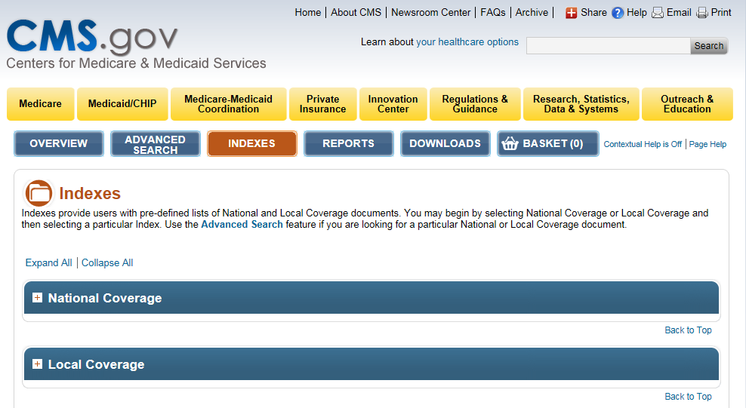
How to Find NCDs & LCDs

Slide 33
What You Should Do When Your Claim is Denied

Slide 34
Disagree With an LCD Denial?
First check date(s) of service against LCD revision history
  Make sure you are using correct LCD version for DOS
Questions to ask
  Are a combination of diagnosis codes required?
  Is a specific place of service required for CPT/HCPCS code in question (e.g. inpatient only)
  Is there a frequency limit which caused denial?

Slide 35
Adjusting LCD or NCD Partially Denied Claims
Effective 12/27/11, National Government Services accepts provider-initiated electronic adjustments to claims partially denied by automated edits for NCDs or LCDs
  Applies to claims with a line item denial reason code of 55A00, 55A01, 52NCD, 53NCD, or 54NCD
Make appropriate corrections to DX
  Use claim change reason code D9
  Adjustment reason code LN
  Delete and rekey denied line(s) back to covered
Notes:
IF YOUR claim has been DENIED WITHOUT Medical Review….SO…there was NO ADR involved….NO documentation was sent…YOU can “correct” that claim via the Electronic Adjustment Process
So…..
We are talking about claims that edited with the reason codes that I just mentioned – No ADR was received – NO documentation was provided
Make the appropriate corrections to the DX or other codes that caused the denial
Claim Change Reason Code – (D9)
Enter COVERED CHARGES
Adjustment Reason Code “LN”
This change will NOT apply to Post-Pay Denials by NGS or others such as the RAC, CERT, PSC or Zone PSC
You will have to go through the Appeals Process for those denials

Slide 36
MUE Overview

Slide 37
What is an MUE?
Maximum UOS that a provider would report under most circumstances for a single beneficiary on a single DOS
  Not all HCPCS/CPT codes have an MUE
Developed based on code descriptors, coding instructions, anatomic considerations, CMS policy, prescribing information, nature of service/procedure
Notes:
An MUE for a HCPCS/CPT code is the maximum Units of Service (UOS) that a provider would report under most circumstances for a single beneficiary on a single date of service.
Not all HCPCS/CPT codes have an MUE.
MUEs are developed based on HCPCS/CPT code descriptors, CPT coding instructions, anatomic considerations, established CMS policies, nature of service/procedure, nature of equipment, prescribing information, and clinical judgment.
Although CMS publishes most MUE values on its website, other MUE values are confidential and are for CMS and CMS Contractors' use only.

Slide 38
Facility Outpatient Services
MUE Table
HCPCS/CPT Code | Outpatient Hospital Services MUE Values | MUE Adjudication Indicator | MUE Rationale
17380 | 1 | 1 Line Edit | Clinical: Data
19000 | 2 | 3 Date of Service Edit | Anatomic Consideration
19001 | 5 | 1 Line Edit | Clinical: Data
Notes:
Here you’re looking at an example pulled form the Facility Outpatient Services MUE table.
Review table columns.

Slide 39
MUE Adjudication Indicator
On April 1, 2013, CMS modified MUE Program so that some MUE values would be date of service edits rather than claim line edits
CMS introduced a new data field to MUE edit table termed “MAI”
  MLN Matters MM8853: Revised Modification to the Medically Unlikely Edit Program
Notes:
At the recommendation of the Office of the Inspector General (OIG), the Centers for Medicare & Medicaid Services (CMS) has examined its claims data relative to MUE levels and has confirmed a pattern of inappropriate billing using multiple lines to bypass the MUEs. Agreeing with the OIG that this practice overcharges both beneficiaries and the Medicare program, CMS has converted most MUEs into per day edits. The MUE Adjudication Indicator (MAI) indicates the type of MUE and its basis. Effective with the July 1, 2014 update, published per day edits are identified on the CMS NCCI website (http://www.cms.gov/Medicare/ Coding/NationalCorrectCodInitEd/MUE.html) by their MAI value of 2 or 3. And not to worry, for those who don’t know what the term “MAI” is, we will be discussing this shortly.
At the onset or implementation of the MUE Program, regarding the adjudication process, the MUE value for a Healthcare Common Procedure Coding System (HCPCS) code was only adjudicated against the units of service (UOS) reported on each line of a claim. On April 1, 2013, CMS modified the MUE program so that some MUE values would be date of service edits rather than claim line edits. At that time, CMS introduced a new data field to the MUE edit table termed “MUE adjudication indicator” or “MAI”.

Slide 40
MUE Adjudication Indicators
MAI “1” – Claim line edit
MAI “2” – Absolute DOS edit
MAI “3” – DOS edit

Slide 41
MAI “1”
MUEs for HCPCS/CPT codes with a MAI of “1” will continue to be adjudicated as a claim line edit
Same HCPCS/CPT code may be reported on a separate line with an appropriate modifier
Notes:
MUEs for HCPCS codes with a MAI of “1” will continue to be adjudicated as a claim line edit.
May be reported on a separate line with an appropriate modifier, and each line will process for payment.

Slide 42
MAI “1” Incorrect Coding
CPT 26118 – Radical resection of tumor, soft tissue of hand or finger, 3 cm or greater
  26118 – 2 units
MUE = 1
MAI = 1 – Claim line edit

Slide 43
MAI “1” Correct Coding
CPT 26118 – Radical resection of tumor, soft tissue of hand or finger, 3 cm or greater
  26118 – 1 unit
  26118 59 – 1 unit

Slide 44
MAI “2”
MUEs for HCPCS codes with a MAI of “2” are absolute DOS edits
Based on policy
UOS on same DOS in excess of MUE value would be considered impossible
Notes:
MUEs for HCPCS codes with a MAI of “2” are absolute date of service edit. These are “per day edits based on policy”. HCPCS codes with an MAI of “2” have been rigorously reviewed and vetted within CMS and obtain this MAI designation because UOS on the same date of service (DOS) in excess of the MUE value would be considered impossible because it was contrary to statute, regulation, or subregulatory guidance. This subregulatory guidance includes clear correct coding policy that is binding on both providers and the MACs.
Limitations created by anatomical or coding limitations are incorporated in correct coding policy, both in the Health Insurance Portability & Accountability Act of 1996 (HIPAA) mandated coding descriptors and CMS approved coding guidance as well as specific guidance in CMS and National Correct Coding Initiatives (NCCI) manuals.
For example, it would be contrary to correct coding policy to report more than one unit of service for Current Procedural Terminology (CPT) 94002 "ventilation assist and management . . . initial day" because such usage could not accurately describe two initial days of management occurring on the same DOS as would be required by the code descriptor.
An MAI of 2 indicates an edit for which the MUE is based on regulation or subregulatory instruction (“policy”), including the instruction that is inherent in the code descriptor or its applicable anatomy.
Examples:
1. The MUE of a “per cervical vertebra” code cannot exceed 7 based on anatomic considerations, that is, the number of cervical vertebrae. The MUE of 7 is therefore inherent in the code descriptor, an integral part of the code set specified for use by Health Insurance Portability & Accountability Act of 1996 (HIPAA).
2. The MUE of a “first 15 minutes” session code for a practitioner cannot exceed 1 since any time beyond that would require a different “subsequent” code, and that limitation is inherent in the code descriptor and its annual incorporation by CMS.
CMS expects all claims reporting services in excess of the MUE for edits with an MAI of 2 will represent either clerical errors or errors in the interpretation of instructions. CMS has not identified any instances in which a higher value would be correct and payable. MACs have therefore been instructed that this subregulatory instruction is binding on the MAC for both initial determinations and redeterminations, as is all subregulatory instruction.

Slide 45
MAI “2” Examples
MUE of a “first 15 minutes” session code for a practitioner cannot exceed 1 since any time beyond that would require a different “subsequent” code
MUE of a “per cervical vertebra” code cannot exceed 7 based on anatomic considerations (number of cervical vertebrae)
Notes:
The MUE of a “first 15 minutes” session code for a practitioner cannot exceed 1 since any time beyond that would require a different “subsequent” code, and that limitation is inherent in the code descriptor and its annual incorporation by CMS.
The MUE of a “per cervical vertebra” code cannot exceed 7 based on anatomic considerations, that is, the number of cervical vertebrae. The MUE of 7 is therefore inherent in the code descriptor, an integral part of the code set specified for use by Health Insurance Portability & Accountability Act of 1996 (HIPAA).

Slide 46
MAI “2” Incorrect Coding
CPT 11042 – Debridement, subcutaneous tissue; first 20 sq cm or less
  11042 – 1 unit
  11042 59 – 1 unit
  11042 59 – 1 unit
MUE = 1
MAI = 2 – Absolute DOS Edit

Slide 47
MAI “2” Correct Coding
CPT 11042 – Debridement, subcutaneous tissue; first 20 sq cm or less
CPT +11045 – each additional 20 sq cm (list separately in addition to code for primary procedure)
  11042 – 1 unit
  11045 (add-on code) – 2 units

Slide 48
MAI “3”
MUEs for HCPCS codes with a MAI of “3” are date of service edits
Based on clinical information such as billing patterns, prescribing instructions, or other information,
Exceptions beyond MUE rare but could occur
Notes:
MUEs for HCPCS codes with a MAI of “3” are date of service edits. These are “per day edits based on clinical benchmarks”. If claim denials based on these edits are appealed, MACs may pay UOS in excess of the MUE value if there is adequate documentation of medical necessity of correctly reported units. If MACs have pre-payment evidence (e.g. medical review) that UOS in excess of the MUE value were actually provided, were correctly coded, and were medically necessary, the MACs may bypass the MUE for a HCPCS code with an MAI of “3” during claim processing, reopening, or redetermination, or in response to effectuation instructions from a reconsideration or higher level appeal.
It acknowledges that exceptions could occur but they would be sufficiently rare that the abnormally high units of service value should be considered to be a billing error.
Providers should carefully assess any denials based on these edits and consider the denial to be an indication of incorrect reporting due to such things as clerical errors or errors in the interpretation or application of coding instructions. It is also possible some provider reporting errors could be associated with a lack of medical necessity for the excess units, although the MUE itself does not address medical necessity, but only the medically unlikely nature of the reported value.
In the rare instance where the provider has verified all information, including the correct interpretation of coding instructions, and still believes that the correctly coded medically necessary service exceeds the MUE, the provider should submit a clearly supported appeal.

Slide 49
MAI “3” Incorrect Coding Example
27403 (Arthrotomy with meniscus repair, knee)
  27403 – 2 units
MUE = 1
MAI = 3 – DOS Edit
Notes:
Remember, exceptions are rare, but could occur. Documentation should be clear and support medical necessity.

Slide 50
MAI “3” Correct Coding Example
27403 (Arthrotomy with meniscus repair, knee)
  27403 50 – 1 unit

Slide 51
MUEs & Bilateral Procedures

Slide 52
MUEs and Bilateral Procedures
Bilateral procedures could be coded many ways, but different methods are only correct in specific situations
Most common methods involve reporting
  A single UOS on one line using the 50 modifier
  One UOS on each of two lines using modifiers RT and LT
  Two UOS on a single line with no modifier
Notes:
There are several ways that claims for bilateral procedures could be coded, but different methods are only correct in specific situations. The most common methods involve reporting
• a single UOS on one line using the -50 modifier;
• one UOS on each of two lines using modifiers RT and LT; and
• two UOS on a single line with no modifier.

Slide 53
Reporting Bilateral Procedures
When reporting bilateral surgical procedures and term “bilateral” not included in descriptor;
  Report single UOS and modifier 50
Notes:
For Medicare claims, when reporting bilateral surgical procedures using codes where the term bilateral is not included in the descriptor, both the "Medicare Claims Processing Manual" and the National Correct Coding Initiative (NCCI) manual specify that these bilateral surgical procedures should be reported using a single UOS and the -50 modifier. The NCCI manual goes on to warn that MUE edits are predicated on the assumption that claims are coded in accordance with these Medicare instructions. Consequently many bilateral procedures have an MUE value of 1, and have had that MUE value for some time.
Since ambulatory surgical center (ASC) providers (specialty code 49) cannot report modifier 50, the MUE value used for editing will be doubled for HCPCS codes with an MAI of “2” or “3” if the bilateral surgery indicator for the HCPCS code is “1”.

Slide 54
Modifier 50 Coding Example
CPT 29580 - Unna Boot
Incorrect Coding
  29580 LT – 1 unit
  29580 RT – 1 unit
Correct Coding
  29580 50 – 1 unit

Slide 55
Where to Find MUE Edit Tables
www.cms.gov > Medicare > Coding > National Correct Coding Initiative Edits > Medically Unlikely Edits

Slide 56
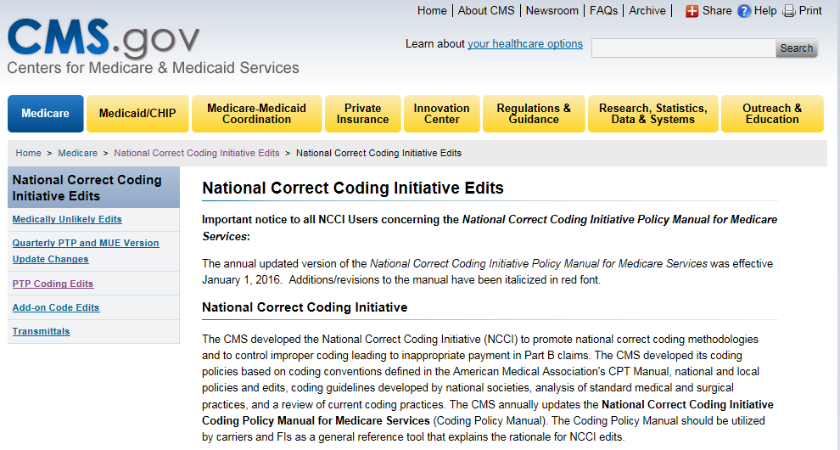
Where to Find NCCI Edits
Notes:
Screenshot shows the screen after selecting NCCI Edits. When selecting NCCI coding edits, Scroll to the Related Links section at the bottom of the page to find links to two Hospital CCI Edits tables and two Physician CCI Edits tables. Click on the Hospital CCI Edits or Physician CCI Edits table you wish to view or save.
A license agreement will appear. To continue to the table selected, the terms and conditions of the AMA copyright must be accepted. Click Accept to indicate you have read and agree to the AMA terms and conditions.
The tables can be opened in Microsoft Excel (the file ending in xlsx) or text file format. Click on the format you want to open the table.
When selecting Medically Unlikely edits, you can scroll to the bottom of the page to find the MUE tables. They are in compressed zipped files. You must choose whether to open and view the file or to save the file for future reference. The tables can be opened/viewed as either a plain text file, or a Microsoft Excel spreadsheet.
Just a quick tip: Remember that MUE tables are updated quarterly and saved tables must be replaced in order to have the most current information.

Slide 57
Wrap Up

Slide 58
Part A IVR Update - Appeals Status
Scheduled to be fully operational on 1/25/16
Part A providers can check status of appeals
  Option 7 (or say “Appeals Status”) from Main Menu
  Must enter correct NPI/PTAN/TIN, beneficiary's name and Medicare number, and an acceptable DCN
  System will respond with no appeal in system, receipt date/finalized date or receipt date/pending
Wait at least 10 days from submitting appeal to check status
Notes:
The Interactive Voice Response (IVR) System Updated to Include Appeal Status
Effective January 25 2016 the IVR will include the ability for Part A Providers to check the status of their Appeals. From the Part A Main Menu there will be an option for Appeals Status. Providers will be able to just say "Appeal Status" or press 7.
Once the correct NPI/PTAN/TIN, beneficiary's name and Medicare numbers and an acceptable DCN have been entered and authenticated, the call will continue on to the Part A Appeals Status.
The following information may be returned to the caller:
No appeal in the system for that DCN
Wait a few days and try again. If appeal is still not located in the system after 10 days, please contact our Provider Contact Center using the information in the Contact Us section of our website at http://www.NGSMedicare.com
Appeals receipt date
Appeal finalized on (date)
Letter regarding determination was sent on (date)
If no letter was mailed, refer to remittance advice for claim details
Appeal pending
Refer to the website for contractor Appeal processing time frame requirements in the CMS Internet Only Manual 100-04, Chapter 29 https://www.cms.gov/Regulations-and-Guidance/Guidance/Manuals/downloads/clm104c29.pdf
For more information on Appeal levels and time limits, please refer to the Appeals section of our website - About Appeals. You can also view this information by going to http://www.NGSMedicare.com and clicking on the Claims and Appeals megatab from the top navigation bar of the Part A home page.

Slide 59
New www.NGSMedicare.com Personalized Provider Website
New voluntary option for providers to use website more efficiently by creating free account
  Options to save frequently-used bookmarks, forms, and job aids/manuals for easy access (up to 10 each)
  Automatically saves recent searches
  Customizes your News based on your provider type
Easy to sign up!
  NGSConnex users log in using NGSConnex User ID and password
  4-step process if not currently a NGSConnex user

Slide 60
Upcoming National Government Services Webinar!
Take an Educational Tour Around Our Website Without Packing a Suitcase!
  Register now for a guided tour of our website to show you how you how fast and easy it is to find the information you need
  www.ngsmedicare.com > education > webinars, teleconferences & events
  9/21/16, 10/19/16

Slide 61
Upcoming National Government Services Webinar!
National Government Services Connex
  Register Now to Learn About the Brand New NGSConnex ADR Feature!
  www.ngsmedicare.com > education > webinars, teleconferences & events
  9/27/16, 10/5/16, 10/19/16
Notes:
New Cost Saving NGSConnex Enhancement: Responding to Additional Documentation Requests
Part A providers now have the ability to submit documentation in response to an additional documentation request (ADR) electronically through your self-service portal, NGSConnex. This new feature allows Part A providers to respond to an ADR online. With just a few clicks you can upload the requested documentation and submit the documentation through the NGSConnex website thus saving you time and money associated with printing and mailing or faxing documentation.
You will find step-by-step instructions on how to submit ADR documentation within the Quick Steps Job Aid posted on the home page of NGSConnex, under the Links section.
This webinar will provide Part A and Part B providers with detailed information on the NGSConnex system. NGSConnex is a web-based application that provides claim status, beneficiary eligibility, financial data, provider demographics, individual claim entry submissions, and the ability to submit redeterminations, reopenings, cost reports, and respond to ADR letters. During the webinar, we will review how to access NGSConnex along with an overview of the information available within the system.

Slide 62
MCD Lunch and Learn Seminars
CMS CCSQ is sponsoring a series of four (4) Lunch and Learn Seminars on the MCD
  September 28, 2016 @ 1:00 PM: MCD General Overview & Searches
  October 12, 2016 @ 1:00 PM: Indexes
  October 26, 2016 @ 1:00 PM: Reports and Downloads
  November 9, 2016 @ 1:00 PM: MCD Archive & Q&A Open Session
Visit CMS MCD for registration!
  https://www.cms.gov/medicare-coverage-database/overview-and-quick-search.aspx
Notes:
The CMS Coverage & Analysis Group would like to invite all users of the Medicare Coverage Database (MCD) to our upcoming MCD Lunch and Learn webinar series. This series will focus on MCD utilization as well as tips of the trade to assist users who work in the MCD.
Each webinar has a specific focus in regard to the functions and features of the Database. The start time for all the webinars is 1 PM EST.

Slide 63
Resources & References

Slide 64
Resources
Off-Campus Provider Based Department “PO” Modifier Frequently Asked Questions
  https://www.cms.gov/Medicare/Medicare-Fee-for-Service-Payment/HospitalOutpatientPPS/Downloads/PO-Modifier-FAQ-1-19-2016.pdf
New Claim Filing Requirements for Hospital-Based Off-Campus Clinics
  http://www.racmonitor.com/rac-enews/1907-new-claim-filing-requirements-for-hospital-based-off-campus-clinics.html
Notes:
https://www.cms.gov/Medicare/Medicare-Fee-for-Service-Payment/HospitalOutpatientPPS/Downloads/PO-Modifier-FAQ-1-19-2016.pdf
http://www.racmonitor.com/rac-enews/1907-new-claim-filing-requirements-for-hospital-based-off-campus-clinics.html
CMS IOM 100-04 Chapter 4 §20.6.11
MM9097: Page 8
https://www.cms.gov/Outreach-and-Education/Medicare-Learning-Network-MLN/MLNMattersArticles/Downloads/MM9097.pdf
MM9205: Page 4
https://www.cms.gov/Outreach-and-Education/Medicare-Learning-Network-MLN/MLNMattersArticles/Downloads/MM9205.pdf

Slide 65
Resources
Centers for Medicare & Medicaid Services Internet-Only Manual Publication 100-04, Medicare Claims Processing Manual, Chapter 4, Section 20.6.11
  https://www.cms.gov/Regulations-and-Guidance/Guidance/Manuals/Internet-Only-Manuals-IOMs.html
MLN Matters®Number: MM9205 - July 2015 Update of the Hospital Outpatient Prospective Payment System (OPPS)
  https://www.cms.gov/Outreach-and-Education/Medicare-Learning-Network-MLN/MLNMattersArticles/Downloads/MM9205.pdf

Slide 66
References
CMS Internet-Only Manual Publication:
  100-02, Medicare Benefit Policy Manual
  100-03, Medicare National Coverage Determinations Manual
  100-08, Medicare Program Integrity Manual, Chapter 13, “Local Coverage Determinations
Federal Register / Vol. 78, No. 152 / Wednesday, August 7, 2013 / Notices
  Medicare Program; Revised Process for Making National Coverage Determinations
    http://www.cms.gov/Medicare/Coverage/DeterminationProcess/Downloads/FR08072013.pdf

Slide 67
Resources
MLN Matters SE1422: Medically Unlikely Edits and Bilateral Procedures
  http://www.cms.gov/Regulations-and-Guidance/Guidance/Transmittals/2014-Transmittals-Items/SE1422.html
MLN Matters MM8853: Revised Modification to the Medically Unlikely Edit Program
  http://www.cms.gov/Outreach-and-Education/Medicare-Learning-Network-MLN/MLNMattersArticles/Downloads/MM8853.pdf

Slide 68
Wrap-Up

Slide 69

CERT A/B MAC Outreach & Education Task Force

Slide 70
CERT A/B MAC Outreach & Education Task Force
The goal of the A/B MAC Outreach & Education Task Force is to ensure consistent communication and education to reduce the Medicare Part A and Part B error rates.
  A joint collaboration of the A/B MACs to communicate national issues of concern regarding improper payments to the Medicare Program.
  Partnership to educate Medicare providers on widespread topics affecting most providers and complement ongoing efforts of CMS, the MLN and the MACs individual error-reduction activities within its jurisdictions
Disclaimer: The CERT A/B MAC Outreach & Education Task Force is independent from the CMS CERT team and CERT contractors, which are responsible for calculation of the Medicare fee-for-service improper payment rate.

Slide 71
CERT A/B MAC Outreach & Education Task Force
CMS works closely with the CERT A/B MAC Task Force and the CERT DME MAC Outreach & Education Task Force
  CMS has a web page dedicated to education developed by the CERT A/B MAC Outreach & Education Task Force
    http://www.cms.gov/Medicare/Medicare-Contracting/FFSProvCustSvcGen/CERT-Outreach-and-Education-Task-Force.html
NGS CERT Task Force Web Page
  Go to our website, http://www.NGSMedicare.com; in the About Me drop down box, select your provider type and applicable state, click on Next, accept the Attestation. Choose the Medical Policy & Review tab, then choose CERT, the CERT Task Force link is located to the right of the web page.

Slide 72
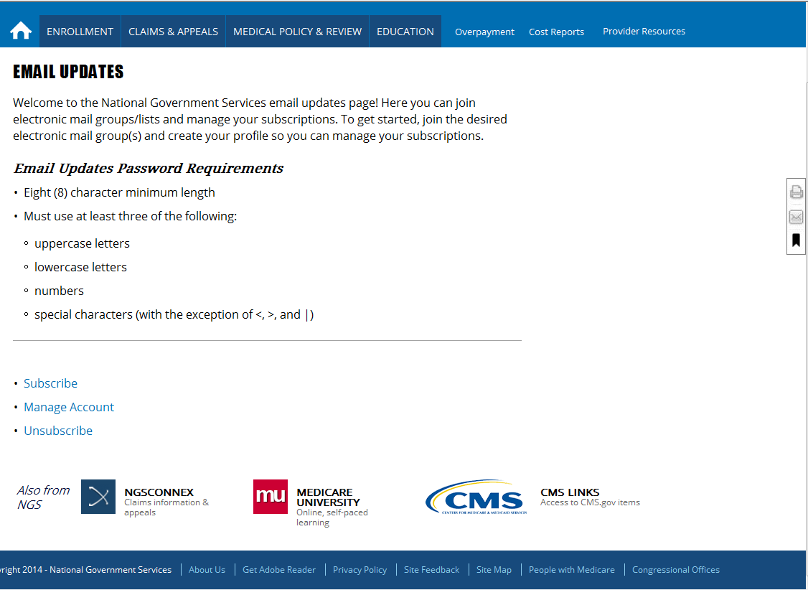
Email Updates
Subscribe to receive the latest Medicare information.

Slide 73

Website Survey
This is your chance to have your voice heard—Say “yes” when you see this pop-up so National Government Services can make your job easier!

Slide 74
Medicare University
Interactive online system available 24/7
Educational opportunities available
  Computer-based training courses
  Teleconferences, webinars, live seminars/face-to-face training
Self-report attendance
Website
  http://www.MedicareUniversity.com

Slide 75
Medicare University
Self-Reporting Instructions
Log on to National Government Services’ Medicare University
  http://www.MedicareUniversity.com
    Topic = Enter title of webinar
    Medicare University Credits (MUCs) = Enter number
    Catalog Number = To be provided
    Course Code = To be provided
  Visit our website for step-by-step self-reporting instructions.
    Click on the Education tab, then the Medicare University Course List tab, click on the Get Credit link. This will open the Get Credit for Completed Courses web page.

Slide 76
Continuing Education Credits
All National Government Services Part A and Part B Provider Outreach and Education attendees can now receive one CEU from AAPC for every hour of National Government Services education received.
If you are accredited with a professional organization other than AAPC, and you plan to request continuing education credit, please contact your organization not National Government Services with your questions concerning CEUs.

Slide 77
Thank You!
Follow-up email
  Attendees will be provided a Medicare University Course Code
Questions?

