Slide 1
CMS Updates
MAPAM
September 15, 2016
Renee Richard
CMS RO 1

Slide 2
Updates
ICD-10 Recent Updates
DMEPOS CB R2 Recompete
Partial Hospitalization (PHP) Update
Modifier JW
Quality Payment Program (QPP)Update – MACRA
CMS Innovation and Health Care Delivery System Reform

Slide 3
ICD-10 Update
2017 ICD-10 PCS and GEMs
  The 2017 ICD-10 Procedure Coding System (ICD-10-PCS) files for FY 2017 are Available
    These 2017 ICD-10-PCS codes are to be used for discharges occurring from October 1, 2016 through September 30, 2017.
  The 2017 General Equivalence Mappings (GEMs) for FY 2017 are available.
https://www.cms.gov/Medicare/Coding/ICD10/2017-ICD-10-PCS-and-GEMs.html
Next Steps for Providers Assessment & Maintenance Toolkit
https://www.cms.gov/Medicare/Coding/ICD10/index.html?redirect=/ICD10

Slide 4
Durable Medical Equipment, Prosthetics/Orthotics & Supplies

Slide 5
DME MAC Jurisdiction A
Noridian Healthcare Solutions, LLC (Noridian), was awarded the contract for the administration of Medicare Fee-for-Service claims for durable medical equipment, prosthetics, orthotics, and supplies (DMEPOS) in Jurisdiction A.
  The Jurisdiction A DME MAC serves Medicare beneficiaries who reside in the states of Connecticut, Delaware, Maine, Maryland, Massachusetts, New Hampshire, New Jersey, New York, Pennsylvania, Rhode Island, and Vermont, and the District of Columbia.
Transition from NHIC to Noridian Healthcare Solutions, LLC was effective July 1, 2016
https://med.noridianmedicare.com/web/jadme/contact

Slide 6
CMS Updates
DMEPOS CB R2 Recompete

Slide 7
The Durable Medical Equipment, Prosthetics, Orthotics, and Supplies (DMEPOS) Competitive Bidding Program
Competitive Bidding—A Better Way to Pay
  Started in January 2011 for certain durable medical equipment, prosthetics, orthotics, and supplies (DMEPOS) in 9 areas of the country (Round 1)
In July 2013
  The program expanded to more areas (Round 2)
  The National Mail-Order Program was implemented
  Limits fraud and abuse in the Medicare program
The Competitive Bidding Program helps people with Medicare
  Save money
  Get quality equipment, supplies, and services

Slide 8
The Competitive Bidding Program
Suppliers submitted bids to provide certain DMEPOS at lower prices than Medicare was paying
Contracts are awarded to winning suppliers to sell/rent DMEPOS
Amount Medicare pays for DMEPOS is based on bids
  When Medicare pays less, the 20% coinsurance is less
Contract suppliers must
  Meet eligibility, quality, and financial standards
  Be accredited by an independent organization

Slide 9
Round 2 Recompete & National
Mail-Order Recompete
Round 2 and National Mail-Order Program
  Contract periods expires on June 30, 2016
Round 2 Recompete and the national mail-order recompete contracts
  Become effective on July 1, 2016
  Expire on December 31, 2018
In most cases, only contract suppliers can provide competitively bid DMEPOS

Slide 10
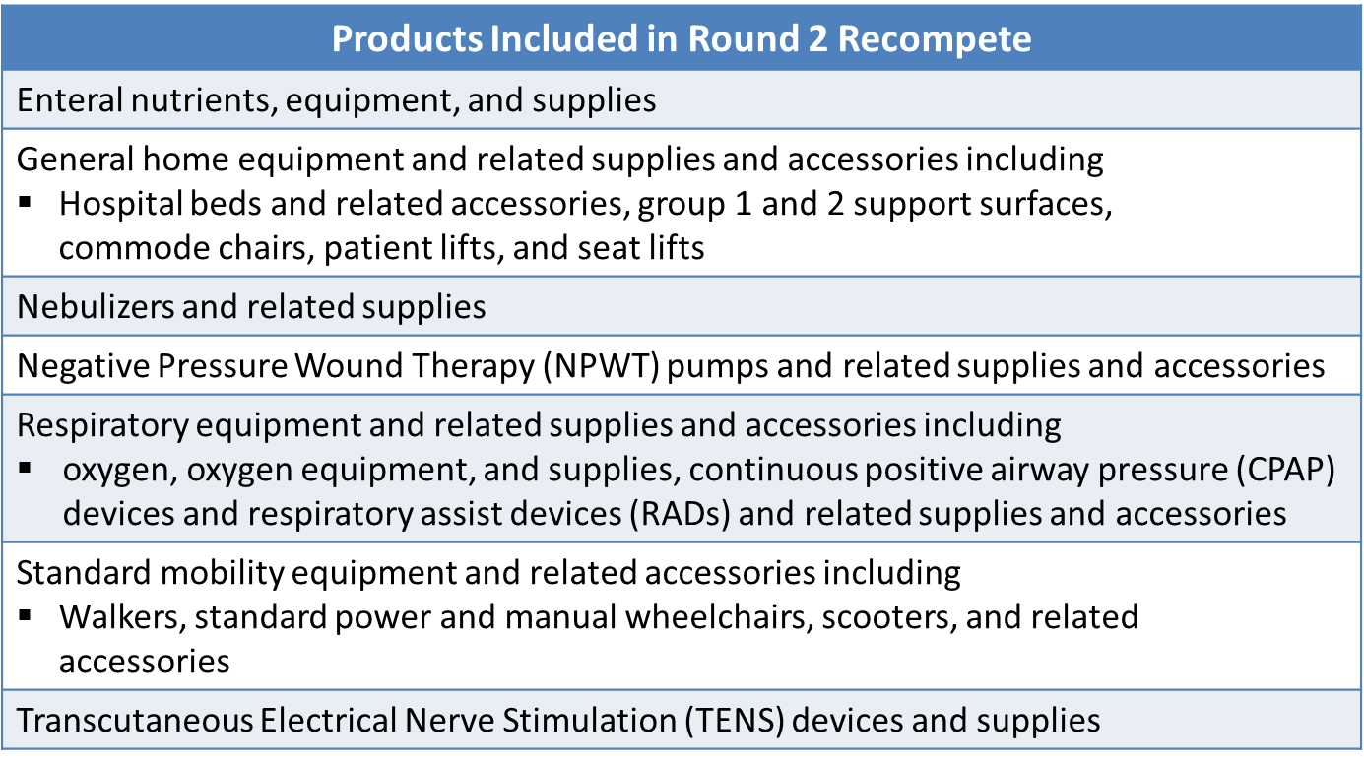
Round 2 Recompete Products
7/1/16-12/31/18

Slide 11
Partial Hospitalization Program (PHP)

Slide 12
MLM SE1607
Enforcement of the PHP 20 Hours Per Week Billing Requirement
Patients admitted to a PHP must be under the care of a physician who certifies the need for partial hospitalization and require a minimum of 20 hours per week of therapeutic services, as evidenced by their plan of care.
Requirement to submit weekly claims
EDITS ON HOLD

Slide 13
PHP 20 Hours Per Week Editing
The best place to send questions is:
Hospital_ODF@cms.hhs.gov

Slide 14
Partial Hospitalization Program (PHP) Rate Setting
The CY 2017 OPPS/ASC proposed rule proposes to update Medicare payment rates for PHP services furnished in hospital outpatient departments and Community Mental Health Centers (CMHCs).
Update to PHP Per Diem Costs
The CY 2017 OPPS/ASC proposed rule proposes to replace the existing two-tiered APC structure for PHPs with a single APC by provider type for providing three or more services per day.
These proposed changes would provide more predictable PHP per diems, particularly given the small number of CMHCs, and would generate more appropriate payments for these services by avoiding the cost inversions that hospital-based PHPs experienced in the CY 2016 OPPS/ASC final rule with comment period.
Notes:
Comment period ended 09/06

Slide 15
Modifier JW

Slide 16
JW Modifier: Drug amount discarded/not administered to any patient
CR9603- Dated April 29, 2016
  Effective for DOS on/or after July 1, 2016
CR9603- Dated June 9, 2016 Trans. 3538
  Effective for DOS on/or after January 1, 2017
  Date of Service
  “Whether the drug is Separately Payable”
  Applies to Status J & K Drugs
  Does not apply to Status N Drugs
  Not required in the inpatient setting
Get all questions into the HODP email
Hospital_ODF@cms.hhs.gov

Slide 17
Medicare Program JW Modifier: Drug/Biological Amount Discarded/Not Administered To Any Patient Frequently Asked Questions
Effective January 1, 2017, providers and suppliers are required to report the JW modifier on Part B drug claims for discarded drugs and biologicals.
Must document the amount of discarded drugs or biologicals in Medicare beneficiaries’ medical records.
The JW modifier is a HCPCS Level II modifier used on a Medicare Part B drug claim to report the amount of drug or biological (hereafter referred to as drug) that is discarded and eligible for payment under the discarded drug policy.
  The modifier shall only be used for drugs in single dose or single use packaging.

Slide 18
Medicare Part B Payment Policy for Discarded Drugs
Pay for the amount of drug that has been administered to a beneficiary
Also pay for the amount of drug that has been discarded, up to the amount that is indicated on the vial or package label.
Discarded drug amount - the amount of a single use vial or other single use package that remains after administering a dose/quantity of the drug to a Medicare beneficiary.
  Medicare Claims Processing Manual, Chapter 17, section 40.1

Slide 19
In which settings is the JW modifier required?
Policy applies to providers and suppliers who buy and bill drugs and is intended to track discarded amounts of drugs that occur as a result of the preparation of a drug dose for administration to a beneficiary.
We anticipate that the JW modifier will be used mostly in the physician’s office and hospital outpatient settings for beneficiaries who receive drugs incident to physicians’ services.
Applies to Critical Access Hospitals (CAHs) since drugs are separately payable in the CAH setting.

Slide 20
In which settings is the JW modifier required?
Does not apply to drugs or biologicals administered in a Rural Health Clinic (RHC) or a Federally Qualified Health Center (FQHC).
  Exceptions are the influenza, pneumococcal, and Hepatitis B vaccines which are paid separately at cost through an RHC’s or FQHC’s cost report and not via a claim.
Not intended for use on claims for hospital inpatient admissions that are billed under the Inpatient Prospective Payment System.

Slide 21
To which drugs does the policy apply?
Modifier policy applies to all separately payable Part B drugs that are designated as single-use or single dose on the FDA-approved label or package insert
All separately payable drugs assigned status indicators G (Pass-Through Drugs and Biologicals) or K (Nonpass-Through Drugs and Nonimplantable Biologicals, Including Therapeutic Radiopharmaceuticals) under the OPPS for which there is an unused or discarded amount.
  This includes those administered in the operating room to hospital outpatients
Package inserts are available on the FDA website at: http://www.accessdata.fda.gov/scripts/cder/drugsatfda/

Slide 22
Modifier JW
  Not appropriate for drugs that are from multiple dose vials or package
  Not required for Drugs that are not separately payable, such as packaged OPPS drugs
  Not required Drugs paid under the Part B drug Competitive Acquisition Program (CAP).
    The CAP remains on hold and there is no current list of CAP medications

Slide 23
Additional JW modifier Information
Does the JW modifier apply to drug overfill?
  JW modifier must not be used to report overfill wastage.
Is the JW modifier applicable when the dose administered is less than the HCPCS billing unit?
  CMS does not use fractional billing units to pay for Part B drugs. Therefore, the JW modifier should not be used when the actual dose of the drug administered is less than the HCPCS billing unit.

Slide 24
Additional JW Modifier Information
3-day/1-day payment window applies
  All hospital outpatient services (and associated charges), including drugs and biologicals, furnished to a beneficiary during the 3 days/1day prior to the beneficiary’s inpatient admission are treated as inpatient services and must be included on the claim for the inpatient admission.
Providers and suppliers may report the JW modifier prior to January 1, 2017.

Slide 25
JW Modifier Billing Guidelines
The drug discarded should be billed on a separate line with the JW modifier. The unit field should reflect the amount of drug discarded.
The modifier, billed on a separate line, will provide payment for the amount of discarded drug or biological.
Example: A single use vial that is labeled to contain 100 units of a drug has 95 units administered to the patient and 5 units discarded. The 95 unit dose is billed on one line, while the discarded 5 units may be billed on another line by using the JW modifier.
Both line items would be processed for payment.

Slide 26
JW Modifier Billing Guidelines
When using the JW modifier, should the dollar amount be included on the wastage line or should the line reflect units only?
General billing rules may require a charge be included on each line on the claim. Also, each MAC that processes claims may have specific billing policies or guidance for certain items or services where there is not national billing guidance from CMS.
Please contact your local MAC for further billing information.

Slide 27


MEDICARE ACCESS & CHIP
REAUTHORIZATION ACT of 2015

Slide 28
Medicare Access and CHIP Reauthorization Act (MACRA)
The Medicare Access and CHIP Reauthorization Act of 2015 (MACRA) is a bipartisan legislation signed into law on April 16, 2015
What does Title 1 of MACRA do?
  Repeals the Sustainable Growth Rate(SGR) formula
  Changes the way that Medicare rewards clinicians for value over volume
  Streamlines multiple quality programs under the new Merit-Based Incentive Payments System (MIPS)
  Providers bonus payments for participation in eligible alternative payment modules (APMS)

Slide 29

…and toward transforming our health care system.
3 goals for our health care system:
BETTER care SMARTER spending HEALTHIER people

Via a focus on 3 areas

Incentives
Care Delivery
Information Sharing

Slide 30
MACRA Goals
Through MACRA, HHS aims t0:
  Offer multiple pathways with varying levels of risk and reward
  Over time, expand the opportunities for a broad range of providers to participate in APMs.
  Minimize additional reporting burdens for APM participants
  Promote understanding of each physician’s or practitioner’s status with respect to MIPS or APMs
  Support multi-payer initiatives and the development of APMS in Medicaid, Medicare Advantage, and other payer arrangements.

Slide 31
MIPS changes how Medicare links performance to payment
There are currently multiple individual quality and value programs for Medicare physicians and practitioners:
Physician Quality Reporting Program (PQRS)
Value-Based Payment Modifier
Medicare EHR Incentive Program
MACRA streamlines those programs into MIPS:
Merit-Based Incentive Payment System
(MIPS)

Slide 32
Eligible Clinicians
MACRA affects clinicians who participate in Medicare Part B.
Years 1 and 2 – Physicians, PAs, Clinical Nurse Specialists, Nurse Anesthetists
  Exceptions- First year in Medicare, Below low volume threshold, Participants in eligible APMs who qualify for the bonus payment

Slide 33

TAKE-AWAY POINTS
1) MACRA changes the way Medicare pays clinicians and
offers financial incentives for providing high value care.
2) Medicare Part B clinicians will participate in the MIPS program,
unless they are in their 1st year of Part B participation, meet criteria for participation in certain APMs, or have a low volume of patients.
3) Payment adjustments and bonuses will begin in 2019.
4) A proposed rule is targeted for spring 2016, with the final rule targeted for fall 2016.

Slide 34
Plans for the Quality Payment Program in 2017:
Pick Your Pace
First Option: Test the Quality Payment Program
as long as you submit some data to the Quality Payment Program, including data from after January 1, 2017, you will avoid a negative payment adjustment. This first option is designed to ensure that your system is working and that you are prepared for broader participation in 2018 and 2019 as you learn more.

Slide 35
Plans for the Quality Payment Program in 2017:
Pick Your Pace
Second Option: Participate for part of the calendar year
  Choose to submit Quality Payment Program information for a reduced number of days. First performance period could begin later than January 1, 2017 and your practice could still qualify for a small positive payment adjustment
Third Option: Participate for the full calendar year.
  For practices that are ready to go on January 1, 2017, they may choose to submit Quality Payment Program information for a full calendar year. This means your first performance period would begin on January 1, 2017.

Slide 36
Plans for the Quality Payment Program in 2017:
Pick Your Pace
Fourth Option: Participate in an Advanced Alternative Payment Model in 2017
  Instead of reporting quality data and other information, the law allows you to participate in the Quality Payment Program by joining an Advanced Alternative Payment Model, such as Medicare Shared Savings Track 2 or 3 in 2017.
  If you receive enough of your Medicare payments or see enough of your Medicare patients through the Advanced Alternative Payment Model in 2017, then you would qualify for a 5 percent incentive payment in 2019.

Slide 37
More Information about QPP
https://www.cms.gov/Medicare/Quality-Initiatives-Patient-Assessment-Instruments/Value-Based-Programs/MACRA-MIPS-and-APMs/MACRA-MIPS-and-APMs.html

Slide 38

Other than payment adjustments, what else does MACRA change?

Slide 39
MACRA supports care delivery and promotes innovation.
Several examples:
1
Allocates $20 million / yr. from 2016-2020 to small practices to provide technical assistance regarding MIPS performance criteria or transitioning to an APM.
2
Creates an advisory committee to help promote development of
Physician-Focused Payment Models

Slide 40
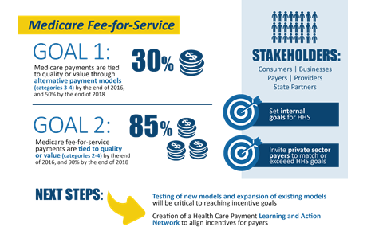
Goals for Value-Based Payments within the Medicare FFS System

Slide 41
CMS Innovation and Health Care Delivery System Reform

Slide 42
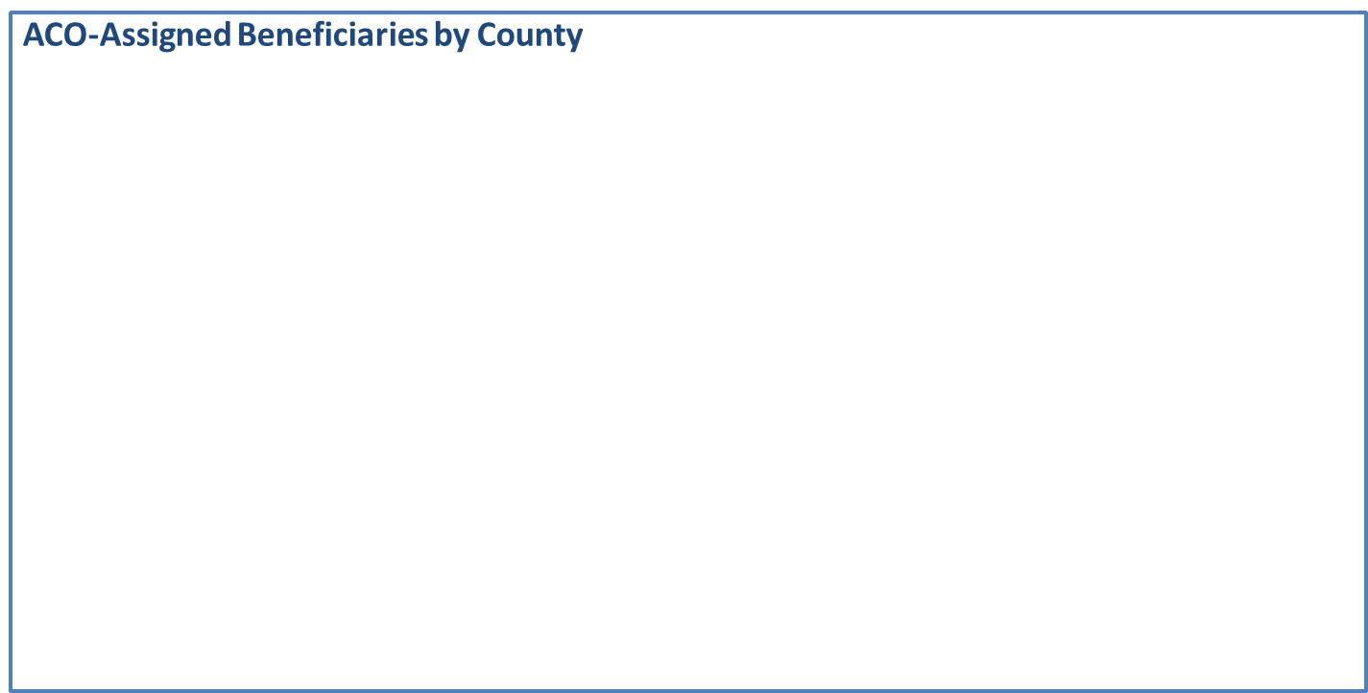
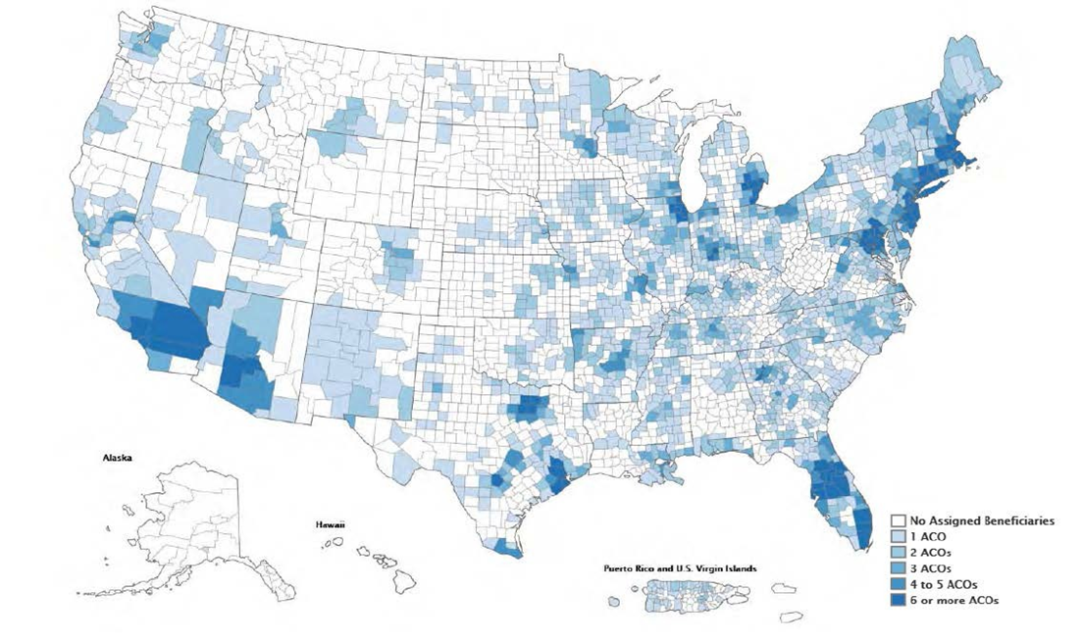
Accountable Care Organizations
423 ACOs have been established in the MSSP and Pioneer ACO programs*
7.9 million assigned beneficiaries
This includes 89 new ACOS covering 1.6 million beneficiaries assigned to the shared saving program in 2015

Slide 43
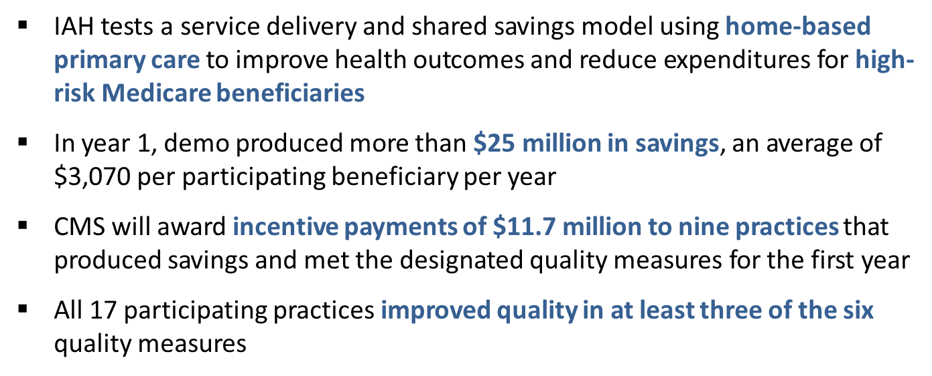

Independence at Home (IAH) Demonstration
There are 15 total practices, including 1 consortium, participating in the model
Approximately 8,400 patients enrolled in the first year
The Demonstration began on June 1, 2012, and will end on September 30, 2017.

Slide 44
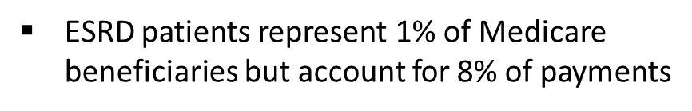
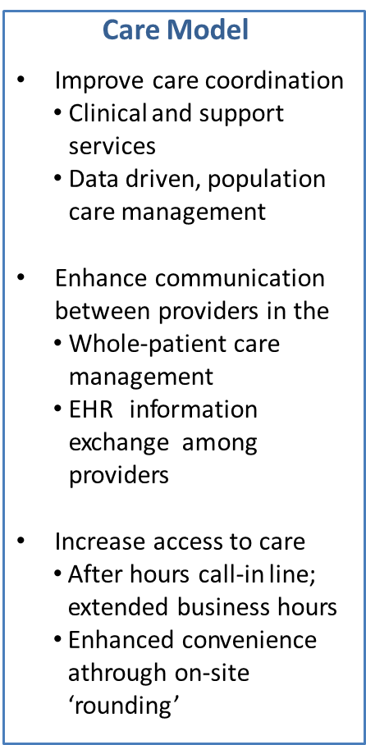
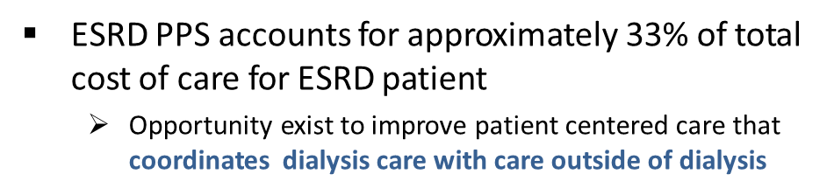
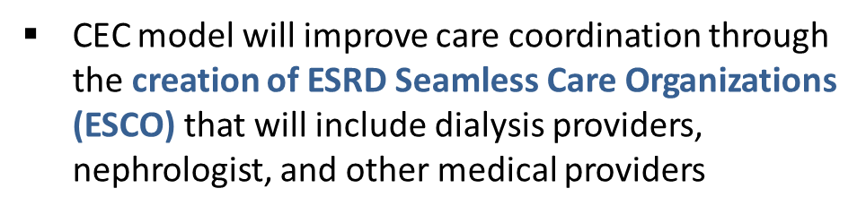
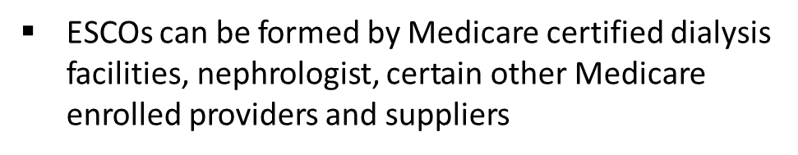
Comprehensive ESRD Care

Slide 45
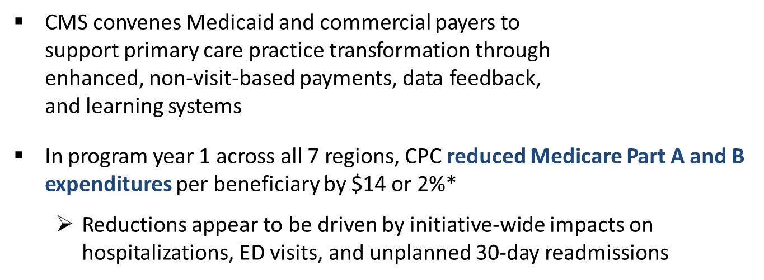

Comprehensive Primary Care (CPC)
7 regions (AR, OR, NI, CO, OK, OH/KY, NY) encompassing 38 payers, nearly 500 practice sites, approximately 2.7 million Medicare & Medicaid beneficiaries.
CPC initiative is currently in program year three of four and scheduled to end in December 2016

Slide 46
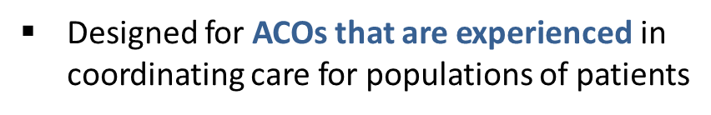
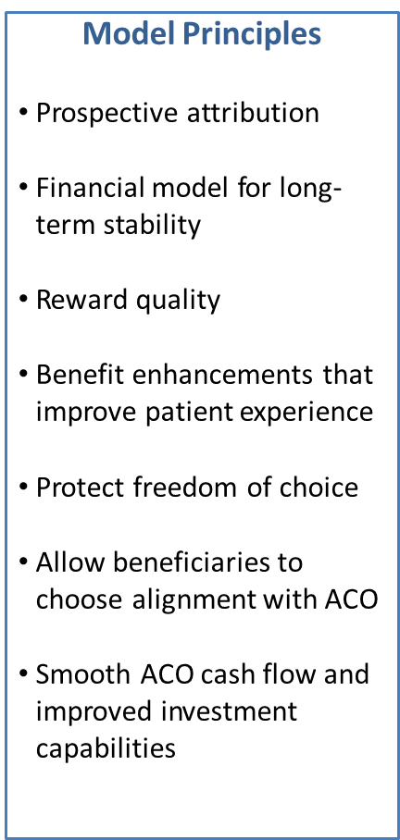

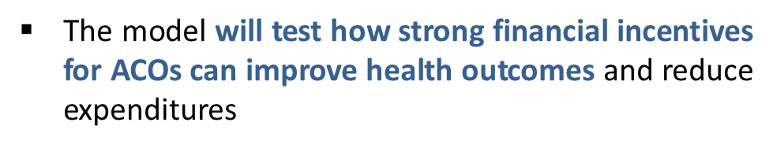
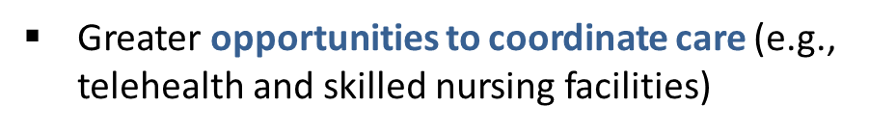

Next Generation ACO Model

Slide 47

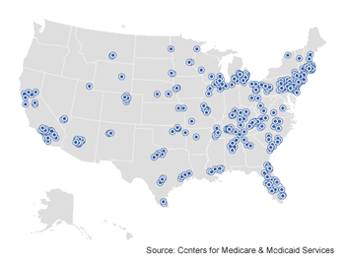
Bundled Payments for Care Improvement
The bundled payment model targets 48 conditions with a single payment for an episode of care
  Incentivizes providers to take accountability for both cost and quality of care
  Four Models
    Model 1: Retrospective acute care hospital stay only
    Model 2: Retrospective acute care hospital stay plus post-acute care
    Model 3: Retrospective post-acute care only
    Model 4: Acute care hospital stay only
337 Awardees and 1237 Episode Initiators in Phase 2 as of January 2016
Duration of Model is scheduled for three years:
• Model 1: April 2013 to present
• Models 2, 3 4: October 2013 to present

Slide 48
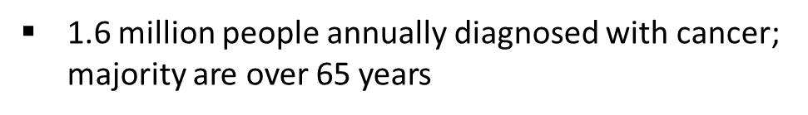
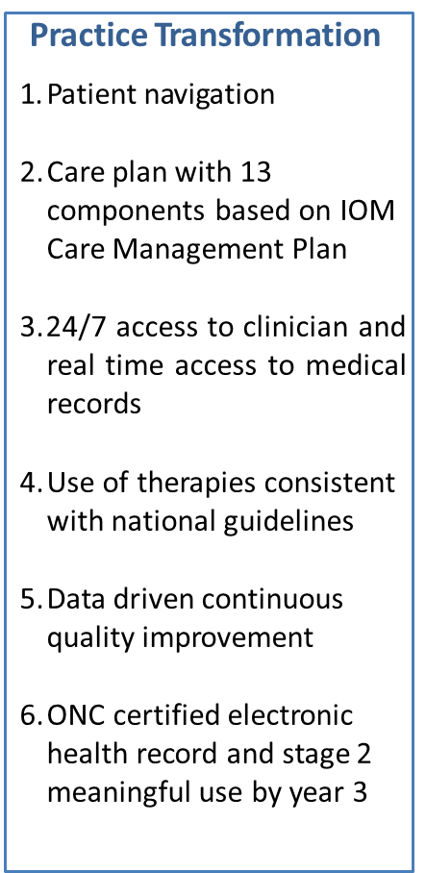
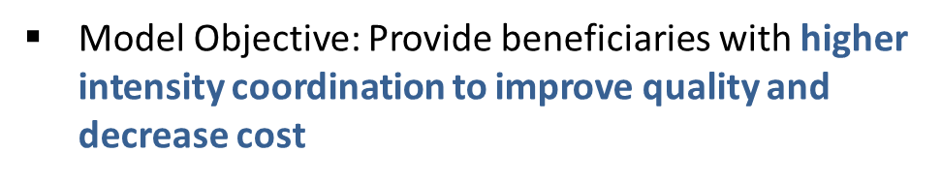
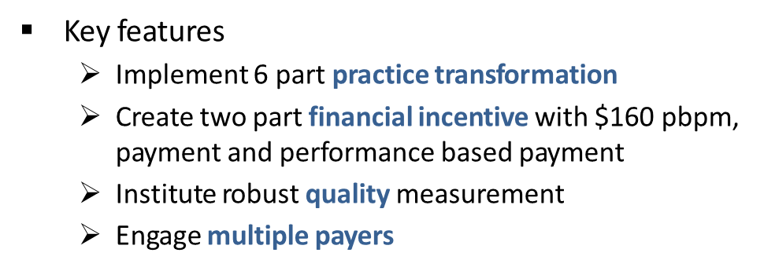
Oncology Care Model

Slide 49
Comprehensive Care for Joint Replacement
CJR model holds participant hospitals financially accountable for the quality and cost of a CJR episode of care and incentivizes increased coordination of care among hospitals, physicians, and post-acute care providers
  CMS has implemented the CJR model in 67 geographic areas
  Acute care hospitals will receive retrospective bundled payments for episodes of care for lower extremity joint replacement or reattachment of a lower extremity (collectively referred to as LEJR)
  MS-DRG 469 or 470
  First performance period for the model will begin on April 1, 2016

Slide 50
Thank you
Renee Richard
617-565-1256
Renee.Richard@cms.hhs.gov

