Slide 1
Payer Performance Management
Payer & Healthcare Outreach
October 17th, 2016

Slide 2

OUR VISION:
To build the information backbone that helps healthcare work as it should.
80,000+
providers across
the network
~200%
growth in
hospital client base
since 2015
1 in 10
Americans seen by
an athenahealth
provider last year
40M
denial prevention
scenarios in Billing
Rules Engine
1,705
quality measures
supported
Notes:
We strive to wick away the grunt work that providers have to do. This means focusing on:
Getting paid faster – we do that by applying the knowledge we have gained throughout our network
Making it easier
What makes us distinct is that we are an integrated network – we are a platform. Different from traditional Electronic Health Record software in that we are not a server rack in a basement somewhere. We are a centralized platform accessed through the internet.
Hospital Stat: grew from 25 hospitals via an acquisition to now 80 hospitals (as of q2 2016).
- Mostly in the under 50 bed market

Slide 3
Performance Management
An iterative process that is heavily reliant on communication, collaboration, and transparency.
Establish objectives and metrics
Share results and recognize high performance
Track & monitor performance against goals and discuss progress
Appraise performance
Notes:
Most important step that is often not executed to the fullest extent necessary: SHARE YOUR FINDINGS!
Share with every stakeholder, especially the payers.

Slide 4




What do you think?
How many of you in this room have visibility into the following metrics?
Days in Accounts Receivable
  Average time to receive payment
Denial Rate
  % of claims requiring back-end re-work
First Pass Resolve Rate
  % of claims that are successfully resolved on initial submission
Provider Collection Burden
  % of charges transferred from the primary insurer to the next responsible party
All of the Above
Notes:
Polling the audience
By show of hands how many of you would like to be able to evaluate the performance of payers you work with?
By show of hands, which of the following metrics would you like to have at your fingertips:
DAR
First Pass Resolve Rate
Denial Rate
Provider Collection Burden
All of the above

Slide 5



Payer & Healthcare Outreach
What we do to reduce friction between the payers & our clients.
Leverage network insight
Provide evidence-based insight on payer performance to help practices respond to industry trends.
Discover areas for continuous improvement
Uncover opportunities for payer performance optimization; seek out collaborations with payers to achieve results.
Add transparency to provider/payer relationship
Use the data as a framework to inform initiatives aimed at creating transparency between providers and payers.
Notes:
PayerView goals include:
Leverage network insight
Discover areas for continuous improvement
Launch transparent, evidence based discussions with the Payers

Slide 6
PayerView Metrics
Measure what matters most.
 | METRIC | 2014 WT | 2015 WT | 2016 WT | DESCRIPTION
Financial Performance 45% | Days in Accounts Receivable | 20% | 20% | 20% | Average length of time it takes for a provider to receive payment for services.
 | First Pass Resolve Rate | 20% | 15% | 15% | Percentage of claims that are successfully resolved on the initial submission.
 | Provider Collection Burden | 10% | 10% | 10% | Percentage of charges ($) transferred from the primary insurer to the next responsible party.
Administrative Performance 25% | Denial Rate | 15% | 15% | 15% | Percentage of claims requiring back-end rework.
 | Enrollment Turn-Around-Time | 0% | 5% | N/A | The number of days required for a payer to return an enrollment request.
 | Enrollment Efficiency | 5% | 5% | 10% | Quantitative ranking of administrative burden surrounding provider enrollment in electronic transactions.
Transaction Performance 30% | Electronic Remittance Advice Transparency | 10% | 10% | 10% | Percentage of electronic remittance advice (835) denial messages with actionable explanations and clear next steps.
 | Eligibility Accuracy | 10% | 10% | 10% | Correlation of eligibility response to adjudication outcome.
 | Benefit Reliability | 10% | 10% | 10% | Percentage of patient responsibilities in which payer returned the correct and actionable patient responsibility information through eligibility at the time of service.
 | Overall Score |  |  | 100% | The overall score reveals payer ranking
Methodology
Notes:
2016 PayerView metrics are focused on measuring friction between payers and the clients on our Network:
8 total metrics that focus on Financial, Administrative, and Transactional performance
We find that Days in Accounts Receivable, First Pass Resolve Rate, Denial Rate, and Provider Collection Burden are particularly descriptive of the burden placed on our clients

Slide 7

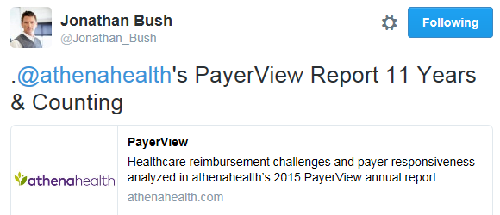
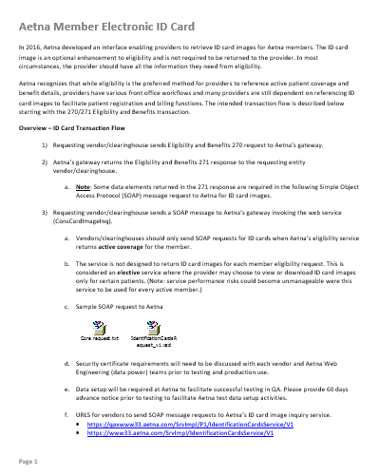
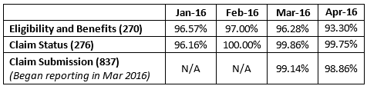
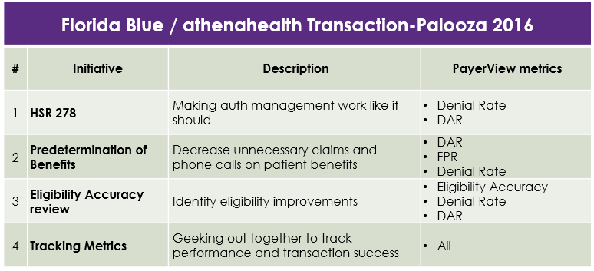
PayerView Cycle
Working with payers to optimize performance… and more!
Outreach/Engage
Identify
Opportunities
Pinpoint & Execute
Measure & Fine-tune
PayerView!
Notes:
Payer and Healthcare Outreach team’s cycle:
Starts with the annual release of PayerView report – a tool that we’ve used for the last 11 years to engage payers.
Next steps are a monthly and ad-hoc process for engaging our top payers where-in we
Identify and engage a Primary Point of Contact
Use our analytics assets to identify opportunities for collaboration
Work with the payers to establish a plan and execute against that plan
We measure the results and impacts and fine-tune where needed
Rinse, monitor, and repeat

Slide 8
Results
How did different groups of payers fare on metrics?
Blues perform best on DAR, Denial Rate, and Enrollment Efficiency.
Medicare payers perform best on FPR, ERA Transparency, Eligibility Accuracy, and Benefit Reliability… but worst on Provider Collection Burden and Enrollment Efficiency.
Medicaid payers perform best on Provider Collection Burden, but worst on DAR, FPR, Denial Rate, ERA Transparency, Eligibility Accuracy, and Benefit Reliability.
 | Blues (51) | Commercial (72) | Medicare (40) | Medicaid (51)
DAR (days) | 25.94 | 36.47 | 28.37 | 46.12
FPR | 94.8% | 93.2% | 96.6% | 88.7%
Denial Rate | 6.0% | 9.1% | 6.3% | 15.0%
ERA Transparency | 94.8% | 94.6% | 99.0% | 92.9%
Provider Collection Burden | 18.9% | 10.1% | 23.7% | 3.8%
Eligibility Accuracy | 97.3% | 96.8% | 99.4% | 96.2%
Benefit Reliability | 93.3% | 69.2% | 100.0% | 47.4%
Enrollment Efficiency | 86.1% | 83.7% | 65.4% | 84.9%
Best / worst
Notes:
Performance by Payer group:
Different types of payers perform better on certain metrics
Stark differences between Medicaid payers and the Blue payers on DAR
Stark differences between Medicare and Medicaid on First Pass Resolve Rate
Sample Design:
In 2015, more than 202 million charge lines were submitted by providers on the athenahealth’s cloud-based network. The network represents over 80,000 providers across 50 states.
Where performance variation is expected, the sample size is large, containing 214 payers, and rankings are categorized for within group comparison: COMMERCIAL, BLUE, MEDICAID, MEDICARE and NATIONAL PAYERS.
Sample Changes in 2015
Based on the above criteria, 214 payers were included in the sample. Medicaid LA, which was included in last year’s PayerView, did not have sufficient volume to be included in 2015. Further, 49 new payers, including Health New England, Medicare B-WY and BCBS-KS, were included in this year’s PayerView as they met all inclusion criteria.

Slide 9
Industry Trends
Medicaid Expansion
Medicaid expansion continues¹
Providers in expansion states seeing
More Medicaid patients²
31
States plus DC
Proportion of PCP Visits from Medicaid
for Medicaid Expansion States
Are Expanding Coverage
AK, AZ, IN, MT, PA have expanded
coverage since 2015
With more providers
seeing Medicaid patients³
But 2016 Medicaid payer’s
performance lagging⁴
13%
of providers accepted
Medicaid patients for the
first time in 2014
1: Kaiser Family Foundation / 2: athenaResearch / 3: athenaResearch / 4: 2016 PayerView analysis
Notes:
There are 3 Key Takeaways from 2016 PayerView:
Medicaid expansion has led to more Medicaid patient visits
Massachusetts is no stranger to this shift and as a result, is now a large part of the Mass market

Slide 10
Industry Trends
Cost Sharing Increase
More cost sharing…
impacting patient obligations at providers…
… with downstream impacts on payer performance
Deductibles Steadily Rising¹
HSA/HDHP Enrollment Skyrocketing²
Patient Obligation Increasing³
Provider Collection Burden
Continues to remain high, and inching ever higher.
Big chunk of practice revenue.
Not going away.
$1,318
Average employee
deductible
up 60% since 2009
19.7M
Americans enrolled in
HSA/HDHP’s
up 146% since 2009
1. Source: Kaiser/HRET Survey of Employer Sponsored Health Benefits, 2006-2015
2. Source: AHIP 2015 Census of Health Savings Account (HSA) - High Deductible Health Plans (HDHP)
3. Source: ACAView 2016, athenahealth and Robert Wood Johnson Foundation. Graphs shows patient obligation for commercially insured adults (18-64)
Notes:
There are 3 Key Takeaways from 2016 PayerView:
Cost Sharing is on the rise
High Deductible Plans are increasingly popular
As a result, patient liability increased
Which further burdens our client’s collection processes

Slide 11
Industry Trends
Volume to Value Shift
Medicare leading the charge…
… with commercial market following suit.
Pledge of the
Health Care Transformation Task Force
75%
Portion of business to be in “Value” arrangements
by 2020
Includes some of the nation’s largest payers and health systems.
Pledge focuses on implementation of “Triple Aim”(better health, better care and lower costs).
Target percentage of Medicare FFS
payments linked to quality and
alternative payment models
2016
2018
30%
50%
85%
90%
All Medicare FFS
All Medicare FFS
All Medicare FFS
FFS linked to quality
Alternative payment models
Sources:
Medicare: https://www.cms.gov/Newsroom/MediaReleaseDatabase/Fact-sheets/2015-Fact-sheets-items/2015-01-26-3.html
Commercial: http://www.hcttf.org/
Notes:
There are 3 Key Takeaways from 2016 PayerView:
A shift from FFS to Value Based models
These shifts create challenges but also opportunities to partner with payers

Slide 12




What we are doing to respond
Leveraging our unique position and capabilities!
Optimize
Improve performance through targeted initiatives identified through reporting and tracking.
Partner
Innovate together to test ideas, pilot new transactions, explore new ways of doing things.
Escalate
Rapidly identify, triage, and resolve operational issues via our “bat phone” approach.
Communicate
Stay in touch and share perspectives on industry goings-on like VBC, policy issues, etc.

Slide 13

Questions?

