Slide 1
Bridging the gap between HIM and Patient Accounts
MAPAM Fall Conference 2016
Daniel Rossi, CCS
HIM Director/Privacy Officer
Harrington Hospital

Slide 2
With the ever changing payment policies, coding guidelines, and growth of electronic medical record and charging systems in use today, there can develop a gap between HIM and Patient accounts understanding of their role in the revenue cycle.
This presentation will show how with open communication and collaboration, the two departments can effectively and efficiently close that gap to protect current revenue and even identify lost revenue opportunities.

Slide 3
“Hospitals exist in a very uncertain time. Reimbursement risk runs high, and receiving payments from patients is not guaranteed. The ability to capture lost revenue and improve the ability to forecast actual revenue received to the budget is necessary for hospitals' and other service providers' survival and vitality.”
        Source: Wall Street 2010

Slide 4

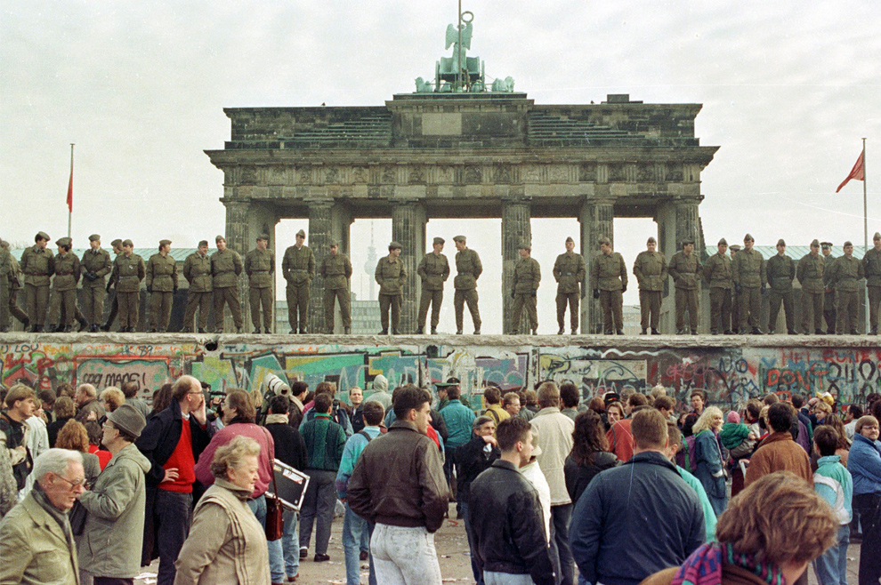
Notes:
Grand canyon has vast ecosystems, not readily visible…but they are there.
East Berlin border guards atop the Berlin Wall at Brandeburg gate. What has history taught us? it has been HIM on one side PT ACCTS on the other…why continue with the “walls”

Slide 5
Revenue Cycle:
The administrative and clinical functions, processes, and software applications that contribute and manage the registration, charging, billing, payment and collections for a patient encounter.
Adopt a $0 to $0 Philosophy

Slide 6
The Revenue “Cycle”
SCHEDULING
CUSTOMER
SERVICE
REGISTRATION
POST
PAYMENT REVIEW
INSURANCE
VERIFICATION
POINT OF SERVICE
COLLECTIONS
CASH POSTING
SELF PAY
COLLECTIONS
CULTURE
PEOPLE
FINANCIAL
COUNSELING
PROCESS
TOOLS
DENIALS MANAGEMENT
CASE MGMT/CDI
THIRD PARTY
FOLLOW- UP
CDM/CHARGE
CAPTURE
BILLING
MEDICAL RECORDS
CODING
Notes:
Regulations
Technology
Payers
Customer expectations

Slide 7
Where Does the Information Come From?
Required Billing Elements - Where do they come from?
50% - Patient Access 15% - Charge Entry Areas
15% - Medical Records 20% - Billing
Required Elements:
Patient Demographic Data
Patients last name, first name, and middle initial
Patient address
Birth date
Male (M) or Female (F)
Marital Status
Admission date or start of care date
Encounter Specific
Hour patient was admitted for inpatient or outpatient care
Occurrence Codes
Code indicating the priority of admission--1 indicates emergency; 2 urgent; 3 elective; 4 newborn; and 9 information not available.
Code indicating the source of admission or outpatient service
Provider has patient signature on file permitting release of data (Y or N)
Principal Diagnostic Coding (ICD-10-CM code)
Admitting Diagnostic Coding (ICD-10-CM code)
Insurance Information
The name and number identifying each payer that payment is expected
Assignment of benefits (Y) yes; (N) no
The name of the patient or insured individual
Relationship of the insured (person having insurance) to the patient
Insured’s identification number assigned by the payer organization
The group name/plan through which the insurance coverage is provided
The insurance group number
Employment status code
Employer’s name and address

Slide 8
Patient Access
Patient Access is the “Front Door” and the first step in the revenue cycle process.
The important functions and information gathered in Access include:
  Verifying of Insurance
  Obtaining Authorizations and certifications
  Gathering patient demographics and insurance information
  Financial Counseling
  Eligibility verification
Notes:
Think of the impact in this area alone if this information is incorrect

Slide 9
Health Information Management
The practice of maintenance and care of health records by traditional and electronic means in hospitals, physician's office, clinics etc…
The important functions and information gathered in HIM include:
  Coding services documented by Physicians
    CPT codes (outpatient procedures)
    ICD-10-PCS (inpatient procedures)
    ICD-10-CM (diagnosis)
    HCPCS (supplies, drugs, etc.)
Ensure Codes accurately reflect patient services as documented
Serves as Subject Matter Experts in, Documentation and Coding
Educates, presents, and trains on opportunities to improve Case Mix Index (CMI)
Oversees and responds to Coding Audits
Manages storage and retrieval of medical records
Maintaining complete compliant documentation
Notes:
Acts as a Liaison between all areas
Providing and Managing Transcription Services

Slide 10
Patient Accounts
Patient Accounts is the “Cash machine”.
The important functions and information gathered in PA include:
  Billing
  Overseeing Claims Edits to ensure “Clean Claim Submissions”
  Employing tools to ensure accuracy in charge capture
  Follow-Up with Insurance companies
    Appeals
    Denials
    Un-paid Claims
  Collections
  Cash Posting
  Subject Matter Experts
    Government Billing
    Commercial and Managed Care Billing
Notes:
Employs and Oversees systems and vendors
Maintaining customer service-patients
This is the tail end….patients last experience with the organization…

Slide 11
Charge Master
The Charge Master is a critical component to billing compliance and charge capture and is often considered the "life blood" to a Hospital's Revenue Cycle by touching almost every department within the facility.
  Standardization of charge master
  Department level review of all processes and charges with management staff to ensure all billable charges are represented on the CDM
  CDM reviews and updates to ensure compliance for all payers
  Maintenance strategies, controls and tools for maintaining an accurate and compliant CDM
Notes:
“Bill what you do” – the process where services provided are entered into the system.

Slide 12
Things to remember…
Users have different system access and Knowledge.
Departments may have a different level of system integration and workflows.
We all “speak” a different language
DNFB, claim is in suspense, …was RTP’d…
CC, MCC, Clinical terms
CPT vs system mnemonics vs charge master

Slide 13
Develop a team approach
Start with a few team members from the Patient accounts and HIM supervisory team.
Learn from each other. You will be surprised at how much the team will come together.
Invite team members from specific departments if needed for assistance.
  Front line users know the systems
Notes:
too many hands in the cookie jar?

Slide 14
Develop a team approach
This is a work group…not a therapy session!
Set expectations
  Non accusatory environment
  Teamwork is vital
  Resolution and results are tracked
  Report results and barriers to obtaining results
Use the system to walkthrough an issue
  Light bulb moments!

Slide 15
Denials
Medical Necessity
Modifiers
Units of service
Missing codes
Mismatch on authorized codes
Post payment audit findings
Payer specific codes required

Slide 16
Considerations
Are charges automatically entered from system or manually input from a charge master?
  Learn how the charge was generated.
    From EMR documentation being completed?
    From an order being completed by someone?
    Mapped through a scheduling system?
    Keyed by a user?
Notes:
Are the sub system dictionaries set up appropriately and mapped to the correct charge in the CDM?
Is the order set to charge at the correct “status”
Does a charge drop when a visit is “attended”
Is it being keyed because something is not set up properly in a subsystem.
Does the department know what is charging and the process?

Slide 17
Considerations
Are manual charges entered timely for prompt payment?
  Should be within 24 hours.
  Is there backup to the person that does this?
  Why are they not automated?
    Don’t know it is an option?
    Don’t trust systems?

Slide 18
Considerations
Is reconciliation performed to ensure all charges are entered and entered accurately?
  Should occur daily.
  Are both automated and manual entry occurring?
  What about errors of omission?

Slide 19
Considerations
Are problems/denials sent to departments to work for processing or corrections?
  There are multiple departments and sites. Who is responsible?
  What is the expectation for a response?
  Does the department understand what you are asking them or even what the problem is?

Slide 20
Daily process
Set up department liaisons
  Identify a main contact person to contact.
  Filter daily items through this person
    Sets up accountability
    Allows for Quick responses
    Rapid identification of potential larger issues
    Develop a relationship and will work together
  Teach each other what caused the issue and why…and what needs to be done to resolve the problem.
Notes:
Coding guidelines vs payer criteria.
Respect each others role!

Slide 21
DNFB
Use the same approach!
  Identify and prevent up front
  Build edits “claim holds”
  Route to dept.
  Expectation on resolution
  Less rework!
CLEAN CLAIMS THE FIRST TIME

Slide 22
Row Labels | Sum of Bill Chgs
ABSTRACTING STATUS FINAL | 16,630.25
ADMISSION PRIORITY IN LIST | 45,775.34
ADMIT DIAGNOSIS | 15,307.06
ADMIT SOURCE | 3,446.44
Admit source & charge proc | 54,257.29
BILL LATE/ACNT TY & ALT CD CPT | 7,842.30
CC 42X;OC11,29,35 | 33,768.95
CC 43X;OC11,17,44 | 383.50
CC Count, CPT and MOd | 1,226.60
CHARGE CAT AND ALT CODE | 52,518.05
DIAG CODE AND OCCUR CODE | 109,955.39
DIS DISP CODE REQ OCC CODE | 13,404.65
DISCHARGE DATE-FINAL&LATE BILL
DISCHARGE HOUR | 1,326.81
DRG STATUS FINAL-ALL BILL TYPS | 353,141.51
DX1-ALL no zero bal | 557,338.49
ED Admit Src Req Level Charge
FINAL ABS ST no zero bal | 76,667.27
In/Out Patient Overlap | 28.93
INS 1 SUBSCRIBER ADDRESS 1 | 11,640.22
INS 1 SUBSCRIBER BIRTHDATE
INS 1 SUBSCRIBER CITY
INS 1 SUBSCRIBER NAME
INS 1 SUBSCRIBER RELATION
INS 1 SUBSCRIBER SEX
INS 1 SUBSCRIBER SOC SEC NO
INS 1 SUBSCRIBER STATE
INS 1 SUBSCRIBER ZIP
INS 2 SUBSCRIBER ADDRESS 1 | 1,239.75
INS 2 SUBSCRIBER CITY
INS 2 SUBSCRIBER NAME
INS 2 SUBSCRIBER RELATION
INS 2 SUBSCRIBER SEX
MISSING 360 SURG CHARGE - WAIT | 26,678.87
MISSING 450 ED CHARGE - WAIT | 361.01
Missing ED Charge | 69,303.11
NO EFF DT FOUND FOR REIMB RULE | 2,702.22
PATIENT ADDRESS | 312.82
Patient is the Subscriber | 7,922.05
PERF PHYS MISSING | 3,082.34
Policy # Patient vs Subscriber | 37,270.90
Policy Number Check | 17,469.56
PRINCIPAL DIS DX-ALL BILL TYPS | 91,950.89
SUB POL NO & SP | 26,573.44
SURGICAL PHYSICIAN | 69,611.91
ZIP Code List | 2,191.75
Grand Total | 1,711,329.67
Notes:
INCLUDE $$$ IMPACT!!!!
PARSE IT OUT TO RESPONSIBLE PARTIES.
Compliance checks!!!!

Slide 23
Thank you!
Questions or Comments
Daniel Rossi, CCS
Harrington Hospital
drossi@harringtonhospital.org

