Slide 1
Managing Self-Pay A/R & Customer Service Follow Up
MAPAM Fall Conference 2016
Magda Rodriguez
Credit Manager
Harrington Hospital

Slide 2
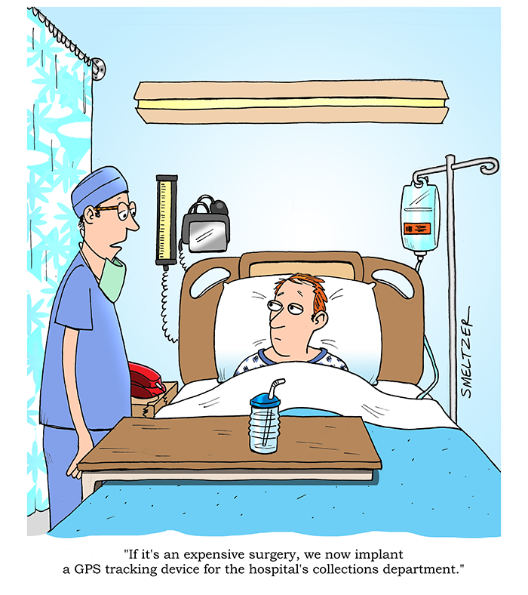

Slide 3


PEACE & SERENITY
A/R BUCKETS
UNBILLED
0 – 30
31 - 60
61 - 90
91 - 180
181 +
BAD DEBT

Slide 4
Self-Pay A/R
What we already know & do…
Self-pay ATB
Outsource SP
Offer Payment Plans
Offer Financial Counseling
Offer Prompt Pay Discounts
Offer Online Payment Portals
Patient Statements
Move to Bad Debt timely –
Collection agency placements

Slide 5


Show me the money!

Slide 6
Customer Service
What is 'Customer Service'
Customer service is the process of ensuring customer satisfaction with a product or service… Customer service can take the form of an in-person interaction, a phone call, self-service systems, or by other means.
BREAKING DOWN 'Customer Service'
Customer service is an extremely important part of maintaining ongoing client relationships, which are key to continuing revenue.
Key to Excellent Customer Service
Most successful businesses recognize the important of providing outstanding customer service. A courteous and empathetic interaction with a trained customer service representative can mean the difference between losing or retaining a customer.
Read more: Customer Service Definition | Investopedia http://www.investopedia.com/terms/c/customer-service.asp#ixzz4MOWSwFjR

Slide 7
Bad Customer Service
Service Montage.mp4

Slide 8

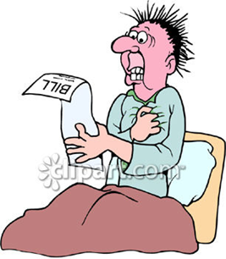


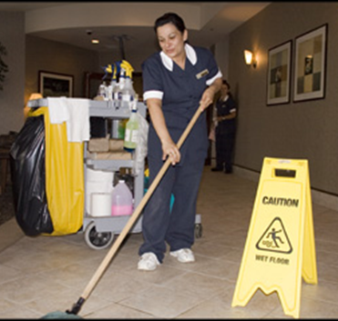
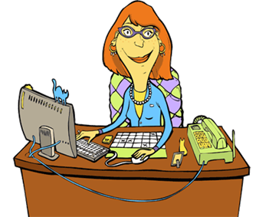
Who are our customers?
Patients
Patient’s families
Vendors
Providers
Staff – which staff?
Who else?

Slide 9
Strengthen Your
Customer Service Skills
Empathy, patience and consistency. Some customers will be irate. Others will be full of questions. And others will just be chatty. You must know how to handle all of them and provide the same level of service every time.
Adaptability. Every customer is different, and some may even seem to change week-to-week. You should be able to handle surprises, sense the customer’s mood and adapt accordingly. This also includes a willingness to learn– providing good customer service is a continuous learning process.
Clear communication. Ensure you convey to customers exactly what you mean. You don’t want your customer to think he’s getting one thing when he’s actually getting another. Use authentically positive language, stay cheerful no matter what and never end a conversation without confirming the customer is satisfied.

Slide 10

Work ethic. Customers appreciate a rep who will see their problem through to its resolution. At the same time, you must have good time management skills and not spend too much time handling one customer while others are waiting. Stay focused on your goals to achieve the right balance.
Knowledge. Ultimately your customers rely on you for your knowledge of healthcare. Stay informed enough to respond to most inquiries and know where to turn if the questions become too detailed or clinical for you to answer. But don’t be afraid to say “I don’t know” either. Customers will appreciate the honesty and your efforts to find the right answer.
Thick skin. The customer’s always right… right? The ability to swallow one’s pride and accept blame or negative feedback is crucial. Q-T-I-P!
Q uit
T aking
I t
P ersonal

Slide 11
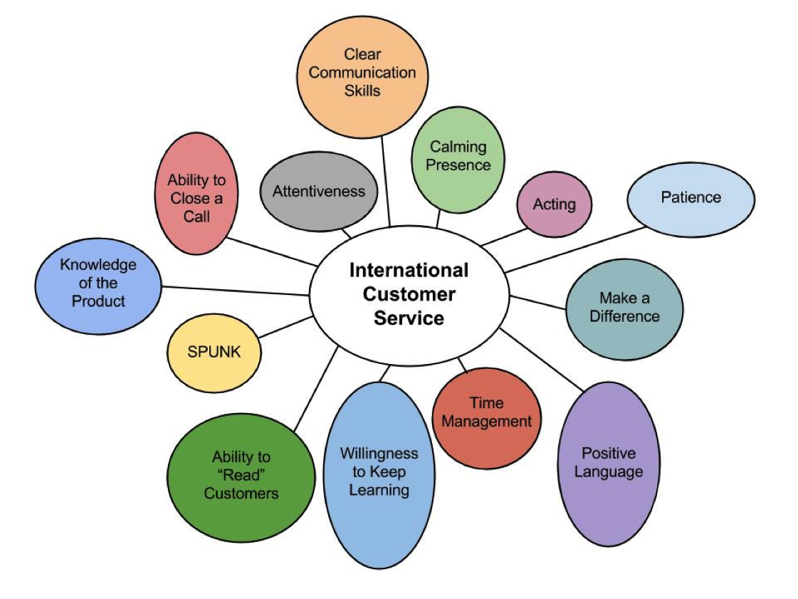
13 Customer Service Skills that Every Employee Needs
CUSTOMER SERVICE

Slide 12
1. Patience
Not only is patience important to customers, who often reach out when they are confused and frustrated, but it's also important to the organization at large. Time spent with a customer is used to better understand their problems and needs.
If you deal with customers on a daily basis, be sure to stay patient when they come to you stumped and frustrated, but also be sure to take the time to truly figure out what they want — they'd rather get competent service than be rushed out the door!
CUSTOMER SERVICE

Slide 13
2. Attentiveness
CUSTOMER SERVICE
Not only is it important to pay attention to individual customer interactions (watching the language/terms that they use to describe their problems), but it's also important to be mindful and attentive to the feedback that you receive at large.
What are your customers telling you without saying it?

Slide 14
3. Clear Communication
Make sure you're getting to the problem at hand; customers don't need your life story or to hear about how your day is going.
More importantly, you need to be cautious about how some of your communication habits translate to customers, and it's best to err on the side of caution whenever you find yourself questioning a situation.
When it comes to important points that you need to customers, keep it simple and leave nothing to doubt.
CUSTOMER SERVICE

Slide 15
4. Knowledge of the Product/Service
CUSTOMER SERVICE
The best forward-facing employees in your hospital will work on having good knowledge of the services available. It's not that every single team/department will be able to do every job, but rather they should know the ins and outs of who to, and how to, direct customer concerns.
Without knowing who/where your resources are from front-to-back, you won't know how to help customers when they come with problems.

Slide 16
5. Positive Language
Sounds like fluffy nonsense, but your ability to make minor changes in your conversational patterns can truly go a long way in creating happy customers.
Language is a very important part of persuasion, and people (especially customers) create perceptions about you and your company based off of the language that you use.
Small changes that utilize "positive language" can greatly affect how the customer hears your response...
CUSTOMER SERVICE

Slide 17
6. Acting
Sometimes you're going to come across people that you'll never be able to make happy.
Situations outside of your control (they had a terrible day, or they are just a natural-born complainer) will sometimes creep into your usual support routine, and you'll be greeted with those "barnacle" customers that seem to want nothing else but to pull you down.
Every great customer service rep will have those basic acting skills necessary to maintain their usual cheery persona in spite of dealing with people who may be just plain grumpy.
CUSTOMER SERVICE

Slide 18
7. Time Management
The trick here is that this should also be applied when realizing when you simply cannot help a customer. If you don't know the solution to a problem, the best kind of help will be to get a customer over to someone who does.
Don't waste time trying to go above and beyond for a customer in an area where you will just end up wasting both of your time!
CUSTOMER SERVICE

Slide 19
8. Ability to “Read” Customers
This skill is essential because you don't want to mis-read a customer and end up losing them due to confusion and miscommunication.
Look and listen for subtle clues about their current mood, patience level, personality, etc., and you'll go far in keeping your customer interactions positive.
CUSTOMER SERVICE

Slide 20
9. Calming Presence
CUSTOMER SERVICE
There's a lot of metaphors for this type of personality: "keeps their cool," "staying cool under pressure," etc., but it all represents the same thing: the ability that some people have to stay calm and even influence others when things get a little hectic.
The best customer service reps know that they cannot let a heated customer force them to lose their cool; in fact it is their job to try to be the "rock" for a customer who thinks the world is falling down due to their current problem.

Slide 21
10. Make a Difference
In order to make a difference, it's best to be able to think on your feet... but it's even better to have guidelines for when you come across a customer who has a problem you've never seen before...
Who? Who is your "go-to" person when you don't know what to do? This way you’re not left wondering who you should forward the problem too.
What? When the problem is noticeably out of your league, what are you going to send to the people above? The full conversation, just the important parts, or maybe some highlights?
How? When it comes time to get someone else involved, how are you going to contact them?
CUSTOMER SERVICE

Slide 22
11. SPUNK / Tenacity
Call it what you want, but a great work ethic and a willingness to do what needs to be done (and not take shortcuts) is a key skill when providing the kind of service that people talk about.
Remembering that your customers are people too, and knowing that putting in the extra effort will come back to you ten-fold should be your driving motivation to never "cheat" your customers with lazy service.
CUSTOMER SERVICE

Slide 23
12. Ability to Close a Call
CUSTOMER SERVICE
To be clear, this has nothing to do with “collecting cash" or other related terms.
Being able to close with a customer means being able to end the conversation with confirmed satisfaction (or as close to it as you can achieve) and with the customer feeling that everything has been taken care of (or will be).

Slide 24
13. Willingness to Keep Learning
This is probably the most general skill on the list, but it's still necessary.
Those who don't seek to improve what they do, whether it's managing, administrating, marketing, or helping customers, will get left behind by those willing to invest in their skills.
CUSTOMER SERVICE

Slide 25
13 Customer Service Skills that Every Employee Needs
CUSTOMER SERVICE

Slide 26

Thank you!

