Slide 1





Incorporating Quality and Customer Service into
Your Revenue Cycle
2016 MAPAM Fall Conference
“Surviving the Healthcare Apocalypse”
October 17-18, 2016
John Behn
Principal, Stroudwater Associates
President, Stroudwater Revenue Cycle Solutions

Slide 2
Today’s Environment
The healthcare industry faces constant change, increasing customer demands and stricter payor guidelines
Revenue cycle demands are more complicated and difficult to navigate

Slide 3

By Martin SoulStealer from London, England - Chainsaw Reb, CC BY 2.0, https://commons.wikimedia.org/w/index.php?curid=26197066

Slide 4
Hospitals As Vehicles for Change
To survive, hospitals must be change agents
Their revenue cycles must eliminate variability, focus on consistent, compliant outcomes and exceed customer expectations
In order to create this revenue cycle model, every hospital must incorporate a commitment to Best Class Customer Service and Quality in all areas of revenue cycle operations
How often do you discuss Revenue Cycle Quality or Customer Service?
Is either a part of your revenue cycle mission statement?

Slide 5

Customer Service
When you think of best class customer service, what images or companies come to mind?

Slide 6










Slide 7
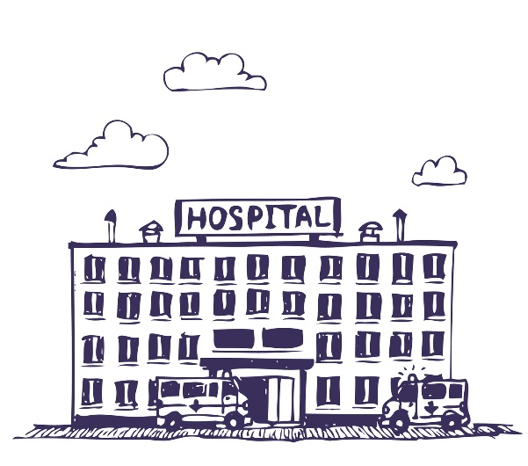

Customer Service
Did your hospital enter your mind?
  Many people don’t immediately think of a Hospital when they consider best class customer service
Why?
  Isn’t our core business entirely focused upon positive, life saving outcomes for our customers?
To be successful we need our hospital to be synonymous with best class customer service

Slide 8

Customer Service
Focus on the customer
  All revenue cycle activity must be developed, implemented and maintained through focus on the customer
  Healthcare is now a retail business
  Customers are asking more detailed questions and are demanding complete, concise and correct responses
  Focus must be placed customer service outputs, messages and methodologies

Slide 9
Customer Service
What does customer service look like?
Customer service equals value to your customers
Our processes must illustrate that every customer counts
Best class customer service starts with expectations
What is your expectation for customer service?
How does your facility value customer service?
At the baseline, what is the purpose of our business?
Every answer includes the customer

Slide 10

Customer Service
To be successful, we must understand and focus upon what our customers value:
  Quality
  Consistency
  Family feel
  Ease
  Confidence
What do your customers value?
By Martin SoulStealer from London, England - Zombie Baby & Nurse, CC BY 2.0, https://commons.wikimedia.org/w/index.php?curid=26198085

Slide 11

Customer Service
When customer service is discussed in your facility, is it lip service or is customer service a mission critical component of your revenue cycle?
How do we know if we succeed or fail?
Do you overpromise and under-deliver and disappoint?
If so, why?
Do we fail because of:
  Missing policies and procedures
  Minimal administrative expectation
  Sub-par internal morale
  Lack of focus and consistency
Image by Martin SoulStealer from London, England - Family Zombie, CC BY 2.0, https://commons.wikimedia.org/w/index.php?curid=26197105

Slide 12

Customer Service
Satisfied and happy customers are the key to your financial viability
Customers have options
They are mobile
Are your customers your greatest marketing source or a source for concern?
By Martin SoulStealer from London, England - Game Of Thrones, CC BY 2.0, https://commons.wikimedia.org/w/index.php?curid=26197417

Slide 13
Customer Service
Focus on the customer – where to start
Define what customer service will mean in your facility
Define who are the customers
  Internal
  External
Create a methodology to measure customer service
Create specific policies and procedures that govern the interactions with customers
  Self-pay polices
  Advance payment/quoting policies
  Answering incoming calls in a consistent manner facility-wide

Slide 14

Customer Service
Customer service applies to both internal and external customers
Identify your customer service concerns:
Internal
  Internal clinicians
  Department heads
  Business office staff
  Registration
  Scheduling
  Outsourced AR companies
External
  Patients
  Families
  Visitors
  External clinicians
  Payor representatives
  Vendors
By Martin SoulStealer from London, England - Nurse & Grab, CC BY 2.0, https://commons.wikimedia.org/w/index.php?curid=26197220

Slide 15
Customer Service
To establish customer service you must:
  Take care of your people
    Only through the appropriate attention to your people will you deliver exemplary external customer service
  Set high, unwavering expectations
    Administration must set high expectations for the delivery of consistent customer service
  There must be consequences, training and education when we fail
  There must be an attention to Quality

Slide 16
Quality
Focus on Quality
Every facility must have a zero-defect mentality
Within business operations, quality must be an obsession
Demanding quality in the revenue cycle takes time, direction and constant action
Quality is a competitive weapon
Quality impacts every operational area and employee

Slide 17
Quality
Every facility must design a process that demands:
  A relentless pursuit of perfection
  High standards
  Customer focus
  Unrelenting/unapologetic attention to detail
  Consistency
  Focus on outcomes/results
  Doing things right the first time, every time

Slide 18

Quality
What comes to mind when you think of the highest quality?

Slide 19









Slide 20

Quality
Where does your facility rank?
How would you know?
Most hospitals have a difficult time measuring business/revenue cycle quality
How does your facility define and measure quality?

Slide 21

Quality
Quality is about doing things right the first time, every time
The pursuit of quality has the goal of exceeding customer expectations
Attention to quality lowers costs, increases margins, facilitates consistency of results and empowers internal accountability and ownership
Quality is about focusing on all aspects of revenue cycle operations from start to finish
By daveynin from United States (Zombie Fest 2009: Doctor zombie) [CC BY 2.0 (http://creativecommons.org/licenses/by/2.0)], via Wikimedia Commons

Slide 22
Quality
Quality operations illustrate:
Organization
Diligence to detail
Preparedness
Consistency
Accountability
Ownership
Low-quality operations illustrate:
Messy workstations
Wasted meetings
Inability to act
Lack of communication
Low morale
Us-vs.-Them mentality

Slide 23
Quality
The attention to quality within your facility is evident
Just look around
Look at:
  Employee workstations
  Content and utility of reports
  Minutes from your revenue cycle meetings
    Who showed up
    What was discussed
    Was action taken
    Were tasks assigned
    Who was prepared for the meetings

Slide 24
Quality
Focus on Quality – Where to Start
  There is no one-way, all-solving process to address quality concerns
  Design mechanisms to measure revenue cycle quality
  Define what revenue cycle quality means in your facility
  Facilities will have different areas of importance
  Some will define quality:
    Denial rate
    First pass claim submission rate
    Customer service measurements
    Successful procedural quoting process
    Total revenue capture
    Full and complete provider documentation
    Knowledge of and adherence to all payor guidelines

Slide 25

Quality
Your commitment to quality will have an immediate and long-lasting impact
  Patients will experience it through:
    Accurate and reliable billing statements
    Consistent customer service
    Attention to detail
    Ease of scheduling / registration
    Efficient process design
  Employees will experience it through:
    Administrative commitment
    Process consistency
    High standards
    Attention to operational detail
    Accountability
    Ownership
By Martin SoulStealer from London, England - A Lean To The Left, CC BY 2.0, https://commons.wikimedia.org/w/index.php?curid=26198384

Slide 26
Quality
The road to quality is paved with:
  Continuous improvement
  Employees who think like owners
  High standards
  High expectations
The search for quality requires:
  Attention to detail
  Intention
  Action
  Persistence
  Ability/empowerment to question everything

Slide 27

Wrap-Up
Best class customer service and quality are competitive weapons
They can either raise you to new levels or drag you into instability
Customer service and quality must be an obsession
Every aspect of your revenue cycle is a direct measurement and reflection of your hospital’s attention and commitment to customer service and quality
Be the hospital that is synonymous with customer service and quality

Slide 28
Thank You
Stroudwater Revenue Cycle Solutions was established to help our clients navigate through uncertain times and financial stress. Increased denials, expanding regulatory guidelines and billing complexities have combined to challenge the financial footing of all providers.
Our goal is to provide resources, advice and solutions that make sense and allow you to take action.
We focus on foundational aspects which contribute to consistent gross revenue, facilitate representative net reimbursement and mitigate compliance concerns. Stroudwater Revenue Cycle Solutions helps our clients to build processes which ensure ownership and accountability within your revenue cycle while exceeding customer demands.
Contact us to see how we can help.
John Behn, MPA
jbehn@stroudwater.com
207-221-8277

