Slide 1

What You Need to Know
About Regulation F
Jay Gonsalves
President, Action Collection Agencies

Slide 2
Jay Gonsalves
Jay Gonsalves, IFCCE, MCE, is president of Action Collection Agencies in Middleboro, Mass.
Gonsalves has been a professional in the collection industry for more than 30 years.
He has been actively involved in ACA International at both the local and national levels. He served as ACA’s 2008/09 president.

Slide 3

ACA International:
The Association of Credit and
Collection Professionals
Membership:
Third-party collection agencies, law firms, creditors, health care providers and vendor affiliates
Mission:
Establishes ethical standards.
Produces a wide variety of products, services, and publications.
Articulates the value of the accounts receivable management industry to policymakers and consumers.
Notes:
ACA is an international association that engages with companies throughout the world.
New ACA Designations
In the last year, the association added three new professional designations including two Leadership designations and an Attorney designation.
The Professional Collection Management (PCM) and Collection Industry Professional (CIP) recognize individuals who are responsible for managing a collection floor and for others who have a management role in the Industry. The Credit and Collections Compliance Attorney designation (CCCA) provides attorneys with the foundation in the various consumer financial protection laws.
We offer conferences and events that connect ARM industry professionals, including our largest event of the year, the Convention & Expo in July.

Slide 4
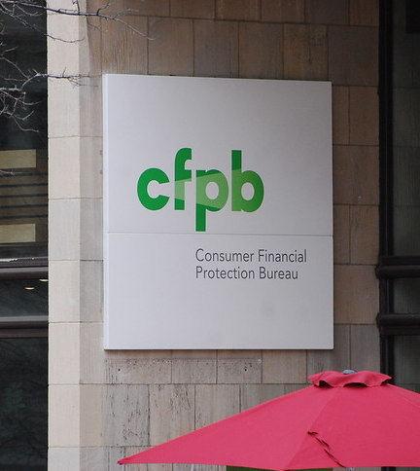
Consumer Financial
Protection Bureau
The CFPB is charged with protecting consumers from “unfair, deceptive, or abusive” acts or practices by financial service providers, including debt collectors.
The CFPB's creation was authorized by the Dodd-Frank Wall Street Reform and Consumer Protection Act in 2010—a response to the financial crisis of 2007-08.
The agency was originally proposed in 2007 by then Harvard Law School professor Elizabeth Warren.
This Photo by Unknown Author is licensed under CC BY-SA-NC
Notes:
ACA staff, ACA Board officers and members from across the country continue to meet frequently with the CFPB.

Slide 5

What is the FDCPA?
The Fair Debt Collection Practices Act (FDCPA) and Regulation F (Reg F), both administered principally by the CFPB, regulate third-party debt collectors.
The FDCPA, which became effective in March 1978, was designed to eliminate abusive, deceptive, and unfair debt collection practices. It also protects reputable debt collectors from unfair competition and encourages consistent state action to protect consumers from abuses in debt collection.

Slide 6

Developing the Debt
Collection Rule
A Long Process…
October 2013: CFPB announces plan to issue rule for debt collection industry.
May 2019: CFPB releases proposed rule.
End of 2020: CFPB finalizes two rules for the debt collection industry.
November 2021: The rules—known as Reg F—go into effect.
Notes:
ACA staff, ACA Board officers and members from across the country continue to meet frequently with the CFPB.

Slide 7
& Reg F
What is Reg F?
What’s in it?
Regulation F is the biggest thing to hit the debt collection industry since the inception of the FDCPA.
It’s a federal regulation issued by the CFPB.
It goes into effect on Nov. 30, 2021.
The final rule addresses, among other things, communications in connection with debt collection, including letters, emails, text messages and phone calls.
Notes:
When you hear folks refer to “the new debt collection rule,” they’re referring to Reg F, as amended by two final rules issued by the CFPB: one issued on Oct. 30, 2020, and a second one issued on Dec. 18, 2020.

Slide 8
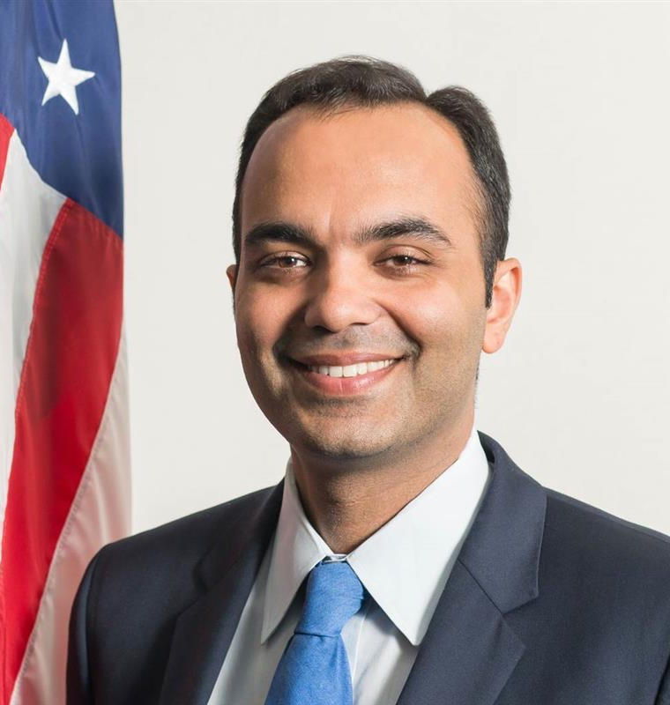
Working with the CFPB Today
Rohit Chopra
New CFPB director
Rohit Chopra’s nomination as CFPB director was advanced by the Senate in Sept.
Chopra had previously served as CFPB assistant director and student loan ombudsman.
Chopra is expected to focus on enforcement activity – rulemaking by enforcement is a concern.
Notes:
ACA staff, ACA Board officers and members from across the country continue to meet frequently with the CFPB.

Slide 9
Highlights from Reg F
What is a “limited-content message”?
A LCM is intended to be a short voicemail message that a debt collector can leave for a consumer without fear of making an unintended third-party disclosure.
Reg F states that if a voicemail message stays within the definitional bounds of a LCM, it cannot result in a prohibited third-party disclosure.
Debt collectors who plan to leave a LCM need to understand how their name will appear on consumers’ caller ID displays.
© 2021 ACA International.

Slide 10
Highlights from Reg F
What is the model validation notice?
The CFPB created a standard form validation notice that provides a safe harbor from liability under the FDCPA.
Q: Can I use one validation notice if I am contacting a consumer about multiple debts?
A: Yes. A collector who combines multiple debts on a single validation notice complies with Reg F by disclosing either a single, cumulative itemization on the validation notice or a separate itemization of each debt on a separate page or pages in the same communication.
© 2021 ACA International.

Slide 11
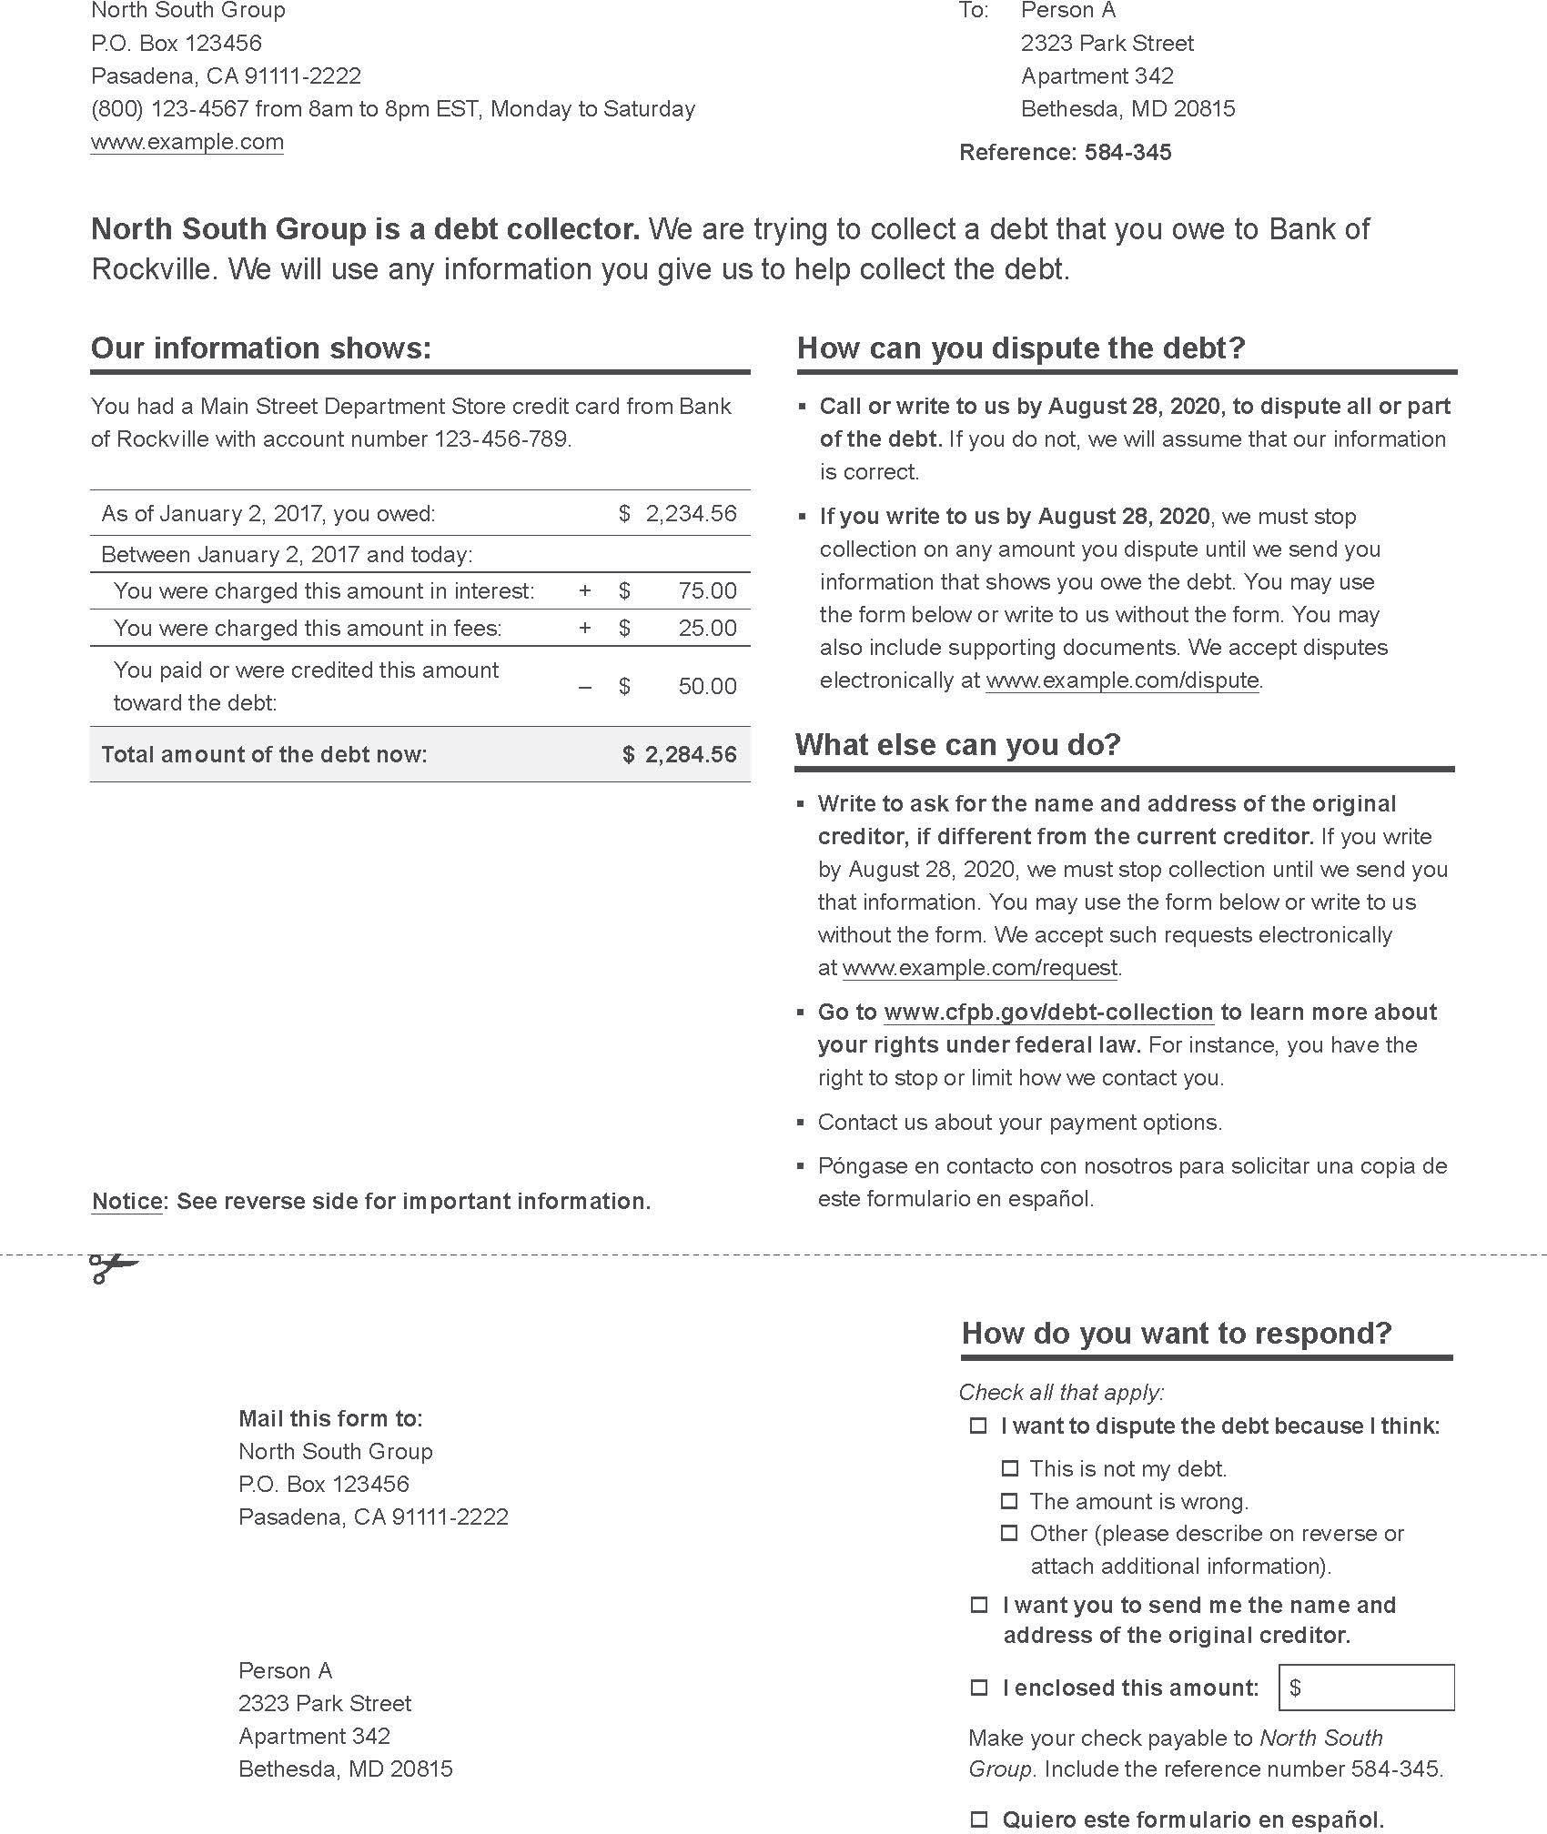
CFPB’s Model Validation Notice
© 2021 ACA International.

Slide 12
Highlights from Reg F
Itemization Dates
Itemization Date means ANY one of the following:
Does not matter which date—but must be consistent
(1) Last Statement Date
(2) Charge-Off Date
(3) Last Payment Date
(4) Transaction Date
(5) Judgment Date
© 2021 ACA International.

Slide 13
Highlights from Reg F
What do I use as an itemization debt for medical debts?
The CFPB has suggested that those who collect medical debts may want to choose the transaction date as their itemization date.
Reg F indicates that if you have multiple transactions dates, you may use any of those dates for the itemization date.
Medical providers may combine multiple dates of service into one account or use family billing that combines separate bills for family members into one account.
© 2021 ACA International.

Slide 14
Highlights from Reg F
How does Reg F address disputes?
Reg F should not change the process of handling FCRA disputes, E-OSCAR disputes or credit report disputes​. It should not change duplicative dispute handling procedures​.
Can continue to handle third-party disputes in the same way.
Dispute Intake Process & the Model Validation Notice​
  Expect an increase of disputes off the initial letter​.
  Expect to receive them electronically & build out processes for how to handle​.
  Allow electronic means for consumers to self-serve​.
© 2021 ACA International.

Slide 15
Highlights from Reg F
Does Reg F permit email and text messages to consumers?
Yes, with several critical guiderails.
A debt collector may communicate with a consumer via an email address obtained directly from the consumer, from the creditor or from a prior debt collector.
A debt collector may communicate with a consumer via text message to a given telephone number if it has the consumer’s express or implied consent to do so. The debt collector must take steps to ensure that the telephone number remains assigned to the consumer.
For both options, collectors must provide a clear and conspicuous opt-out method.
© 2021 ACA International.

Slide 16

Reg F and Health Care
Health care providers should work with their debt collection agency partners to determine:
  The timing for the itemization date.
  Information sharing and account assignment(s) for collections.
  Digital communication strategies and getting patients' consent and communication preferences at date of service.

Slide 17

Reg F and Health Care
Itemization Date
What data or information will drive any changes to your placement date to ensure you have the right information in your collection system to calculate and verify that “itemization date” you choose to use in your collection notice?

Slide 18

Reg F and Health Care
Information Sharing and Account Assignments for Collections
What permissions to share information related to a medical debt are health care providers obtaining and passing along to their debt collection partners?

Slide 19

Reg F and Health Care
Digital Communications
What digital communications preferences, data and consents are health care providers capturing at point of service?

Slide 20
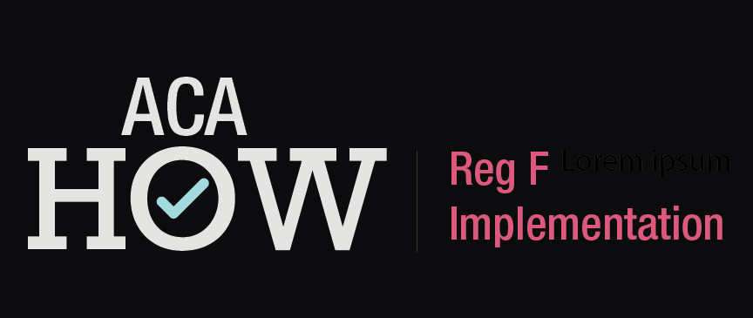
ACA How: Reg F Implementation
ACA developed a comprehensive Reg F implementation guide that dives deep into how to comply with the new regulations in your operations. Visit www.acainternational.org to learn more.
Notes:
ACA How: Regulation F Implementation is a series of videos to help guide you through what exactly is needed to be done to comply with Reg F. This product picks apart every section of regulation F, and instructs you on HOW you need to adjust the way you do business. Enjoy 15 hours of education, taught by industry-leading professionals, all broken down into 3 to 5 minute easy-to-navigate tutorials.

Slide 21
Other Federal Issues
Text Blocking from Phone Carriers
H.B. 2547
If passed in current form would prohibit any collection efforts for two years on medical debt.

Slide 22
Telephone Consumer Protection Act
ACA is continuing to lead efforts to urge the FCC to define “autodialer” and provide other clarifications for circuit splits
2021 Prospects
Supreme Court struck down ATDS definition in Facebook
William P. Barr et al. v American Association of Political Consultants et al
Congress already drafting legislation responding to Facebook decision

Slide 23
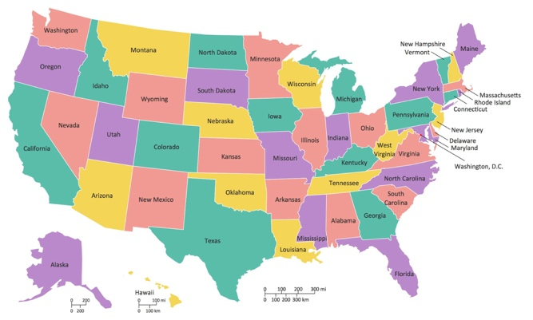
A Busy Year at the State Level
All 50 states are holding legislative sessions in 2021.
ACA is tracking 850+ state-level bills that would impact the debt collection industry.
While many states adjourned early this summer, most states are convening limited special sessions.
These special sessions are being called to make up for lost time due to COVID-19 protocols and for redistricting issues.
Roughly half will carry over legislation
to the 2022 session.
Notes:
ACA is tracking over 850 bills across the country.
Every state will hold a legislative session this year
Last year we tracked over 750 bills and an additional 1,800 COVID related executive orders and emergency regulations. This year we are over 800 bills being tracked.
ACA works with our state units and a network of 30 state-level lobbyists to best position the industry in state capitols across the country.
A lot of state session are starting to adjourn for the summer but many of these states will carry over legislation to next year. We will continue to work these bills over the recess and through next year’s session.

Slide 24



2021 State Legislative Highlights
Ohio SB 13: After 2+ years of lobbying by the Ohio Receivables Management Association and numerous grassroots campaigns, the governor signed the legislation. The bill as introduced would have reduced the SOL on all written and oral contracts to 3 years. The final bill creates a 6-year SOL for consumer transactions.
Nevada SB 248: This bill places new restrictions on medical debt collection. Requires conflicting state and federal disclosures and no action for 60 days. Initial notice sent via certified mail. ACA and the Nevada Unit filed for a temporary restraining order in federal court. Still awaiting a ruling.
New Hampshire HB 109: This bill would have prohibited a collection agency from leaving a voicemail. The New England Collectors Association lobbied and testified against it before the bill was voted down in committee.
© 2021 ACA International.

Slide 25


2021 State Legislative Highlights
Virginia SB 1340: Legislation would have lowered the SOL on all medical debt to 3 years. The Virginia Collectors Association worked to get it tabled for the session.
Hawaii: Multiple garnishment bills have been introduced, including one to prohibit garnishment on all consumer debt. The Hawaii Collectors Association worked with an industry coalition to have the legislation amended. Current pending versions would only affect consumers impacted by COVID-19.
Washington, D.C.: Passed an emergency bill to regulate debt collections. Limits number of calls per week, requires pre-post charge-off documentation. ACA helped hire a lobbyist through a IAF grant. A new bill was passed to replace the original legislation with several industry- supported amendments. A third permanent bill will be considered this fall.
© 2021 ACA International.
Notes:
While there have been so many bills and regulations that we have been fighting and amending over the last several month the regulations in DC are still at the forefront.
In D.C., we were able to replace a really bad bill with an amended bill that put the industry in a much better place. This was done with an Industry Advancement Fund grant that helped us hire a lobbyist in D.C. Our lobbyist worked with a coalition of industry lobbyist to amend the bill to get clarification on call limitations (calls initiated by the consumer or made by a debt collector at the request of a consumer do not count toward the call limit of three calls in any 7-day period) The amendments also removed pre-charge off documentation requirements.

Slide 26
Pending Massachusetts Legislation
HB 462: Rep. William Straus (D)
Summary: This measure specifies exemptions to the prohibition on robocalls from being made to any mobile telephone or another hands-free device (would include debt collection calls).
Status: In Joint Committee on Consumer Protection and Professional Licensure. Hearing held. No action reported.
HB 469: Rep. Joseph Wagner (D)
Summary: This measure prohibits robocalls to cellphones except those in several categories, including from governmental agencies, employers and doctors, and within a 'pre-existing business relationship.
Status: In Joint Committee on Consumer Protection and Professional Licensure. Hearing held. No action reported.
SB 663: Sen. James Eldridge (D) & HB 1168: Rep. Tram Nguyen (D)
Summary: Would shorten the statute of limitations to 4 years. Would exempt weekly wages less than 90x the federal or state minimum wage from garnishment or attachment
Status: In the Joint Financial Services Committee. Hearing held. No action reported.
© 2021 ACA International.

Slide 27
ACA’s Successful Case Against Mass. Debt Collection Regulation
In 2020, ACA filed a lawsuit challenging Massachusetts Attorney General Maura Healey’s emergency debt collection regulation, which almost entirely halted collection calls to Massachusetts consumers.
ACA’s lawsuit challenged the regulation on a number of grounds, including infringement on members’ First Amendment guarantee of free speech; the 14th Amendment’s guarantees of due process and equal protection of the laws; and the separation of powers doctrine.
Judge Richard G. Stearns of the U.S. District Court for the District of Massachusetts, who also issued a memorandum opinion and order granting ACA’s motion for a temporary restraining order and preliminary injunction against the attorney general’s restrictions, approved dismissal of the case Jan. 13.
© 2021 ACA International.
Notes:
“ACA’s successful request for a preliminary injunction in Massachusetts came at a critical time as many state and local lawmakers were considering similar restrictions,” Madden said. “ACA’s timely success clearly exposed the overreach being considered by some lawmakers and provided a tangible reference point for our industry advocates fighting for a common-sense approach to any emergency laws or regulations.”

Slide 28
Questions?

