Slide 1
Health Connector Overview and Open Enrollment Update
SARAH BUONOPANE
Senior Outreach Coordinator and Policy Analyst
December 9, 2016
Notes:
Terri to introduce

Slide 2
The Health Connector: Who Are We?
    The Massachusetts Health Connector is the state’s health insurance Marketplace, providing individuals and small businesses with access to affordable coverage.
Since 2006, when it was created by the Massachusetts health reform law, the Health Connector has offered subsidized and unsubsidized health insurance programs
Since implementation of the Affordable Care Act (ACA), the Health Connector offers the subsidized ConnectorCare program, and offers Qualified Health Plans (QHPs) and Qualified Dental Plans (QDPs) to individuals and small businesses
Who can purchase health insurance through the Health Connector?
    Individuals who don’t get health insurance through their job can get it through the Health Connector, and many people who apply qualify for help paying for their coverage through ConnectorCare or federal tax credits
    Small businesses (those with fewer than 50 employees) can buy health and dental insurance for their workers through the Health Connector. Some small businesses can get federal assistance in paying for their portion of the health insurance
Notes:
Niki

Slide 3
The Health Connector’s Role
    The Role of the Health Connector:
  Health insurance exchange facilitating access to private health insurance coverage
  Outreach and public education about health insurance, how to access it and why to have it
  Policymaking and appeals related to the Massachusetts individual mandate
  State procurement partnerships
  Other market involvement (e.g., risk adjustment)
Who Uses the Health Connector
Individuals
ConnectorCare 182,906
Tax Credit-Only 8,551
Unsubsidized 42,993
Total Health 234,450
Dental 62,980
Small Businesses
Health 6,038/1,312
(Members/Groups)
Dental 1,005/190
(Members/Groups)
Data as of October 2016.
Notes:
Niki

Slide 4
Getting Coverage Through the Health Connector

Slide 5

Who can purchase through the Health Connector? What are their options?
    Coverage is available through the Health Connector for those that do not have an offer of Employer Sponsored Insurance (ESI) (i.e., part-time workers, contractors, seasonal employees, etc.) and employer groups with fewer than 50 employees.
Qualified Health Plan (QHPs) | QHP w/Premium Tax Credit ONLY | ConnectorCare Plan | Catastrophic Plan | Qualified Dental Plans (QDPs) | Small Group Plans
Individuals* with income greater than or equal to 400% of the Federal Poverty Level (FPL) Eligible to purchase health and/or dental plan They have a broad range of choices that range from Bronze to Gold | Individuals* with income greater than 300% FPL or less than or equal to 400% FPL Eligible to purchase health and/or dental plan Eligible for Premium Tax Credit (PTC) Must not have offer of affordable or Minimum Value ESI** | Individuals* with income less than or equal to 300% FPL not otherwise eligible for Medicaid Eligible for Premium Tax Credit (PTC), cost-sharing reductions and premium subsidies No deductibles; low premiums and co-pays Can choose from up to seven carriers Must not have offer of affordable or Minimum Value ESI** | Individuals* under 30 and individuals with a hardship exemption Eligible to purchase a Catastrophic health plan | Individuals, children, or families* Eligible to purchase: Pediatric-only Dental EHB “High” Dental Plan “Low” Dental Plan (Non-group & Small group) | Employer groups of fewer than 50 employees Eligible to purchase QHPs or QDPs Eligible employees must work on a full-time basis (an average of at least 30 hours per week for a given month)
* Resident of MA; Citizen or Lawfully Present (Qualified Noncitizen, Qualified Noncitizen Barred, or Nonqualified Individual Lawfully Present); and not in prison ** Affordability standards are set by the federal government and are based on the cost of an individual plan. Minimum value is also defined by the federal government.
Notes:
Niki

Slide 6
Who can receive help paying for health insurance through the Health Connector?
    You may qualify if you:
  Shop through the Massachusetts Health Connector
  Live in Massachusetts
  Are a U.S. citizen, national or are otherwise lawfully present in the U.S.
  Have income that is 400% of the Federal Poverty Level (FPL) or lower
    You won’t be able to qualify if you:
  Get coverage through Medicare, MassHealth (Medicaid) or other public health insurance programs
  Are in jail at this time
  Are offered affordable, comprehensive health insurance from an employer
  Note: If the cost of your employer’s health insurance plan for individuals is more than 9.66% of your income, that coverage is not considered affordable
Notes:
Maria

Slide 7
Can you get help paying for health insurance through the Health Connector?
    Current Health Connector Federal Poverty Level (FPL) guidelines:
2016 Federal Poverty Guidelines
Federally facilitated marketplaces will use the 2016 guidelines to determine eligibility for Medicaid and CHIP.
Household Size | 100% | 133% | 150% | 200% | 250% | 300% | 400%
1 | $11,880 | $15,800 | $17,820 | $23,760 | $29,700 | $35,640 | $47,520
2 | 16,020 | 21,307 | 24,030 | 32,040 | 40,050 | 48,060 | 64,080
3 | 20,160 | 26,813 | 30,240 | 40,320 | 50,400 | 60,480 | 80,640
4 | 24,300 | 32,319 | 36,450 | 48,600 | 60,750 | 72,900 | 97,200
5 | 28,440 | 37,825 | 42,660 | 56,880 | 71,100 | 85,320 | 113,760
6 | 32,580 | 43,331 | 48,870 | 65,160 | 81,450 | 97,740 | 130,320
7 | 36,730 | 48,851 | 55,095 | 73,460 | 91,825 | 110,190 | 146,920
8 | 40,890 | 54,384 | 61,335 | 81,780 | 102,225 | 122,670 | 163,560
Notes:
Niki

Slide 8
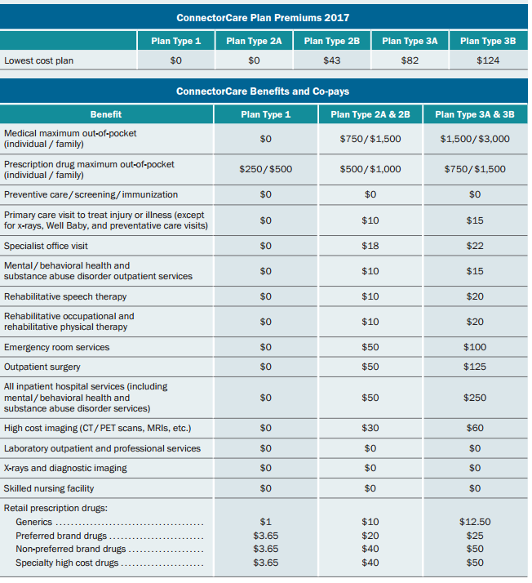
Examples of ConnectorCare Plan Premiums and Benefits
This information, as well as other useful resources, can be found at https://www.mahealthconnector.org/help-center/resource-download-center
Notes:
Maria

Slide 9


Small Group Coverage
    Most small group employers work with a trusted insurance broker to obtain coverage, and the Health Connector works with brokers as well. Employers with fewer than 50 employees can buy health and dental plans for their full-time employees through the Health Connector’s Business Express program.
    The program offered to small businesses is called Business Express
    Small groups can purchase Business Express on the 1st of each month and they have rolling renewals (e.g., July to July)
    There are no association dues or membership fees
    Over 70 plan designs to choose from, including both medical and dental plans from well-known insurance carriers
Notes:
Bill

Slide 10
Enrolling in health insurance coverage
    Some individuals may seek help when enrolling in coverage. Enrollment assistance is available through the Health Connector’s Customer Service Centers and across Massachusetts through Assisters (Navigators and Certified Application Counselors).
    Customer Service:
The Health Connector also has a customer service line and walk-in centers around the Commonwealth located in Boston, Worcester and Springfield (year-round), as well as in Brockton, Fall River and Lowell (during Open Enrollment only)
For information on how to contact the Health Connector visit https://www.mahealthconnector.org/about/contact
Assisters:
These trained and certified individuals, including Navigators and Certified Application Counselors, can help from application through enrollment into new health insurance plans and answer questions about eligibility, application, payments, plan details, and health care reform rules and requirements
To find an Assister visit https://www.mahealthconnector.org/help-center
Notes:
Maria

Slide 11
Health Connector Open Enrollment 2017

Slide 12
2017 Open Enrollment
  Open Enrollment is the time of year when individuals and families may enroll in non-group coverage or switch existing Health Connector coverage for any reason, without needing a qualifying event.
  This year Open Enrollment is November 1, 2016- January 31, 2017
    Health Connector members can begin shopping and make new plan selections on November 1, but any new plan selection will not be effective until January 1, 2017
    New applicants can submit applications and enroll for coverage starting January 1, 2017 without experiencing a qualifying event. If new members would like coverage in 2016, they must have a qualifying event
    Any Health Connector members enrolled in 2016 will be redetermined and renewed into a plan for 2017
12

Slide 13
2017 Open Enrollment (cont’d)
Changes for the 2017 Open Enrollment Period:
  Eligibility Redetermination: Federally-Required Program Integrity Updates:
  IRS income comparison: The Health Connector may use income data from the IRS or state DOR to determine eligibility for subsidies
  Mandatory tax filing: Members will have had to file taxes to keep subsidies
  New process for mixed households: Households with both Health Connector and MassHealth eligible individuals will be processed together
  Plan Renewal:
  Due to some carrier premium increases, we anticipate increased costs for a significant subset of our membership
  These premium increases could impact:
    Unsubsidized members, particularly Harvard Pilgrim HealthCare and Neighborhood Health Plan members
    ConnectorCare members enrolled in higher-cost carriers
13

Slide 14
2017 Product Shelf
  The 2017 Qualified Health and Dental Plans available through the Health Connector will offer a range of plan designs, carriers and premiums.
  ConnectorCare Plans
    All of the ConnectorCare carriers are available in 2017; BMC Healthnet Plan, CeltiCare, Fallon, Health New England, Neighborhood Health Plan, Minuteman and Tufts-Direct
    (7 carriers in total)
  Qualified Health Plans
    In addition to the carriers mentioned above, Blue Cross Blue Shield, Harvard Pilgrim, and Tufts Premier will be available for non group and group enrollment in 2017 (10 carriers in total, 62 QHPs)
  Qualified Dental Plans
    In 2017, Altus Dental and Delta Dental of MA are available for non-group enrollment. In addition to Altus and Delta Dental, Blue Cross Blue Shield of MA and Guardian will also be available for group enrollment; (4 carriers in total)
14

Slide 15
2017 Product Shelf (cont’d)
  The Health Connector will strongly encourage all members to comparison shop in order find a 2017 plan that meets their healthcare needs – including cost.
  Rising premium costs, for certain medical carriers and plans, means many members will experience high renewal increases
  Many unsubsidized and APTC-only enrollees, particularly those enrolled in Harvard Pilgrim HealthCare and Neighborhood Health Plan, will see large premium increases for their renewal plans
  Rising premium costs will also impact ConnectorCare members enrolled in higher cost carriers. These members will experience large increases in the contributions for their renewal plans
  Despite these increases, almost all of our enrollees facing steep increases can find similar (or identical) plan options with lower costs from other carriers
  All of our carriers offer networks with high quality providers
  Many enrollees who shop will find plans with lower costs than their renewal plan and their current plan
15

Slide 16
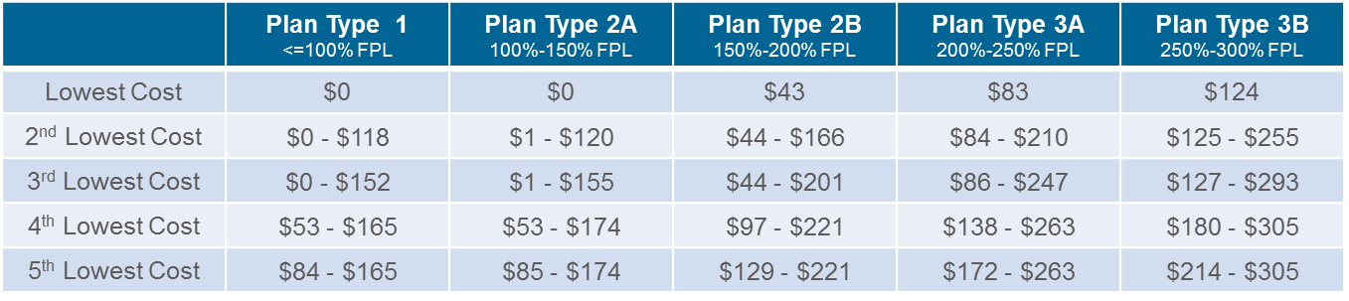
2017 Product Shelf (cont’d)
  Premiums are changing for ConnectorCare member in 2017. Some members enrolled in higher cost carriers may have a higher premium.
ConnectorCare Member Contribution Range for 2017
16

Slide 17
NEW! ConnectorCare:
Enhanced Opioid Treatment
  ConnectorCare enrollees with opioid dependency will have zero cost-sharing for medication-assisted treatment (MAT) and associated services and Rescue Opioid Antagonists.
Medication Assisted Treatment (MAT)
Examples include buprenorphine, naltrexone, and methadone
ConnectorCare Issuers must set MAT medications as zero cost-sharing for all ConnectorCare plan types
If an identical generic formulation is available, ConnectorCare issuers may set additional cost-sharing for brand formulations
Any services directly associated with a MAT visit, including counseling and drug screening, must also be provided at zero cost-sharing for all ConnectorCare plan types
  Opioid Antagonists:
  Examples include Nalaoxone (Narcan)
  ConnectorCare Issuers must designate at least one (1) opioid antagonist (overdose reversal) approved for use in take-home setting (e.g., with a standing prescription) and (1) opioid antagonist for use by health care professionals as zero cost-sharing for all ConnectorCare plan types
    The selection of the zero cost-sharing medication(s) is at the discretion of the ConnectorCare Issuer

Slide 18
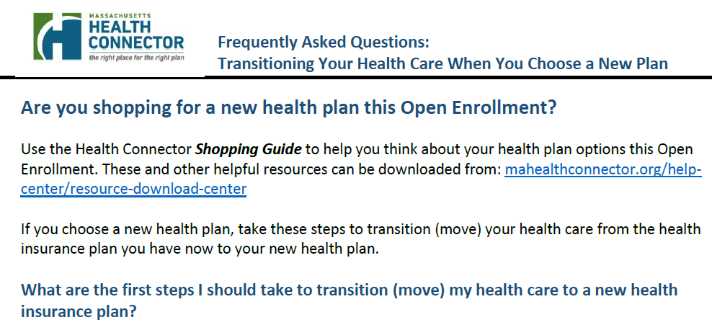
Transitioning Members
  We are focused on providing members with information to help smooth the transition
Recommended Steps for Members Transitioning to a New Carrier:
  Visit our online Provider Search Tool and check to see if any providers are in-network with a new plan
  Visit a new plan’s website or call customer service
  Ensure the member refills any prescriptions and receives copies of any medical records
18

Slide 19
Resources
Health Connector home page: www.mahealthconnector.org
Resource download page (Shopping Guides, Guide to Subsidies, ConnectorCare Overview, Standardized QHPs): www.mahealthconnector.org/help-center/resource-download-center
Enrollment assister search: https://betterhealthconnector.com/enrollment-assisters
Customer service information (call and walk-in centers): https://betterhealthconnector.com/about/contact
Small Business page: www.mahealthconnector.org/get-started/small-businesses
Wellness Track: https://betterhealthconnector.com/wellness-track
Coverage options for non-benefits eligible employees or former employees: www.mahealthconnector.org/learn/tools-resources/small-businesses/coverage-options-for-non-benefits-eligible-employees
    List of Health Connector certified brokers: https://betterhealthconnector.com/get-started/small-businesses/certified-broker-directory
Notes:
Maria

Slide 20


Questions?
SARAH BUONOPANE
Email: sarah.buonopane@state.ma.us
Visit MAhealthconnector.org

