Slide 1
Health Connector Overview
Niki Conte
Associate Director of Public Outreach and Education
December 2019

Slide 2
Agenda
  The Health Connector’s Role and History
    Chapter 58
    The Affordable Care Act (ACA)
  Health Connector Today
    Eligibility
    Programs and Plans
    Applying and Enrolling
  Health and Dental Plans for 2020
    ConnectorCare Program
    Key Take-Aways and Member Scenarios for 2020
  Questions

Slide 3
Health Connector Background, Chapter 58 and the Affordable Care Act

Slide 4
The Health Connector’s Role and Massachusetts Health Care Reform
The Massachusetts Health Connector is the state’s health insurance Marketplace, providing individuals and small businesses with access to affordable coverage.
  Massachusetts passed a state health reform law in 2006, known as Chapter 58.
  This health reform effort:
    Increased access to health insurance in Massachusetts,
    Mandated that all Massachusetts residents have health insurance if it is affordable and meets certain standards, and
    Established a health insurance marketplace (called the Health Connector), to help residents and employers find health insurance and administer subsidized plans.
  Chapter 58 still sets the policies that govern the Massachusetts Individual Mandate, which requires all adults to carry health insurance that meets a minimum level of coverage.
  Chapter 58 served as the model for the Affordable Care Act (ACA).
    The ACA called for the creation of Marketplaces where individuals and small businesses could compare and enroll in health insurance plans.

Slide 5
The Affordable Care Act (ACA)
The Obama administration signed the ACA into law in 2010.
  Congress passed the Patient Protection and Affordable Care Act on March 23, 2010, and the Health Care and Education Reconciliation Act on March 31, 2010.
    Together, these two laws are referred to as the Affordable Care Act (ACA).
  Since Massachusetts already had the Massachusetts Health Connector, some changes were made to meet ACA standards.
    Beginning in 2014 the Health Connector has served as the ACA- compliant, state-based Marketplace in Massachusetts.
    Since implementation of the Affordable Care Act (ACA), the Health Connector offers Qualified Health Plans (QHPs) and Qualified Dental Plans (QDPs) to individuals and small businesses.

Slide 6
The Affordable Care Act (ACA)
Major parts of the ACA apply to consumers, health insurance companies and health insurance plans.
  The major provisions of the ACA include:
  A national Individual Mandate
  State option to expand Medicaid for certain consumers (Massachusetts expanded in 2014)
  Insurance market reforms, including consumer protections, including:
    The ability to stay on a parent plan until age 26
    No exclusions for pre-existing conditions
  Affordable insurance coverage options for low- and middle-income families
  Federal tax credits for small businesses
  Federal and state-based Marketplaces where individuals and small businesses could compare and enroll in health insurance plans

Slide 7
Health Connector Eligibility, Programs, and Plans

Slide 8
Health Connector Eligibility
Consumers must meet certain criteria to be eligible to purchase health insurance through the Health Connector.
  Consumers may qualify if they:
    Shop through the Massachusetts Health Connector
    Live in Massachusetts
    Are a U.S. citizen, national or are otherwise lawfully present in the U.S.
    Are not in jail
  Consumers with incomes at or below 400% of the federal poverty level may also qualify for subsidies if they:
  Don’t get coverage through Medicare, MassHealth (Medicaid) or other public health insurance programs
  Are not offered affordable, comprehensive health insurance from an employer
  Agree to file taxes
  Note: If the cost of an employer’s health insurance plan for individuals is more than 9.78% of your income, that coverage is not considered affordable

Slide 9
Health Connector: Subsidies and the ConnectorCare Program
The ACA created a new subsidy structure to lower the cost of monthly premiums and out-of-pocket spending for certain lower-income eligible individuals.
  The ACA created federal Premium Tax Credits for consumers with incomes at or below 400 percent of the federal poverty level.
    These federal premium tax credits can be taken in advance of tax filing, and are frequently referred to as “Advance Premium Tax Credits” or APTCs.
    Households that received APTCs will have to “reconcile” what they received against their annual income when they do their federal income taxes.
    If an individual does not reconcile APTCs, that individual may be ineligible to receive APTCs in future years until the APTCs are reconciled.
  ConnectorCare is a special program with low premiums, no deductibles, and limited cost-sharing available to consumers with incomes at or below 300 percent of the FPL.
    ConnectorCare lowers the premiums and cost-sharing by using federal APTCs and additional state subsidies.

Slide 10
MassHealth Programs
In Massachusetts, Medicaid and the Children’s Health Insurance Program (CHIP) are combined into one program called MassHealth.
  MassHealth offers these benefits to them directly or by paying part or all of their health insurance premiums.
  One of the aims of The Affordable Care Act has been to increase the number of individuals who have health coverage.
    To do this, the law gives states the option to expand Medicaid, which Massachusetts has done through the MassHealth program.
  Individuals between the ages of 21 and 64 who have incomes up to 133 percent of the federal poverty level (FPL) may qualify for MassHealth (if they did not already under different eligibility rules).
    FPL is based on an applicant’s income and family size.

Slide 11
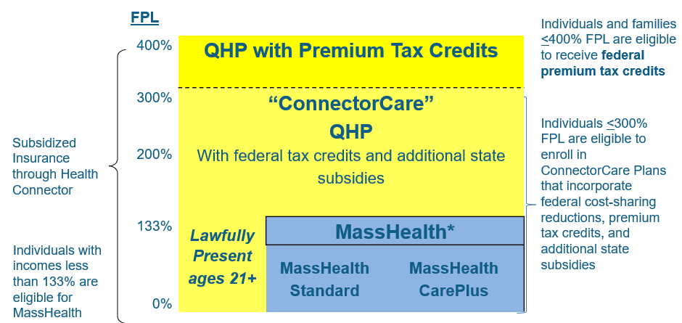
Health Connector and MassHealth Eligibility
The chart below shows eligibility for MassHealth and Health Connector Programs by income

Slide 12
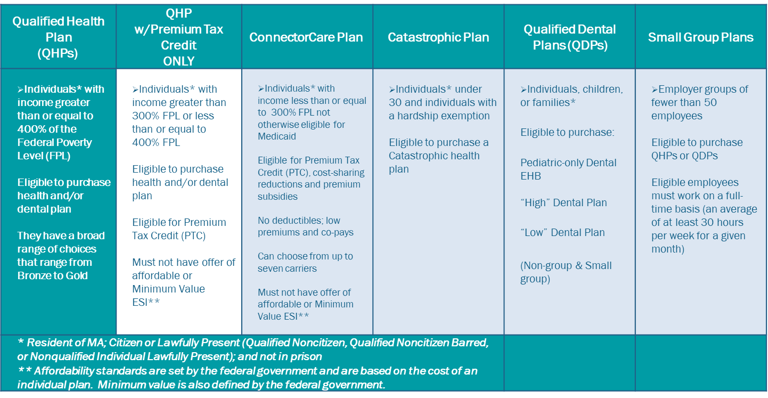
Health Connector Programs
The chart below shows the available Health Connector Programs and who may qualify for them.

Slide 13
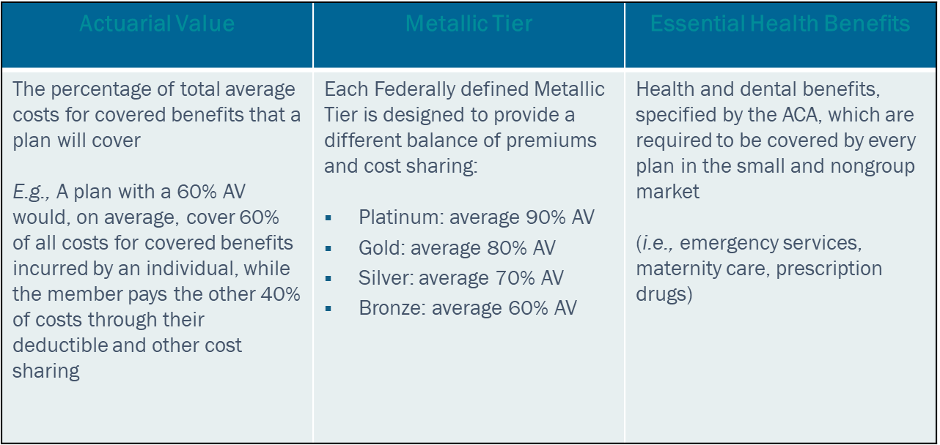
Health Connector Plans
The Health Connector has plans available with different premiums and cost-sharing arrangements. All plans meet a minimal set of benefits, known as Essential Health Benefits.

Slide 14
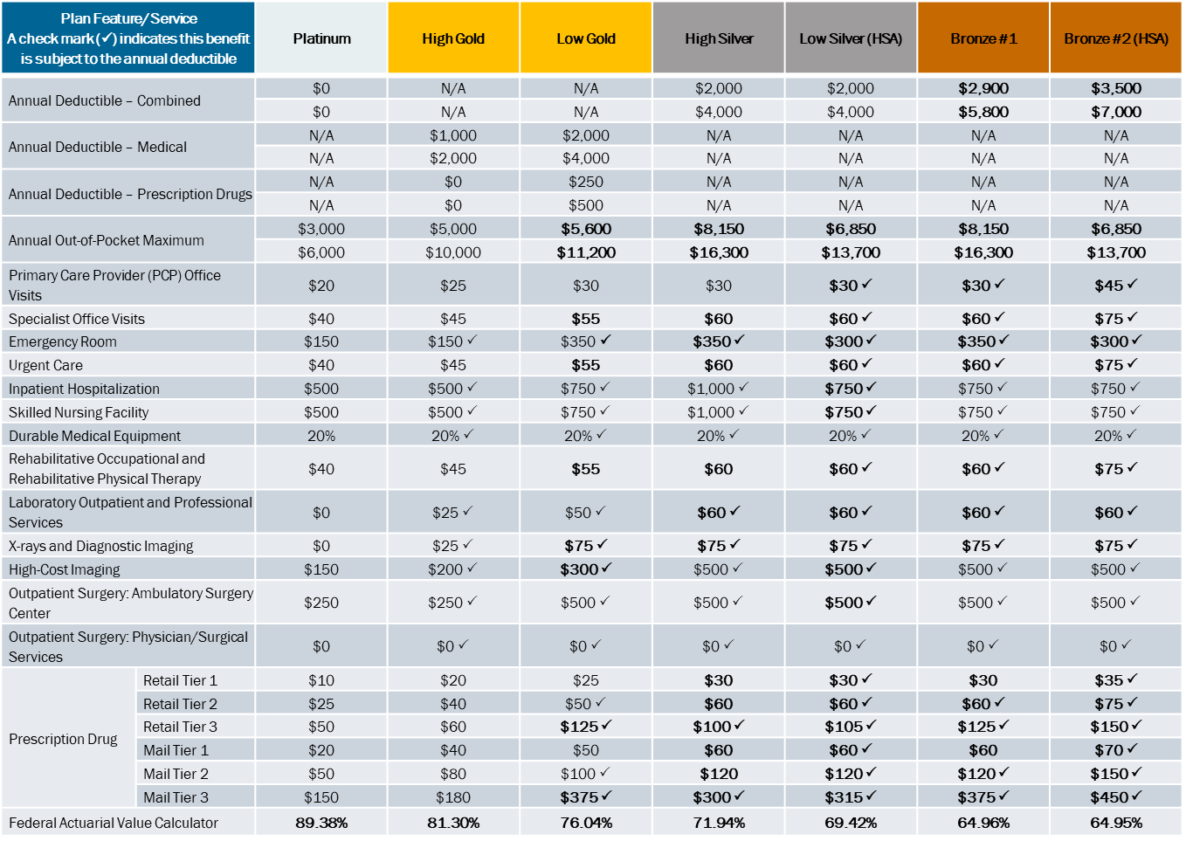
Health Connector Plan Design
The chart below shows the available Health Connector Standard Plan Designs for 2020 by metallic tier.

Slide 15
Health Connector: Applying and Enrolling
When can someone apply and enroll into Health Connector coverage?
  Individuals and Families can apply and enroll or change plans for any reason during the Health Connector’s annual Open Enrollment.
  Individuals may enroll at other times of the year if they have a change in their situation or meet certain criteria.
    For example, marriage, birth or adoption of a baby, or a move can all trigger an exception that allows a person to enroll in or change plans.
  Small businesses can enroll in coverage any time during the year.
  Individuals and small businesses can apply online:
    Individuals: www.mahealthconnector.org
    Small Businesses: www.mahealthconnector.org/business
  Free assistance is available throughout Massachusetts through certified Navigators and Certified Application Counselors.
    Go to: https://my.mahealthconnector.org/enrollment-assisters for a list of organizations

Slide 16
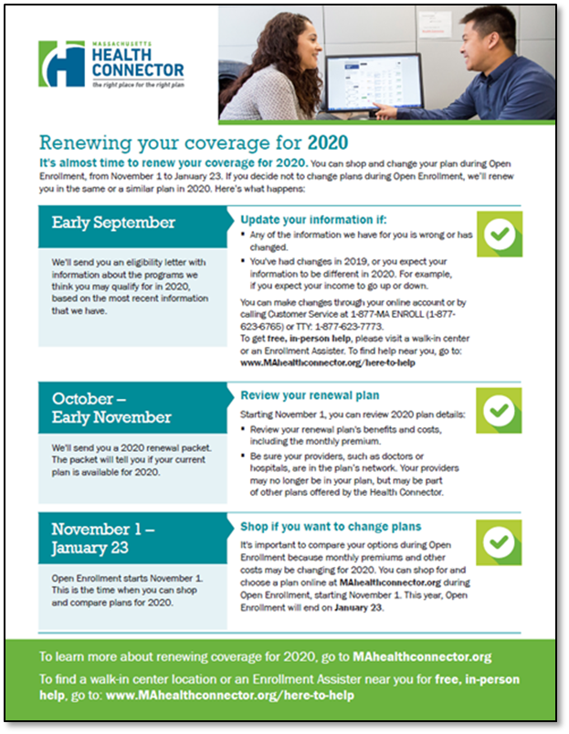
Health Connector Open Enrollment 2020
Open Enrollment 2020 is November 1, 2019 - January 23, 2020
  The Health Connector remains committed to offering our members and new enrollees a stable and well supported enrollment experience.
  The Health Connector is actively preparing for Open Enrollment with member mailings and additional member support.
  For more information about Open Enrollment, go to: www.mahealthconnector.org/get-started/plan-renewal-information
  Additional Resources:
    Health Connector home page: www.mahealthconnector.org
    Massachusetts Individual Mandate: https://www.mahealthconnector.org/stay-covered
    Policy Center: https://betterhealthconnector.com/about/policy-center/policies

Slide 17
Health and Dental Plans for 2020

Slide 18
Health Connector Health Plans for 2020
Each year, the Health Connector conducts a comprehensive review of Health and Dental Plans proposed by health and dental carriers to be sold in the upcoming year on MAhealthconnector.org. This review and process is known as the Seal of Approval process.
  All of the Health Connector plans available on Mahealthconnector.org are Qualified Health Plans (QHPs) and Qualified Dental Plans and meet state and federal plan requirements
  All approved health and dental plans must meet Actuarial Value (AV) and Metallic Tier requirements and must include a minimum set of certain benefits called Essential Health Benefits (EHB)
  The Health Connector works closely with the MA Division of Insurance to ensure carriers meet all certification criteria and the MA Division of Insurance is responsible for approving the rates (premiums) for each plan sold through the Health Connector
18

Slide 19
Overview of 2020 SoA Results
The 2020 Qualified Health and Dental Plans includes a range of plan designs, carriers, and premiums, featuring:
  A broad choice of carriers and plans for unsubsidized non-group and small group enrollees, with:
    9 medical with 56 non-group and 69 small group Qualified Health Plans (QHPs)
    2 dental carriers with 12 Qualified Dental Plans (QDPs)
  One plan closing (HNE non-standard Bronze)
  Modest premium changes of, on average,
    4.0 percent for health plans
    1.7 percent for dental plans
  A steady ConnectorCare program that continues to offer affordable choice
    There are no new carriers entering, no carriers leaving, and no carriers leaving any current service areas
    As in 2018 and 2019, ConnectorCare carriers will continue to “load” their silver tier non-group plans with an additional percentage of premium to offset the loss of federal cost-sharing reductions
19

Slide 20
ConnectorCare Program

Slide 21
ConnectorCare: Enrollee Contributions and Regional Carrier Changes
  As in past years, all ConnectorCare members, regardless of where they live, will have access to at least one ConnectorCare plan at the Affordability Schedule-defined monthly cost
  In a few regions only one choice at the Affordability Schedule-defined monthly cost is available to members
    These regions are A4 – Franklin, F2 – Dukes, G1 and G3 – Cape, and G2 – Nantucket
  In regions G1 and G3 BMC is no longer going to be offered at the Affordability Schedule-defined monthly cost
    This means that members enrolled in BMC ConnectorCare plans in these regions will see premium increases for 2020
  New for 2020: Fallon has expanded in portions of Regions C and D
    Region D2 is a new region that now includes a Fallon ConnectorCare choice
    Region C2 now has Fallon ConnectorCare as a choice and is expanded to additional towns
21

Slide 22
Town List: Region D2 and C2
D2
  Billerica: 01821,01822
  Chelmsford: 01824
  Dracut: 01826
  Dunstable: 01827
  Lowell: 01850, 01851, 01852, 01853, 01854
  North Billerica: 01862
  North Chelmsford: 01863
  Nutting Lake: 01865
  Pinehurst: 01866
  Tewksbury: 01876
  Tyngsboro: 01879
  Westford: 01886
C2
  Mansfield: 02048
  Bellingham: 02019
  Canton: 02021
  Dedham: 02026, 02027
  Dover: 02030
  East Walpole: 02031
  Foxboro: 02035
  Franklin: 02038
  Medfield: 02052
  Medway: 02053
  Millis: 02054
  Norfolk: 02056
  Norwood: 02062
  Sharon: 02067
  Sheldonville: 02070
  South Walpole: 02071
  Stoughton: 02072
  Walpole: 02081
  Westwood: 02090
  Wrentham: 02093

Slide 23
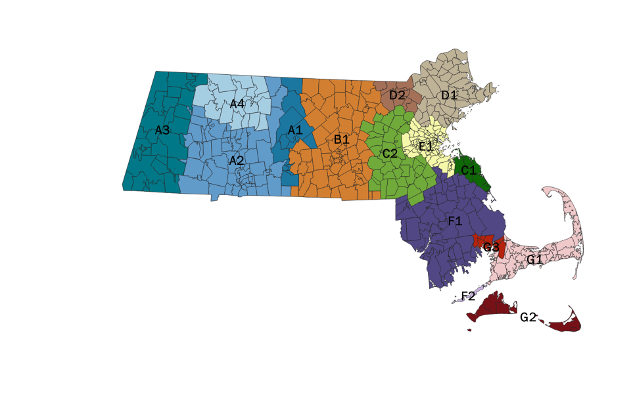
ConnectorCare: Carriers by Region
  The chart below shows the ConnectorCare carriers by cost and highlights which plans will be a higher or lower cost for 2020
Region | Lowest Cost | 2nd Lowest Cost | 3rd Lowest Cost | 4th Lowest Cost
A1 | TD | BMCHP | HNE | AHP
A2 | TD | BMCHP | HNE
A3 | TD | HNE
A4 | HNE
B1 | TD | FCHP | BMCHP | AHP
C1 | TD | BMCHP | AHP
C2 | TD | BMCHP | FCHP | AHP
D1 | TD | BMCHP | AHP
D2 | TD | BMCHP | AHP | FCHP
E1 | TD | BMCHP | AHP
F1 | TD | BMCHP | AHP
F2 | AHP
G1 | TD | BMCHP
G2 | AHP
G3 | TD | BMCHP | AHP
  Carriers in green have moved to a lower cost position relative to 2019. Carriers in red have moved to a higher cost position.
23

Slide 24

2020 ConnectorCare Enrollee Contributions
 | Region A1 | Enrollee Premium Contribution By Plan Type
 |  | 1 <100%FPL | 2A 100-150% FPL | 2B 150-200% FPL | 3A 200-250% FPL | 3B 250-300% FPL
1 | Tufts-Direct | $0 | $0 | $45 | $87 | $130
2 | BMC | $0 | $0 | $45 | $87 | $130
3 | HNE | $104 | $107 | $156 | $199 | $246
4 | AllWays Health Partners | $155 | $156 | $206 | $250 | $299
 | Region C2 | Enrollee Premium Contribution By Plan Type
 |  | 1 | 2A | 2B | 3A | 3B
1 | Tufts-Direct | $0 | $0 | $45 | $87 | $130
2 | BMC | $0 | $0 | $45 | $87 | $130
3 | Fallon | $0 | $0 | $45 | $87 | $130
4 | AllWays Health Partners | $191 | $193 | $243 | $286 | $331
 | Region E1 | Enrollee Premium Contribution By Plan Type
 |  | 1 | 2A | 2B | 3A | 3B
1 | Tufts-Direct | $0 | $0 | $45 | $87 | $130
2 | BMC | $0 | $0 | $45 | $87 | $130
3 | AllWays Health Partners | $217 | $226 | $276 | $318 | $360
 | Region A2 | Enrollee Premium Contribution By Plan Type
 |  | 1 | 2A | 2B | 3A | 3B
1 | Tufts-Direct | $0 | $0 | $45 | $87 | $130
2 | BMC | $0 | $0 | $45 | $87 | $130
3 | HNE | $104 | $107 | $156 | $199 | $246
 | Region F1 | Enrollee Premium Contribution By Plan Type
 |  | 1 | 2A | 2B | 3A | 3B
1 | Tufts-Direct | $0 | $0 | $45 | $87 | $130
2 | BMC | $0 | $0 | $45 | $87 | $130
3 | AllWays Health Partners | $206 | $211 | $263 | $305 | $352
 | Region A3 | Enrollee Premium Contribution By Plan Type
 |  | 1 | 2A | 2B | 3A | 3B
1 | Tufts-Direct | $0 | $0 | $45 | $87 | $130
2 | HNE | $37 | $74 | $130 | $199 | $246
 | Region F2 | Enrollee Premium Contribution By Plan Type
 |  | 1 | 2A | 2B | 3A | 3B
1 | AllWays Health Partners | $0 | $0 | $45 | $87 | $130
 | Region A4 | Enrollee Premium Contribution By Plan Type
 |  | 1 | 2A | 2B | 3A | 3B
1 | HNE | $0 | $0 | $45 | $87 | $130
 | Region G1 | Enrollee Premium Contribution By Plan Type
 |  | 1 | 2A | 2B | 3A | 3B
1 | Tufts-Direct | $0 | $0 | $45 | $87 | $130
2 | BMC | $12 | $50 | $105 | $151 | $194
 | Region B1 | Enrollee Premium Contribution By Plan Type
 |  | 1 | 2A | 2B | 3A | 3B
1 | Tufts-Direct | $0 | $0 | $45 | $87 | $130
2 | Fallon | $0 | $0 | $45 | $87 | $130
3 | BMC | $0 | $0 | $45 | $87 | $130
4 | AllWays Health Partners | $147 | $145 | $194 | $237 | $282
 | Region D1 | Enrollee Premium Contribution By Plan Type
 |  | 1 | 2A | 2B | 3A | 3B
1 | Tufts-Direct | $0 | $0 | $45 | $87 | $130
2 | BMC | $0 | $0 | $45 | $87 | $130
3 | AllWays Health Partners | $161 | $171 | $221 | $263 | $307
 | Region G2 | Enrollee Premium Contribution By Plan Type
 |  | 1 | 2A | 2B | 3A | 3B
1 | AllWays Health Partners | $0 | $0 | $45 | $87 | $130
 | Region C1 | Enrollee Premium Contribution By Plan Type
 |  | 1 | 2A | 2B | 3A | 3B
1 | Tufts-Direct | $0 | $0 | $45 | $87 | $130
2 | BMC | $0 | $0 | $45 | $87 | $130
3 | AllWays Health Partners | $191 | $193 | $243 | $286 | $331
 | Region D2 | Enrollee Premium Contribution By Plan Type
 |  | 1 | 2A | 2B | 3A | 3B
1 | Tufts-Direct | $0 | $0 | $45 | $87 | $130
2 | BMC | $0 | $0 | $45 | $87 | $130
3 | AllWays Health Partners | $166 | $172 | $221 | $263 | $305
4 | Fallon | $216 | $221 | $271 | $313 | $355
 | Region G3 | Enrollee Premium Contribution By Plan Type
 |  | 1 | 2A | 2B | 3A | 3B
1 | Tufts-Direct | $0 | $0 | $45 | $87 | $130
2 | BMC | $12 | $50 | $105 | $151 | $194
3 | AllWays Health Partners | $221 | $266 | $327 | $375 | $422

Slide 25
Key Take-Aways and
Member Scenarios for 2020

Slide 26
Key Takeaways for 2020
  Members generally will not experience significant plan or rate changes in 2020.
  Health New England will closing one Bronze Plan for 2020- the HNE non-standard Bronze.
    All members enrolled in this plan will be placed into the Standard HNE Bronze Plan, but may face a higher premium if they chose to enroll into this Standard HNE Bronze Plan
  The BMC ConnectorCare plan will no longer offered at the affordability schedule in region G1 and G3 - Cape Cod
    All members enrolled in this plan will face higher premiums if they chose to stay enrolled in BMC
  Fallon will be available in portions of Regions C and D, expanding ConnectorCare choice in those areas:
    Region D2 is a new region that now includes a Fallon ConnectorCare choice
    Region C2 now has Fallon ConnectorCare as a choice and is expanded to additional towns
26

Slide 27
Member Scenarios
  Scenario 1: A BMC ConnectorCare member in Hyannis is confused because in 2019, their premium was $0; but in 2020, their renewal notice says they will have a $50 monthly premium
  BMC ConnectorCare members in regions G1 and G3 will see their premiums increase beyond the affordability schedule for 2020, due to increases in BMC’s premium such that the Health Connector cannot make these ConnectorCare plans available at the affordability schedule
  These BMC members can either stay in their plan that exceeds the affordability schedule defined premium, or switch to Tufts Direct, which remains at the affordability schedule
27

Slide 28
Member Scenarios
  Scenario 2: A member residing in the town of Tewksbury sees a new ConnectorCare option through Fallon. As a ConnectorCare member for the past several years, she is not familiar with Fallon and comes in to ask you about it
  Fallon expanded its network, and a new ConnectorCare region, D2, was created.
  This is a new choice for members in the region of D2, which allows for expanded choice in the area
  Members with questions about what Fallon’s provider network and options can use the Health Connector’s provider search tool, or contact Fallon directly
28

Slide 29
Member Scenarios
  Scenario 3: A member in Health New England brings their renewal notice, which indicates that their current Bronze Plan is no longer available. They ask you what they need to do to enroll in coverage for 2020?
  Health New England (HNE) is closing the non-standard Bronze Plan for 2020, which means that all members currently enrolled in this plan cannot continue with this same plan in 2020
  All members in this plan will be placed into a similar plan- the standard HNE Bronze Plan- for 2020
  While this is a similar plan, it does have a higher premium than the previous Bronze Plan
  If these members want to be enrolled into this new Bronze Plan, they do not have to take action and the enrollment will happen automatically, so long as they pay their January 2020 premium by December 23rd, 2019
  If they want to look at other options, they may do so by using one of the shopping tools through our website. If they want to enroll into a different plan, they must select that new plan and make their new payment by December 23rd, 2019 for coverage beginning January 1, 2020
29

Slide 30
Questions

