Slide 1

MassHealth Provider Services
Massachusetts Association of Patient Account Managers (MAPAM)
Date 12/12/2019
Executive Office of Health & Human Services
Presented by: Stanley Calixte

Slide 2
Agenda
Eligibility Verification Overview
Inquire Claim Status
Claim Status and Response (276/277)
Corrective Actions for Denied Claims
Billing Timelines and 90-Day Waiver
Final Deadline Appeal
Provider Resources
Notes:
Redo – after slides are approved

Slide 3
Eligibility Verification Overview

Slide 4
Eligibility Verification Overview
It is important to understand the basics regarding MassHealth eligibility, coverage, programs and plans available to members
This knowledge helps providers know how to effectively use the eligibility verification tools that are available to MassHealth providers
    Prevents inaccurate patient eligibility information
    Reduces eligibility related denials
    Insures that the claims are submitted timely to the correct insurer
    Identifies other primary insurance information
    Identifies integrated and managed care information
MassHealth has eligibility verification tools available for providers

Slide 5
Eligibility Verification Overview
The Eligibility Verification System is:
    A web based application that enables a MassHealth provider to verify a member’s eligibility
    Is accessible through the Provider Online Service Center (POSC)
    Available 24 hours a day, 7 days a week
    Provides easy access to the most current and complete member eligibility information
Providers reduce the risk of denied claims by using EVS to verify member enrollment and eligibility prior to providing services to MassHealth members.
It is highly recommended that you check eligibility on each date of service to avoid timely filing issues.
If you have questions about how to check a member’s eligibility, please refer to the Verify Member Eligibility Job Aid
to learn how to access and check member eligibility using EVS on the POSC
(URL: https://www.mass.gov/how-to/check-member-eligibility)

Slide 6
Eligibility Verification Overview
What you need when checking eligibility?
  POSC User ID & Password
  MMIS Provider ID/Service Location
  Dates of Service
  Member ID Number or Member Name and DOB
There are two types of Restrictive Messages that appear on EVS:
  Eligibility Restrictive Messages
  Managed Care Data Restrictive Messages
The Managed Care Data Restrictive Messages identify which type of health plan a member is enrolled in, and their contact information for inquiries regarding:
  Billing (medical and behavioral health claims)
  Service authorizations (medical and behavioral health services)
  Behavioral Health vendors
If you have questions about how to check a member’s eligibility, please refer to the Verify Member Eligibility Job Aid
to learn how to access and check member eligibility using EVS on the POSC
(URL: https://www.mass.gov/how-to/check-member-eligibility)

Slide 7
Inquire Claim Status

Slide 8
Inquire Claim Status
What you need
Your POSC login information, if you are checking online
Your MassHealth Provider ID/Service Location Identifier
Either of the following:
  Claim Internal Control Number (ICN)
  Member’s MassHealth ID and date(s) of service(s)
How to check
Providers can check claims submitted to MassHealth by logging onto the POSC and searching individually, by batch, or by reviewing the MassHealth Remittance Advice (RA).
Reminder: You can only submit non-dental and non-pharmacy claims through the POSC

Slide 9
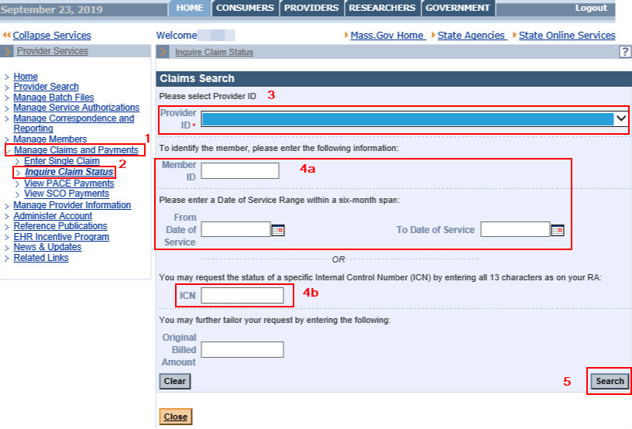
Inquire Claim Status
For checking individual claim status through POSC
Login to the POSC
Open Manage claims and Payments
Click Inquire Claims Status to open the Search for Claims panel
Select Provider ID from the drop-down list
Enter Either:
  The member ID and the From Date of Service and To Date of Service
  The ICN
Click Search

Slide 10
Claim Status and Response
(276/277)

Slide 11
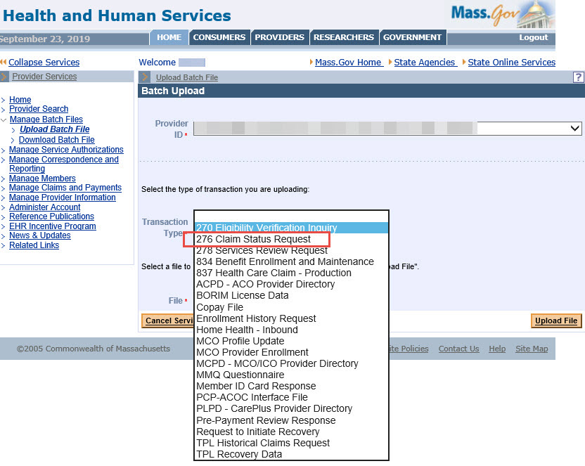
Claim Status and Response (276/277)
The 276/277 HIPAA-compliant electronic transaction is the standard for claim status inquiries to determine if a claim is paid, denied or suspended. Through the 276/277 transaction, claim status can be verified 24/7 using the POSC.
For checking batch claim status
Login to the POSC
Click manage Batch Files
Click Upload Batch File
From the Batch Upload screen to the right select the Provider ID from the drop down and
Select Transaction Type from the drop-down list
Click Browse to select the file to upload
Click Upload File
From the Batch Upload Confirmation panel
Review the Batch Upload Confirmation message
Make a note of your tracking number
Upload another file as needed

Slide 12
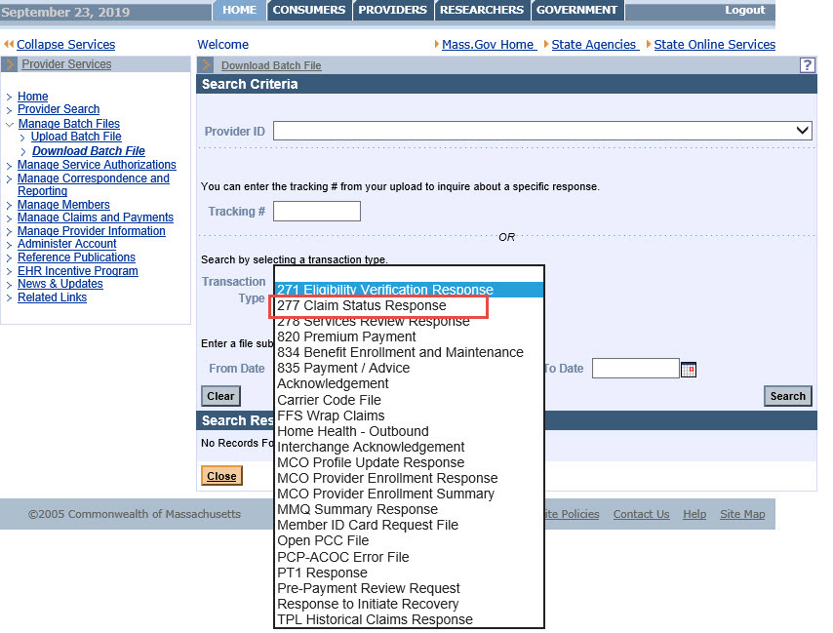
Claim Status and Response 276/277
The 277 response is available within one business day from the submission of the 276 transaction
From the POSC home Panel
Click Manage Batch Files
Click Download Batch File
From the Download Batch File screen to the right select the Provider ID from the drop-down list and
You Can enter the tracking # from your upload to inquire about a specific response or,
Search by selecting a transaction type as indicated for “277 Claim Status Response”
Enter the From Date and To Date and
Hit Search
For more details or question on this process please reach out to EDI@mahealth.net or Fax: (617) 988-8971

Slide 13
Corrective Action for Denied Claims

Slide 14
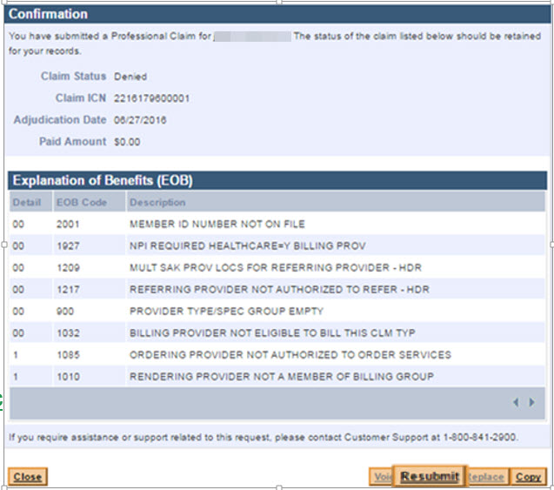
Corrective Action for Denied Claims
    Explanation of Benefit Codes
  Use the EOB codes information to help resolve the denied claim
  Not all EOB codes cause denials
  If the EOB codes are not clear please refer to link below
  https://www.mass.gov/files/documents/2017/11/06/edit-codes-summary.pdf

Slide 15
Corrective Action for Denied Claims
  Use the former ICN to resubmit the claim if one or more of the following items are changing: service date and procedure code
    This is a link to the job aid to help you through the resubmission process. http://www.mass.gov/eohhs/docs/masshealth/newmmis/jobaid-resubmit-a-denied-claim-immediately.pdf
  If the claim is over 90 days from the date of service, submit the claim to the 90 Day Waiver Unit if you are changing the following: Member ID, Pay-to-Provider number, or Claim Type
      Submit a 90-day Claim Waiver Request Form
  A former ICN is NOT required if the claim meets the following criteria:
    If claim is still within 90 days from the date of service.
    If original claim was submitted within the 90-day period and is within a year from the date of service.
  4. You can use the Claims Status feature to locate any denied claims previously submitted
    The provider will only have access to the RESUBMIT functionality if the original claim was submitted electronically, either through an 837 transaction or DDE submission
    In these circumstances, the system will automatically associate the former ICN with the resubmitted claim

Slide 16
Corrective Action for Denied Claims
  5. Incorrectly Paid (over or under paid) - Follow the Adjustment Procedure:
    Electronic claims may be adjusted and resent electronically by replacing the original claim http://www.mass.gov/eohhs/docs/masshealth/newmmis/jobaid-replace-a-claim.pdf
  6. Paid in Error - Follow the Void Procedure:
    Electronic claims may be voided electronically http://www.mass.gov/eohhs/docs/masshealth/newmmis/jobaid-edit-claims-void.pdf

Slide 17
Billing Timelines and 90-Day Waiver

Slide 18
Billing Timelines and 90-Day Waiver
This information is for you if you’re a provider and
Need to submit a claim
Have submitted a claim
The claim has been denied
Need to request a 90-day waiver, or
Want to appeal a denied claim
Review the timeline to understand when to submit a claim and when to submit an appeal. There is additional information regarding the appeal procedures when a claim denies for ‘Final Deadline Exceeded’

Slide 19
Billing Timelines
  30 Days: Average time for both electronic and paper claims to process on a remittance advice.
  60 Days: The usual turnaround time for Medicare/MassHealth crossover claims forwarded to MassHealth by Massachusetts Medicare Fiscal agent to be processed.
  90 Days: Initial claims must be received by MassHealth within 90 days of the service date. If another insurance was billed before MassHealth, claims must be received within 90 days from the date of the explanation of benefits (EOB) of the primary insurer.
  12 Months: Final submission deadline to resolve claims that were initially submitted within 90 days of the date of service (DOS). Claims that exceed this deadline will be denied.
  18 Months: Final submission deadline to resolve claims submitted to another insurance carrier prior to MassHealth. Claims must be initially submitted within 90 days from the date of the explanation of benefits (EOB) of the primary insurer. Claims that exceed this deadline will be denied.
  36 Months: Final submission deadline for all claims. Claim(s) over 36 Months can not be appealed.
For more information, please see https://www.mass.gov/service-details/billing-timelines-and-appeal-procedures; also in All Provider Regulations 130 CMR 450.309, 450.319 and 450.314
Reminder: Providers are encouraged to check claim status on POSC within 48 hours first prior to the submission of a second claim. MMIS adjudicates claims real time and claims status is available within at least two business days

Slide 20
90-Day Waiver For All non-Pharmacy Claims
You can request a 90-day waiver when one or more of the following conditions apply and the claim is not currently pended, paid, or suspended. You must provide necessary documentation with each claim.
The member or provider was retroactively enrolled with MassHealth
The member did not inform the provider of the member’s enrollment with MassHealth within 90 days of the date of service
The provider is making a change to the member’s MassHealth ID number on a claim that was originally submitted within the time limits defined in MassHealth regulations at 130 CMR 450.309 and 450.313
The provider is making a change to the pay-to-provider number on a claim that was originally submitted within the time limits defined in MassHealth regulations at 130 CMR 450.309 and 450.313
You are billing the claim for the first time, and meet the criteria outlined in MassHealth regulations at 130 CMR 450.309 through 450.313
Please refer to All Provider Bulletin 232 for more details on the Final Deadline Appeal Procedures

Slide 21
90-Day Waiver For All non-Pharmacy Claims
Claims submitted with a 90-day waiver request form using the correct delay reason code (1, 4 or 8) will initially appear in a suspended status on the remittance advice for edit 818-Special Handling 90-day Waiver.
Once a 90 day waiver request is reviewed, the claim is released from suspense and will adjudicate in either “Paid” or “Denied” status
The 90 day waiver decision will reflect on a subsequent remittance advice after processing
A denied 90 day waiver claim will adjudicate with a 2626- Request for 90 Day Waiver Denied error code with a corresponding EOB code
Please refer to All Provider Bulletin 232 for more details on the Final Deadline Appeal Procedures

Slide 22
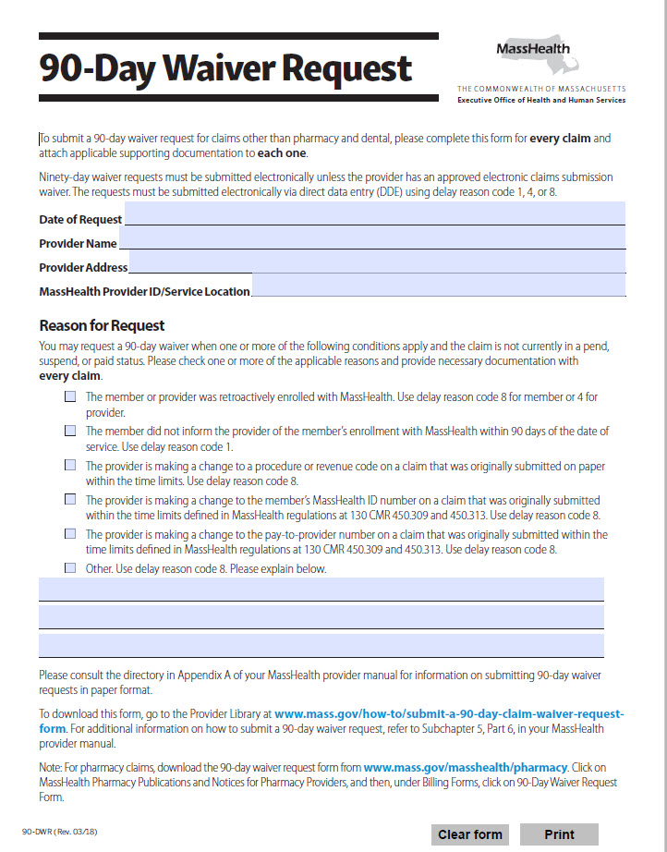
90-Day Waiver For All non-Pharmacy Claims
Quick Tips:
Complete the 90-Day Waiver Request form for non related dental or pharmacy claims
Must be completed for every claim and provide supporting documentation to each one
Must be submitted electronically unless provider has an approved electronic claims submission waiver.
Electronic submission must include delay reason code 1, 4, or 8. The 90 day waiver form and all supporting documentation must be uploaded with the claim.
Please refer to All Provider Bulletin 232 for more details on the Final Deadline Appeal Procedures

Slide 23
Final Deadline Appeals

Slide 24
Final Deadline Appeals
Appeal Procedures for Error Codes 853 or 855 (‘Final Deadline Exceeded’)
To be eligible for appeal, the claim must have denied for error code 853 or 855 (Final Deadline Exceeded).
The appeal must be filed within 30 days of the date that appears on the remittance advice in which the claim originally denied with error code 853 or 855.
In order for an appeal to be approved, it must demonstrate that the claim was denied or underpaid as a result of a MassHealth error.
A final deadline appeal request must be submitted via Direct Data Entry (DDE) using delay reason code 9 and upload all applicable documents related to the request.
For more information, please see All Provider Regulations 130 CMR 450.323
Please refer to All Provider Bulletin 232 for more details on the Final Deadline Appeal Procedures

Slide 25
Final Deadline Appeals
Final deadline appeal requests will initially appear in a suspended status on the remittance advice with Edit 828 (claim/appeal is under review) while the request is being reviewed.
The decision resulting from the review will be reflected on a subsequent remittance advice.
  If the appeal is approved, the claim is released from suspense.
  If the final appeal is denied, one of the following edit codes will appear with the claim
    9086 – Denied after review
    9087 – Insufficient information
    9088 – Duplicate appeal request
    9089 – The request does not meet the criteria at 130 CMR 450.323(A).
    Written notification of the approval or denial will be sent to the provider and constitutes the final agency action.
Please refer to All Provider Bulletin 232 for more details on the Final Deadline Appeal Procedures

Slide 26
Resources

Slide 27
Resources
MassHealth for Providers website: https://www.mass.gov/masshealth-for-providers
MMIS Job Aids website: https://www.mass.gov/service-details/job-aids-for-the-provider-online-service-center-posc
    Job aids available for providers
Provider Online Service Center (POSC) Website: www.mass.gov/masshealth/providerservicecenter
  Online MassHealth Claim and Service Authorization submission
MassHealth Customer Service 1-800-841-2900
  Or e-mail us at providersupport@mahealth.net
**Provider Payment Rates: Community Health Care Providers (Ambulatory Care) https://www.mass.gov/lists/provider-payment-rates-community-health-care-providers-ambulatory-care
** Provider Payment Rates: Hospitals/Nursing Facilities and Rest Homes https://www.mass.gov/lists/provider-payment-rates-hospitalsnursing-facilities-and-rest-homes
Sign up for E-mail Alerts - join-masshealth-provider-pubs@listserv.state.ma.us
** Rate link is for MassHealth payment amounts only - providers must follow guidelines for allowable codes and policy information in the applicable provider manual

