Slide 1
Medicare Audit Contractors
December 12, 2019
The Massachusetts Association of Patient Account Management (MAPAM)
2186_1019

Slide 2

Today’s Presenter
Lori Langevin
  Provider Outreach and Education Consultant
Notes:
National Government Services pledge is to offer innovative and effective experiences to assist and support our providers and partners in reducing provider burden while navigating the Medicare Program.

Slide 3
Disclaimer
National Government Services, Inc. has produced this material as an informational reference for providers furnishing services in our contract jurisdiction. National Government Services employees, agents, and staff make no representation, warranty, or guarantee that this compilation of Medicare information is error-free and will bear no responsibility or liability for the results or consequences of the use of this material. Although every reasonable effort has been made to assure the accuracy of the information within these pages at the time of publication, the Medicare Program is constantly changing, and it is the responsibility of each provider to remain abreast of the Medicare Program requirements. Any regulations, policies and/or guidelines cited in this publication are subject to change without further notice. Current Medicare regulations can be found on the CMS website.

Slide 4
No Recording
Attendees/providers are never permitted to record (tape record or any other method) our educational events
  This applies to our webinars, teleconferences, live events and any other type of National Government Services educational events

Slide 5
Objectives
Understand the difference between the Medicare audit contractors
Provider’s role in the Medicare audit process

Slide 6
Agenda
Medicare Audit Contractors
  Supplemental Medical Review Contractor
  Zone Programs Integrity Contractor/Unified Program Integrity Contractor
  Recovery Auditors
  Medicare Administrative Contactors
  Comprehensive Error Rate Testing
How to Prepare for a Medicare Audit

Slide 7
Medicare Audit Contractors
Several initiatives to prevent or identify improper payments before CMS processes a claim, and to identify and recover improper payments after paying a claim
The overall goal is to reduce improper payments by identifying and addressing coverage and coding billing errors for all providers types
CMS IOM Publication 100-08, Medicare Program Integrity Manual, Chapter 1

Slide 8
Supplemental Medical Review Contractor

Slide 9
SMRC
Mission
  Perform and/or provide support for a variety of tasks aimed at lowering the improper payment rates and increasing efficiencies of the medical review functions of the Medicare and Medicaid programs. The focus of the reviews may include but are not limited to issues identified by CMS internal data analysis, the CERT program, professional organizations and other Federal agencies, such as the OIG/GAO and comparative billing reports

Slide 10
SMRC
Noridian Healthcare Solutions, LLC is the SMRC under contract with CMS
The SMRC contact center is available
  Monday–Friday
  8:30 a.m.–6:00 p.m. ET/ 7:30 a.m.–5:00 p.m. CT
  Telephone: 833-860-4133

Slide 11
SMRC Process
Identify providers noncompliance with coverage, coding, billing, and payment policies through the research and analysis of data related to assigned task. (e.g., profiling of providers, services, or beneficiary utilization)
As directed by CMS
  Perform medical review
  Perform extrapolation
Notify the individual billing entities of review findings identified and make appropriate recommendations for POE and ZPIC referrals
Notes:
The primary role of the ZPIC/UPIC is to investigate instances of suspected fraud, waste, and abuse. They develop investigations early, in a timely manner, and take immediate action to ensure that Medicare Trust Fund monies are not inappropriately paid. They also identify any improper payments that are to be recouped by the MAC.

Slide 12
Role of SMRC
Serving as a readily available source of medical information to provide guidance in questionable claims review situations
Providing the clinical expertise and judgment to develop LCDs and internal MR guidelines
Keeping abreast of medical practice and technology changes that may result in improper billing or program abuse
Providing clinical expertise and judgment to effectively focus MR on areas of potential fraud and abuse
Serving as a readily available source of medical information to provide guidance in questionable situations
Notes:
The process of the ZPIC/UPIC includes:
• Request medical records and documentation;
• Conduct an interview;
• Conduct an onsite visit;
• Identify the need for a prepayment or auto-denial edit and refer these edits to the MAC for installation;
• Withhold payments; and,
• Refer cases to law enforcement.
ZPIC/UPIC also support victims of Medicare identity theft. A provider or supplier who believes that he/she may have had their provider information stolen and used to submit Medicare claims for which payment was made can request that the ZPIC/UPIC for their zone investigate the case. They will then work with CMS to determine the appropriate remedial action to assist the provider.

Slide 13
Role of MAC
MACs may initiate claim adjustments and/or overpayment recoupment actions through the standard overpayment recovery process

Slide 14
Zone Program Integrity Contractor Unified Program Integrity Contractor

Slide 15
ZPIC/UPIC
Mission
  To help address fraud, waste and abuse by performing Medicare data analysis and comprehensive problem identification and research to identify potentially fraudulent Medicare providers and coordination of benefit integrity activities among MACs in the region, and dissemination of relevant benefit integrity information to the respective MACs

Slide 16
ZPIC/UPIC Northeastern
Safeguard Services – Jurisdiction K
UPIC Northeastern
Safeguard Services
States in UPIC Northeastern
  Pennsylvania, New York, Delaware, Maryland, D.C., New Jersey, Massachusetts, New Hampshire, Vermont, Maine, Rhode Island, Connecticut

Slide 17
ZPIC/UPIC Process
Perform data analysis
Request medical records and documentation
Conduct interviews
Conduct onsite visits
Identify the need for a prepayment or auto-denial edit and refer these edits to the MAC for installation
Withhold payments
Refer cases to law enforcement
Notes:
The process of the ZPIC/UPIC includes:
• Request medical records and documentation;
• Conduct an interview;
• Conduct an onsite visit;
• Identify the need for a prepayment or auto-denial edit and refer these edits to the MAC for installation;
• Withhold payments; and,
• Refer cases to law enforcement.
ZPIC/UPIC also support victims of Medicare identity theft. A provider or supplier who believes that he/she may have had their provider information stolen and used to submit Medicare claims for which payment was made can request that the ZPIC/UPIC for their zone investigate the case. They will then work with CMS to determine the appropriate remedial action to assist the provider.

Slide 18
Role of ZPIC/UPIC
Investigate instances of suspected fraud, waste and abuse
Develop investigations early, and in a timely manner
Take immediate action to ensure that Medicare Trust Fund monies are not inappropriately paid
Identify any improper payments that are to be recouped by MACs
Notes:
The primary role of the ZPIC/UPIC is to investigate instances of suspected fraud, waste, and abuse. They develop investigations early, in a timely manner, and take immediate action to ensure that Medicare Trust Fund monies are not inappropriately paid. They also identify any improper payments that are to be recouped by the MAC.

Slide 19
Role of MAC
Claim processing, including paying providers/suppliers
Provider outreach and education
Recouping monies lost to the Medicare Trust Fund
  The ZPICs identify these situations and refer them to the MACs for the recoupment
Medical review not for benefit integrity purposes
Complaint screening
The MAC will refer to the ZPIC if fraud is suspected
Claims appeals of ZPIC decisions
Claim payment determination and claims pricing
Auditing provider cost reports
Notes:
The following are some of the major functions that the ZPICs do not perform. These functions are performed by the MAC:
• Claims processing, including paying providers/suppliers;
• Provider outreach and education;
• Recouping monies lost to the Trust Fund (the ZPICs identify these situations and refer them to the MACs for the recoupment);
• Medical review not for benefit integrity purposes;
• Complaint screening;
• Claims appeals of ZPIC decisions;
• Claim payment determination;
• Claims pricing; and
• Auditing provider cost reports.

Slide 20
Recovery Auditors

Slide 21
RA Program
Mission
  To identify and correct Medicare improper payments through the efficient detection and collection of overpayments made on claims of health care services provided to Medicare beneficiaries, and the identification of underpayments to providers so that the CMS can implement actions that will prevent future improper payments

Slide 22
RA Region 1 - Jurisdiction K
Performant Recovery, Inc.
  Website
  Email
  Telephone: 866-201-0580
Please visit their website for
  Issues under review
  Forms and sample documents
  FAQs
  Review provider contact Information for accuracy
Notes:
Region 1: Performant Recovery, Inc
Region 1. Includes NY, ME, NH, VT, MA, RI, CT, OH, KY, IN, and MI.

Slide 23
RA Process
Issue selected for review
CMS approves issue
RA requests claims
RA reviews documentation (complex review) or claim (automated review) and makes determination
If an error is found, a file is sent to the claims processing MAC to be adjusted for over or underpayment
Notes:
So the review process is a little similar to CERT. But first they go to CMS with the issues they want to review. CMS approves those issues and then Performant Recovery, the RA contractor, requests the claims and/or medical documentation to review.
There are two types of review – automated, where no medical records are needed or requested, just claims are being reviewed, or Complex, where medical records are requested to be reviewed along with the claims.
If an error is found, the RA works with the Medicare Administrative Contractor by sending an electronic file with their findings.

Slide 24
Time Frames
RA has 30 calendar days to complete the review and send a decision letter
RA may look back up to three years from the claim paid date to review claims
RA will forward the adjustment to the MAC 30 days after the initial findings letter or after a discussion period has been completed

Slide 25
Role of RA
Review claims on a postpayment basis using the same Medicare policies as MACs
  NCDs
  LCDs and
  CMS manuals/regulations
To ensure accuracy, RA is required to employ nurses, therapists, certified coders and a contractor medical director

Slide 26
Role of MAC
After a RA post pay review, an electronic file of claims to be adjusted is sent to claims processing contractor
  Marked as RA adjustments in claims processing system
Electronic reports are sent to RA on daily basis to notify them that an adjustment has been processed
Notes:
That electronic file consists of audit adjustments that we, as the MAC, have to process. We then notify the RA that the adjustments have been processed.

Slide 27
Provider Tips
Identify RA demand letter
  Right corner will contain letter number that begins with “R” For example: R-1234567
  The first paragraph says: “This finding was a result of a Recovery Audit Program review.”
Review the demand letter sent from the MAC
Providers need to review their remittance advice
  If they see a N432 that means an adjustment was done due to a RA review
Notes:
The demand letters are generated from HIGLAS, which is the financial system. It is a standard system provided to us by CMS and is programmed to use the master address located in the provider file.
It is important to know that these demand letters will not go to a specific person within your facility. You should set up internal controls to monitor things like the remittance advices and demand letters to ensure that they get to the appropriate person on a timely basis.
Providers can tell whether an adjustment is due to an RA review by looking on the remittance advice and seeing whether Remittance Advice Remark Code N432 “Adjustment based on a Recovery Audit” is displayed.
You should get a demand letter shortly after seeing the adjustment on the remittance advice. For this reason, it is very important to monitor the remittance advice daily.
You do not have to have a hardcopy demand letter in order to exercise appeal rights if you wish to do so.
The RA demand letter looks just like other demand letters with a few exceptions.
First, it will have a letter “R” at the beginning of the letter number, which indicates it is an RA demand.
Second, the first paragraph will state “this finding was a result of a Recovery Audit Program Review.”
There will be enclosures that will include more specific information on the claim reviewed with findings.

Slide 28
Provider Tips
Request rebuttal
  Opportunity to provide a statement and accompanying evidence indicating why overpayment action will cause financial hardship and should not take place
    Not disagreeing with overpayment decision
    No review of supporting medical documentation will take place
  Must be submitted by the 15th day from date on demand letter
Notes:
The rebuttal process allows the provider the opportunity to provide a statement and accompanying evidence indicating why the overpayment action will cause a financial hardship and should not take place.
A rebuttal is not intended to review supporting medical documentation nor disagreement with the overpayment decision.
A rebuttal should not duplicate the redetermination process. This is an entirely separate process.
Keep in mind the timeliness requirements for submitting a rebuttal request, which is the 15th day from the date on the demand letter.
As a result, it is a good idea to stress to your mail handlers the importance of the demand letters being routed timely to the appropriate person within your organization.

Slide 29
Provider Tips
Appeal with local MAC
  Include specific reason why you feel RA determination should be overturned
Notes:
Like CERT, the Appeals process is the same and you want to be sure to include the specific reason you feel the determination should be overturned.

Slide 30
MAC Medical Review

Slide 31
MAC Medical Review
Mission
  To reduce costs related to improper payments and appeals, therefore reducing provider burden

Slide 32
MAC Medical Review
National Government Services
  Our website
  Fax
    JK: 315-442-4231

Slide 33
MAC Medical Review Process
TPE strategy and the NGS medical review process
  The purpose is to reduce costs related to improper payments and appeals
    This will reduce provider burden
  Providers selected for TPE will receive a notification letter from NGS
Notes:
As directed by CMS, effective 10/1/2017, NGS Medical Review will transition all lines of business to a Targeted Probe and Educate (TPE) strategy. The purpose of this transition is to reduce costs related to improper payments and appeals, therefore reducing provider burden.
Providers selected for TPE will receive a notification letter from NGS via USPS or fax. The notification letter will provide details about TPE.

Slide 34
MAC Medical Review Process
Postpayment probes
  MR may conduct postpayment claim reviews
  A sample of paid claims is selected and a request for medical records is requested from the provider
  Providers must submit medical records as directed by the medical review notice letter within 45 days of the record request
Notes:
On rare occasions, MR may conduct postpayment claim reviews. In the postpayment probe process, a sample of paid claims is selected and MR requests records from the provider in a letter that summarizes the probe process and includes a list of specific claims for which the provider must copy and submit medical records to support the service.
Providers must submit medical records as directed by the MR notice letter within 45 days of the record request. In certain circumstances, an extension may be granted on this timeframe, through contact with the reviewer who initiated the request.

Slide 35
Time Frame
Prepayment decision timeline
  Claims will suspend
  Documentation requested via ADR
  Return documentation – 45 days (recommend 30 days)
    Claims will deny on day 46 if records not received
  NGS will make review determinations within 30 calendar days of receiving the provider’s requested documentation
  Detailed results letter
    One-on-one education
Notes:
Prepayment Decision Timeline
The MAC will make and document review determinations within 30 calendar days of receiving the provider’s requested documentation.
Failure to respond within 45 days will result in a denial of the claims related to the additional documentation request.
Reference:
Per CR 8443, eff 3/1/15, MR has 30 days to conduct prepay review
https://www.cms.gov/Regulations-and-Guidance/Guidance/Transmittals/Downloads/R568PI.pdf

Slide 36
Role of MAC Medical Review
TPE notification and ADR letters
  Notification outlines the TPE process
  Reason for review
    Why your facility was selected
    Procedure code/HCPCS code – short description of what is being reviewed
  Do not send documentation until you receive an ADR letter
    Will include a list of specific elements needed to support the service being reviewed
Notes:
The notification letter will provide details about TPE, it will also include our educational email address that providers should use to schedule education.
In addition, something new that Medical Review is doing for TPE, we are asking providers to notify us using the shared mail box, of a delegated contact associate from their facility who could answer any questions we may have regarding their TPE review, requests for additional information and serve as a contact name for our TPE correspondence.
We are asking providers to submit the contact information to our shared email address and include the contact name, provider name, provider number, email address, and phone number.

Slide 37
Provider Tips
Responding to TPE ADRs
  NGS recommends responding to ADRs within 30 days
    CMS allows providers 45 days of the ADR date
  Forward the requested documentation to the correct address
  Send responses separately and attach a copy of the corresponding ADR
  Include all records necessary to support the services for the dates requested
  Do not include unrelated correspondence
  Records must be complete and legible
  NGSConnex allows providers to respond to ADRs electronically
  Ensure services include necessary signatures and credentials of professionals
Notes:
In order to avoid claim processing delays it is important that providers respond to ADR in a complete and timely manner.
Listed below are guidelines and checklists that will provide assistance in submitting claims:
1.NGS recommends responding to ADRs within 35-40 days of letter date (CMS allows providers 45 days of the ADR date) See the ADR Timeline Calculator available on our website for help with determining the target date that the requested medical records must be received by NGS.
2.Be sure to forward the requested documentation to the correct NGS post office box.
3.Send each response separately and attach a copy of the corresponding ADR. It is acceptable to send multiple responses in a single mailing; however, each response must be individually bundled with a copy of the corresponding ADR within the mailing to facilitate proper handling and review of the ADR response.
4.Include all records necessary to support the services for the dates requested.
5.Do not include additional correspondence with documentation submissions. Unrelated correspondence should be mailed separately.
6.Records must be complete and legible. Be sure to include both sides of double-sided documents.
7.The NGS self-service portal, NGSConnex, allows both Part A (including home health, hospice and FQHCs) and Part B providers to respond to ADRs electronically with no need to mail or fax a response to complete the ADR process. Further details are available on our website. If you are a current user of NGSConnex, click on the link for a new NGSConnex User Guide for step-by-step instructions on how to submit ADR. If you are not a current user, sign up and get started!
8.All services must include necessary signatures and credentials of professionals. See the CMS IOM Publication 100-08, Medicare Program Integrity Manual, Chapter 3, Section 3.3.2.4, “Signature Requirements”. (KB 592)

Slide 38
Provider Tips
What can you do?
  Review all contractor provider publications and LCDs
  Understand Medicare coverage requirements
  Ensure office staff and billing vendors are familiar with claim filing requirements
  Perform self-audits of medical records against billed claims using coverage criteria, LCD and coding guidelines
  Ensure documentation is legible and demonstrates that the patient’s condition warrants the services being reported and billed
Notes:
What can you do to assure a successful prepayment audit?

Slide 39
Comprehensive Error Rate Testing

Slide 40
CERT
Mission
  Designed to monitor and improve Medicare payment accuracy, evaluates provider claim submission practices and protect the Medicare Trust Fund
Notes:
The CERT program is federally-mandated and designed to monitor and improve the accuracy of Medicare payments. This program creates a way for CMS to ensure that Medicare claims are paid correctly and accurately by consistently reducing the number of errors made in claims adjudication. The main objectives of the CERT program are to protect the Medicare Trust Fund, ensure claims are paid correctly the first time, evaluate Medicare contractors’ processing and payment procedures, and evaluate Medicare providers’ claims submission practices.
We consider it a Medicare contractor’s report card and your role in this process is crucial to ensure success!

Slide 41
CERT
Documentation/Review Contractor
AdvanceMed
  CERT Documentation Center
  1510 East Parham Road
  Henrico, VA 23228
  Fax: 804-261-8100
  Customer Service
    443-663-2699 or toll free: 888-779-7477
  Email
  Include bar coded coversheet with CID number

Slide 42
CERT Provider Website
CERT Provider Documentation Information
  Submit records to CERT
    Submission methods
  Letters and contact information
    Schedule for initial and subsequent request
  Sample request letters
    Copies of documentation request letters and envelope
  Documentation request listings
    List of required documents by specialty type

Slide 43
CERT Process
CERT selects a stratified random sample of paid or denied claims from all Medicare contractors
CERT requests medical records from the billing and ordering provider by letter, phone and fax
  If some of the requested records are housed at another site
    Providers should forward a copy of the request to the
    other site
    Or, give CERT other site contact information; CERT will follow up with other site with additional record requests
Notes:
The CDC randomly selects a sample of claims for review. They then request copies of medical records from the provider/supplier who submitted the claim(s). If you receive a request from the CDC you must send all documentation, including medical records, that support the payment of the item or item(s) billed on the claim as soon as possible after receiving the initial request.
Medical records can be submitted electronically, via esMD, fax, or documentation can be submitted on a CD.
CERT selects a stratified random sample of approximately 50,000 claims submitted to Part A/B MACs and DME MACs during each reporting period. This sample size allows CMS to calculate a national improper payment rate and contractor and service-specific improper payment rates.
It is important to note that the improper payment rate is not a “fraud rate,” but is a measurement of payments that did not meet Medicare requirements.

Slide 44
CERT Process
CERT Process
Requesting Medical Records
  Initial additional documentation requests for CERT are sent to the address on file
  Subsequent ADR letters for that claim can be sent
  to a specific correspondence address designated by
  the provider
    Call CERT office: 888-779-7477
  The above processes are based on each individual CID
Notes:
Initial Additional Documentation Requests (ADR) for CERT are sent to the address on file with the National Supplier Clearinghouse NSC for DMEPOS suppliers, or the MAC for the provider/supplier that billed/submitted the claim.
SUBSEQUENT ADR letters for that claim can be sent to a specific correspondence address designated by the provider. This can be provided to the CERT CSR by calling 888-779-7477 once the provider receives the initial letter.
The above processes are based on each individual CID; providers will need to contact the CERT office as mentioned above for each sampled claim.

Slide 45
CERT Process
Requesting Medical Records
  Chain Address Program
    Providers having at least ten PTAN numbers can elect a single point of contact to participate in the “chain address” program
    Call CERT office: 888-779-7477
      Provide PTAN numbers and the designated point of contact information
    CERT will email/call the point of contact with a list of outstanding CID numbers
  Group Calls
    When a provider has multiple CERT requests with the same phone number, the CERT RC will group all requests together to discuss all outstanding requests
  *Important note: This change is only in regard to the CERT program
Notes:
Providers having at least ten PTAN numbers who would like to elect a single point of contact can participate in the “chain address” program recently implemented by CERT.
This program is as follows - Call the CERT office (888-779-7477) with a list of PTAN numbers and the designated point of contact information.
To assure you supply the information to CERT within the 45 days, CERT will email/call the point of contact with a list of outstanding CID numbers.
Note: Due to the initial letter being sent to the provider address on file, these may be requests the point of contact has not yet received. When requested, the CERT CSR will forward a copy of the letters not yet received.
Group Calls
In order to reduce provider burden, when a provider has multiple CERT requests with the same phone number, the CERT RC will group all requests together so that a single contact can be made with the provider(s) associated with that phone number to discuss all outstanding requests.
*Important note: This change is only in regards to the CERT program.

Slide 46
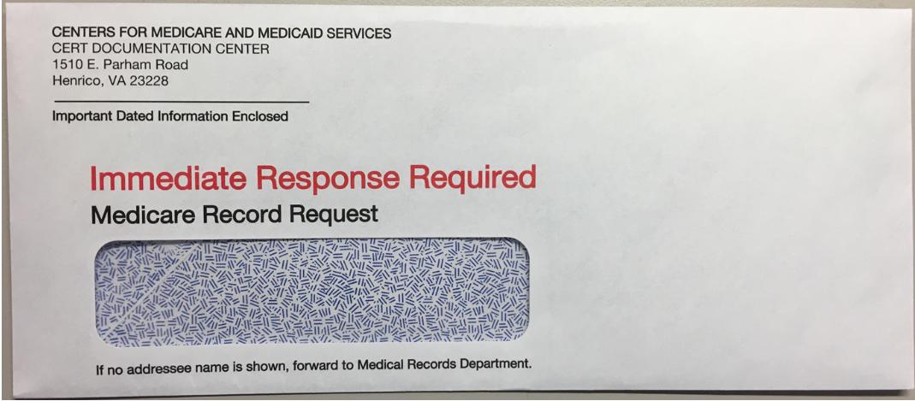
CERT Documentation Center Envelope
Notes:
This is a copy of how the CERT DC Envelope will look like.

Slide 47
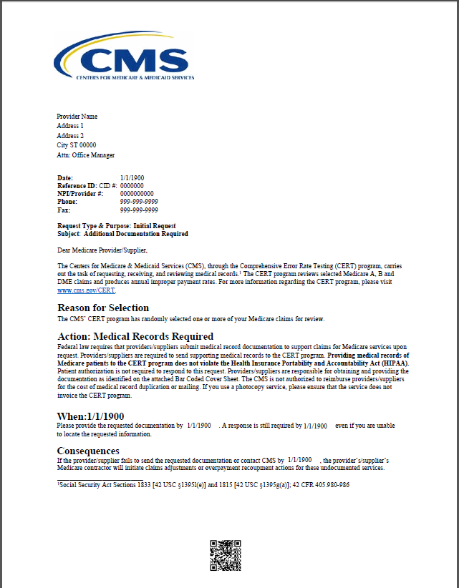
Notes:
This is a copy of the medical record request letter you will receive from CERT. I know the print is small, but this is just to give you an idea of what a request letter will look like should you receive one and are not sure what it is.
This letter will explain the CERT program, and outlines what claims they are sampling, along with requested documentation to support the services billed.
The letter is about 4 pages long. The first page gives information about reason claim was selected, when records are due and what are the consequences if records are not received. It goes on to the second page with submission methods for the medical records as well as contact information if you have any questions. The third page is claim information.

Slide 48
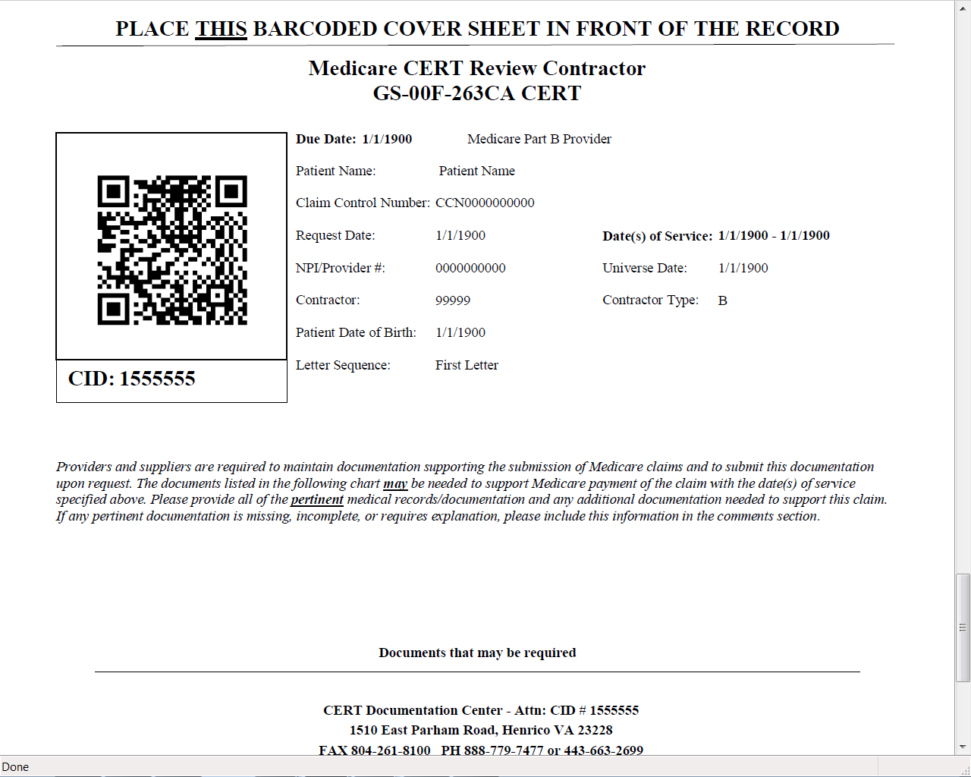
Notes:
And the last page is the bar code cover sheet, which should be placed on top of all records sent to the CERT contractor no matter what method.

Slide 49
Timeframe
Respond to requests timely
  75 days
  Be sure staff places a high priority on responding to requests
  NGS may contact to remind you
If no response, claim will be given a “no documentation” error and reimbursement recouped
  CERT will assign error code 99
Notes:
When you receive a letter from the CERT Documentation Center, it is very important that your medical records area places a high priority on responding to requests for records. National Government Services may contact providers to encourage and remind you to submit documentation.
If you receive a letter requesting documentation for CERT, and you do not return the information immediately, you will receive telephone contacts and letters every 10–15 days for approximately 75 days. If you do not return the requested documentation by the 75th day, the claim will be cancelled and any Medicare reimbursement will be recouped. CERT will assign error code 99.
We understand that sometimes the dollar amount on the claim isn’t worth the effort you have to take to send the medical documentation to CERT to be reviewed. What you probably don’t know, is not only a failure to comply with a request for medical records will result in a recovery of payments for all services provided on the claim, it also counts as an error on the contractors’ part because CERT was not able to verify if we, as the contractor, paid the claim correctly or not. Remember I mentioned earlier that the CERT program is like a report card. This is why it is so important that you submit the requested medical records within the timeframe indicated in the medical record request letter!

Slide 50
CERT Timetable – Watch the days
Day 0: Provider has 45 days from this letter to furnish the requested documentation
Day 25: Telephone contact to follow-up on request and/or offer assistance
Day 30: Send letter 2. Provider has 15 days left to complete the request
Day 40: Telephone contact to follow-up on request and/or offer assistance
Day 45: Send letter 3. (response is due)
Day 55: Telephone contact to follow-up on request and/or offer assistance (response is overdue)
Day 60: Send letter 4 (response is overdue)
Day 76: Claim is counted as nonresponse error and is subject to overpayment recovery by the MAC

Slide 51
Role of CERT
The documentation is reviewed by independent medical reviewers to determine if the claim was paid properly under Medicare coverage, coding and billing rules
If the documentation does not support that the rules were met, the claim is counted as either a total or partial improper payment
Notes:
The CDC randomly selects a sample of claims for review. They then request copies of medical records from the provider/supplier who submitted the claim(s). If you receive a request from the CDC you must send all documentation, including medical records, that support the payment of the item or item(s) billed on the claim as soon as possible after receiving the initial request.
Medical records can be submitted electronically, via esMD, fax, or documentation can be submitted on a CD.
CERT selects a stratified random sample of approximately 50,000 claims submitted to Part A/B MACs and DME MACs during each reporting period. This sample size allows CMS to calculate a national improper payment rate and contractor and service-specific improper payment rates.
It is important to note that the improper payment rate is not a “fraud rate,” but is a measurement of payments that did not meet Medicare requirements.

Slide 52
Role of CERT
The error is then categorized into one of five major categories
  No documentation
  Insufficient documentation
  Medical necessity
  Incorrect coding
  Other
Report sent to MACs with CERT errors
Notes:
The CDC randomly selects a sample of claims for review. They then request copies of medical records from the provider/supplier who submitted the claim(s). If you receive a request from the CDC you must send all documentation, including medical records, that support the payment of the item or item(s) billed on the claim as soon as possible after receiving the initial request.
Medical records can be submitted electronically, via esMD, fax, or documentation can be submitted on a CD.
CERT selects a stratified random sample of approximately 50,000 claims submitted to Part A/B MACs and DME MACs during each reporting period. This sample size allows CMS to calculate a national improper payment rate and contractor and service-specific improper payment rates.
It is important to note that the improper payment rate is not a “fraud rate,” but is a measurement of payments that did not meet Medicare requirements.

Slide 53
Role of MAC
NGS receives a bimonthly CERT notification report of review results and responds to all identified errors (over and underpayments)
Claims will be adjusted through normal claim adjustment process to allow additional payment if underpaid or recoup any overpayments
Providers will be notified through the normal adjustment process that will include appeal rights
Notes:
The CDC randomly selects a sample of claims for review. They then request copies of medical records from the provider/supplier who submitted the claim(s). If you receive a request from the CDC you must send all documentation, including medical records, that support the payment of the item or item(s) billed on the claim as soon as possible after receiving the initial request.
Medical records can be submitted electronically, via esMD, fax, or documentation can be submitted on a CD.
CERT selects a stratified random sample of approximately 50,000 claims submitted to Part A/B MACs and DME MACs during each reporting period. This sample size allows CMS to calculate a national improper payment rate and contractor and service-specific improper payment rates.
It is important to note that the improper payment rate is not a “fraud rate,” but is a measurement of payments that did not meet Medicare requirements.

Slide 54
Provider Tips
Verify all addresses are up-to-date with Medicare
Identify and respond timely to CERT documentation request
Be familiar with documentation requirement
Submit all necessary documents to support all services and dates of service on claim

Slide 55
Provider Tips
Obtain documentation from third party
  If some of the requested records are housed at another site
    Providers should forward a copy of the request to the other site
    Or, give CERT other site contact information; CERT will follow up with other site with additional record requests
Appeal with local MAC
Notes:
The CERT Appeal process mirrors the Medicare Appeals process – the first level is a Redetermination, conducted by the Medicare contractor, you complete the same form as you do with a regular Medicare appeal, either the CMS 20027 or our Redetermination request form. Like a regular Redetermination, you want to be sure it is requested within 120 days.

Slide 56
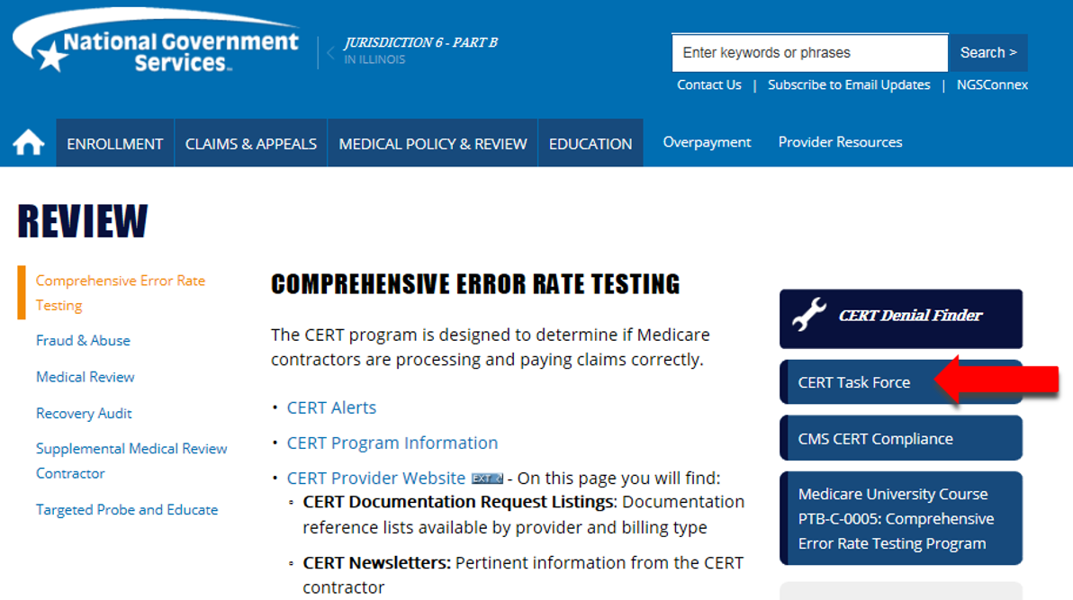

Slide 57
How to Prepare for a Medicare Audit

Slide 58
How to Prepare
Determine who is accountable for specific roles within office and ensure an understanding of their goals and objectives
Be familiar with the documentation requests
  Required documentation lists will indicate components needed to review claim (letter or website)
  Documentation submission method
  Contact information
Notes:
Assign a person or unit to respond to the type of audit (ZPIC/UPIC, RAC, MAC or CERT)

Slide 59
How to Prepare
Documentation submitted is
  The contractor’s only picture of the patient and the care you provided
  The proof that the claim is accurate
    The services billed were delivered
    The services delivered and billed met Medicare standards of medical necessity
If it wasn’t documented, it did not happen
Notes:
The documentation you submit is the only proof that the services were rendered and met medical necessity standards. If a service billed isn’t documented, it didn’t happen.

Slide 60
How to Prepare
Review details of medical records
  Signature, legibility, clarity, complete
  All lab tests and other pertinent information included in medical record
  Ensure documentation supports the level of coding
  Check to be sure number of units documented are the same in the medical record as submitted on claim

Slide 61
How to Prepare
Missing or Illegible Signatures
  Signature log or signature page
  Signature attestation
    “I, [print full name of the physician/practitioner], hereby attest that the medical record entry for [date of service] accurately reflects signatures/notations that I made in my capacity as [insert provider credentials, e.g., M.D.] when I treated/diagnosed the above listed Medicare beneficiary. I do hereby attest that this information is true, accurate and complete to the best of my knowledge and I understand that any falsification, omission, or concealment of material fact may subject me to administrative, civil, or criminal liability.” M.D. Signature ____________________
  Reference
    CMS IOM Publication 100-08, Medicare Program Integrity Manual, Chapter 3, Section 3.3.2.4
Notes:
A signature attestation is used for one provider and it affirms the provider signed the medical records. It should be submitted routinely with CERT requests to prevent claims from being denied for illegible signature because of the providers unique writing style.
A signature key should include every providers’ signature and initials within the group. Again, it should be submitted routinely with CERT requests for documentation.

Slide 62
How to Prepare
Know how to locate resources
  ICD-10; CPT/HCPCS; documentation requirements
Know local and national coverage determinations that apply
Understand Medicare rules and regulations
Know your appeal rights with local MAC
Establish a quality assurance program for your practice
Notes:
Knowing how to locate Medicare rules and regulations is paramount in billing and coding claims to Medicare.
If you bill for services that have a LCD or NCD know what is being required in order for Medicare payment to be made… there are SIAs that are written along with the LCD to enhance billing and coding…..and understanding the LCD or NCD is imperative for claims payment…..an understanding of how to have a LCD or NCD changed is also very important….did you know there are instructions on our website that enables you to ask for a reconsideration on an LCD that is final and current…meaning it is in effect today.
Knowing your appeal rights are equally important…
Every physicians practice should have a quality assurance program /internal assessment of what is actually happening in your practice . There should be a quality assurance program in place that will touch on every facet of your business which includes self assessment . Audit what you do and how you do it

Slide 63
How to Prepare
Final Check
  Timely response is critical
  Provide all requested records
  Records must be legible
  Include appropriate signatures and credentials
  Check right beneficiary, right service, right date of service
  Clear copies of both sides of document
  Verify mailing address and/or fax numbers are correct
Notes:
Your final check for proper documentations should include:
A timely response to the medical record request – this is critical
Provide all requested records
Records must be legible
Include appropriate signatures and credentials
Make sure you are submitting the medical records for the correct beneficiary, along with the appropriate service and correct date of service
Clear copies of both sides of document
Verify mailing address is correct

Slide 64
Resources

Slide 65
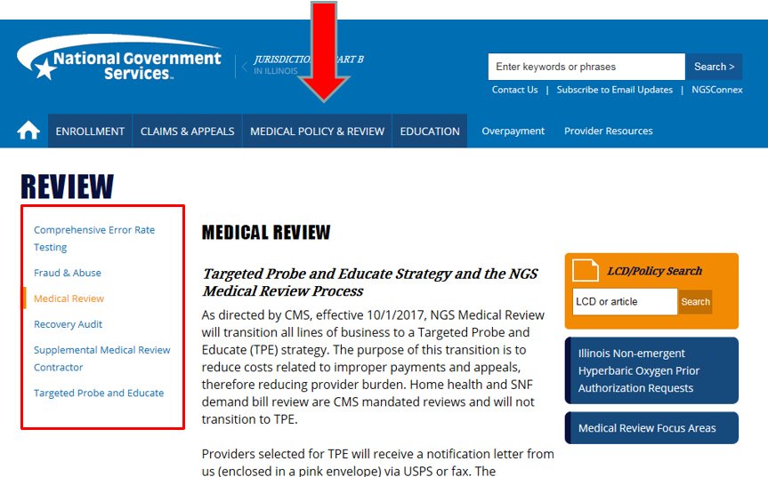
Resources

Slide 66

Thank You!
Questions?
Follow us

